Slide 1
Roadmap
15 November 2016
Mary Jo Kochendorfer

Slide 2
Agenda
Re-Architecture
Team
3.0.0-beta
Resources
Roadmap

Slide 3
Re-architecture
The overall objectives—to better enable contribution and maximize shared benefit by promoting code reuse and transferrable customizations
New architecture:
Independent Services that communicate through IPC (RESTful APIs) for different functional areas. E.g. Requisition Service, Orders Service, Stock Managment Service, Notifications, Authentication etc. An Independent Service:
Defines the interface and default behavior
May expose Extension Points that a Module may utilize to extend its behavior
Provides Data Store, logging, and authorization services to an Extension Module
Modules for extension within an independent service. For example, as an Implementer, I want to add a new calculation for order quantity to the Requisition Service; add a new accounting policy to the Inventory Management Service, etc. A Module:
Is packaged and deployed as a JAR through Maven

Slide 4
OpenLMIS Dedicated Team Members
Director, Jake Watson
Software Dev Manager
SolDevelo
Architect
VR Dev
Architect
Community Manager
Lead
10 devs
UI Dev
3 SolDevlo Devs
3 QA
Implementation
Manager
Vaccine Lead
Implementation Lead, Malawi
Product Owner
Technical
Product

Slide 5
3.0.0-beta
Release Notes: https://openlmis.atlassian.net/wiki/display/OP/3.0.0-beta+Release+Notes
Burn-up chart
Main goals were to demonstrate:
New micro-services architecture
Ability to support extensions
Basic feature set within requisitioning

Slide 6
Software Development
In Progress
View the JIRA Board
Burn-down chart
What’s Planned
View Grooming Notes
Who we are building for?
User Personas
Will be updated from trips to Tanzania and Zambia
Process and Tooling
Developer Guide Resources
Testing Strategy
Coding Standards
Reviews and workflow
Technical Documentation
API Documentation
Functional Documentation
JIRA Stories
Wiki

Slide 7
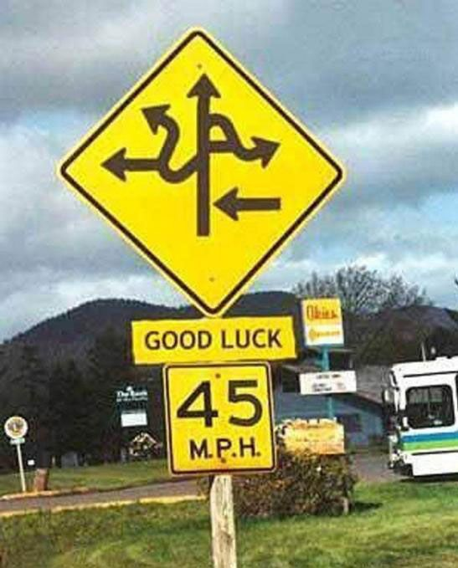
Looking at the roadmap
It’s complicated
Still working on tooling
JIRA View
Most updated and relevant for team
Timeline View
Manually updated and not one-to-one mappings with JIRA
User Story Map View
Currently only at epic level
Plan to update with stories to facilitate prioritizing

Slide 8
Key Goals and Dates for 3.x
Goals
Green: reproducing functionality within 2.0
Red: Demonstrating extensibility
Blue: End-to-end visibility
Orange: Offline
And..
Gray: Unscheduled and unclear
Dates
Beta: October End
3.0: February End
3.1: May End
3.2: August End
3.3: November End

Slide 9
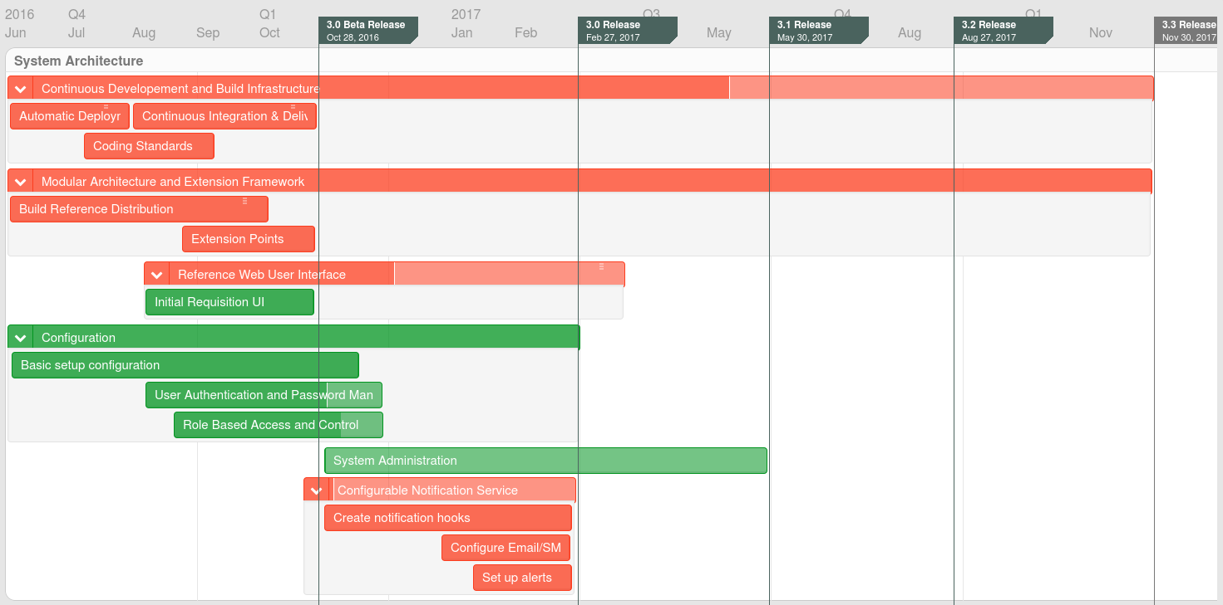
Architecture
Most updated information is in JIRA
Notes:
Call out approach for UI Configuration and System Administration.
Indicate that Authentication and Notifications are separate services and will be referenced by all services. Build in ‘hooks’ within each service.

Slide 10
Modular Architecture
Demonstrate and document at least one of each type of extension:
business logic extensions (in Java)
data entity extensions (that include storing new custom fields of data)
UI extensions (in AngularJS)
We want to make sure all the ways that OpenLMIS v3 will support extension are ready for the 3.0 release.

Slide 11
Requisitions
Beta
3.0
3.1
3.2

Slide 12
Requisitions
3.0 Scope
Create, submit, authorize, approve, delete and save a requisition
UI data validations
Offline data entry
Approvers can reject a requisition
Skip a requisition period
Skip and add back products (line items)
Convert a requisition to an order file
Collect program data alongside requisitions
Display total requisition cost (based on reference data)
3.1 Potentially
Comments (new functionality)
Display allocated budget by program, facility & period
Skip the authorization step

Slide 13
Requisition Template
3.0
Templates by program
Recreating column headers available in 2.0
Not supporting all options. Will provide an example option via extension.
Potentially deprecating
No of New Patients (to be addressed in Program data)
3.1 Potentially
Configurable Headers

Slide 14
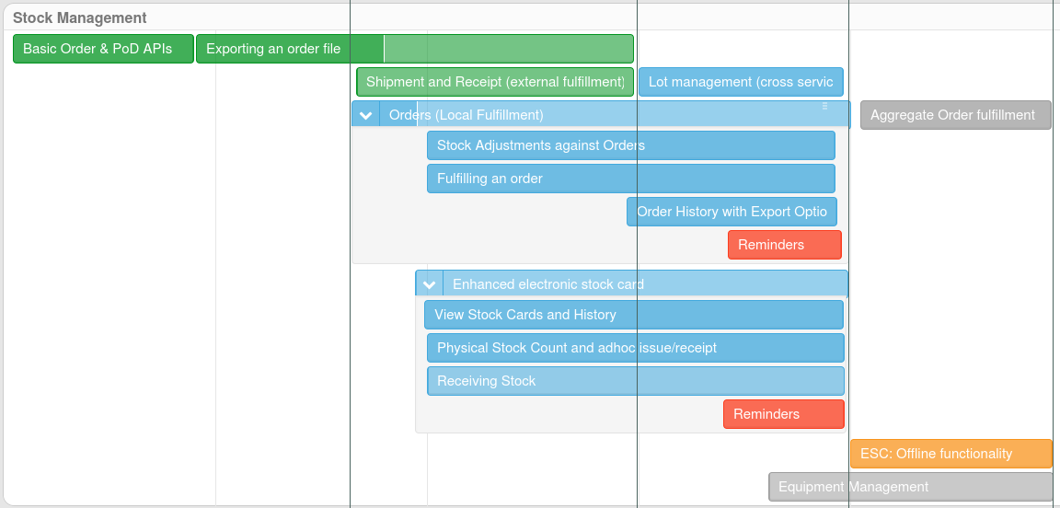
Stock Management
Beta
3.0
3.1
3.2

Slide 15
Orders (External Fulfillment)
3.0 Scope
View orders
Generate order files
Order file template (endpoints)
Send order files to FTP
Print order files (PDF/csv)
Potentially 3.1
Retrieve shipment files

Slide 16
Orders (Local Fulfillment)
Unscheduled
View orders
Set/confirm fill quantities
Print POD
More…
3.1
Lot Management
Aggregate Order Fulfillment (?)

Slide 17
Stock Management
3.0 Potentially
View Stockcard
Perform Physical Count
3.1
Lot management
Ad-hoc issue/receipt
Receiving: accept stock into inventory using electronic POD
Adjustments
Configurations

Slide 18
Reporting
Beta
3.0
3.1
3.2

Slide 19
Reporting
Encapsulated Jasper engine
Reports
Reporting Rate
Order fill Rate
Facility status
Inventory valuation
Stock out rate
??
3rd Party BI
Potentially 3.1
Administrative reports
Notes:
Reports are still up for discussion in terms of which are the priority reports

Slide 20
Configuration
3.0
Reference data will be similar to 2.0, however:
New product model association
Regimens may be different based on approach
Reference data upload and configuration done via endpoints
3.1
Upload tool

Slide 21
System Management
3.0 Scope (endpoints not UI)
Facilities
Programs
Products
Supervisory/Requisition Group
Configure order file (csv)
…
3.1
UI screens

Slide 22
Thank you
Stakeholder Meeting November 15, 2016

