Slide 1
VIMS inventory workflow

Slide 2
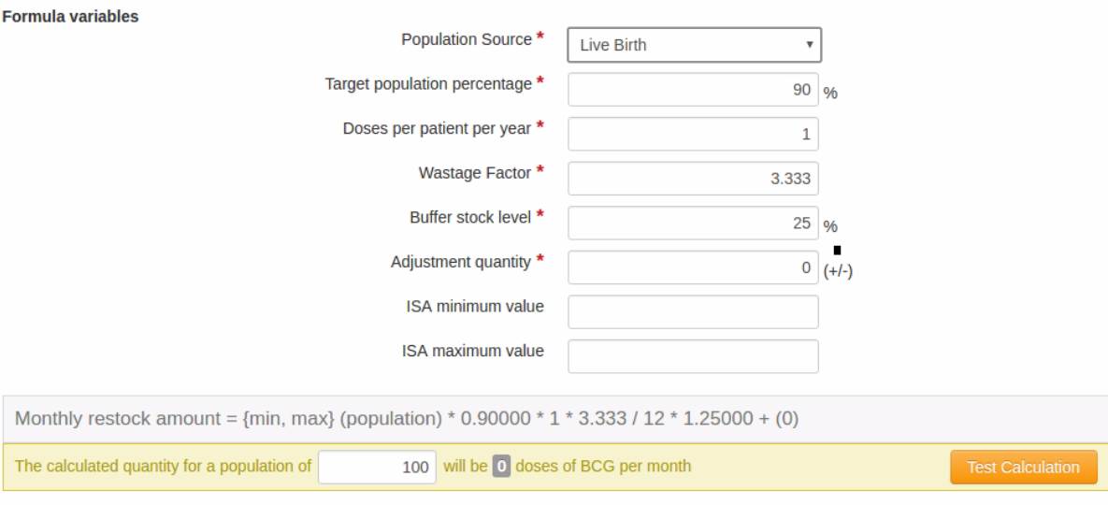
Monthly restocking amount calculation

Slide 3
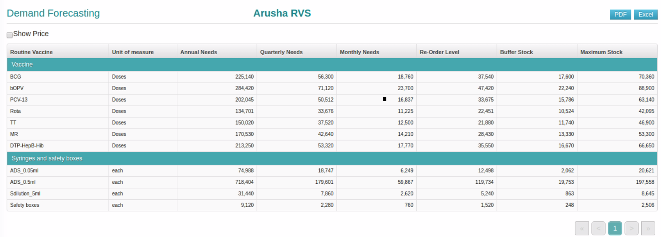
VIMS calculates demand forecast by warehouse

Slide 4
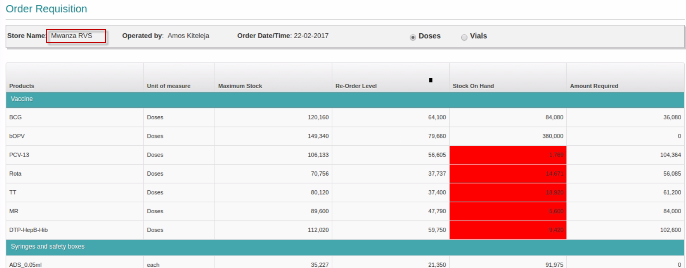
VIMS auto-calculate quantity to order

Slide 5
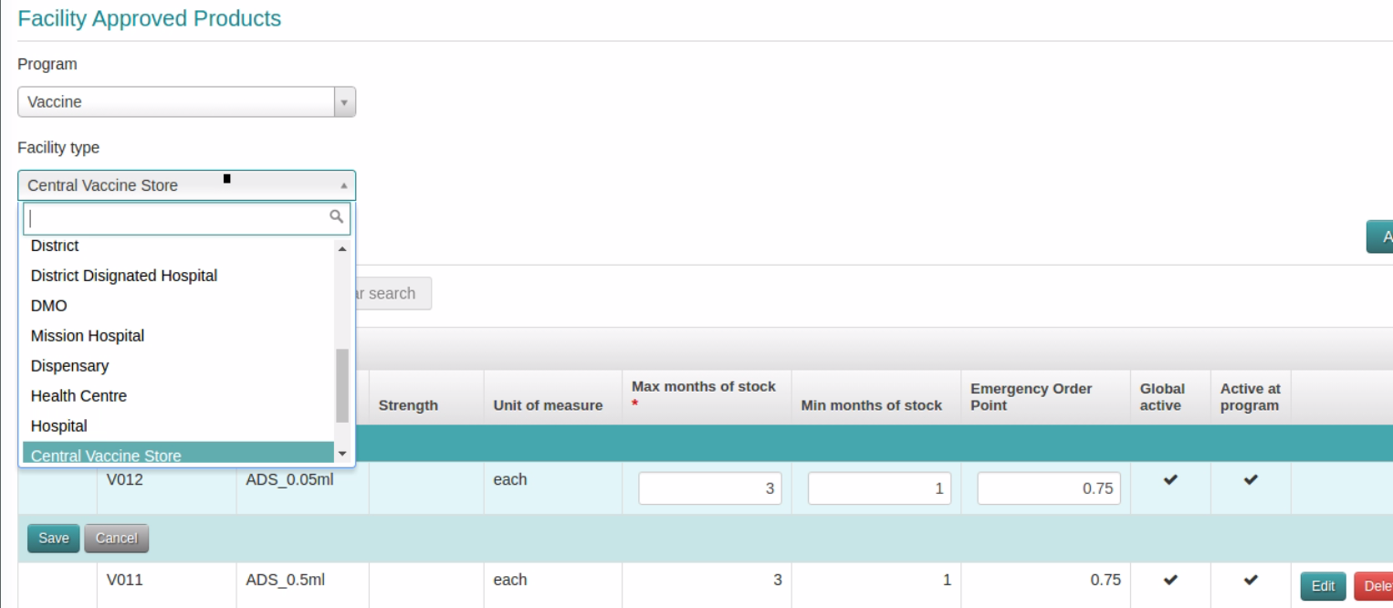
VIMS maintains Max/Min policy by WH and product

Slide 6
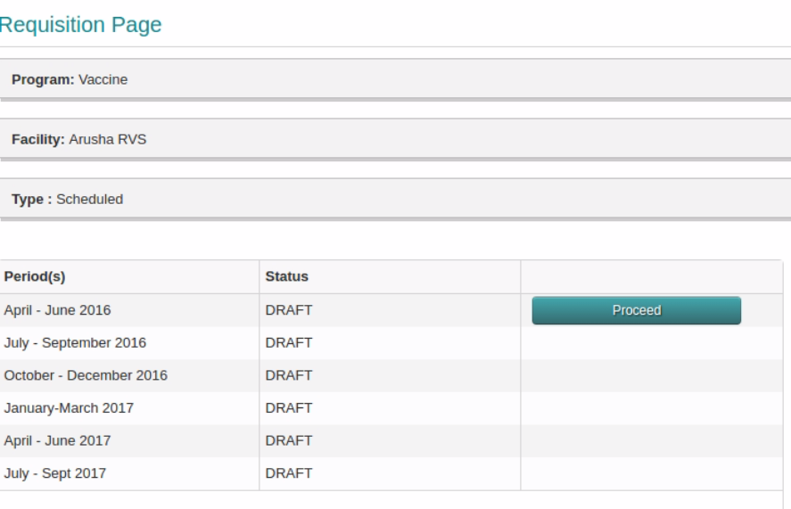
Districts places requisition

Slide 7
Requisition

Slide 8
Regional manager sees pending orders

Slide 9
Requisitions/Orders to fulfil

Slide 10
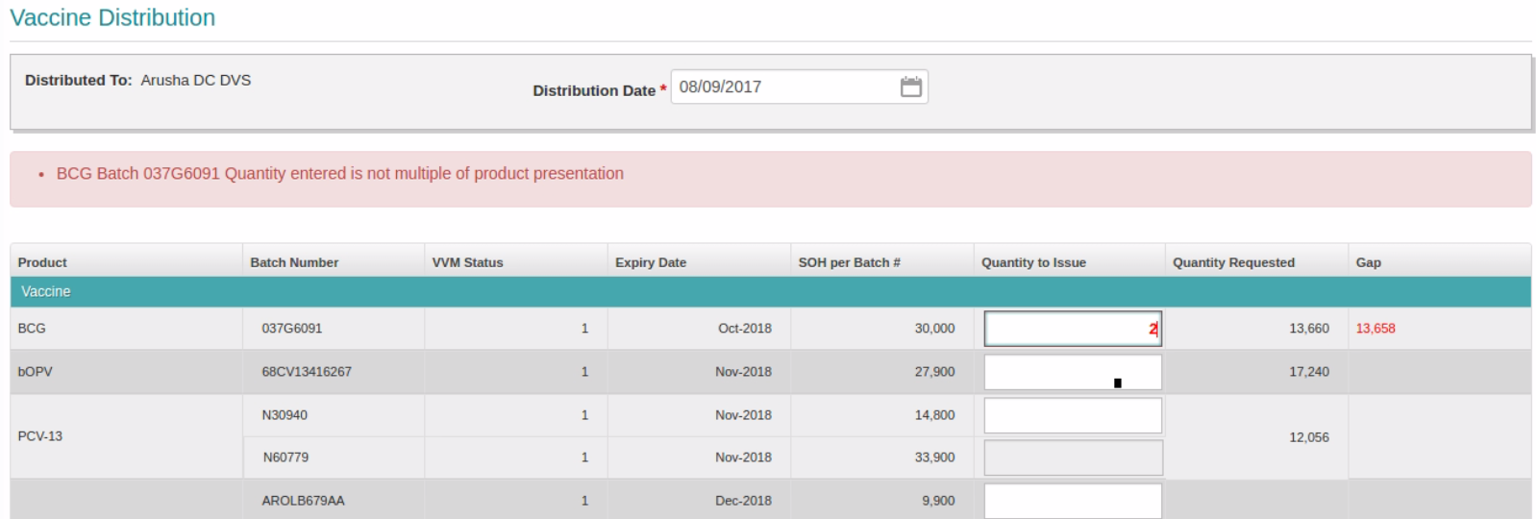
Actual distribution/issue

Slide 11
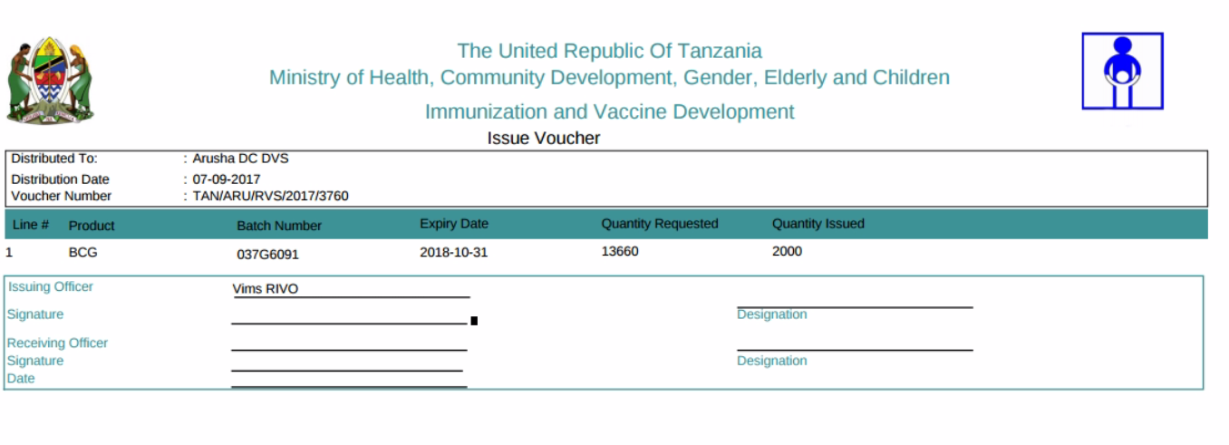
VIMS generates issue voucher

Slide 12
District receives stock and provide POD

Slide 13
Stock status reports shows monthly needs

Slide 14
Stock ledger shows details

