Slide 1
OpenLMIS Engagement
“Open source software is developed by people who show up”
- Mr. T (a.k.a. Brian Taliesin)

Slide 2
Key Messages
Next Steps
Regional workshops
Roadmap
How will it be generated?
Transparency
Software Development
Engagement
Online resources
Community committees

Slide 3
Regional Workshop
Senegal
When: last week of June (25th?)
Who: hope to have representatives from DRC, Benin, Guinea, Senegal
What: user-centric design workshop
How: leveraging prototypes and user centric design activities
Desired Outcomes
Design recommendations (specifically on user experience)
Mock-ups
User personas (idealized system users) that will directly inform development of the user interface
Notes:
VillageReach is leading a number of activities in support of this important work, one of which will be a User Design Workshop to take place the last week of June 2017 (3 days to be confirmed during the week of June 26-30). This workshop will be an opportunity for VillageReach and the OpenLMIS software development team to collect feedback from country EPI staff on specific user needs and for participants to work together within the design framework to inform the optimal user experience for the OpenLMIS vaccine functionality system.
In order to address user needs and ensure relevancy for a variety of country users, VillageReach will conduct this user design workshop in Dakar, Senegal to work with country-level users to co-create the user experience for vaccine functionality. VillageReach will facilitate the workshop in French and will lead participants through various design activities over the course of the three days.
VillageReach would like to invite two EPI staff members from each collaborating country to participate in the workshop. In order to capture user needs at multiple levels within the country’s vaccine system, we ask that two different types of users should be represented. These two participants should be:
1. An EPI officer or other central-level manager, and
2. An “end user,” someone who is conducting initial data collection within the LMIS. (Such as a facility CCE manager, a pharmacist, facility store room manager, etc.)
This way we will be able to work across the levels of the system and co-design user experiences to fit the variety of needs.

Slide 4
Roadmap
How it is created
Derive baseline from vaccine workshop
Leverage user stories from currently implemented systems
Input and guidance by the Product Committee
Priorities derived by (not in order)
Customer value (both end user and country requirements)
Donor objectives
Cost
Feasibility
Industry standards/best practicies (set by global actors/community)

Slide 5
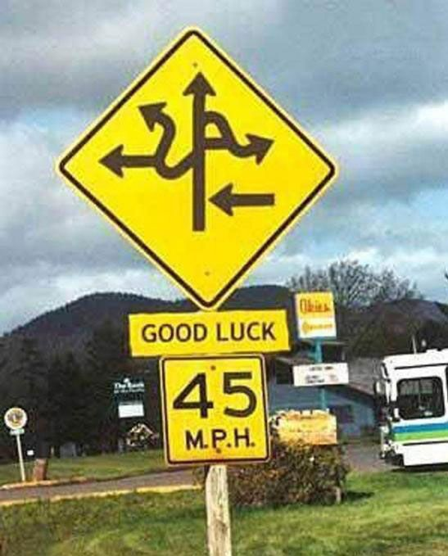
Keeping up with the roadmap
It’s complicated
Join the Product Committee ☺
Ticket View
Most updated and relevant for team
Timeline View
High-level
Manually updated and not one-to-one mappings with JIRA

Slide 6
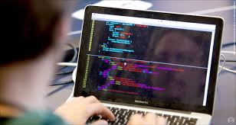
Software Development
Micro-services and architectural vision
Maintainability
Quality
Cross country availability
Supporting Standards
GS1 with GTIN and TradeItems
Coordinating with country implementations for re-usability
Engagement
Technical Committee
Listserv
JIRA
Contribute

Slide 7
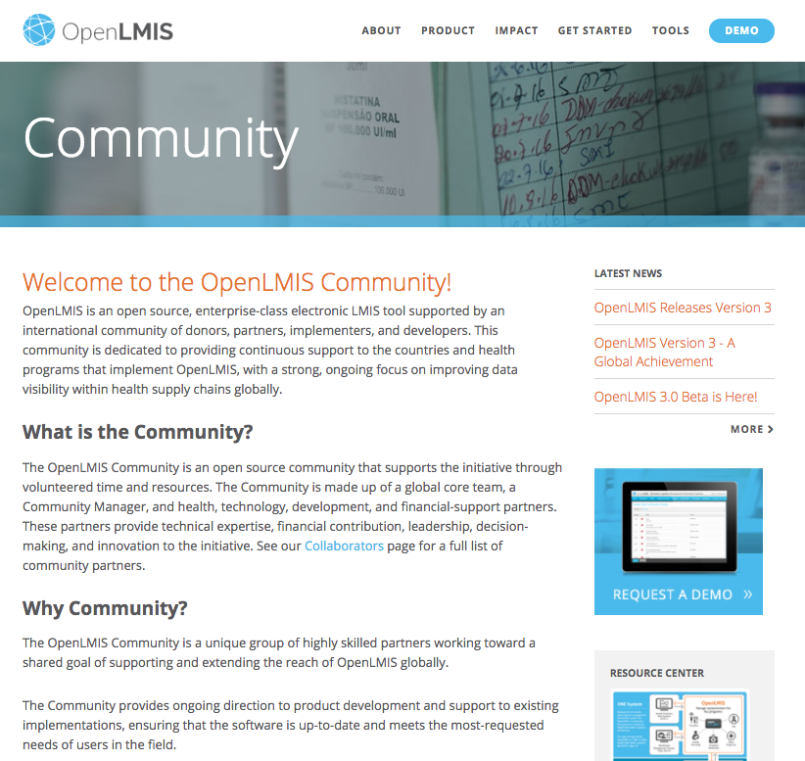
OpenLMIS Community Engagement
OpenLMIS wiki
Governance, Product, and Technical Committees
Openlmis.org
Community meetings
General info mailing list

Slide 8
Product Committee
Role: "build the right (correct) product"
What: Operations related to the roadmap, requirements, and incorporation of features into the product
Communication:
Meets every two weeks to review direction
Listserv
How:
update the backlog
share information regarding implementations and their relevance to the OpenLMIS platform
decide what work from implementations should be incorporated back into OpenLMIS.

Slide 9
Vaccine Working Group??
Do we want to make a working group?
Ideas for continued engagement outside of the current channels?

Slide 10
Continued Conversation Topics
CCE Capacity discussion
Calculation of reorder/allocation amounts for routine resupply
MOS, CCE capacity, buffer, average consumption, FEFO
Program data capture
During requisitioning? Allocation? Delivery
Closed/open vial discarded/wastage
Requisition updates/changes to meet vaccine needs
Lot management system requirements (do we require? How?)
Location of stock
End to end mapping/view

Slide 11
Thank You
For additional information:
info@openlmis.org openlmis.org

Slide 12
Current Development & Product Roadmap
3.0
3.1
3.2
3.3
Modular Framework
Requisitions
System Administration
Stock Management
Reporting/Analytics
(ongoing deployments)
Ad-hoc Program Data
Collection
Vaccine Feature Set

Slide 13
Features of OpenLMIS version 3
Version 3 Key Features & Functionality | Release Date
Comprehensive set of features available to support the requisitioning and ordering products Offline data capture Complex approval hierarchies | Available now
Configurable setup of products, facilities, programs, and more | Available now
Monitor stock levels Electronic stock cards with lot tracking and management Perform physical inventory & adjustments Track ins/outs of stock – send and receive | 3.1 May/June 2017
Third party Business Intelligence (BI) tool (ex. Tableau) | Available now
API-enabled interoperability | Available now
Supports GTIN tracking in accordance with Global Standards One (GS1) | Available now
Vaccines module Cold chain equipment support Manage demand calculation & estimates Support mixed supply chains (push distributions and pull reordering) Track wastage amounts | 3.3 ~November 2017

Slide 14
Why open source? Why version 3?
shared investment shared benefit
Through OpenLMIS’ modular architecture…
Country programs select which features they want from the version 3 code.
Countries can develop customized modules to run on top of that instance to support their workflows.
These modules can be contributed back to the open source community, allowing others to benefit from this development, saving money and extending resources.
OpenLMIS
Version 3
Country
Implementation
Reference Data Service
Reference Data Service
Fulfillment
Requisition
Requisition
Authentication
Authentication
Notifications
Notifications
“Pull” Specific Features
“Push” Specific Features
“Pull” Specific Features

Slide 15
Why open source? Why version 3?
Easier Upgrades as Global Product Advances
Country X is using their chosen set of OpenLMIS modules. The new modular architecture makes upgrades easy when the global OpenLMIS product releases new features.
Countries Sharing Functionality
Country X develops a customized module to support batch viewing of requisitions – something not included in the core OpenLMIS code.
Country Y wants to use this module in their OpenLMIS implementation. They are able to take the module and apply it in their context without spending manpower or financial resources on its development.
OpenLMIS
Version 3
Country
Implementation
Reference Data Service
Reference Data Service
Fulfillment
Requisition
Requisition
Authentication
Authentication
Notifications
Notifications
“Pull” Specific Features
“Push” Specific Features
“Pull” Specific Features

Slide 16
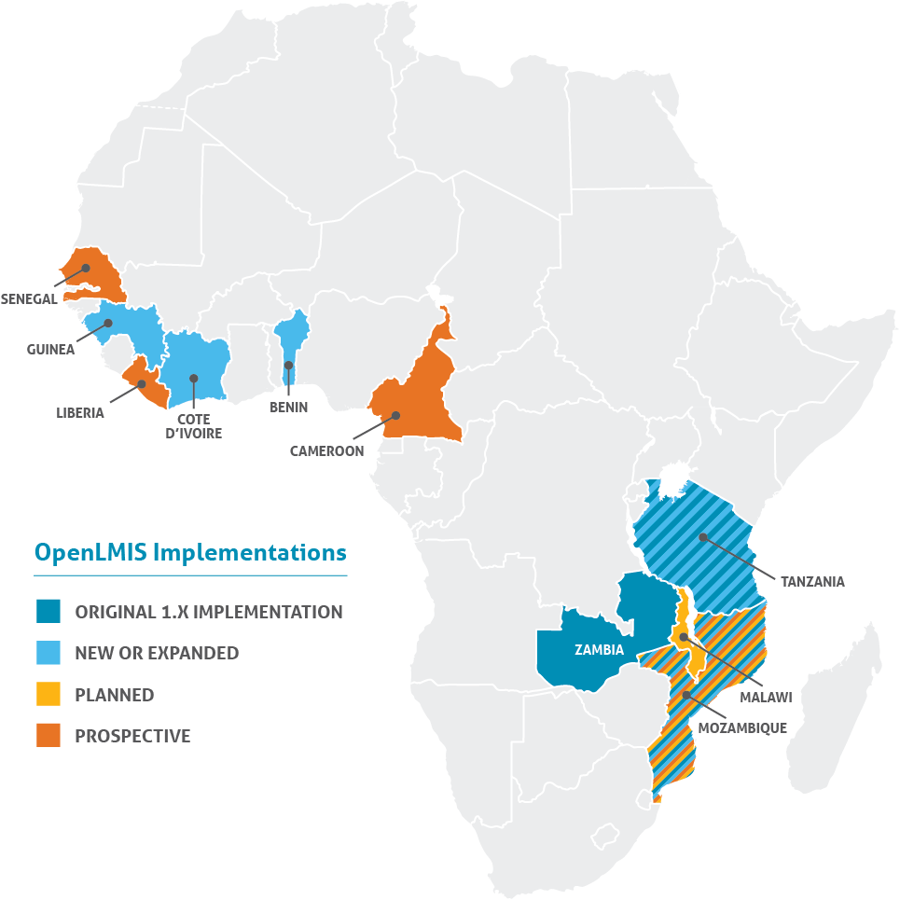
Implementations

Slide 17
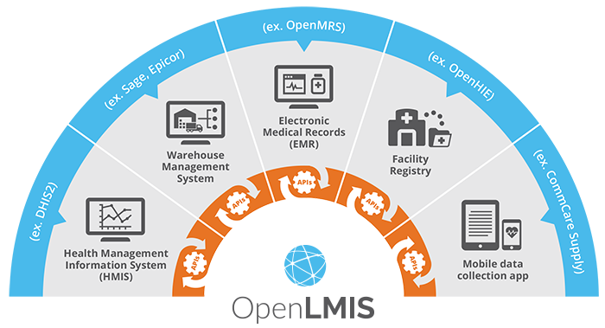
Integration & Interoperability
Zambia SmartCare
Zambia MACS
Tanzania EPICOR9, mSupply
Mozambique ESMS (front-end client)
Tanzania CommTrack
TZ HMIS/LMIS dashboard

