Slide 1
Reporting Domain Overview
OpenLMIS vaccine Module
Requirements prioritization workshop
May 2017

Slide 2
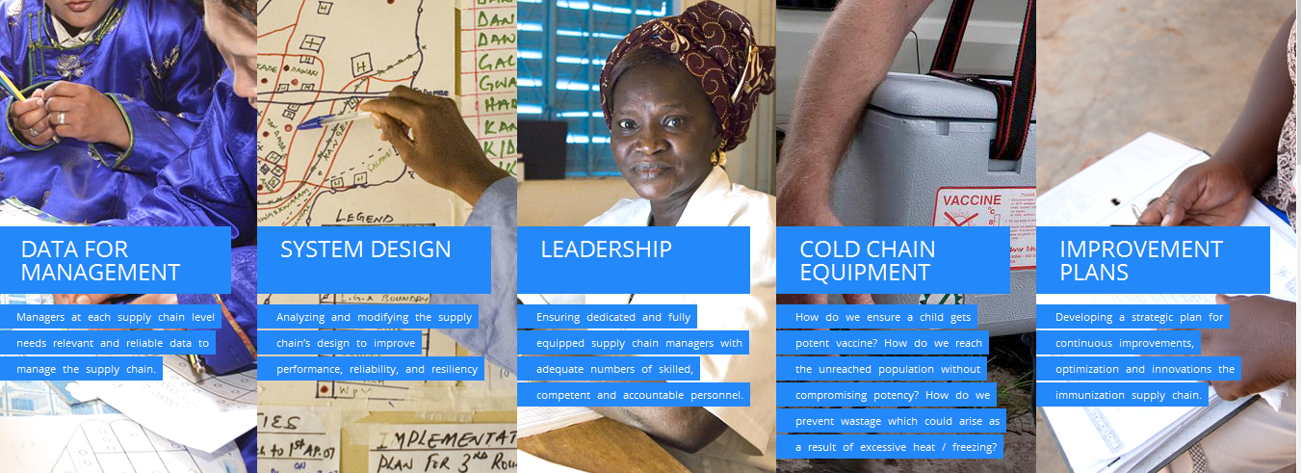
Role of Data
Notes:
This slide is familiar to most of us in the room – it’s the five fundamentals laid out in Gavi’s iSC strategy. That first fundamental – Data for Management reads -- Managers at each supply chain level need relevant and reliable data to manage the supply chain
Extrapolate that further, and say, that USERS at each supply chain level need relevant and reliable data to do their job effectively and thus bring about improvements in supply chain management.

Slide 3
DISC Indicators
Gavi’s D4M Working Group, included iSC partner organizations (UNICEF, WHO, BMGF, JSI, CHAI, VR etc)
Developed DISC Guidance, including standardizing
  7 Primary Supply Chain Indicators
  Their definitions, calculations, data sources, visualization and RCA
Push in the last six months/year to start including DISC KPIs in country level reporting, and figuring out what is possible to collect depending on SC maturity, existing data collection reality
OpenLMIS wants to support by enabling the vaccine module to be a platform for this data to be collected (where and when possible)

Slide 4
Data Sources
Vaccine Module Features
Reporting
Manage CCE inventory (including location, capacity, date of manufacture, date of installation)
✥ Functional status of CCE
CCE Reporting
& Management
CCE Inventory Catalog
CCE Functioning Log
Capture CCE functional status
✥ Temperature alarms
CCE Temperature Log
Capture CCE temperature status
Remote Temperature Monitoring
Custom reports as identified by working group
Generate temperature alarms & notifications (by facility, geog. area)
Forecasting
& Estimation
Vaccination Targets
Calculate vaccine needs using multiple variables (MoH targets, wastage rates, *historical consumption, historical supply, available CCE capacity and functional status)
✥ Forecast Accuracy / Forecast Demand Ratio
Vaccine Orders
Immunization Reports
Stock Card/Ledger
Display estimates by facility / delivery area / product / multiple time periods
Custom reports as identified by working group
Domain
Wastage Reporting Form
CCE Capacity
Support *pull, push, and mixed supply chains
✥ On-Time & In-Full Orders or Deliveries
Re-Supply
Proof of Delivery
Vaccine Arrival Report
For push supply chain needs: Create & display distribution plans by product, time period, delivery area, facility
Resupply Status Reports by facility / geographic area / time period
Delivery Schedule
Resupply Schedule
*For pull supply chain needs: Create requisitions, authorizations, & approvals
Submitted Requisitions
*Support local fulfillment; integrated supply chains
Custom reports as identified by working group
*Enter vaccine stock data and capture stock movements (amounts, history, received stock)
✥ Stocked according to plan
Stock
Management
MoH Min/Max Stock Policy
✥ Full stock availability
Stock Card/Ledger
*Capture vial wastage (by facility, zone, period, reason)
Supports product bundling (kits)
✥ Closed vial wastage
Stockout Report
Custom reports as identified by working group
Wastage Reporting Form
Generate stock level notifications
Please note that Reporting is also a specified domain of the vaccine module.
* Indicates feature supported by current core OpenLMIS roadmap ✥ Indicates DISC Key Performance indicator (KPI)
Notes:
What is the reporting domain? As you see it here, it’s this vertical domain that has all the other operational domains of CCE, of F and E, of Re-S, and of SM all plug into reporting. So it’s a domain that both cuts across the others but also is a layer above that pull them all together.

Slide 5
Why start with this domain?
Have a discussion on what’s NEEDED for each persona so that they can do their job
WHY do they need it and HOW OFTEN do they need it
This discussion will set the stage for tomorrow’s deep dive into operational workflows.
You will reference back today’s discussions throughout =
REPORTING DOMAIN AS FOUNDATIONAL LAYER for WORKSHOP THINKING and DISCUSSION

Slide 6
Definitions, Differences, Nuances
KPI – Key Performance Indicator:
  DISC is one set; does the group also think others are a must?
  WHY do you think so? WHO needs it? HOW OFTEN do they need this?
  Which is the 1st KPI in terms of importance? The 2nd? The 3rd?

Slide 7
Definitions, Differences, Nuances
Reports
  Routine reporting / Built-in reporting – needed to manage, to review, and to make decisions routine workflow and actions on a regular basis
  ONE-TIME/ANNUAL Donor/External Agency Reporting Requirement – Data Extraction and further analysis required on top of it – may or may not drive an action to the personas using this system – IS THERE A ROLE FOR THIS TYPE OF REPORT IN OPENLMIS?
  “View” versus “Report” – “View stock on hand so I can submit a requisition” versus “Report on Stock Status/ Stock Levels” – action is more corrective than immediate

Slide 8
Definitions, Differences, Nuances
Dashboards
  Data visualization tool displaying FEW KPIs and analysis such as scorecards
  AT A GLANCE! Performance View
  Can drill-down or filter but ould be able to see under-performing/well performing KPIs at a glance
  All on a single screen
  Can be a single dashboard for a set of personas, or for a domain/workflow, etc
  Auto-update without too much work on the part of a user
  We will talk about this in small groups IF TIME PERMITS today

Slide 9
What do you have to do this afternoon?
Each group has a facilitator
Possess a list of KPIs and Reports and Blank Templates
Your role:
  Discuss these KPIS and Reports and their usefulness
  You can agree or disagree; you can add additional KPIs and remove existing ones
  You can edit the existing ones to better capture/define the “need”
  BUT….. You HAVE TO do it this way:
    Talk about WHO needs these KPIs and Reports to do their JOB
    WHY do they need it?
    HOW OFTEN do they need it?
    If time permits, talk about how a user would want to get this KPI or Report and how it can be visualized
    If time permits, what a dashboard for that domain could look like or for a persona you pick

Slide 10
Report back to Plenary
Identify the person who will report back for your group (MORE STICKERS!)
Report on:
  1-2 KPIs and WHO, WHY, HOW OFTEN
  1-2 Reports and WHO, WHY, HOW OFTEN
Larger group reacts and discusses – chance to weigh in if you’re in another group
Likely come up with more than 2 – that work is not lost – facilitator is tasked with capturing that, documenting it online, and we will use them in the prioritization exercise on Day 3

Slide 11
Thank You
For additional information:
info@openlmis.org ; openlmis.org

Slide 12













What is OpenLMIS?
OpenLMIS is a state-of-the-art, open source, web-enabled, enterprise class electronic logistics management information system (LMIS) purpose-built to manage health commodity supply chains
The OpenLMIS initiative incorporates a community-focused approach to develop open source and customizable LMIS systems

