Slide 1
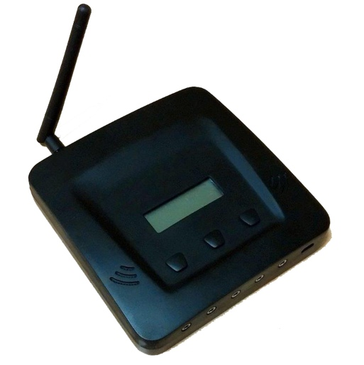
Temperature & Power Data upload to dashboard
via GPRS
Less than 5MB a month
Typically upload every 60 mins (configurable)
via SMS (optional)
failover when GPRS connectivity is poor/not working
Requires 2-way SMS Gateway service (dashboard receives SMS) with local country phone number
Not recommended unless free/very cheap SMS plan with SIM & cheap 2-way SMS gateway plan
*
SMS Alerts – Real Time – to clinics staff (Optional)
Direct from CT5
For whom: clinic level health staff
What does the alert say: Alert about temperature from individual sensors/fridges and power.
How many numbers: Up to 5 numbers
How is device configured: Configured via GPRS or SMS

Slide 2
Facility Level Alerts – Real Time
For whom: clinic level health staff
What does the alert say: Alert about temperature from individual sensors/fridges and power.
How are alerts sent:
SMS direct from device (see previous slide)
SMS direct from Nexleaf dashboard
Requires SMS Gateway service, preferably with local number or sender name
OR requires cell phone carriers ‘email to SMS gateway’ if supported (e.g. you can send an email to 9492126877@txt.att.net and I will receive it as a txt message)
Email direct from dashboard
Aggregated Alerts - Scheduled
For whom: Managers responsible for multiple facilities
What does the alert say: list of facilities with issues and severity
How often sent: Sent once or twice a day at scheduled times
How are alerts sent:
SMS direct from dashboard (see above description)
Email direct from dashboard

