Slide 1
Equipment Asset Management
Feature Summary
July 11, 2014

Slide 2
Facility/Supervisor Interface

Slide 3
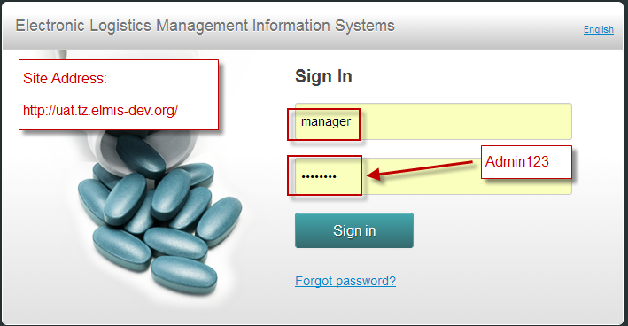
Login with Facility/Supervisor Account

Slide 4
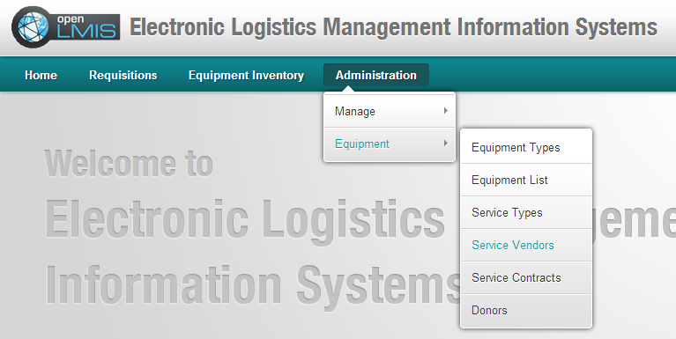
Admin Menu Related to Equipment Asset Management

Slide 5
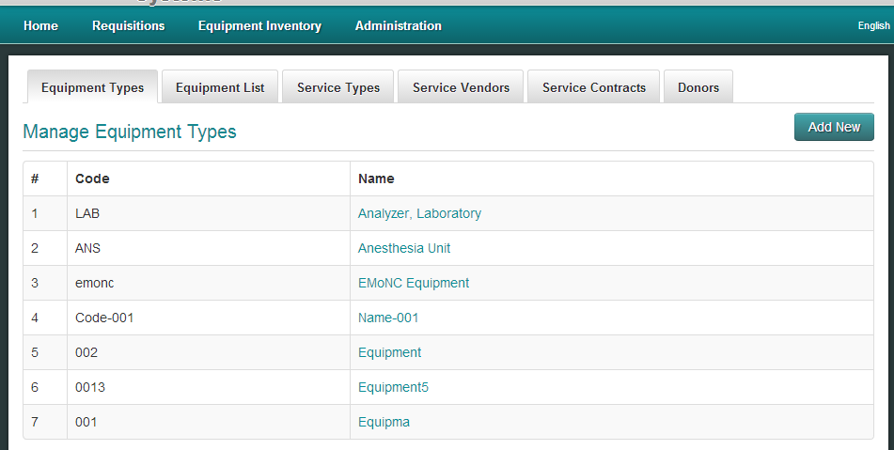
Add/Update Equipment Types

Slide 6
Associate Equipment with Equipment Type

Slide 7
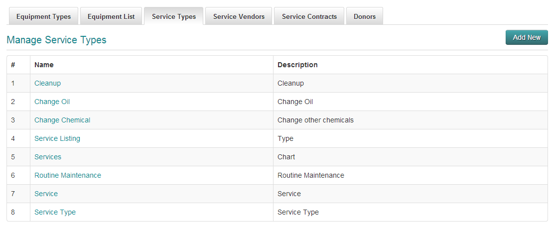
Add/Update Service Types

Slide 8
Add/Update Vendors Who Supports the Equipment

Slide 9
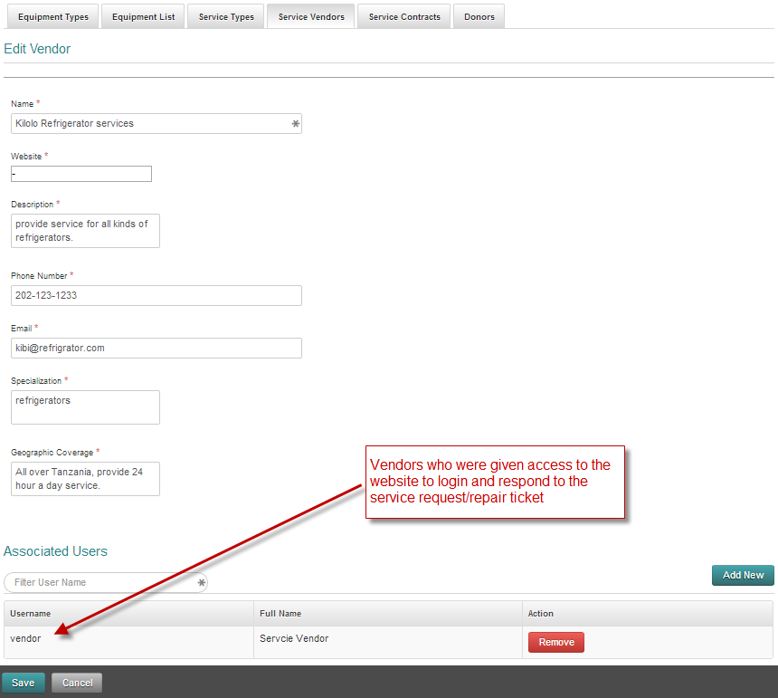
Vendor Detail and Vendor Login Accounts

Slide 10
Service Contract Details

Slide 11
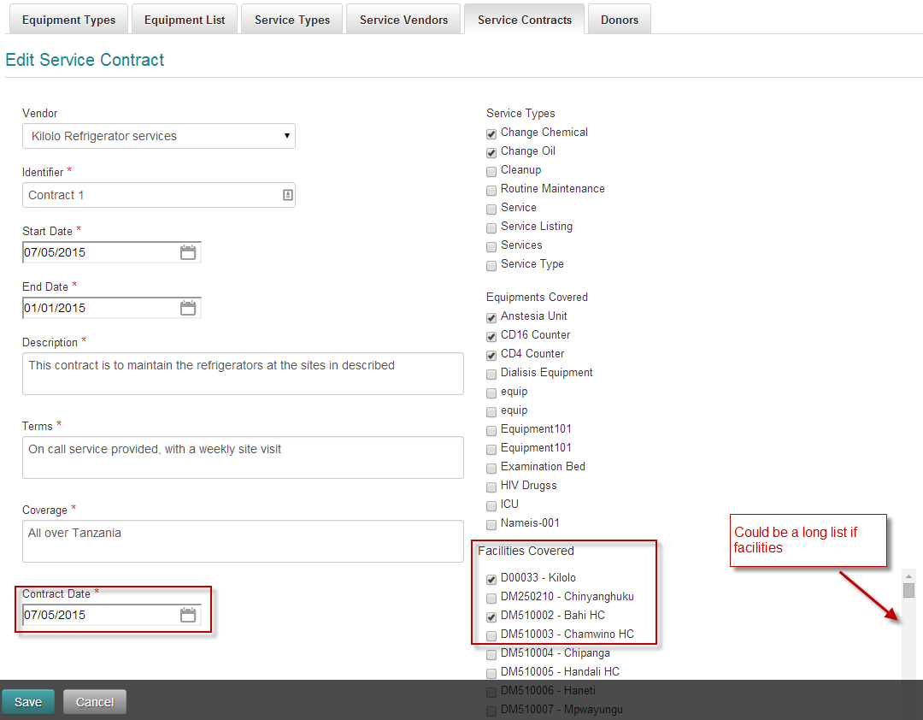
Service Contract Details

Slide 12
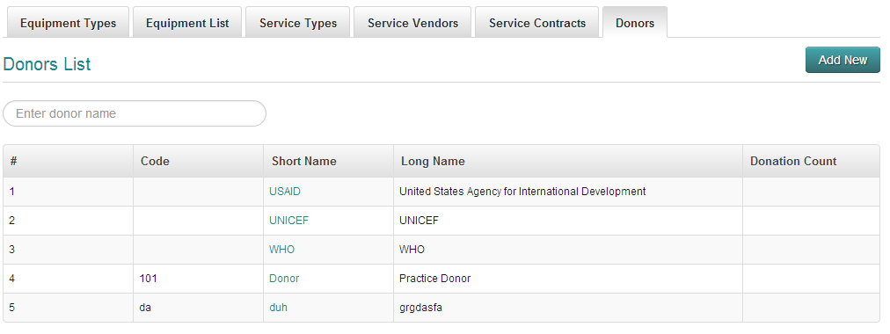
Donors

Slide 13
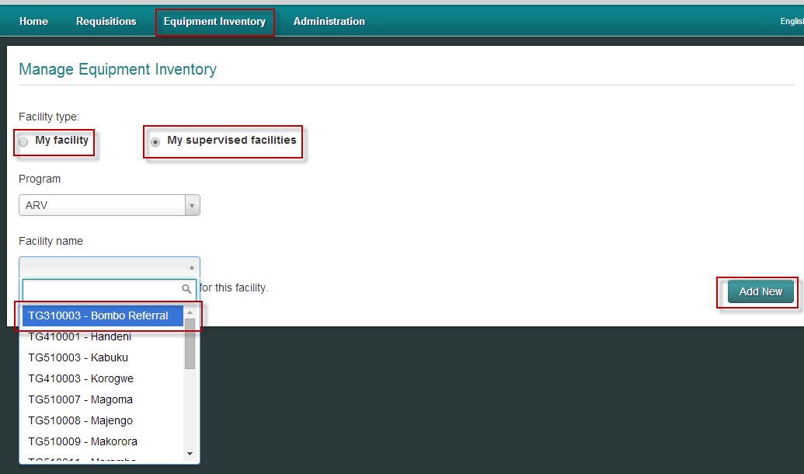
Interface for Facilities/Supervisor to Report on their Equipment

Slide 14
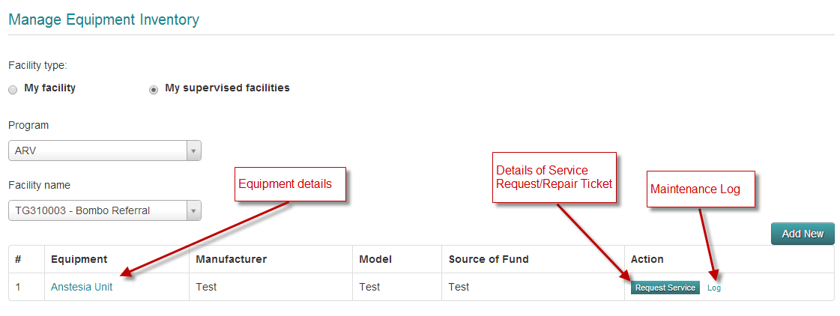
Facility to Manage their Equipment and Request Service

Slide 15
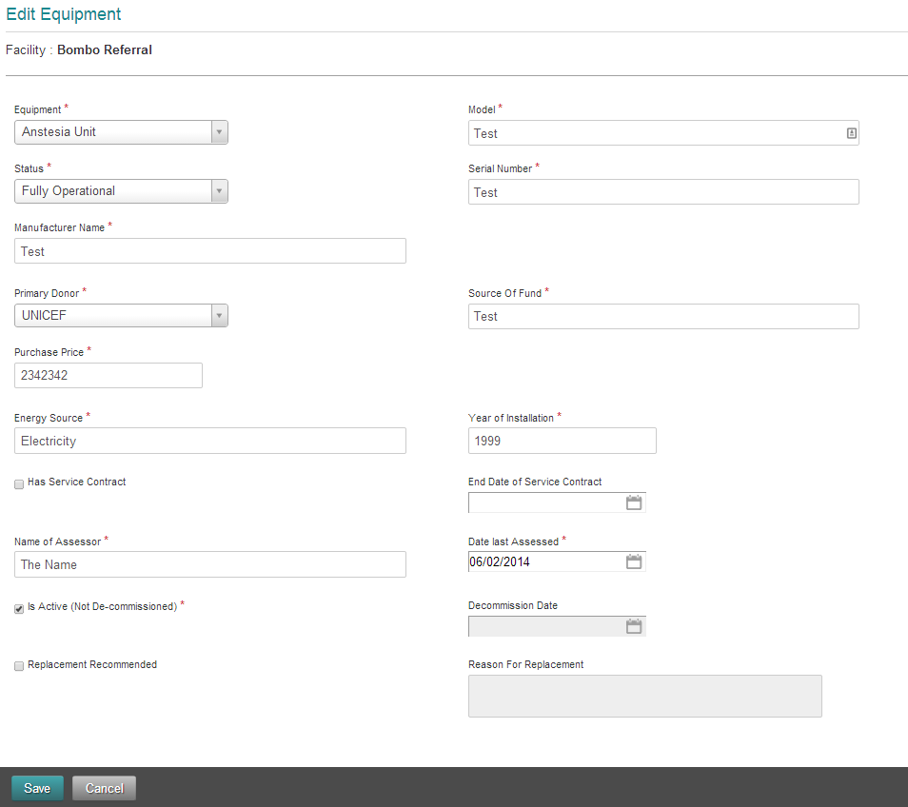
Equipment Details

Slide 16
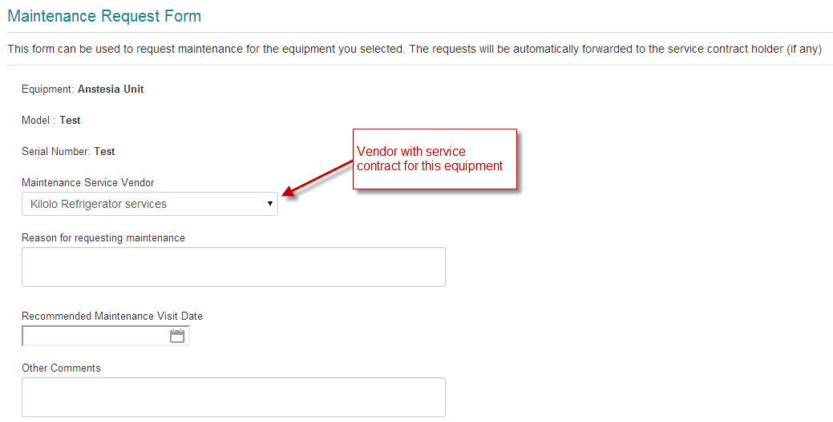
Service Request/Repair Ticket

Slide 17
Equipment Maintenance Log

Slide 18
Vendor Interface

Slide 19
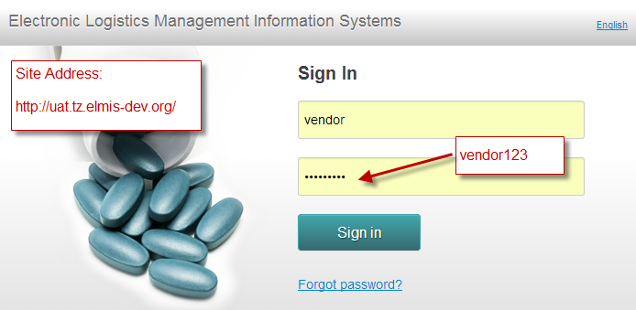

Slide 20
Vendor Login

Slide 21
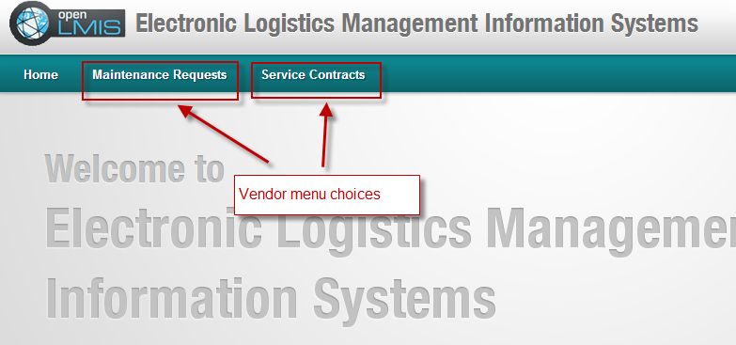
Vendor Interface

Slide 22
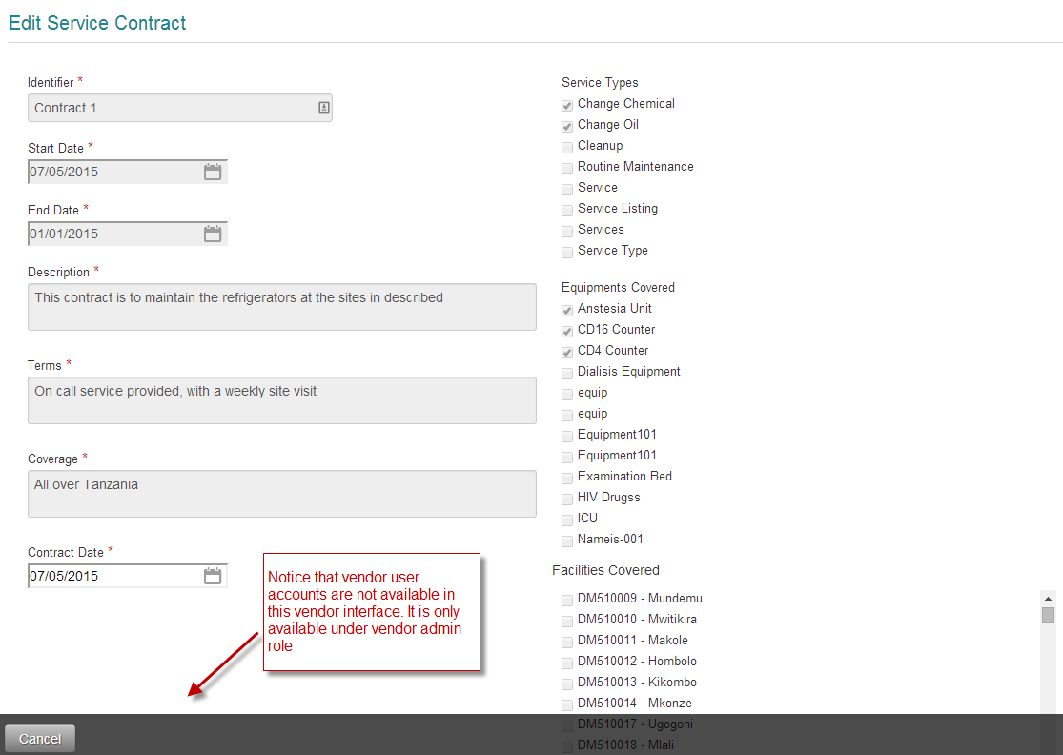
Service Contract Details

Slide 23
Interface to View Service Request/Repair Tickets

Slide 24
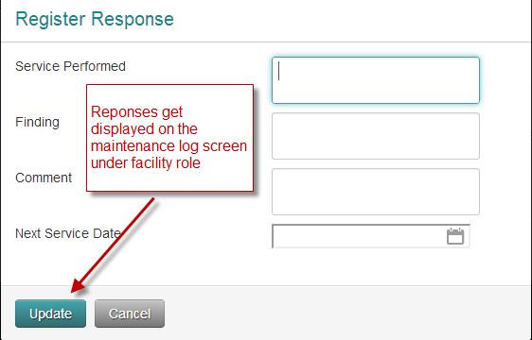
Repair Details

