Slide 1
Data Standards for routine health facility systems
Update on the DHIS Health App
Kathryn O’Neill | HQ/HIS/IER/GPM | September 2017

Slide 2
Routine Health Facility Information System (RHIS)
Health Data Collaborative working group (WHO/UiO/USAID/ME ++)
Address critical gaps/harmonize and disseminate standards for improved facility and community based reporting, analysis and use of data for action
Catalyse joint support to countries to scale up and strengthen integrated facility systems, based on international standards and good governance
Identify ways that investments can be better aligned to ensure scale-able integrated, sustainable systems, improved governance and institutional capacity in analysis and data use
Global deliverables
Package of data standards & tools - indicators, metadata, data quality, ICD coding, master facility lists, analytical outputs, template forms, open access
A standard Health App for DHIS2
A joint strategy & investment plan for DHIS2 development, implementation and maintenance
Country deliverables
Aligned support to scale up and strengthen integrated facility based health information systems, based on international standards
Documented country best practices & guidance for sound governance

Slide 3
DHIS Standards based Health App
Package of reference data standards for countries to improve data quality, analysis and use
STANDARDS FOR MEASUREMENT
Core indicators and metadata
Data quality metrics
METADATA REPOSITORY
DATA QUALITY REVIEW (DQR)
HEALTH SYSTEMS AND DISEASE-SPECIFIC MODULES
Programme specific indicators and data elements
Best practice dashboards, analyses
Aggregate and case-based reporting
Standard data entry forms/registers
MORTALITY
MORBIDITY
HIV
IMMUNIZATION
TB
EARLY WARNING
MALARIA
RMNCH
03/11/17
WHO Health App
3

Slide 4
Indicator metadata repository
Standard indicators & definitions
Core Content
Recommended core list of facility indicators derived from the 2017 reference list of core health indicators
guide country selection of indicators and definitions
reflects evolving public health priorities/strategies
promotes better alignment, reduction in reporting burden
Indicator metadata registry of core indicators integrated into DHIS2 as reference
Future priorities
Addressing implementation and governance issues
Learning and best practices

Slide 5
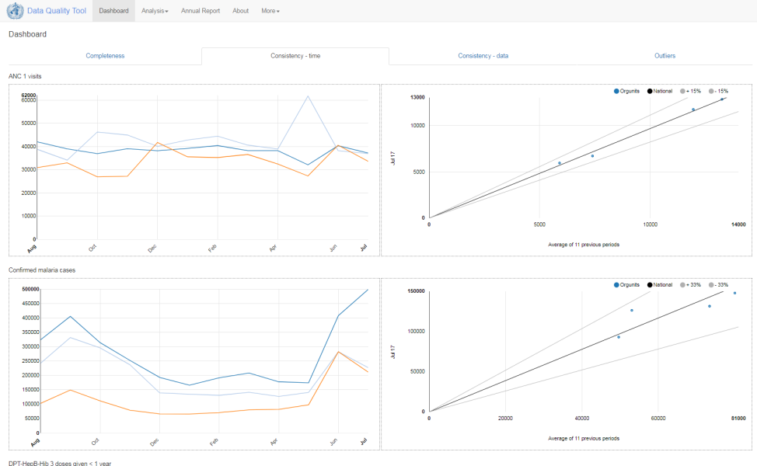
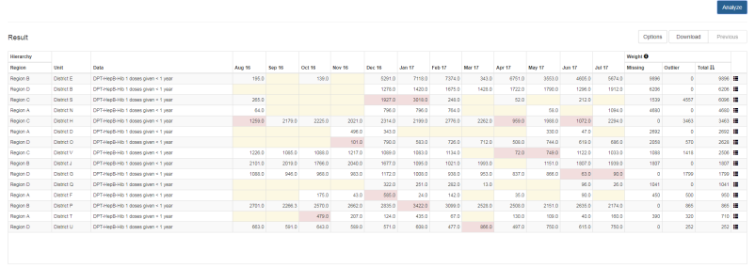
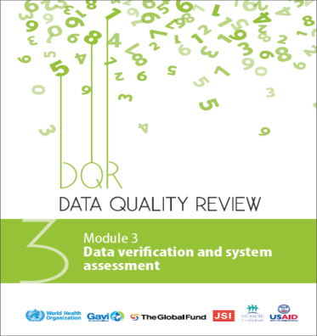
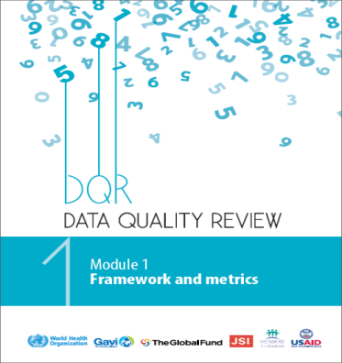
Data quality review
A standard methodology for assessing data quality
Core analysis
Completeness and timeliness
Internal consistency of data (eg. outliers)
External consistency of data
Includes metrics for HTM, immunization, MCH
Highlights/future priorities
DQR methodology integrated into DHIS2 + tools available for use with other systems
Scale up of implementation and use with support by GF, GAVI, USAID/Measure

Slide 6
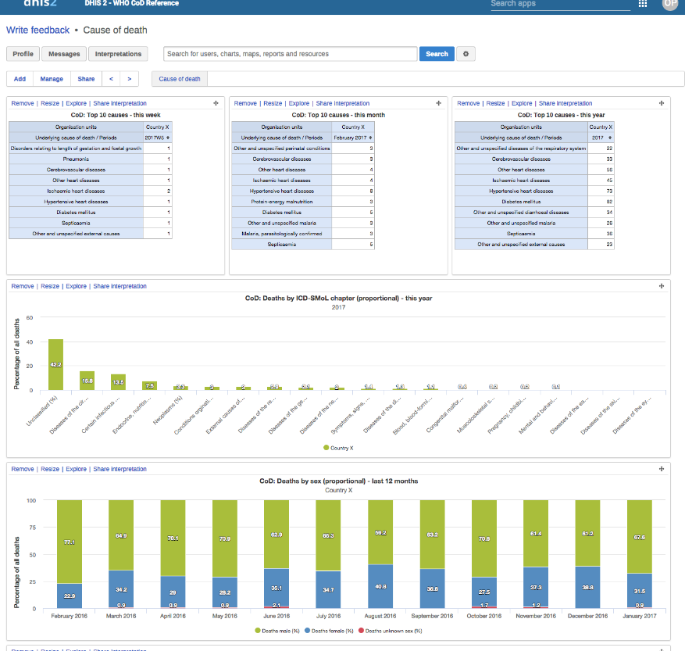
Mortality module
Standardized reporting of causes of death, based on ICD
Core analysis
Institutional mortality by cause of death
Outpatient morbidity and routine surveillance of priority diseases
Highlights/future priorities
ICD coding, based on the WHO Start-Up Mortality List (SMoL) – low resource settings, where CRVS weak
Individual cause of death collected on the International Form of the Medical Certificate of Cause of Death

Slide 7
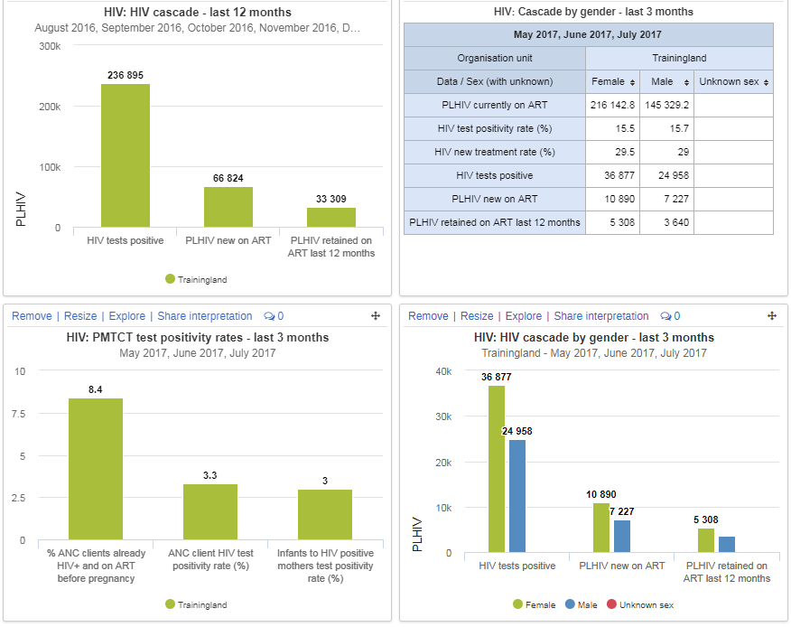
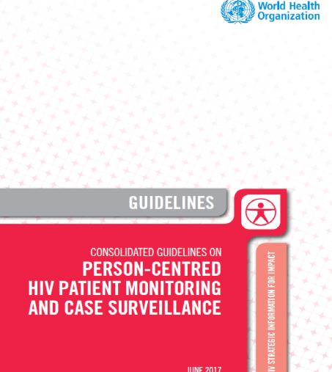
HIV module
HIV patient monitoring and case surveillance
Core analysis
HIV 90-90-90 cascade;
Diagnosing 90% of PLHIV
Ensuring 90% of the diagnosed started on ART
Viral load suppression in 90%
Highlights/future priorities
Strengthen individual data and improve data quality
Using data dashboards to fill program gaps (e.g testing, retention)
Alignment with partners (e.g PEPFAR) and integrate with national HMIS

Slide 8
Malaria module
Surveillance in control and elimination phases
Core analysis
Surveillance during burden reduction phase
Morbidity, mortality
Prevention
Treatment
Surveillance for elimination
Cases notified, investigated, classified
Foci identified, investigated, classified & response
Commodities monitoring
Data validation & controls
Highlights/future priorities
From aggregate to patient monitoring & case surveillance

Slide 9
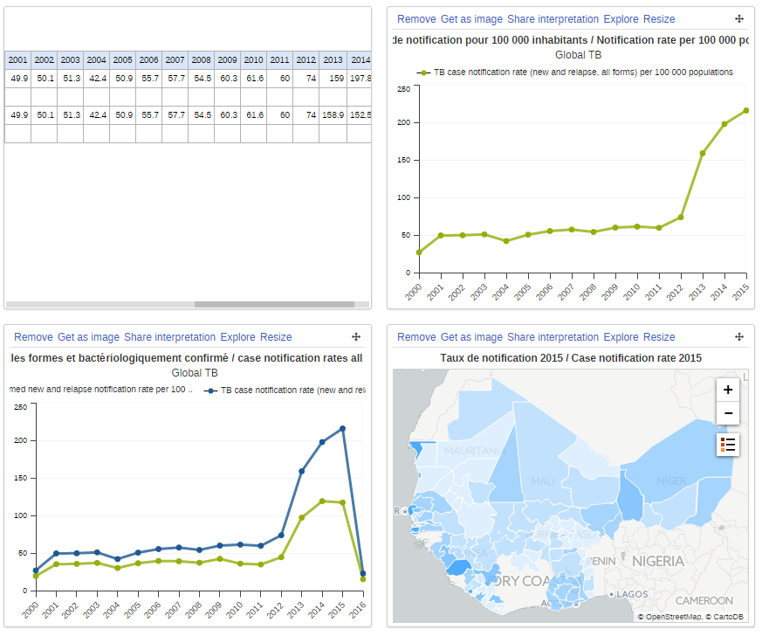
TB module
TB surveillance for programme evaluation
Core analysis
TB notifications dashboards
Outcomes dashboards (trends in treatment)
Drug susceptibility - The ‘Rifampicin Resistant (RR)-TB’ dashboard
TB-HIV dashboard
Highlights/future priorities
Country /global accessible TB historical data
Identify weaknesses in TB surveillance through subnational data analysis
TB individual data (tracker)

Slide 10
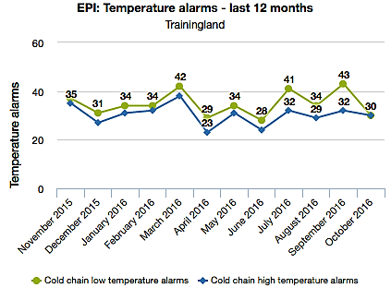
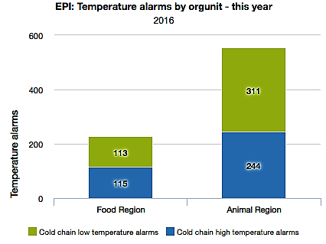
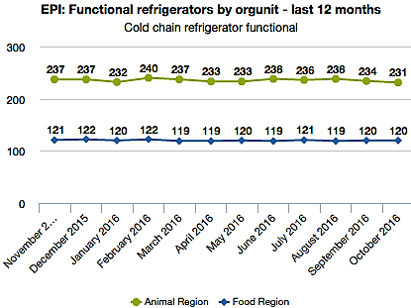
Immunization module
Analysis and use of routine immunization data
Core analysis
Immunization coverage for each vaccine in national schedule
Monitor drop-outs
Monitor availability of vaccines and injection supplies
Monitor cold chain (vaccine vial wastage, vaccine temperature)
Highlights/future priorities
WHO, GAVI promoting/supporting integration of EPI into HMIS
Supporting implementation at country level (through country governance)
Aligning with existing tools (e.g DVDMT)

Slide 11
Curriculum: Analysis and use of facility data
Module
1
Module
2
Module
3
Module
4
GENERAL
MORTALITY
& MORBIDITY
HEALTH
SYSTEMS
PROGRAMME
SPECIFIC
Core indicators
Aggregate
Case based
Mortality and causes of death
Health infrastructure
HIV/AIDS
NATIONAL
DISTRICT
FACILITY
Tuberculosis
Data quality
Human
resources
Malaria
Outpatient morbidity & routine surveillance of priority diseases
RMNCAH
Population estimates/ denominators
Drugs and
supplies
Immunization
NTDs
Analysis
General service delivery
NCDs
Presentation and communication
Surveillance
STRUCTURE
Introduction
Indicators
Data quality
Analysis
Data limitations
Practical assignments
STRUCTURE
Introduction
Indicators
Data quality
Analysis
Data limitations
Practical assignments
STRUCTURE
Introduction
Indicators
Data quality
Analysis
Data limitations
Practical assignments
STRUCTURE
Introduction to data
Indicators
Data quality
Core analysis
Data limitations
Practical assignments

Slide 12
Status of WHO Health App DHIS configurations
Content | Type | Status | Comment
Cause of death | Tracker |  | Ready
Data Quality Tool | App |  | Released
Immunization | Aggregate |  | Ready for testing
HIV | Dashboard |  | Ready
Malaria | Both |  | Advanced development
Metadata browser | App |  | Advanced development
NTDs | Both |  | Content developed for several diseases, yet to be integrated with main workstream
RCH | Dashboard |  | Started
TB | Aggregate |  | Ready
 | Tracker |  | Started

Slide 13
Country implementation:
HDC HIV, TB, Malaria - Global Fund, WHO +++
Deliverables
High quality district level data for highest burden countries for HIV, TB, malaria
Approach
Integrating standards-based reporting into national HMIS
Focus:
HIV: 10 countries | TB: 15 countries | Malaria: 20 countries
Process
5 country demonstration and learning (January 2018)
Scale up to other countries 2018–2019

Slide 14
Implementation issues
For further discussion
Issues
How to migrate to existing systems - additional variables, mapping to different definitions
How to ensure initial and sustained technical support ( for DHIS - IT platform and subject matter expertise/content)
How to get partners more aligned in support of technical and financial investment in HMIS in countries
Potential approaches
Working jointly with countries on governance issues – as part of learning agenda
Establishing systematic mechanism for technical support requests from countries (both DHIS and content/use)
Establishing pools of expertise, involving national institutes/consultants & regional platforms, (eg HISP, DHIS academies ++)
Health data collaborative approach: getting behind country priorities and support through common investment framework

