Slide 1
JavaScript Framework
Choices for OpenLMIS

Slide 2
Why change JavaScript Framework?
Why should we change?
AngularJS out dated?
Performance?
Something better out there?
Does benefit of changing out weights cost involved?

Slide 3
AngularJS out dated?
AngularJS 1.x roadmap
July 2018 of version 1.7 is expected to be it’s last
3 more years of LTS (Long Term Support)
Angular 5.x is the current product line
Major upgrade
Will require re-learning the language
ES6, Typescript based

Slide 4
AngularJS Slow?
Angular 5.x is definitely faster then 1.x
Perhaps we should ask our self what is slow in our implementation of AngularJS
Is the slowness solely related to JavaScript framework
Are there other factors?
eLMIS experience?
OpenLMIS experience?
OpenSRP experience?

Slide 5
Is there something better out there?
React
Vue.js
Ember.js
Many other choices

Slide 6
Arguments to ditch Angular
Since going to Angular 4 or 5 is like learning a new language why not go for something like React which is more popular these days and seems to be faster than Angular? React is backed by Facebook.
There are other choices like Vue.js which tried to adopt best of both Angular and React and is not as steep learning curve as React or Angular 4 or 5
OpenLMIS team’s experience with alternate frameworks?

Slide 7
Arguments to stick with Angular
Angular 5 will have address some of AngularJS limitations
Angular is a full stake framework
MVC or MVW
React alone does not bring a full framework, but have an echo system that requires adoptions of many other libraries to bring it at the level of Angular 5
Angular is backed by Google

Slide 8
Cost benefits analysis
Cost
Benefits
Lots of existing code
Migration challenges
Weeks of learning curve
Adding extra weeks/months to next OpenLMIS release
Performance gains would not be immediate
Increased download size
Staying current with industry trend
Performance gain
Mobile advantage
Responsive frameworks

Slide 9
Source: Traversy Media

Slide 14
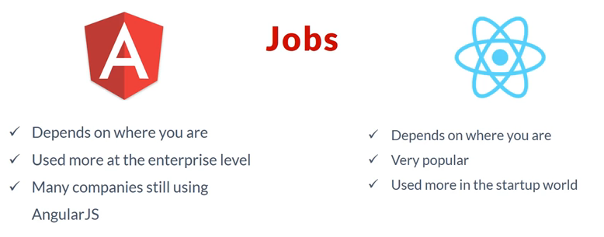

Slide 15
Which framework?
Angular 5.x
React
Vue.js
Ember.js
Meteor
Express
Aurelia
??

Slide 16
Spike with …
React with ngReact
Vue.js with ng-vue

