Slide 1
OpenLMIS V3
Reports Module

Slide 2
Report Complexities
Two users may get different data for the same filters (User Facilities Complexity)
Two users may get different value in filters for the same report (Filter Interdependency Complexity)
User can only see those reports for which she has view righs (Report Availability Complexity)

Slide 3
Report Complexities
Custom report is a template based report design which allow to build reports and execute from the application without any code deployment
Must follow query, and layout and parameter guidelines (details in later slides)

Slide 4
Report Complexities
Some report have additional logic either defined in query or backend e.g. Stock Status which calculates MOS and compare with Min and Max level to determine if the facilities is understocked, overstocked and stocked according to plan
Where Geogaphic zone level is not selected, any aggregation would be based on user facilities (Logistics Summary Report)

Slide 5
Report Complexities
Jasper Integration
In eLMIS Report Module we use jasperreports library in which there is a built in Jasper compiler that translate jrxml file into jasper(.jasper) files(binary files) which are then translated and rendered to user in different file format (.csv,html,pdf etc).

Slide 6
Report Complexities User Facilities
Report data involving facilities is filtered for logged in user
Facility is visible to user if it part of requisition group, supervisory node and program assigned to user through role assignment
This relationship has implications on how filters are populated and applied to data

Slide 7
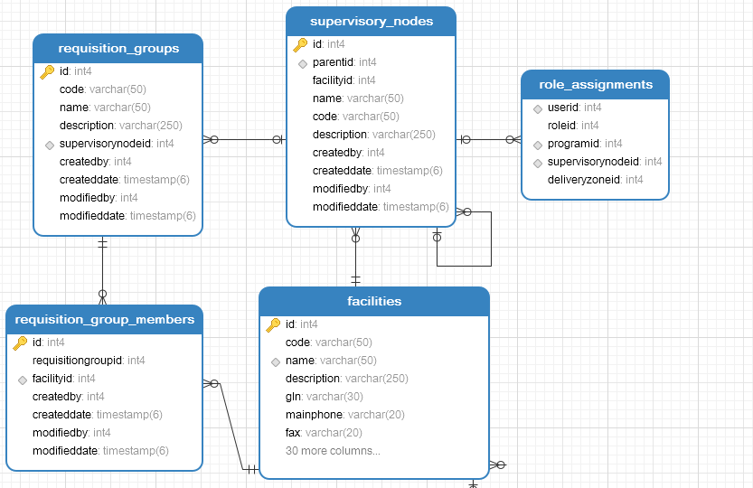
Report Complexities User Facilities
User access model is derived from role, program and supervisory node assigned to user.

Slide 8
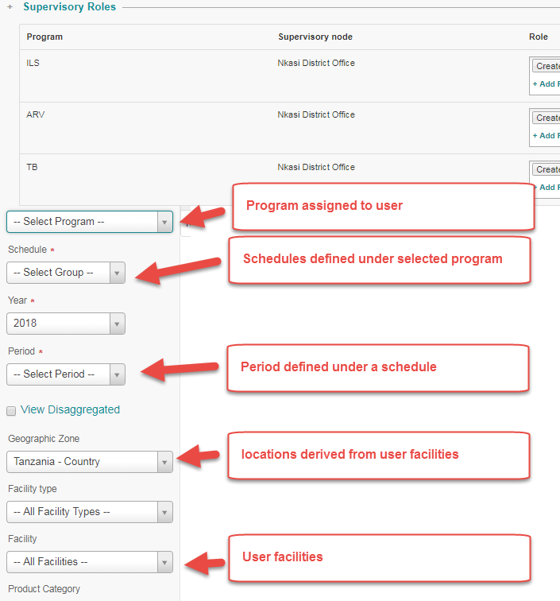
Report Complexities Filter interdependency
Program and Geographic zone filters options depend on supervisory roles assigned to user
Facility filter options depend on user facilities
Some filters have parent/child relationship. Parent must be selected before child is populated

Slide 9
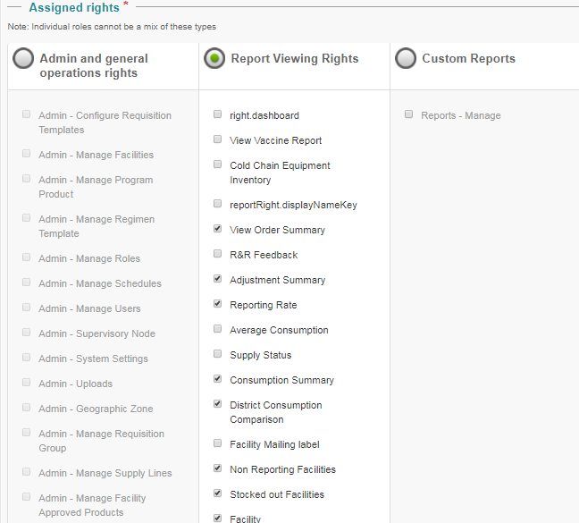
Report availability depend view permissions assigned to user role

Slide 10
Upload GIS Map
Steps
Login as Administrator
Select Menu Administration > Manage > Geographic Zones > Geo Json
Locate and upload the GeoJSON file from your local computer
Make the association between the boundary data coming from the GeoJSON file and the Geo Zones records already in the database
Use "Search" and "Hide matched" option for easy record location and clean interface
Drag and drop the boundary record to the corresponding Geo Zone record
"Save" the option when done.

Slide 11
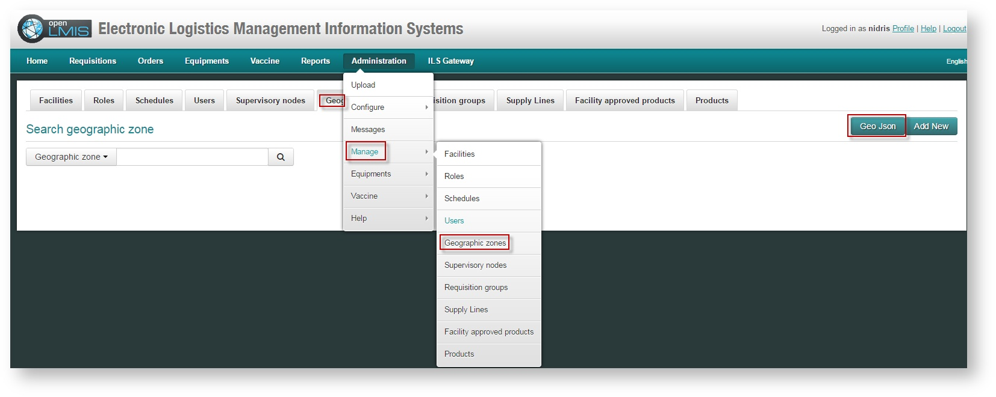
Upload GIS Map

Slide 12
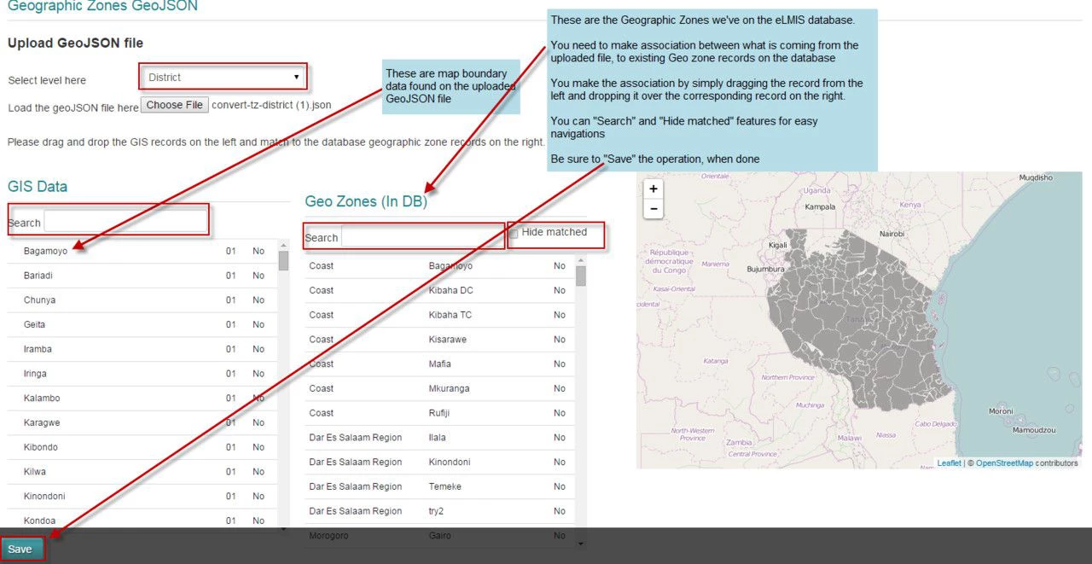
Upload GIS Map

Slide 13
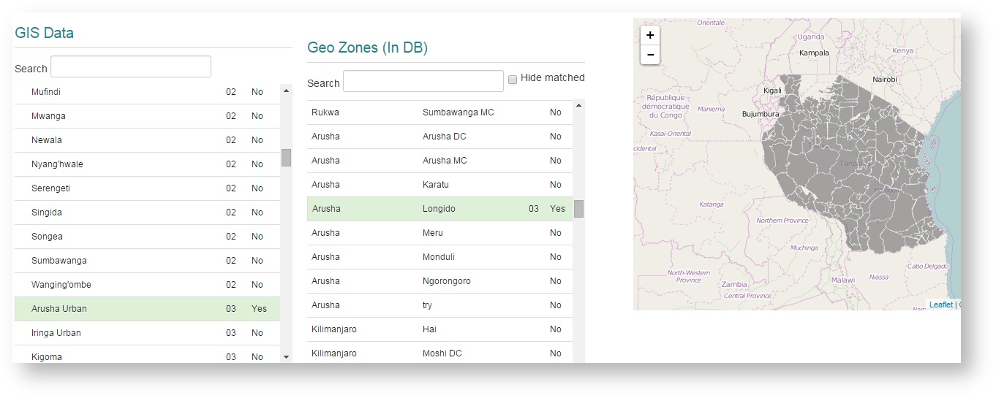
Upload GIS Map

Slide 14
Reports
Stock Status Report
Stock Status Summary with Map
Adjustment Summary Report
Logistics Summary Report
Consumption Report
Order Fill Rate Report
Order Report
Issue Voucher for Medical Supplies
Facility List / Mailing Labels Report
User Summary
Custom Reports

Slide 15
Test Users
https://uat.tz.elmis-dev.org/
User Name | Password | First Name | Last Name | Job
dlyimo | guest123 | Doroth | Lyimo | Distr Pharmacist
Elia | guest123 | Elia | Martin (Admin) | eLMIS Administrator
hkimaro | guest123 | Hussein | Kimaro | Facility Incharge
amauki | guest123 | Akwilina | Mauki | Regional Pharmacist- Arusha
kkawambwa | guest123 | Kawambwa | Kawambwa | DTLC- Kasulu DC

Slide 16
Stock Status Report

Slide 17
Stock Status
Description
Lists the stock status of all products for each facility in the logistics system. . Managers can use this report to identify facilities that are not stocked according to plan and take action to correct the imbalances. Month is stock is calculated dividing stock on hand by Average monthly consumption. A facility is marked understocked if the mos of fall below facility’s minimum stock level; appropriately stocked if MOS is between Min and Max level and overstocked if MOS is more than facility’s max level

Slide 18
Stock Status Features
Filters (Program, Period, Geographic Zone, Facility Type, Product Type)
Export to pdf and Excel
Color coded status
Sortable by column
Configurable report title/subtitle, logo

Slide 19
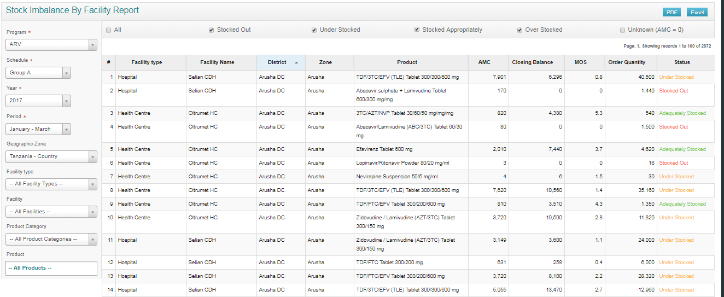
Stock Status
HTML

Slide 20
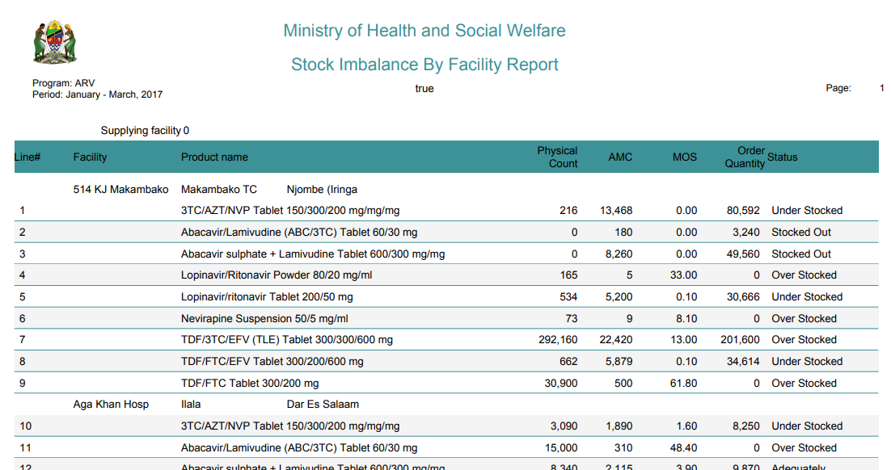
Stock Status PDF

Slide 21
Stock Status Excel

Slide 22
Stock Status Demo
https://uat.tz.elmis-dev.org/public/pages/reports/main/index.html#/stock-imbalance?schedule=2&period=59&year=2017&facility=&program=2&facilityType=&productCategory=&products=0&max=10000&page=1&status=SO&reportType=RE&facilityOwner=

Slide 23
Stock Status Summary with Map

Slide 24
Stock Status Summary with Map
Displays interactive map visualization of stock status data of product(s) with drill down capability to list of facilities that are stocked out, over stocked, under stocked. User can select product to display trend charts which show consumption and stock on hand.

Slide 25
Stock Status Summary with Map Features
Filters (program, geo zone, product, period)
Status break down by district
Drill down to list of facilities
Status break down by products
Last 4 months trend
Export to pdf and Excel
Configurable report title/subtitle, logo

Slide 26
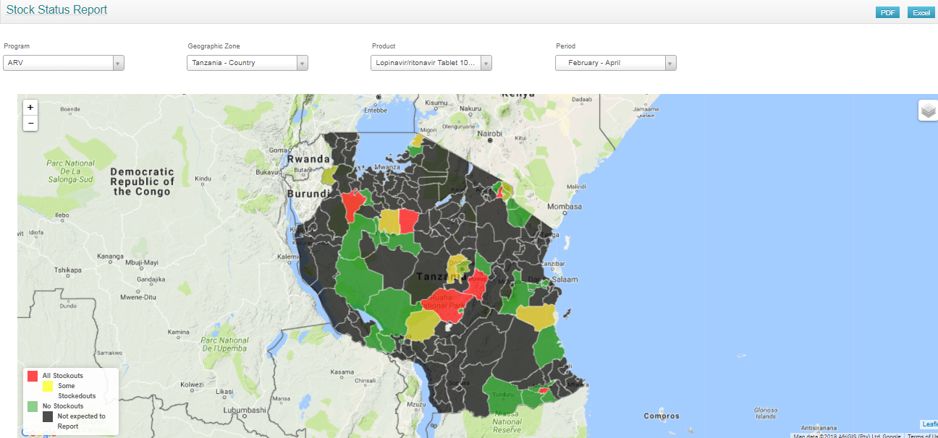
Stock Status Summary with Map

Slide 27
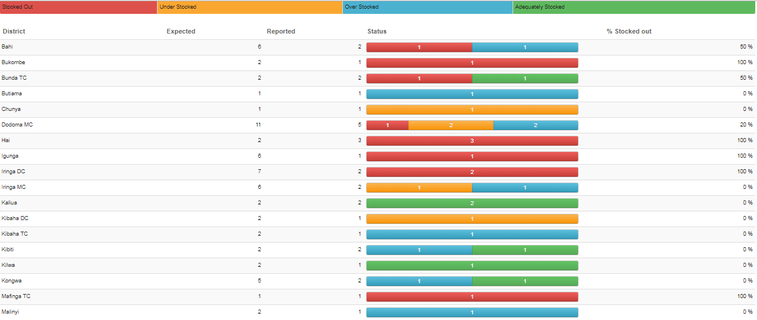
Stock Status Summary with Map

Slide 28
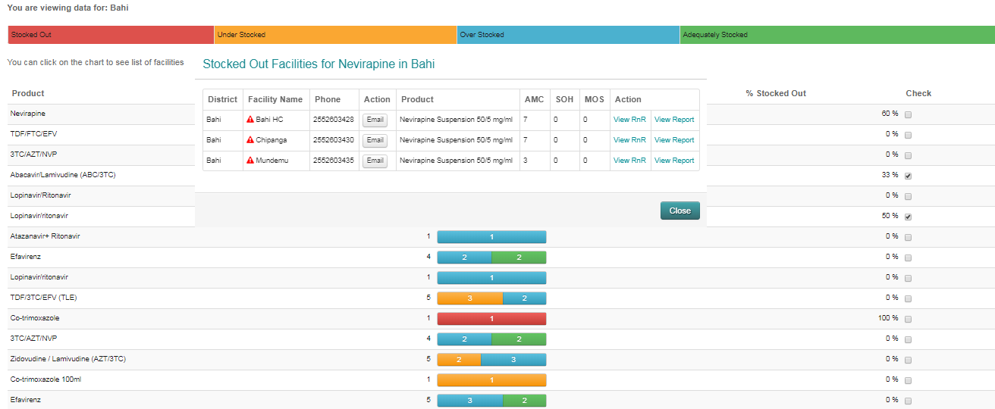
Stock Status Summary with Map

Slide 29
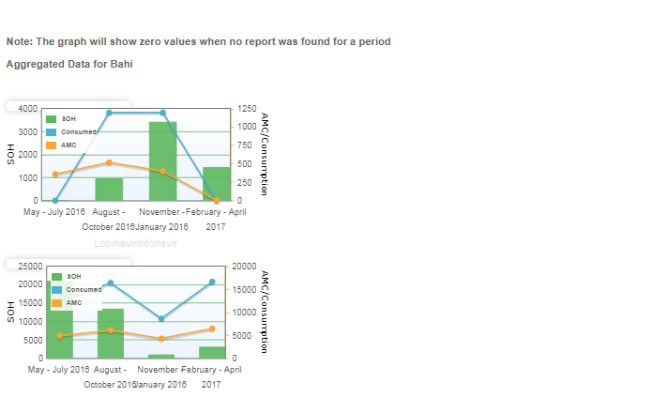
Stock Status Summary with Map

Slide 30
Stock Status Summary with Map
Demo
https://uat.tz.elmis-dev.org/public/pages/reports/maps/index.html#/stock-status?program=2&zone=437&zoneName=Tanzania%2B-%2BCountry&product=1446&period=59&schedule=2&productCategory=&year=2017&facilityType=&facilityOwner=&products=0&facility=

Slide 31
Adjustment Summary Report

Slide 32
Adjustment Summary Report Description
Summarizes adjustments by product and by adjustment type. Logistics managers may view this report to identify any unusual adjustments for a particular product or by a particular facility.

Slide 33
Adjustment Summary Report Features
Filters (Program, Period, Geographic Zone, Facility Type, Product Type)
Export to pdf and Excel
Status color code
Sortable by column
Configurable report title/subtitle, logo

Slide 34
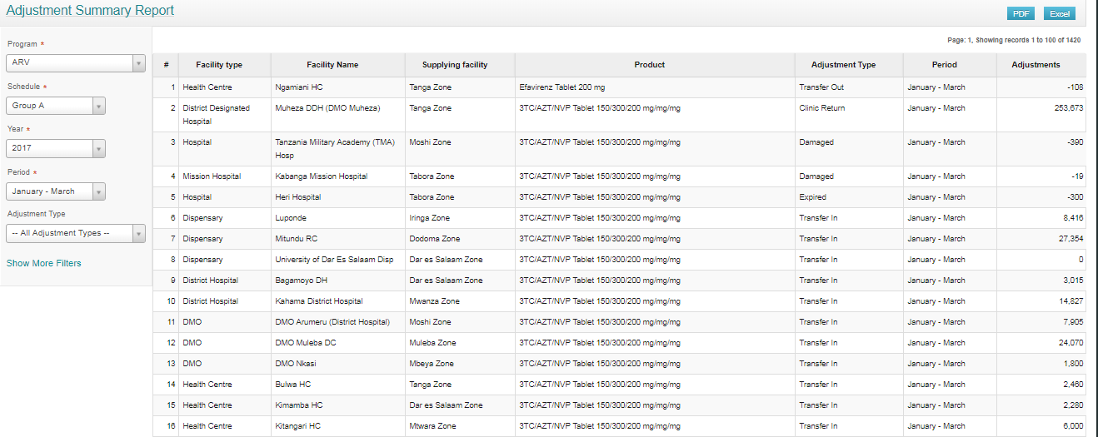
Adjustment Summary Report HTML

Slide 35
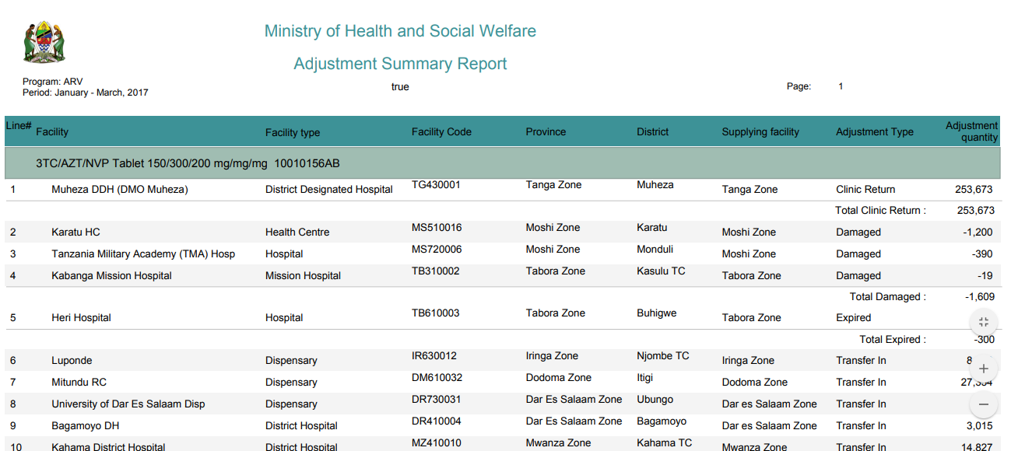
Adjustment Summary Report PDF

Slide 36
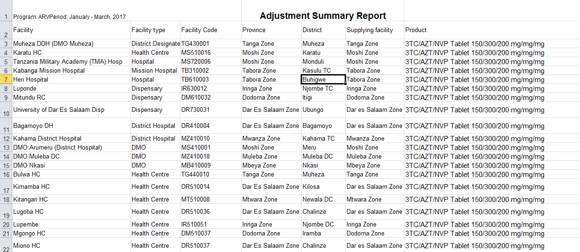
Adjustment Summary Report EXCEL

Slide 37
Adjustment Summary Report
Demo
https://uat.tz.elmis-dev.org/public/pages/reports/main/index.html#/adjustment-summary?year=2017&schedule=1&period=72&productCategory=&facility=&program=2&adjustmentType=&facilityOperator=&facilityType=&products=0

Slide 38
Logistics Summary report

Slide 39
Logistics Summary report
Description
Displays stock movement opening balance, receipts, dispensed, adjustments, and closing balance for each product at each distribution level. It calculates the months of stock and the percentage of total available stock that are held at supervisory level assigned to logged in user. Logistics managers may use this report to monitor the percentage of stock held at different facilities they manage.

Slide 40
Logistics Summary report
Features
Filters (Program, Schedule, Period)
Export to pdf and Excel
Sortable by column
Dis-aggregted by facility
Configurable report title/subtitle, logo

Slide 41
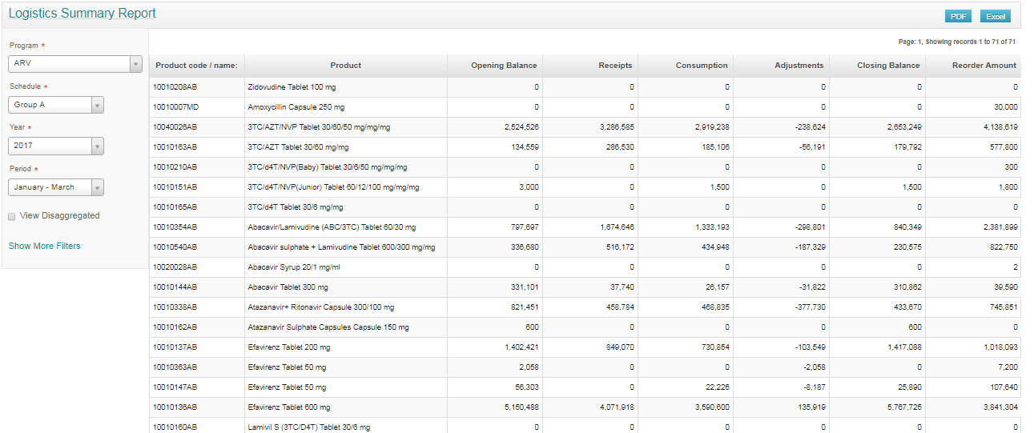
Logistics Summary report
HTML

Slide 42
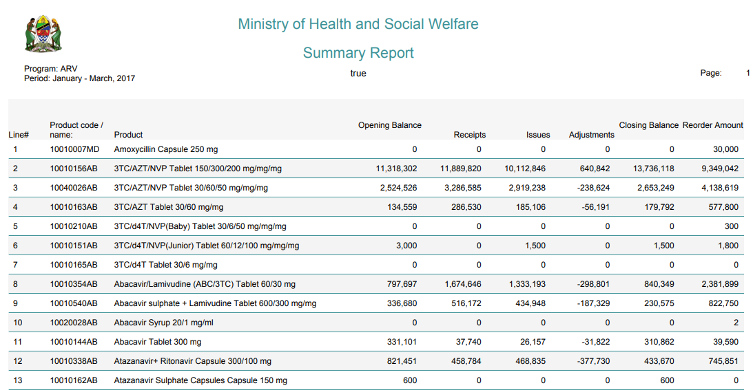
Logistics Summary report
PDF

Slide 43
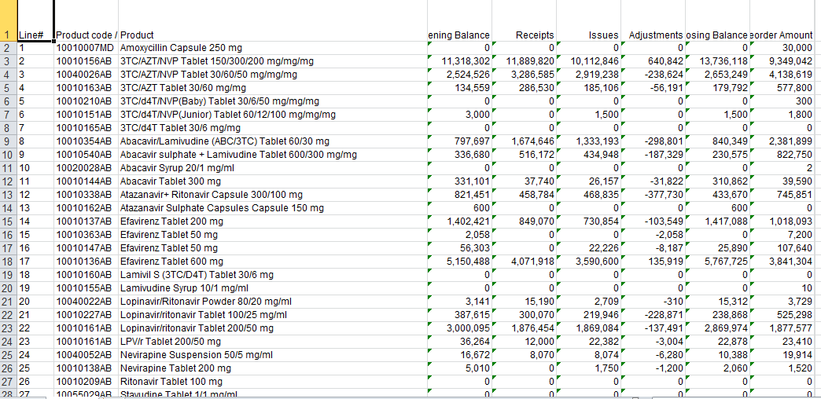
Logistics Summary report
Excel

Slide 44
Logistics Summary report
Demo
https://uat.tz.elmis-dev.org/public/pages/reports/main/index.html#/summary?schedule=2&period=59&product=&year=2017&program=2&facility=&facilityType=&productCategory=&max=10000&disaggregated=false

Slide 45
Consumption Report

Slide 46
Consumption Report Description
This report shows quantities dispensed to users by facility type. It aggregates quantities dispensed by service delivery points (SDPs) and calculates the percentage dispensed by each facility type. The Consumption Report is used for planning for MSD procurement and for transfers from central MSD to MSD zones. It is also used for budgeting.

Slide 47
Consumption Report Features
Filters (program, schedule, period, geographic zone, product)
Dispensation in units and pack size
Adjustment for stocked out days
Aggregation upto selected geographic zone (district, region, country)
Sortable columns
Export to PDF and Excel

Slide 48
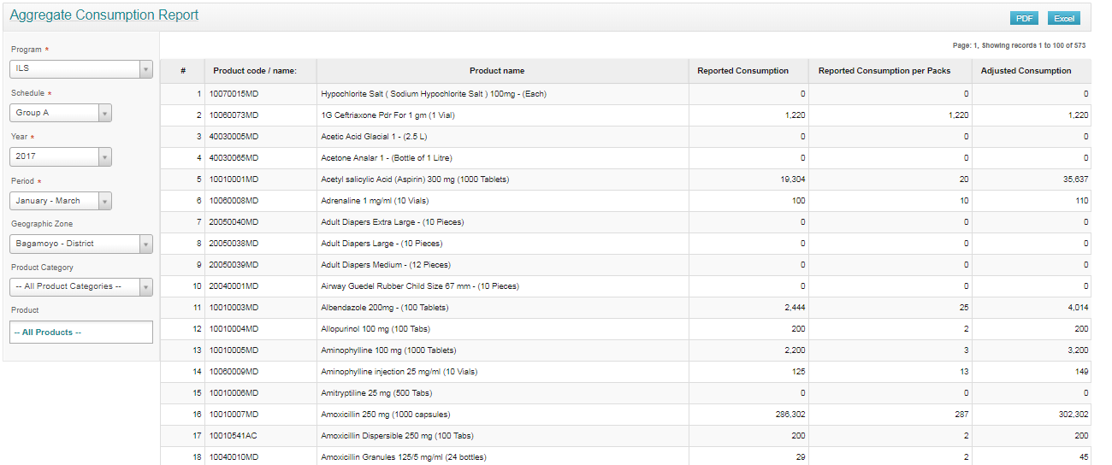
Consumption Report HTML

Slide 49
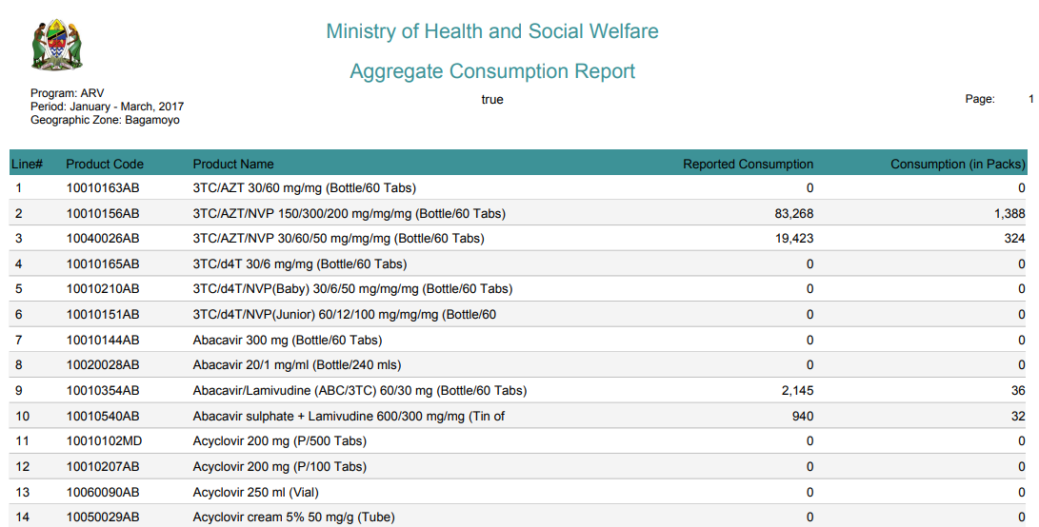
Consumption Report PDF

Slide 50
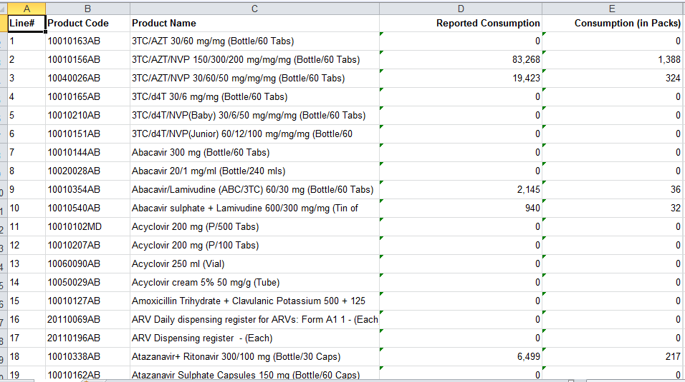
Consumption Report Excel

Slide 51
Consumption Report Demo
https://uat.tz.elmis-dev.org/public/pages/reports/main/index.html#/aggregate-consumption?schedule=2&period=59&year=2017&program=2&productCategory=&products=0&max=10000&zone=475&zoneName=Bagamoyo%2B-%2BDistrict&facilityType=&facility=

Slide 52
Order & Item Fill Rate Report

Slide 53
Order & Item Fill Rate Report Description
Fill rate is essential to the order management process. It’s the percent of your orders that are shipped in full on the first shipment as a percentage of all of your orders. Item fill rate is the percentage of quantity shipped of a product again ordered quantity.

Slide 54
Order & Item Fill Rate Report Features
Filters (program, schedule, period, geographic zone, product)
Aggregation upto selected geographic zone (district, region, country)
Sortable columns
Export to PDF and Excel

Slide 55
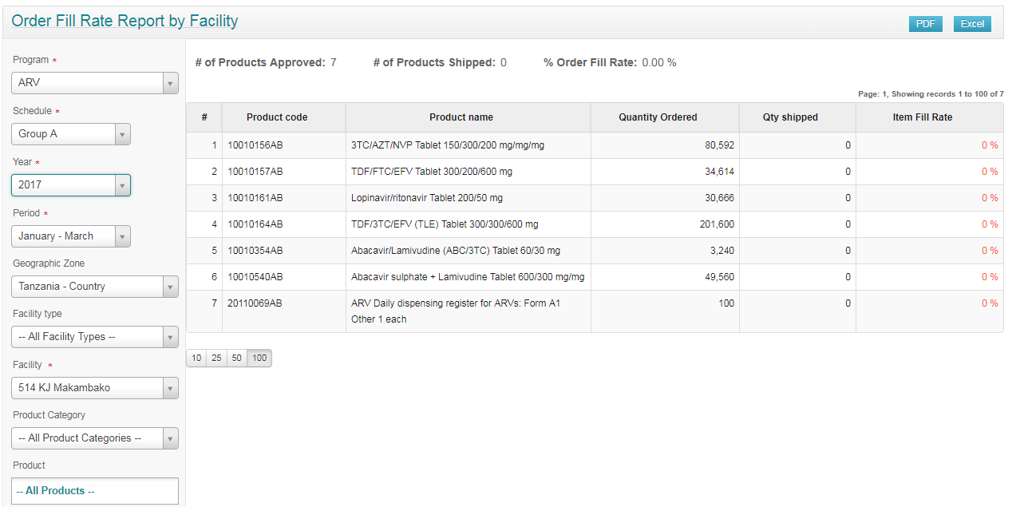
Order & Item Fill Rate Report HTML

Slide 56
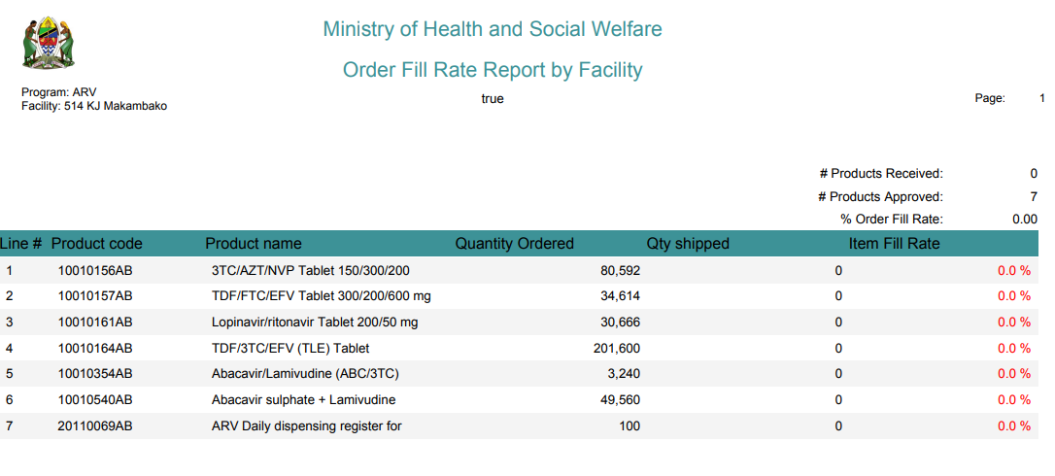
Order & Item Fill Rate Report PDF

Slide 57
Order & Item Fill Rate Report Excel

Slide 58
Order & Item Fill Rate Report Demo
https://uat.tz.elmis-dev.org/public/pages/reports/main/index.html#/order-fill-rate?schedule=2&period=59&productCategory=&facility=15750&year=2017&program=2&facilityType=&products=0&max=10000

Slide 59
Order Report

Slide 60
Order Report Description
Displays cost estimation of approved requisition. Used for budgeting

Slide 61
Order Report Features
Filters (program, schedule, period, geographic zone)
Aggregation at selected geographic zone (district, region, country)
Sortable columns
Export to PDF and Excel

Slide 62
Order Report HTML

Slide 63
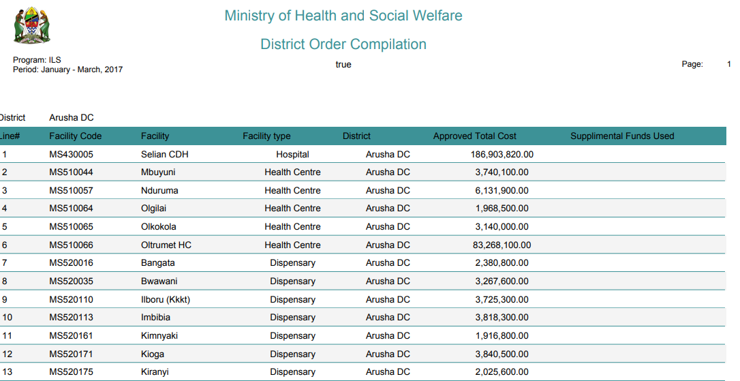
Order Report PDF

Slide 64
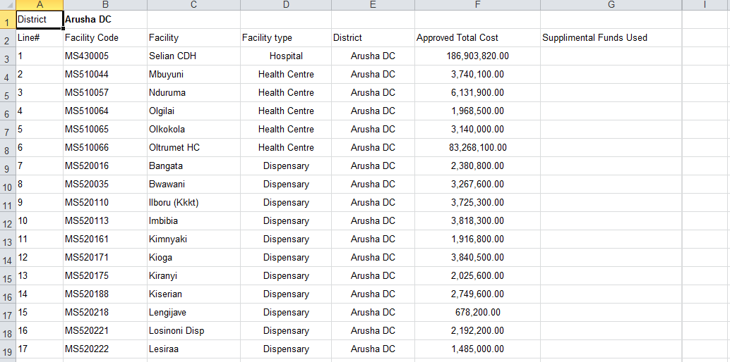
Order Report Excel

Slide 65
Order Report Demo
https://elmis.co.tz/public/pages/reports/main/index.html#/district-financial-summary?year=2017&schedule=2&period=59&program=1

Slide 66
Issue Voucher for Medical Supplies

Slide 67
Issue Voucher for Medical Supplies Description
Zambia facility specific report which is sent to MSL for resupply
PDF version is used for sign-off

Slide 68
Issue Voucher for Medical Supplies Features
Filters (order type, program, schedule, period, geographic zone, Facility)
Sortable columns
Export to PDF and Excel

Slide 69
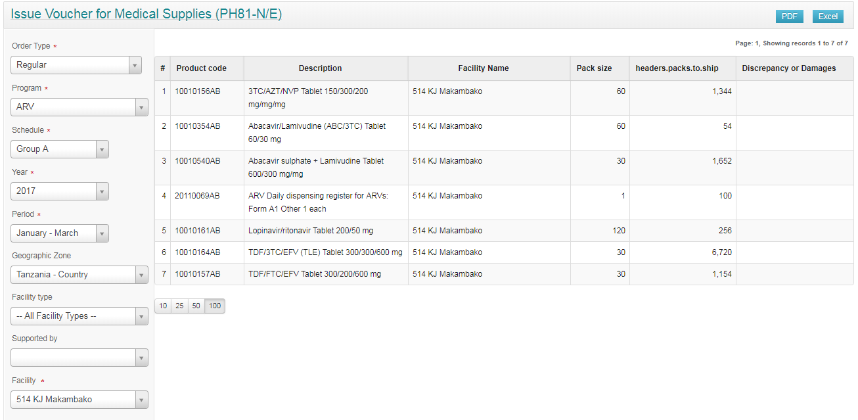
Issue Voucher for Medical Supplies HTML

Slide 70
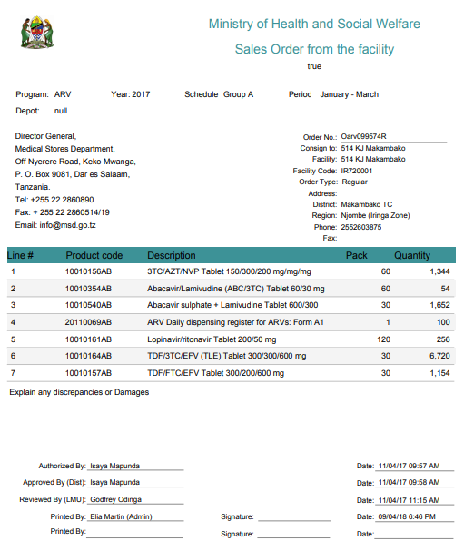
Issue Voucher for Medical Supplies PDF

Slide 71
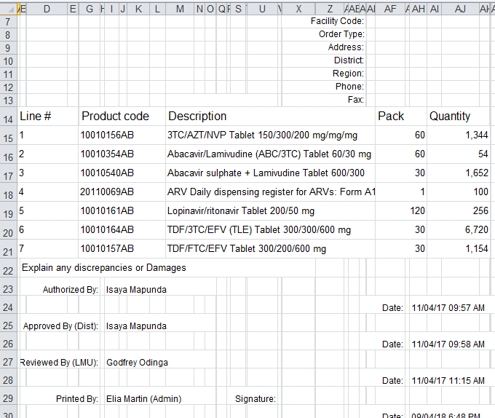
Issue Voucher for Medical Supplies Excel

Slide 72
https://uat.tz.elmis-dev.org/public/pages/reports/main/index.html#/order?schedule=2&period=59&facility=15750&year=2017&program=2&facilityOwner=&facilityType=

Slide 74
Facility List report

Slide 75
Facility List report Description
This report displays a list of all the facilities by location, type and active status

Slide 76
Facility List report Features
Filters (Program, Period, Geographic Zone, Facility Type, Supplied By, Active status)
Export to pdf and Excel
Sortable by column
Configurable report title/subtitle, logo

Slide 77
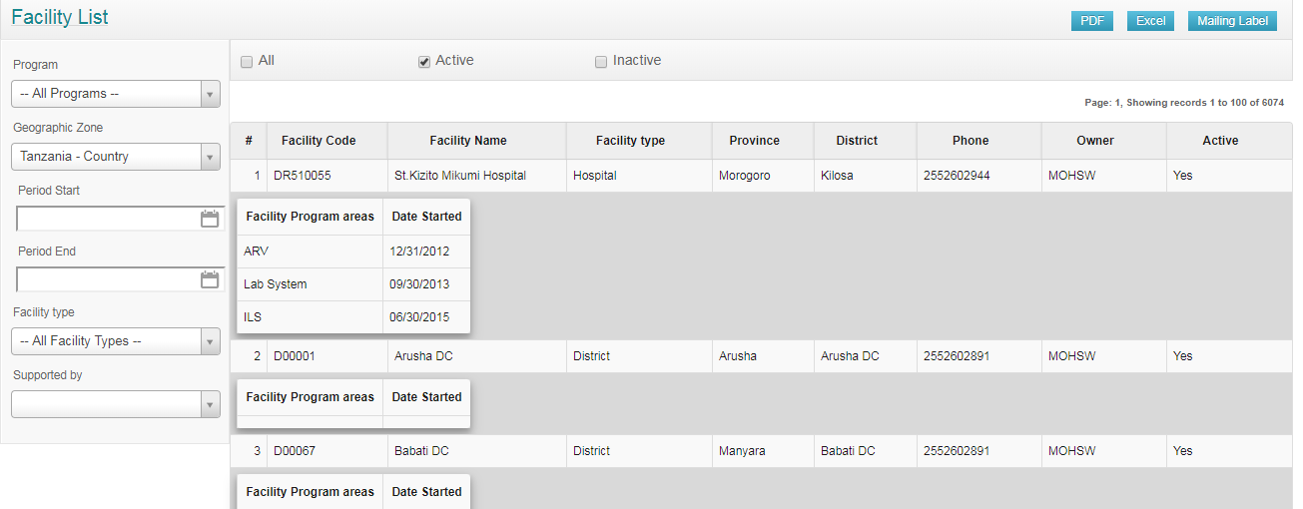
Facility List report HTML

Slide 78
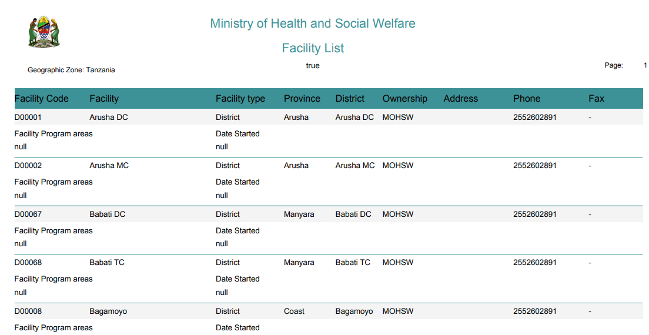
Facility List report PDF

Slide 79
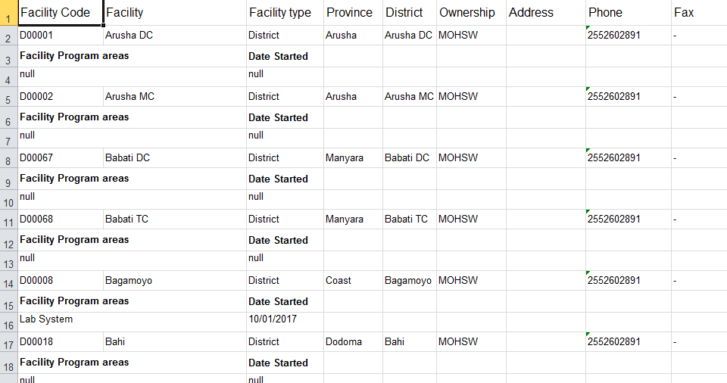
Facility List report Excel

Slide 80
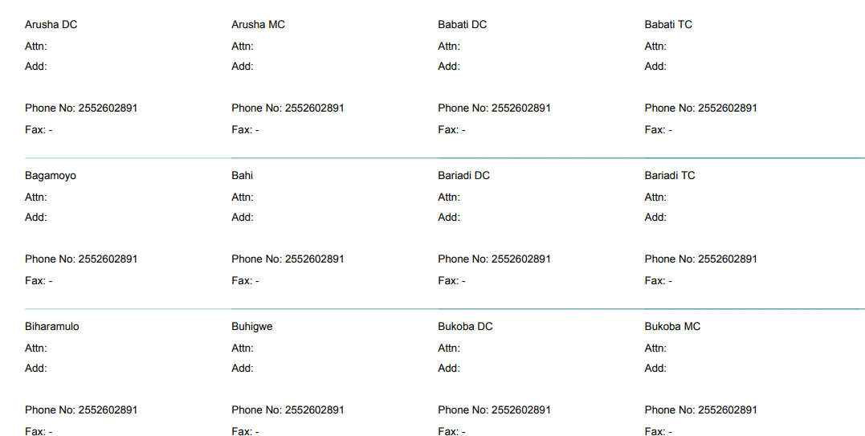
Facility List report Mailing Labels

Slide 81
Facility List report Demo
https://uat.tz.elmis-dev.org/public/pages/reports/main/index.html#/facility-list?status=true&statusList=AC,IN&periodStart=&periodEnd=&program=2&facilityOwner=&zone=448&zoneName=Coast%2B-%2BRegion&facilityType=

Slide 82
User Summary

Slide 83
User Summary Description
Display user distribution across program and location. Use for user management

Slide 84
User Summary Features
Filter ( Role, Program, Supervisory Node)
User count
Export to PDF and Excel
PIE chart

Slide 85
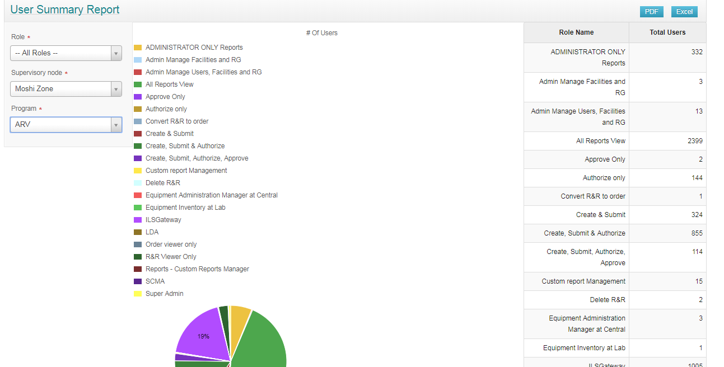
User Summary HTML

Slide 86
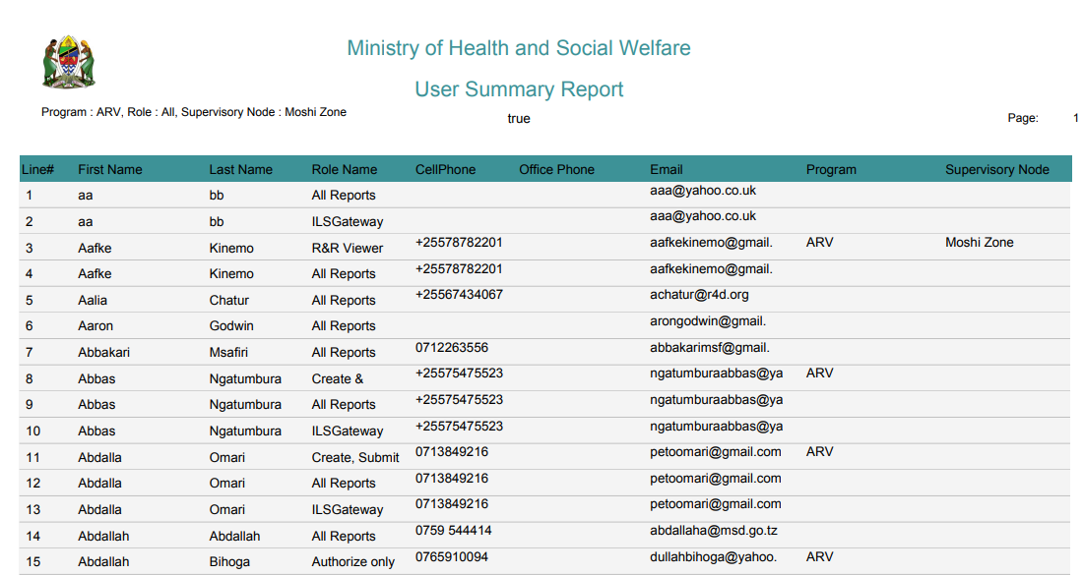
User Summary PDF

Slide 87
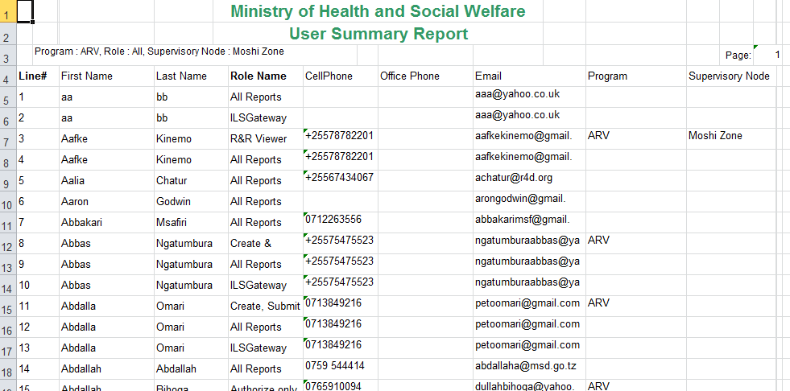
User Summary Excel

Slide 88
User Summary Demo
https://uat.tz.elmis-dev.org/public/pages/reports/main/index.html#/user-summary

Slide 89
Custom Reports

Slide 90
Custom Reports
custom report designer allows you to quickly and effectively build a custom report that users will be able to execute from the application.
To access the custom report designer, you will need to have the right custom report designer permission. You will be able to add this role to users by using the roles management screen.

Slide 91
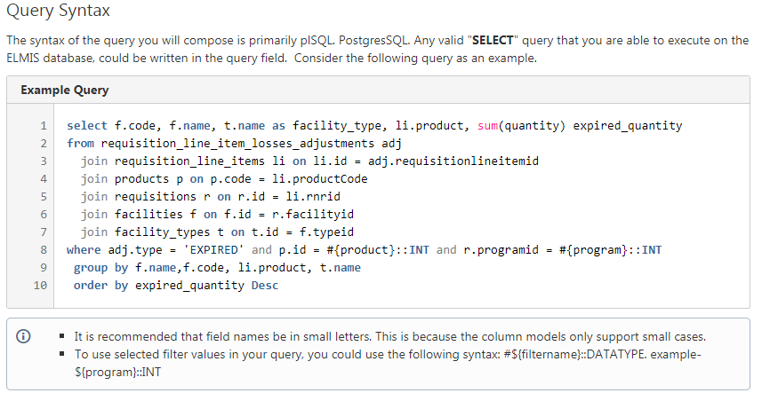
Custom Report
Query

Slide 92
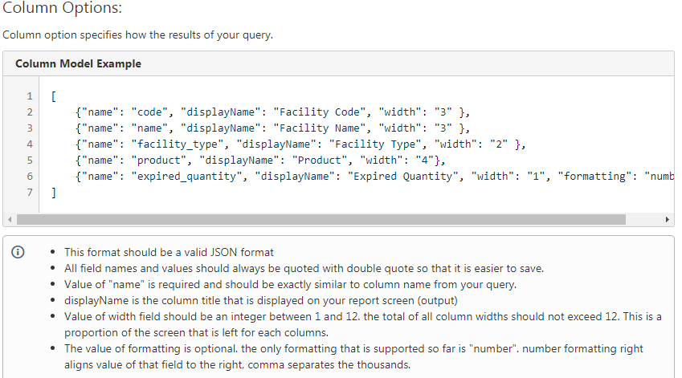
Custom Report
Query

Slide 93
Custom Report
Filters

Slide 94
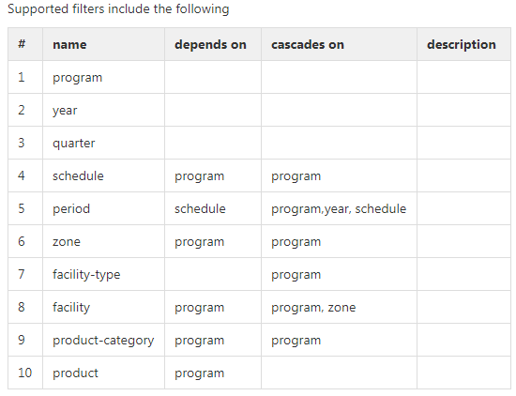
Custom Report
Filters

Slide 95
Admin Users | Products Supported
Aggregate Patients by All Regimens | Program Reporting Summary
Aggregate Patients by Regimen | Recently Initiated Requisitions
Consumption By Location | Regimen Distribution by Facility
Consumption By Product Category | Reporting Group Density
Converted to Order by Type by Geographic Zone | Requisitions by Status and Year
Emergency vs Regular Requisitions | Schedules and R&R
Facilities that Ever Reported | SOH By Location
Losses & Adjustments By Location | Top RnR Approvers
Top 100 Ordered Products (Slow) | Top RnR Initiating Users
Top 100 Stocked Out Products (Slow) | Total R&R Count by Program
Top Expiry Reported by Quantity | Total Requisitions by Status

Slide 96
New Reports

Slide 97
Trends over time
Trends over time: Currently eLMIS requires the user to select one individual period to produce most reports and analysis, and does not show multiple periods in the same data sets. While there is one small graph feature showing some data over four quarters of one year, there is need for more comprehensive trend analysis features.

Slide 98
Multiple programs
Analysis features which contain data from multiple programs in the same data set do not currently exist. At the moment users can only see the data for one program at a time.

Slide 99
Treatment of the emergency order data during analysis
Treatment of the emergency order data during analysis: If an emergency order covers a period 1st April to 25th May, and later a routine R&R is submitted for 1st April to 30th June, this currently sometimes leads to double counting in some of the eLMIS analysis. The 1st April to 30th June data currently does not override the 1st April to 25th May submission earlier on the emergency R&R.

Slide 100
Treatment of the emergency order data during analysis
Treatment of the emergency order data during analysis: If an emergency order covers a period 1st April to 25th May, and later a routine R&R is submitted for 1st April to 30th June, this currently sometimes leads to double counting in some of the eLMIS analysis. The 1st April to 30th June data currently does not override the 1st April to 25th May submission earlier on the emergency R&R.

