Slide 1
Implementing a Dashboard for Pharmaceutical information in Namibia Global Digital Health Forum 2017
Presenter: Bayobuya Phulu : Senior Technical Advisor MSH/SIAPS
Co-authors: G. Mazibuko, L. Indongo, E Sagwa, R Indongo, S. Mwinga, H Kagoya, W Churfo, D Mabirizi
NAMIBIANS AND AMERICANS
IN PARTNERSHIP TO FIGHT HIV/AIDS
P E P F A R

Slide 2
OUTLINE
Objectives
Problem
Sources of electronic data
Uses of the dashboard
Introduction to the Dashboard for Pharmaceutical Information

Slide 3
Objectives
Review transitioning from paper-based to electronic pharmaceutical management tools in Namibia
Discuss lessons learnt in implementing electronic systems for patient and data management in Namibia
Demonstrate selected key reports on the Namibian Pharmaceutical Information Dashboard

Slide 4
The Problem
Namibian health commodities have been largely managed with paper-based tools
Manual aggregation and analysis of data from the paper-based tools was a huge challenge – resulting in lack of up-to-date data consumption data
Lack of visibility of facility-level stock status data by the regional/ central level contributed to poor re-supply decisions distribution and redistribution of commodities across the country (e.g. critical stock outs of antiretroviral medicines in 2014 & 2015) (resulting in hoarding of commodities, and increased possibility of pilferage)
Poor linkage between patient numbers and commodity information
Inventory management decisions were delayed by lack of information on stock status, at different levels of the supply chain in the country
Supply Chain decisions were made based on a number of assumptions and limited evidence

Slide 5
Intervention: a multipronged approach
Enhancing the capturing of data at the facility-level and central level
Implementation of electronic dispensing tool, the facility electronic stock card & Syspro
Enhancing data transmission to a central point
Using mobile phone network, internet and memory sticks (for remote sites)
Electronic Dispensing Tool (EDT) network, EDT reporting module, The Facility Electronic Stock Card (FESC) LMIS reporting & Syspro CSV reports
Enhancing data processing and information dissemination
The National Database for ART information (NDB)
The Dashboard for Pharmaceutical information
Quarterly and adhoc summary reports to key stakeholders

Slide 6
Sources of dashboard data : The Facility Electronic Stock Card (FESC)
Inventory management of pharmaceutical commodities at health facilities
Notes:
What activities are there to use FESC, this is to indicate that the tool is ment to minimize the workload on the staff. You must explain.

Slide 7
Patient & stock Management at ART sites
Sources of dashboard data : The Electronic Dispensing Tool (EDT)

Slide 8
Sources of dashboard data: Pharmacy Management Indicators
The Namibian Pharmacy Management Information system (PMIS) uses 22 indicators to monitor service delivery at National, Regional and Facility level
The information collected;
Serves as an Early warning system for the risk of medicine shortages
Supports strategic planning for pharmaceutical services
Makes the health system more accountable for pharmaceuticals and services
Facilitates resource allocation and reallocation
Identifies facilities that need specific targeted interventions and helps in monitoring performance improvement over time
Compares districts / regional performance in pharmaceutical services service delivery

Slide 9
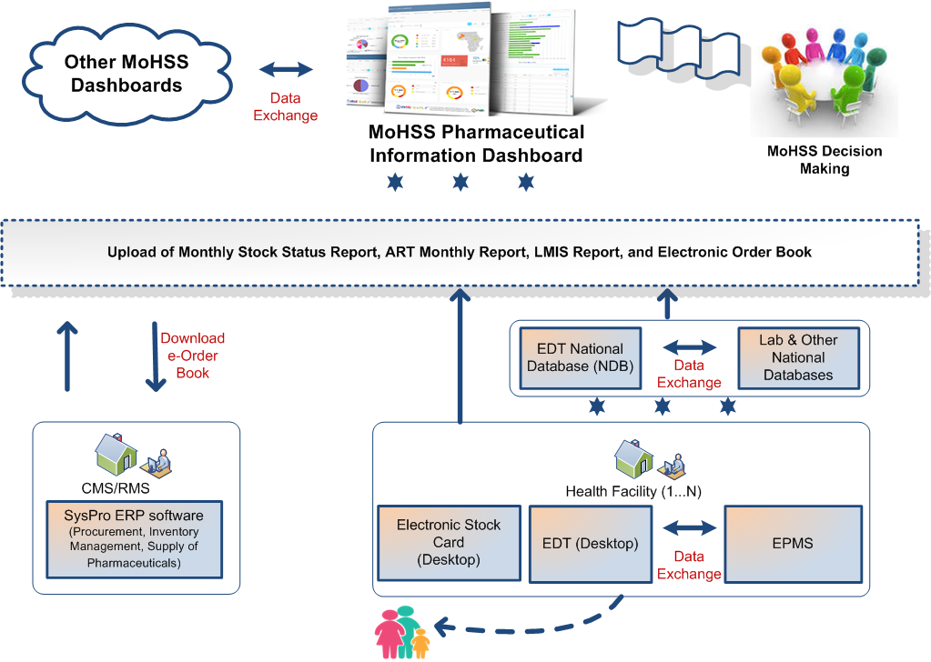

Slide 10
Description of the Namibia PMIS dashboard
Three main modules on the Dashboard’s welcome page
Antiretroviral Therapy (ART) module
Patient reports
ART commodities reports
Essential commodities and clinical supplies module
Stock status reports
Early warning system reports for stock outs
Stock status reports by category, level and by health facility
Pharmaceutical Service Performance Indicators
Service quality reports national & by region

Slide 11
Benefits of the Dashboard
Data processing
Consolidates data from various tools/ health facilities and facilitates pharmaceutical data visibility at national, regional, and facility levels,
The data is more comprehensive, timely and available on a monthly basis
ART Program
Readily informs the programs on essential service indicators, such as ART patient numbers, regimen distributions, adherence, patients lost to follow up (LTFU), and early warning indicators (EWIs) of HIV-DR

Slide 12
Benefits of the Dashboard (continued)
Planning
More reliable data for forecasting and supply planning at the national level
Better visibility of essential logistics data at health facilities
Facilitates stock re-distribution and minimises wastage
Serves as an early warning indicator of potential stock out / over stocking of all pharmaceutical commodities
Quantification
Readily available data for annual pharmaceutical planning and budgeting by Regions
More accurate data for the ART program for estimating the growth in the ART population, for scale-up planning

Slide 13
The ART Portal of the Dashboard

Slide 14
Lessons learnt
Web-based platforms can be used to consolidate data from various sources (tools) and facilities & patient levels to provide a comprehensive picture that facilitates decision-making
Political commitment from top management is crucial in implementation
Fostering a structured and incremental transition from paper based to electronic information systems engaged health facility supervisors and is necessary to influence behaviour change in how they visualise and use electronic tools – electronic tools have become part and parcel of the pharmacy in Namibia (Sustainability is the Question).
Data from multiple sources, levels, and tools has been consolidated into one dashboard that has enhanced the visibility of data and facilitated evidence based decisions in Namibia

Slide 15
Lessons learnt
Training of managers on how to use the data is important to create demand for/ use of reports & dashboard data
Pharmaceutical information platforms can also provide important patient-focussed information for program managers such as:
Numbers of patients on ART, by age, gender and location
ART uptake and regimen distributions
Adherence and retention in case
Early-warning indicators for HIV drug-resistance
Visibility of data on stock status and price can be used to enhance accountability for pharmaceuticals

Slide 16
Next steps in Namibia
Sustainability
Empower the Ministry’s National Medicine Policy Coordination unit to coordinate the systems for reporting and feedback
Finalize incorporating electronic data flow processes & hosting of system servers into government of Namibia systems
The Office of the Prime minister is implementing an e-Governance strategy for managing all Government’s data systems
Implement innovative ways of automating basic routine reports from the tools and synchronising with the national database, the Dashboard, and other MoHSS information platforms

Slide 17
MoHSS Pharmaceutical Information Dashboard
http://pmis.org.na/

Slide 18
Selected Dashboard reports for demonstration
2 HIV reports (patient numbers & regimen distribution)
1 TB report (Distribution by level for selected TB medicines)
1 Malaria report (Distribution by district of national stock for selected antimalarial)
1 Vaccines report (National Stock status for selected vaccines)
Service delivery indicator (PMIS) : HF 12

Slide 19
ACKNOWLEDGEMENTS
Ministry of Health and Social Services (MOHSS), Namibia
Division: Pharmaceutical Services (Div: PhSs)
Directorate of Special Programs (DSP)
Directorate of Tertiary Health Care and Clinical Support Services
Regional health directorates
Health facilities
U.S. Agency for International Development (USAID)
Systems for Improved Access to Pharmaceuticals & Services (SIAPS)
Collaborating PEPFAR implementing partners in Namibia

