Slide 1
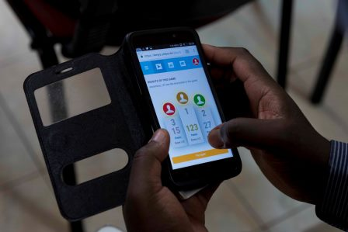
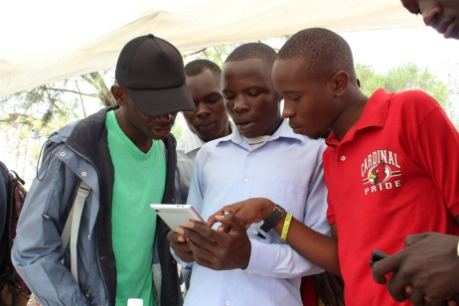
Health Games: Game Based Learning for Health
Sam Schmader and Sarah Andersson
December 5, 2017

Slide 2
Why Health Gaming?
Help target populations (health workers, youth) acquire or update their skills remotely, on their own schedule.
Gaming is fun and interactive and can be implemented to build a learning and sharing community.
Accessible through mobile phones, tablets, or laptops; skills can be acquired or refreshed outside of traditional classroom-based trainings through a blended learning approach.
Gaming linked to social media and other offline actions to promote human interactions.
Notes:
Smartphone usage makes gaming an easy entry point to youth populations for health education
Sources vary, but internet penetration is high in Kenya (~88%, 83%, 69%, 82%) (the country of focus for our initial game launches) making gaming a viable option through mobile, tablet, and computers

Slide 3
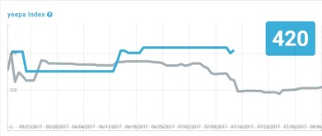
HealthGames: Playing, Measuring, Learning
Individual Learning Perspective
How good am I compared to others?
Which topics should I learn, which ones should I not?
What areas of learning are going to be some “easy wins”? What will require more time?
Organizational Impact & Measurement Perspective
Where do we stand?
Where are interventions needed?
Why are there performance differences between teams/departments?
Are investments paying off? Where should we intervene to make a difference?
Notes:
Health Games provides benefits from both an individual learning perspective and an organizational impact and measurement perspective
Helps to answer the following types of questions through

Slide 4
How HealthGames Works
Utilizing best practices in multiple choice question design, authors craft questions of varying difficulty for each game
Questions include learning tips that link learners to online resources related to the game’s theme
Timed-limited questions (30-60 seconds) between gamers with the jackpot feature transforms a routine quiz-style format into a competitive game
Users choose their gaming method between “Play Along”, “Group Gaming”, or “Training Alone”
Notes:
Question design is no different than what is used for crafting an ordinary question
Timed competition between players and the jackpot feature of putting all points on the line in attempt to be first and right makes the quiz into a competitive game

Slide 5
Analytics feed the player performance index
With continuous play, the platform’s algorithm takes into account question difficulty and group performance to determine individual user learning indices
The platform evaluates learning against the number of questions answered correctly and the number of difficult questions answered correctly
Questions are repeated as gamers continue playing in order to measure knowledge retention, which also feeds into the yeepa index

Slide 6
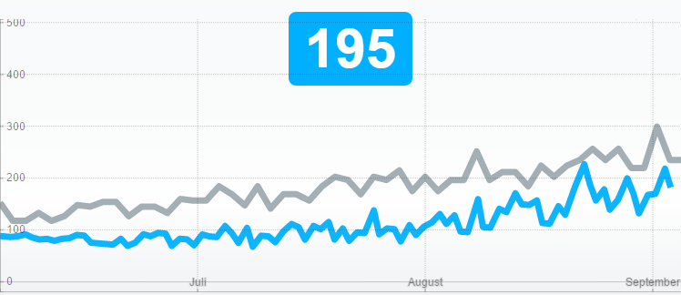
Learning Progress is represented like a Stock Index
Learning Progress is Represented like a Stock Index
Notes:
Blue represents your own performance and grey indicates the average of other users
The index requires a good deal of initial play to build up

Slide 7
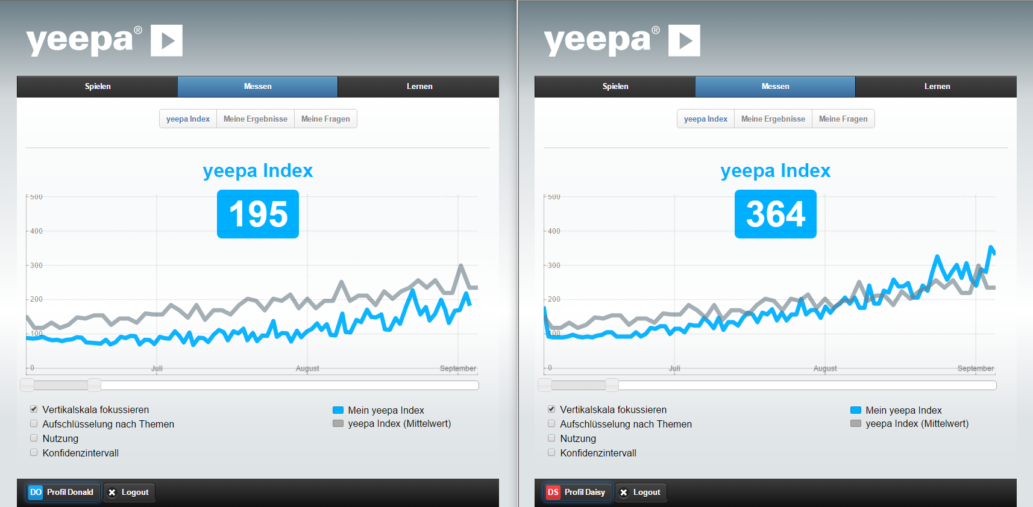
Adam needs help
Example: Players’ View
Anna keeps improving
Notes:
Here was have two examples
Adam is performing below the average of his group
Anna started off with lower performance than the average of her group, but with continuous learning she improved and is now a higher performer in the group

Slide 8
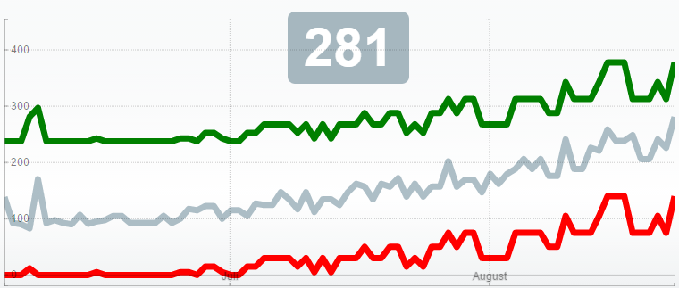
The Learners are Better in Topic 1
Comparing Performance Across Teams or Groups
The grey is the mean index over both topics; at the moment the index is 281. You can see a big difference between topic 1 (Corporate Compliance, green) and topic 2 (Occupational Health and Safety, red)
Notes:
This topic comparison is an illustrative example from past application of the yeepa platform
As groups use the platform for additional games and areas of learning, yeepa can provide insights into learning trends across the group.
In this example, the group is performing well in corporate compliance, but needs greater attention in the area of occupational health and safety

Slide 9
Extending Learning from Periodic to Continuous
Health Games offers the ability to extend learning from a series of workshops to an entire year (compared to days) and provides impact analytics to measure progress
Gamification
with
Health Games
Cyclic Learning
Continuous Learning
Organized Training
collective learning curve
Self motivated learning based on online games, which predict/show areas for further learning
Notes:
yeepa is a great extension for a series of workshops and to increase their impact over an entire year, instead of just a few days, with measured impact analytics
The right illustrates our approach to learning with continuous learning as a part of a blended learning approach that includes organized trainings, on the job training, and other forms of capacity building

Slide 10
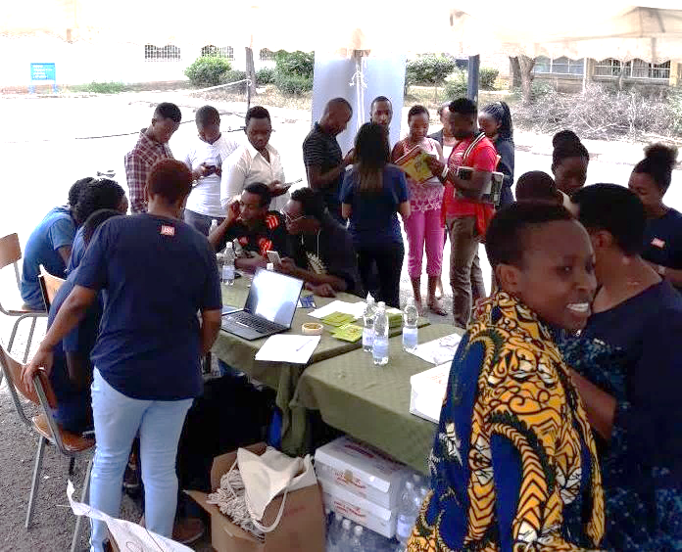
A Recent Example: Your Choice, Your Future!
Your Choice, Your Future! is an online game that aims to promote contraceptive awareness among youth
Launched the game October 11 and 12 in two locations in Nairobi, Kenya
October 11 - the Day of the Girl child - at the Kenya Institute of Mass Communication (KIMC)
October 12 at Women Fighting Against AIDS youth center in Kayole
Photo by Edwin Ombasa
In 2 days, 154 youth registered on the platform and played over 20,000 questions!
The first day of the launch at KIMC

Slide 11
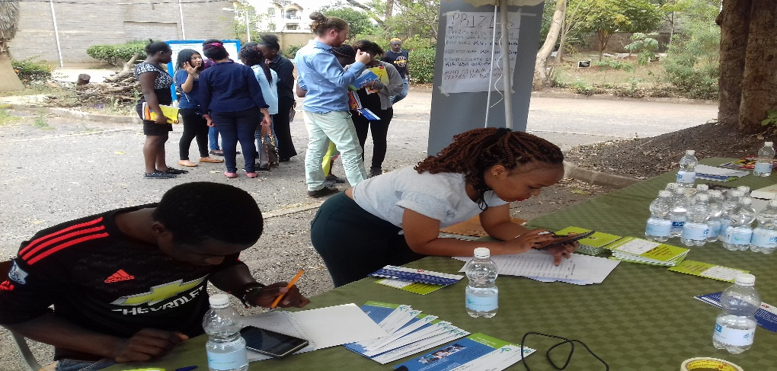
What We Learned
Youth had limited knowledge of contraceptive methods, they found gaming a fun way to learn more and kept playing because the questions kept changing
The youth preferred gaming to workshops or seminars
Incentives such as online weekly prizes are important to engage youth and encourage continuous gaming
Linking gaming with online and offline resources adds value beyond learning
Having a nurse at both launches helped address questions about contraceptive methods and access to youth friendly health services in the area
The Health Games Facebook page enables continuous engagement
Photo by Edwin Ombasa
Students at KIMC interacting with the game

Slide 12
Achievements To Date
Target audience reached for the contraception and healthy lifestyles games
Continuous gamers are performing better over time
Total Questions Answered Over 5 Weeks
Over 700 registered and played
Average age is 23.6 years
35 winners since launch
85 gaming continuously (<40 games/ wk)
3500 reached via Facebook
166, 466

Slide 13
“[I] can see myself at the top...I can't stop playing this I urge my friends to join me in the game and get to know our reproductive health well” - Youth participant in Your Choice, Your Future!

Slide 14
How to Play
Questions are designed as multiple choice
You are playing in direct competition with members of your group.
You can only proceed to the next question if all the members of the group have answered the question.
You have a maximum of 30 seconds to answer each question
To maximize your score use the jackpot feature. If you are certain of your answer, click on the jackpot on the upper right hand corner before you click on the answer, to double your points. Get the answer wrong and lose all your points!

Slide 15
Instructions to Log In
www. health-games.org
Select Registration Code (once you have created your account, for subsequent logins you will click on the ‘Login tab’).
Enter Registration Code 4949
Create Account
Fill out your account details in particular Nickname, Email and Password.
Click on Submit. Your nickname and password are now your login credentials for subsequent logins so please remember them!!
Click on the Play tab above and select the Building Healthy Lifestyles game
Click on Play Along to join the game

Slide 16
Thank You!
Email: supplychain@jsi.com
insupply@jsi.com healthgames@jsi.com
Reach us at:
sarah_andersson@jsi.com
sam_schmader@jsi.com
Web: www.jsi.com
www.health-games.org www.insupply.jsi.com
Twitter: @inSupplyJSI
@HealthGamesJSI
@JSIHealth
Facebook: www.facebook.com/HealthGamesJSI

