Slide 1
Emergency Requisitions Redesign
Sam Im• December 19, 2017
Emergency Requisitions

Slide 2
Emergency Requisitions
Sam im• December 19, 2016

Slide 3
Agenda
Current process for Emergency Requisitions
Review proposals, Q&A
Next steps

Slide 4
Current Process
Pros:
Stock on Hand and consumption data is reported every time an emergency requisition is completed
Cons:
Data entry for all products with a stock on hand balance is required because of regular requisition template validations
Tedious & time-consuming process

Slide 5
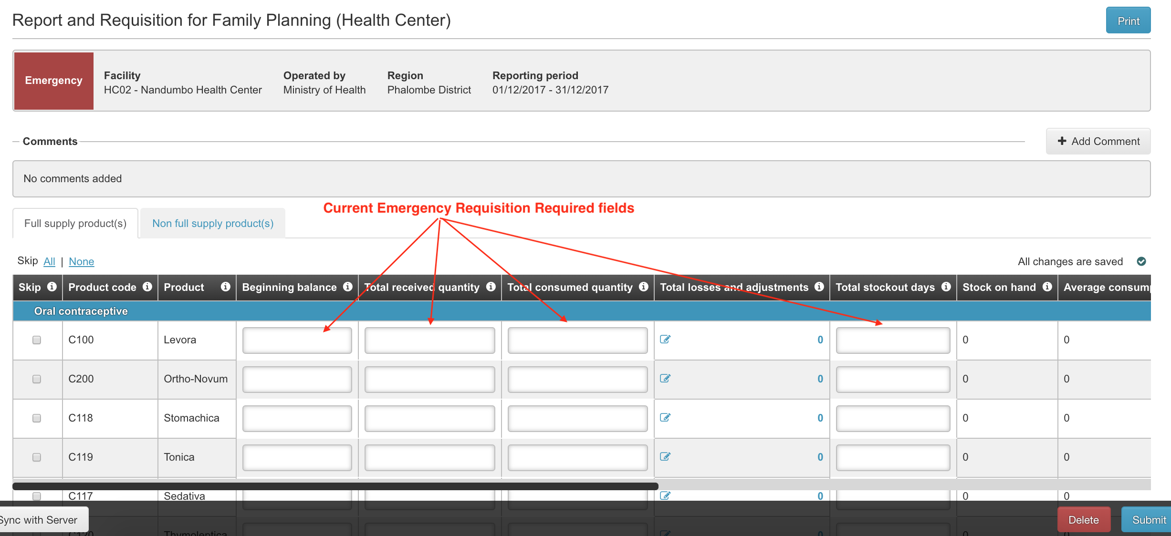

Slide 6
Proposal: Option A
Description: Quick and easy emergency requisition by selecting a product and entering only the requested amount and explanation.
Pros:
Simple data entry
Cons:
Same limited template for all programs
Doesn’t support reporting consumption or stock data for emergency requisitions

Slide 7
Proposal: Option B
Description: Configurable template that allows to collect minimal reporting data when completing an emergency requisition.
Pros:
Configurable template by program
Cons:
More expensive to implement
Will need to figure out how to report on removed columns

Slide 8
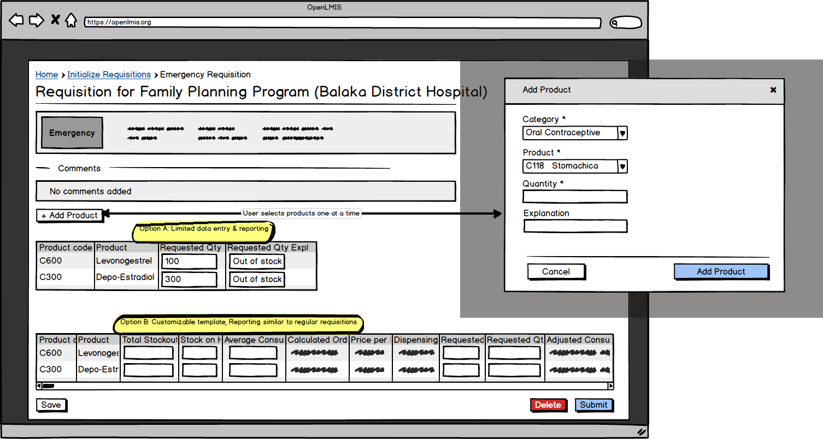

Slide 9
Thank You
For additional information:
info@openlmis.org www.openlmis.org

