Slide 1
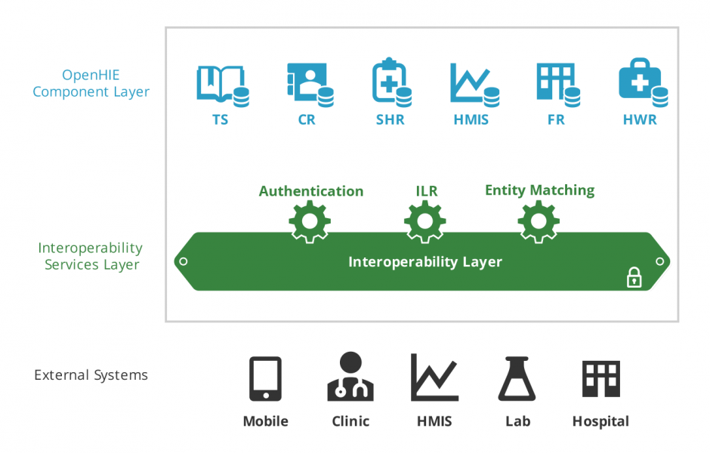
OpenHIE and Malawi
Master Facility Register
Demographic Data Exchange
DHIS2
iHRIS
OpenInfoMan (not deployed)
OpenHIM (not deployed)

Slide 2
Using ILR To Manage Multiple Lists of Health Facilities
St Vince Hosp St. Vince Hosp St Vince Hospital st vince Saint Vince St. Vince Hsptl
ID: 23 ID: u912382 ID: 9324 ID: 243 ID:209348 ID: 932
Master Facility Registry
DHIS2
iHRIS
cStock
OpenLMIS
etc.
Centralize all sources of data in ILR
ILR asks “Give me your updated health facility data”

Slide 3
Pull Data into the ILR using mCSD and HL7 FHIR
{ "resourceType": "Location",
"id": ”209348",
"status": "active", "name": ”Saint Vince", "type": { "coding": [{
"system": "http://health.gov.mw/facilitytypes", "code": ”HOSP", "display": ”HOSPITAL" } ] },
"telecom": [ { "system": "phone", "value": "(+1) 734-677-7777"
}]
"address": { "line": [ "3300 Washtenaw Avenue, Suite 227" ], "city": ”Lilongwe", "country": ”MW" }, "position": { "longitude": 42.256500, "latitude": -83.694710 } }
OpenLMIS
Use mCSD “Request for Care Services Update (ITI-Y2)” transaction to get updates to facility data http://bit.ly/2o1llON
mCSD tells you how to use HL7 FHIR location https://www.hl7.org/fhir/location.html

Slide 4
Need to Map IDs Across Sources of Health Facility Data
St Vince Hosp St. Vince Hosp St Vince Hospital st vince Saint Vince St. Vince Hsptl
ID: 23 ID: u912382 ID: 9324 ID: 243 ID:209348 ID: 932
-> MFR 23 -> MFR 23 -> MFR 23 -> MFR 23 ->MF 23
Master Facility Registry
DHIS2
iHRIS
cStock
OpenLMIS
etc.

Slide 5
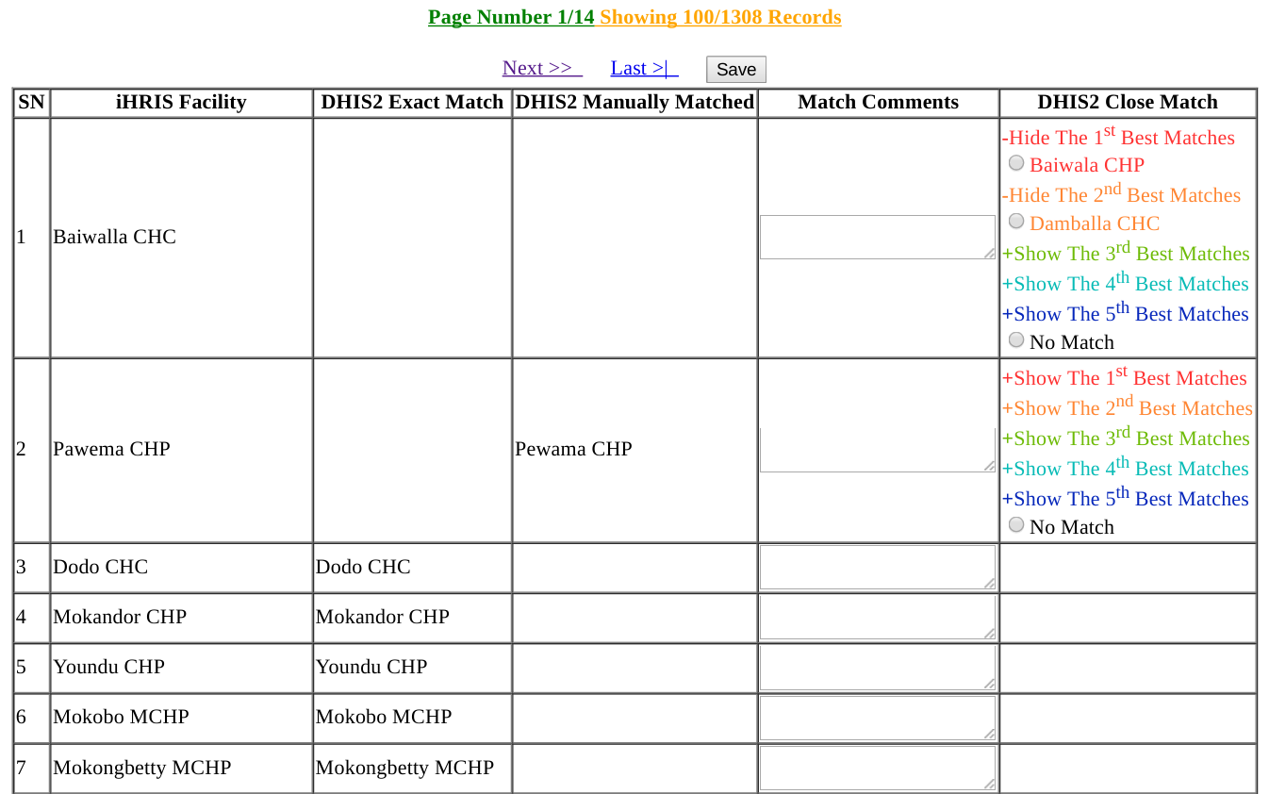
Web Based Facility Mapping Using Data From ILR

Slide 6
Two Typical Patterns for Using Mapped Facility Data
Update source systems with MFR ID from ILR
Add a field “MFR ID” to facility to iHRIS, OpenLMIS, DHIS2 etc
Use mapping data in the ILR to add MFR ID to source systems
Example: iHRIS sends # of HWs to DHIS2 using MFR ID
iHRIS exports (25 nurses, MFR Facility ID: 23)
iHRIS sends data on to DHIS2
Use Interoperability Layer (OpenHIM) to modify transcations
Do not need to modify existing systems
Example: iHRIS sends # of HWs to DHIS2 via OpenHIM
iHRIS exports (25 nurses, iHRIS Facility ID: 9324)
OpenHIM looks up mapping in ILR (iHRIS ID: 9324 -> MFR ID: 23)
OpenHIM rewrites iHRIS export to (25 nurses, MFR ID: 23)
OpenHIM sends data on to DHIS2

Slide 7
Interacting with DATIM
OpenHIM
InterOp Layer (not deployed)
Malawi eHealth Architecture
Master Facility Register
DHIS2
OpenHIM
(Interop Layer)
DATIM Global
DHIS2
InterLinked Registry
OpenMRS
OpenHIM
(Interop Layer)
DATIM Malawi
DHIS2
InterLinked Registry
Load MFL data (and translates MFL data into mCSD standard if no ILR)
Ensure authorization to access data. Log all transactions.
Routine Indicator Reporting using ADX standard across multiple jurisdictions

