Slide 1
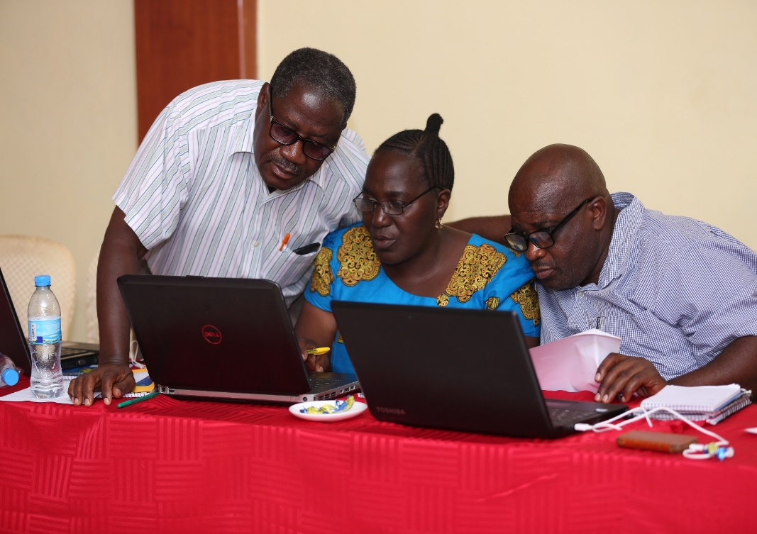
Vaccines Information Management System (VIMS) Overview for OpenLMIS product committee

Slide 2
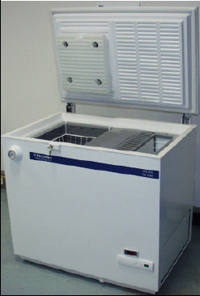
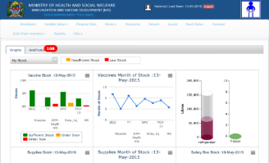
Overview and features
Cold Chain Inventory Management
Vaccine Stock Management
EIS
National
Region
I
M
S
District
V
Facilities (Hospital, HC, Dispensary)
Routine immunization Data
EIS =
VIMS +
EIR
Electronic Immunization Registry
Aims to Link Availability, Potency and Program Performance
Used by the IVD program in 16/26 regions (4,872 facilities)
Developed using OpenLMIS 2.0

Slide 3
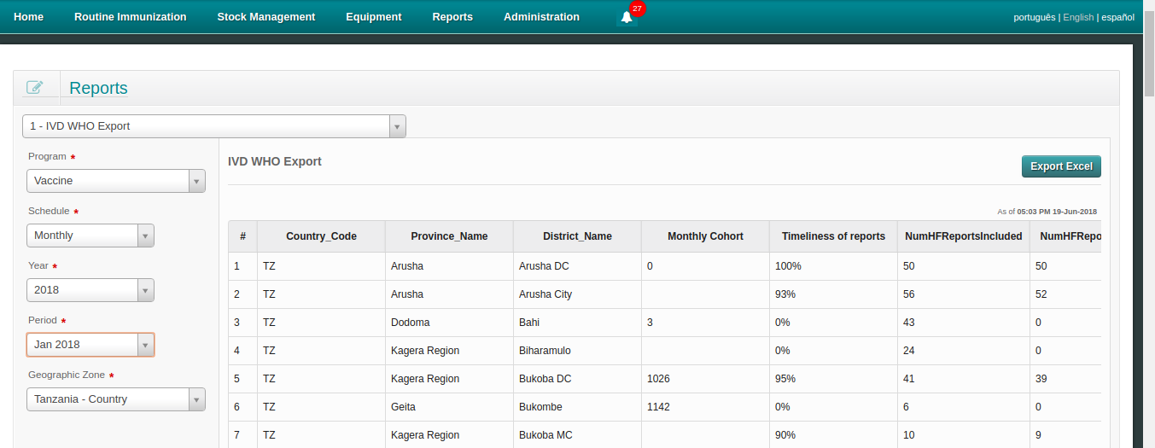
Current status
Interoperable with 3 facility systems HFR, EIR, and DHIS2
Data quality checks
Alerts/notifications of pending actions
Proof of delivery with email notifications
Custom dashboards and reports to facilitate analysis and Decision Making

Slide 5
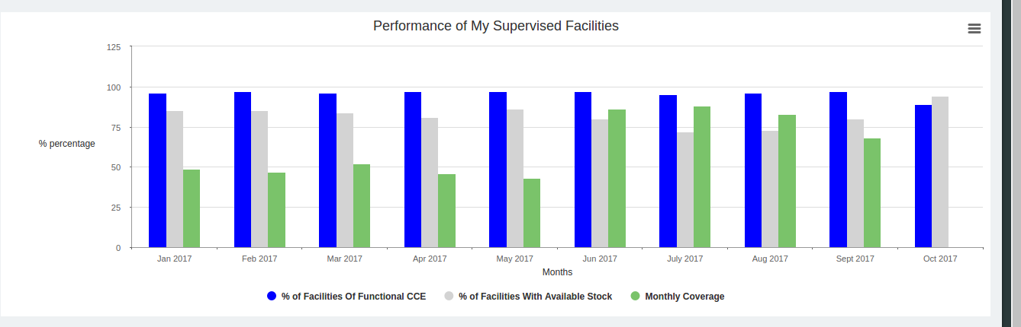
Triangulation of data for better decision making
Linking Potency, Availability and Program Performance

Slide 6
Future plans
Remaining 10 Regions to be trained in the next 6 Months
Working on Integration with DHIS2 through Health Information Mediator (HIM)
Exploring potential of using VIMS for Warehouse Management at Central Level in new EPI warehouses
Enhancement of System Dashboards based on User Requirements
Conversations about upgrades to OpenLMIS v3?
Challenges to address in the future:
Offline functionality + Sync functionality
Need for more in country capacity for system enhancement

Slide 7
Asante sana

