Slide 1
OpenLMIS Implementations Update
Tanzania

Slide 2
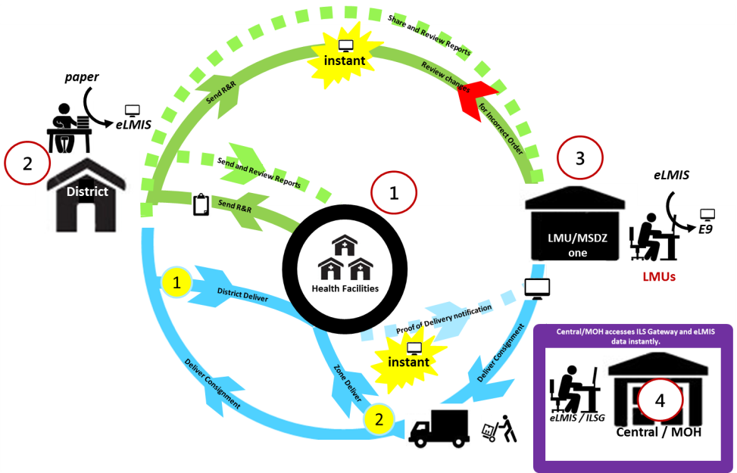
Implementation update(s):
Tanzania Mainland
Implementation Starting point: District
Started: 2013 At Scale by: 2015
Program Supported: EM, Lab commodities, ARV
& TB&L
# Health Facilities: 5890
eLMIS integrated with MSD ERP (E9) for order fulfillment
Zanzibar
Started: 2015 At Scale by: 2016
Program Supported: EM, ARV and TB&L
# Health facilities: 190+
zeLMIS integrated with CMS ERP (mSupply) for order fulfillment
Facility
eLMIS
17% of HF enter their own R&R in eLMIS
Notes:
There was no electronic system used centrally.
Essential Medicines include family planning, Antimalarial, etc.
Describe the current features here: A quarterly system Requisitioning, Commodity & Stock management.
Facility creates paper R&R
District receives paper R&R and enter into eLMIS
LMU/MSD receives approved R&R and reviews before entering in to ERP. Rejection functionality
Central level views reports and dashboards and receive alerts
Trainings & Sensitizations done at all levels including IP
17% of HF entering their own R&R in eLMIS reduces the burden at district hence allowing them to focus more of data use for supportive supervision.

Slide 3
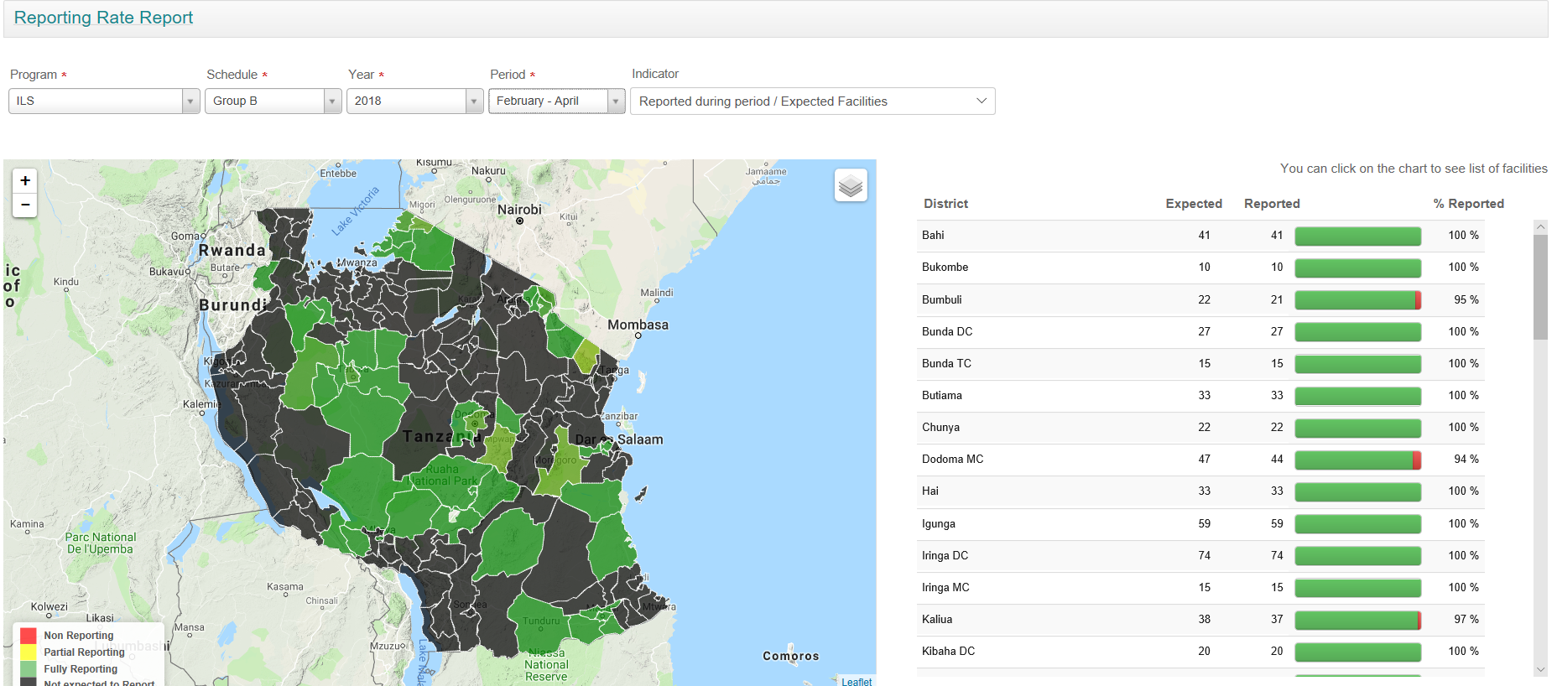
Current Reports & Dashboard.
Reporting Rate for all the programs is averaged above 96%
Notes:
Not many dashboard but the common one in use is the reporting rate.
The current report are made visible based on the quarterly staggering design of the supply chain in Tanzania

Slide 4
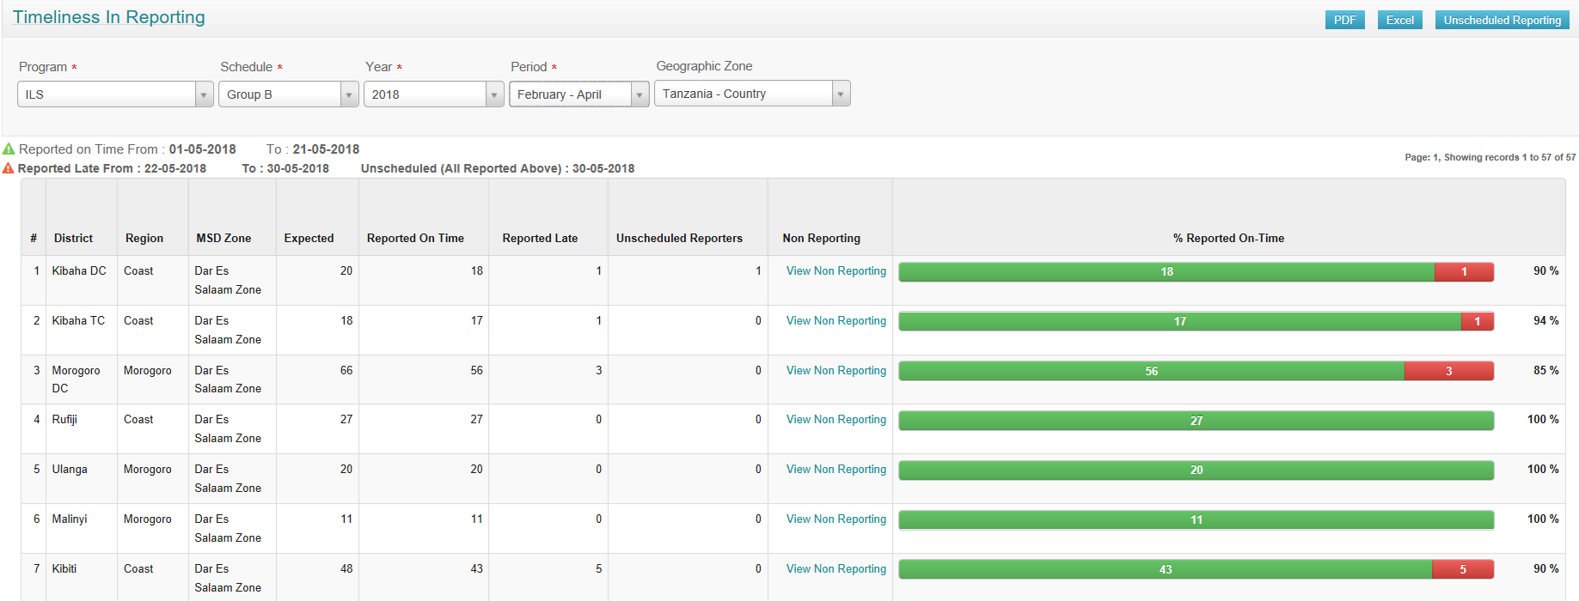
Current Reports & Dashboard..cont..
Timeliness of reporting Rate for all the programs is averaged above 92%

Slide 5
Current Reports & Dashboard..cont..
Other Reports in use:
Consumption reports
Stock Availability reports
Adjustments reports ( commodity transfers, wastages)
A few custom reports to respond to specific needs of the Ministry & Programs.
However there are more needs for more dynamic report & dashboard that we are looking forwarding
Notes:
Custom reports developed for quantification data requirement, on demand national periodic supervision
For Tanzania we hope the completion of the Gap project and an upgrade to OpenLMIS v3 will address the current needs for dynamic reports & dashboards and future integrations.

Slide 6
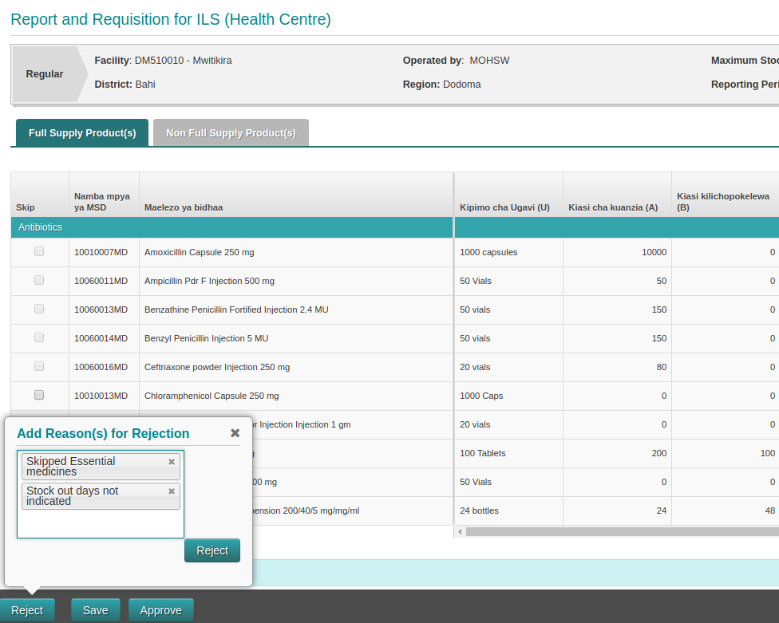
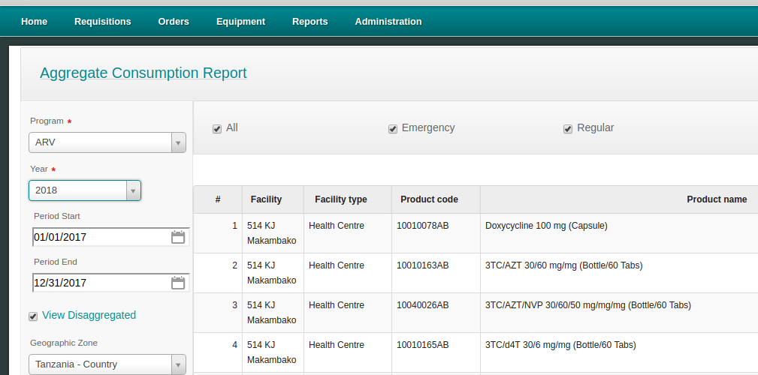
New proposed features:
Supply Chain Redesign
Reconfiguration of eLMIS R&R workflows
Monthly reporting – All HFs
Bi-monthly requisition – A/B
3. Recommended notifications
Capturing rejection reasons
2. Recommended reporting capabilities
User defined date range (Monthly/Annually)
Disaggregate view facility consumption
Disaggregate view facility stock status
Notes:
The new features that required reconfigurations and little development are planned to accommodated the Holistic Supply Chain Review that happened last year.
A move from quarterly reporting and requisitioning to a monthly reporting & bi-monthly requisitioning.

Slide 7
Integration consideration:
Through the Health Information Mediator - HIM
 | Indicators | Frequency | Integration Option | Status
MSD Epicor – eLMIS | HF shipment | Monthly | HIM | Complete & Tested
 | HFs budget allocations | Monthly | HIM | Work in Progress
eLMIS – DHIS2 | HFs Stock on Hand | Monthly | HIM | Complete & Tested
 | HFs Consumption - All products | Monthly | HIM | Complete & Tested
Facility Level Systems (example: GoTHOMIS) – eLMIS | Updating R&R | Monthly | HIM | Work in Progress
Already proven and demonstrated LMIS – HMIS data sharing through LLIN & RMNCH products
Notes:
The current in country focus is for system integrations in the health sector through the Health Information Mediator.
Shipment files sharing is the next step towards having POD which v3 already has.

Slide 8
Ensuring Sustainability
All instances of eLMIS in Tanzania mainland and Zanzibar are stable and very responsive in operation
Plans underway for a Transition to Government ownership of:
Resource allocation and budgeting for support
Hosting at in country National Internet Data Center – NIDC
Future governance, determination of new features and be able to prioritize those
Capacity building plan and local support
Engagement & participation in the OpenLMIS community

Slide 9
Thank you! Asante!

