Slide 1
SUPPLY CHAIN INFORMATION SYSTEMS MATURITY MODEL: IN-DEPTH OVERVIEW
USAID GLOBAL HEALTH SUPPLY CHAIN PROGRAM
Procurement and Supply Management

Slide 2
WHAT ARE THE OBJECTIVES FOR TODAY?
Better understand the approach for the Supply Chain Information Systems Maturity Model
“Test” the draft Model by running through a few sample scenarios
Provide constructive feedback on how to improve on the Model

Slide 3
AGENDA
Start | Finish | Length | Description
2:35pm | 3:00pm | 25 minutes | Detailed Overview: Supply Chain Information Systems Maturity Model Explore the SCISMM Model in more detail
3:00pm | 3:10pm | 10 minutes | Break
3:10pm | 3:20pm | 10 minutes | Set the Stage: Pakistan & Malawi
3:20pm | 4:15pm | 55 minutes | Activity 1: Test the Model Split into Pakistan & Malawi groups to discuss scenarios using the model Leverage Nepal’s example
4:15pm | 4:25pm | 10 minutes | Activity 2: Feedback What did you like about the model? What gaps did you identify while using the model? What would make the model more valuable/useful/helpful?
4:25pm | 4:30pm | 5 minutes | Wrap Up Next Steps Questions Thank you!

Slide 4
DETAILED OVERVIEW:
SUPPLY CHAIN INFORMATION SYSTEMS MATURITY MODEL

Slide 5
HIGHLIGHTS & REVIEW THE SUPPLY CHAIN INFORMATION SYSTEMS MATURITY MODEL
Intended Use: Enable strategic decision & work plan discussions
Reminder: This is a working draft
Discussion encouraged

Slide 6
SC IS MATURITY MODEL

Slide 7
SET THE STAGE:
PAKISTAN & MALAWI

Slide 8
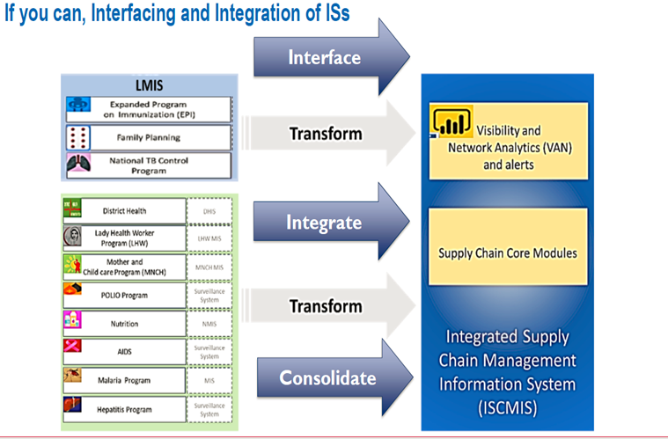
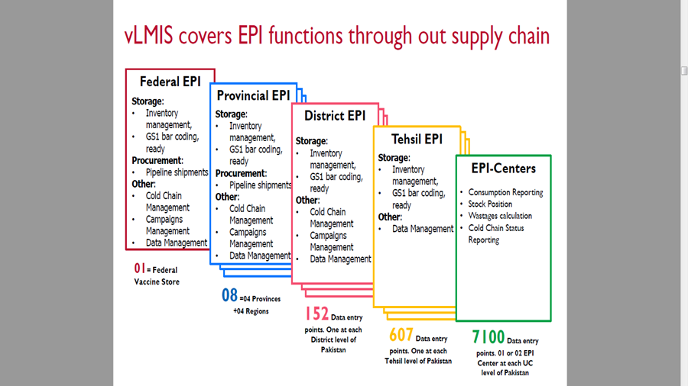
COUNTRY OVERVIEW: PAKISTAN
cLMIS used for IM only in CWS, and for reporting in all other locations
vLMIS is deployed nationally for IM
All LMIS solutions to be migrated to a single platform

Slide 9
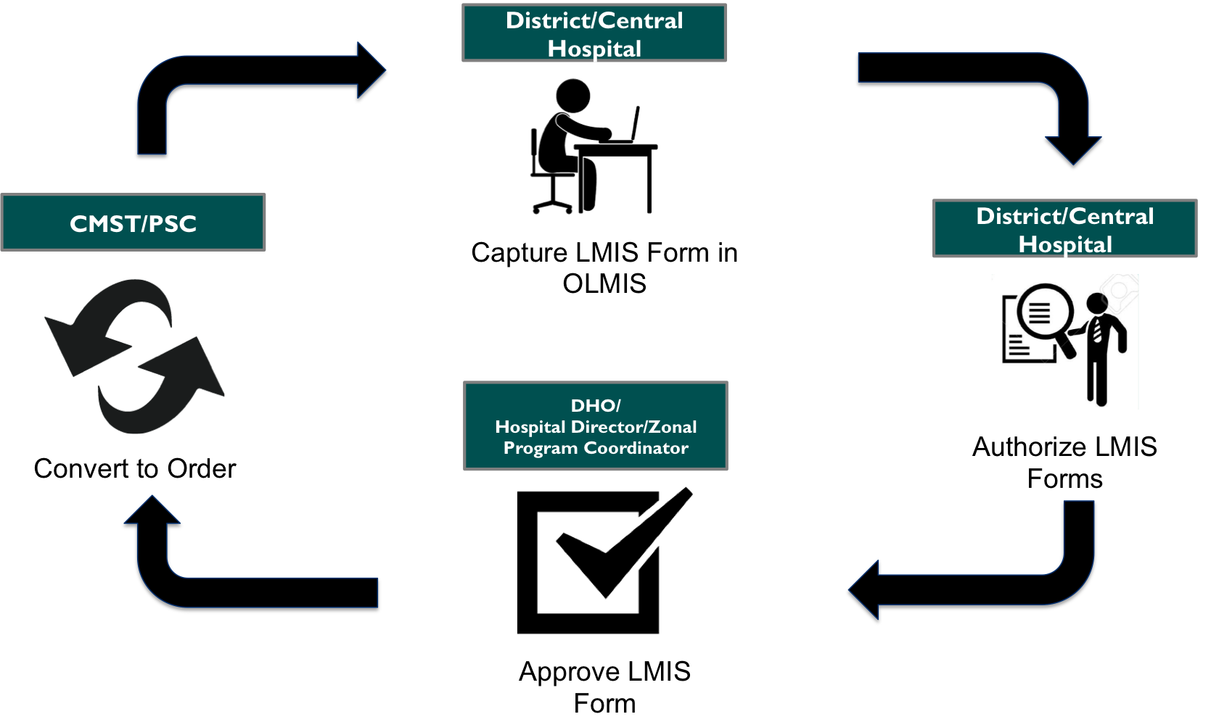
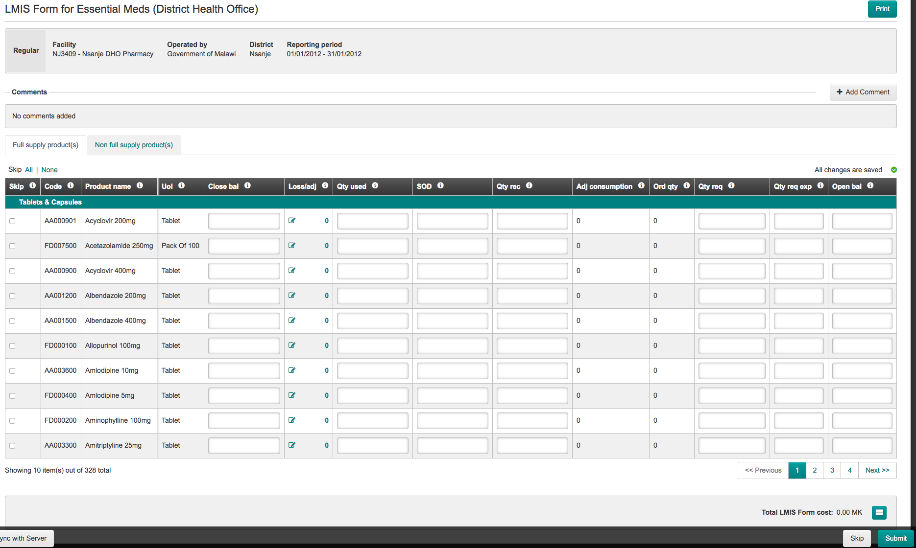
COUNTRY OVERVIEW: MALAWI
System in focus: openLMIS
Operates at all health facilities
Registers inventory, consumption, adjustments, and requisitions
Follows requisitions from initial request, through approval, to when requisition is passed to central medical store

Slide 10
ACTIVITY 1:
TEST THE MODEL

Slide 11
ACTIVITY 1: TEST THE MODEL
Directions
Split into two groups based on background: Pakistan or Malawi
Using the maturity model, assess:
    Where is the country today? What systems/capabilities does that correspond to?
    What other capabilities are needed?
    Prioritize identified capabilities
    Use the roadmap to plan implementation of prioritized capabilities
Record any takeaways & questions
Select a presenter to report back on key take-aways and experience (2 minutes)
Guidelines
Be open-minded and think outside the box
Try not to get hung up on information that your group may not know, make assumptions if necessary

Slide 12
ACTIVITY 2:
FEEDBACK

Slide 13
ACTIVITY 2: FEEDBACK
Directions
As an individual, provide constructive feedback to the following questions (5 minutes)
    What did you like about the model?
    What gaps did you identify while using the model?
    What would make the model more valuable/useful/helpful?
Review answers with group and categorize post-its
Select a presenter to report back on the group’s feedback by question (2 minutes)
Guidelines
One thought per post-it note

Slide 14
WRAP UP

Slide 15
OBJECTIVES MET?
Better understand the approach for the Supply Chain Information Systems Maturity Model
“Test” the draft Model by running through a few sample scenarios
Provide constructive feedback on how to improve on the Model

Slide 16

QUESTIONS & THANKS!
? ? ?
THANK YOU
We really appreciate your time!
Please feel free to reach out to us for the final work product at the end of September.

Slide 17
APPENDIX

Slide 18
SUPPORTING DOCUMENT: OUTLINE
1. Introduction
2. Supply Chain Information Systems
  2.1 What are SC Information Systems?
  2.2 Why are SC Information Systems Important?
  2.3 How are they Different from Existing Approaches?
3. SC Information System Capabilities
  3.1 System Capability Basis
    3.1.1 About SCOR
    3.1.2 About APQC
  3.2 Key Supply Chain System Capabilities
    3.2.1 Process Capabilities
    3.2.2 Technical Capabilities
    3.2.3 Capability Definitions and Maturity Levels
4. Maturity Roadmap
  4.1 Maturity Levels
  4.2 Pre-requisites
  4.3 Implementation Architecture
  4.4 Key Considerations
5. Technology Options
6. Country Context

Slide 19
CONTACT: SWOHLER@GHSC-PSM.ORG
The USAID Global Health Supply Chain-Procurement and Supply Management project provides commodity procurement and logistics services, strengthens supply chain systems, and promotes commodity security.
We support USAID programs and Presidential Initiatives in Africa, Asia, Latin America, and the Caribbean, focusing on HIV/AIDS, malaria, and population and reproductive health commodities.

