Slide 1
OpenLMIS Private Health
STREAMLINE → TRACK → OPTIMIZE
Notes:
We’re here to introduce a product that can help you streamline your business, track everything, and optimize so you can save money and time. It’s called OpenLMIS Private Health.

Slide 2
OpenLMIS
10
11,000
8
YEARS
HEALTH FACILITIES
COUNTRIES ACROSS AFRICA
Notes:
OpenLMIS is a tried and tested open source product. In the last decade, we’ve worked with over 11,000 health facilities in 8 geographies across Africa. It’s powered by evolved technologies that have been perfected over the years.

Slide 3
The Problem
Frustrated by stockouts. Losing customers. Lacking data visibility.
Notes:
In our work, we’ve see these common problems over and over. Frustrating stockouts, which leads to losing customers. Having tons of data, but no simple way to analyze it.
Are these problems that you face? What’s your current stockout rate? How much does waste cost you? What would improving that mean to you?

Slide 4
Private Pharmacies
Private Clinics
Private Hospitals
Notes:
You’re in luck because after years in public health, we are now customizing OpenLMIS for your market: growing private networks of pharmacies, hospitals and clinics.

Slide 5
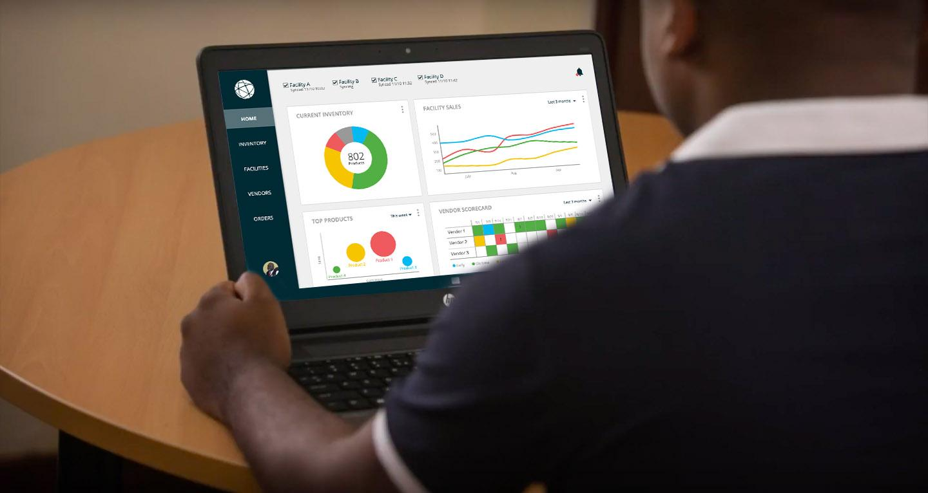
Notes:
We’re developing a solution that puts you in control of your business -- solving problems like stockouts and waste before they happen.

Slide 6
Principles
Configurable
Interoperable
Intuitive
Notes:
There are three principles that are key to this product.
First, it’s configurable -- it grows with your business and allows you to customize the product to fit your needs.
Second, it’s interoperable -- it pulls together data from different sources, like your EMR. It works with tools you’re already using, so you don’t have to throw away work you’ve already done.
And finally, it’s intuitive -- allows you to hit the ground running with little instruction and technical skills needed.

Slide 7
Why it’s great
SAVE MONEY
STREAMLINE operations
TRACK everything
OPTIMIZE inventory
Notes:
This product will streamline the operations of your staff so you can effectively serve and retain customers. In doing so, it tracks all the information you need. Which will help you optimize your stock levels, and -- in effect -- save money.
EXTRA NOTES:
OpenLMIS puts information at your fingertips to optimize your business: keep customers served (don't turn them away); optimizing the money-making products on your shelves and minimize the wasteful/loss products; putting a real-time cockpit display in front of you that is driven by the user-friendly, streamlined operations of your staff (sensors); empowering everyone in the organization (help your staff all become customer-driven); helping you optimize your network (manage your vendors)

Slide 8
STREAMLINE
Clerks & Cashiers
Healthcare Providers
Facility Managers
Notes:
Here’s how we can help you streamline operations for your different members of your staff.

Slide 9
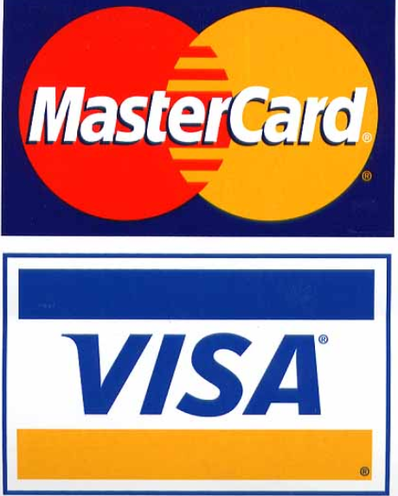
Clerks & Cashiers
31.50
Simple point of sale
Cash
Other
Notes:
For clerks and cashiers, we offer features like a simple point of sale. This can be configured to fit payment systems that are popular with you and your customers.

Slide 10
Clerks & Cashiers
Simple point of sale
On demand support
HELP
What do you need?
I want to delete an order
|
Notes:
We will also offer on demand support through help bots and video tutorials

Slide 11
Clerks & Cashiers
Simple point of sale
On demand support
Alerts to prepare prescriptions
Gloria Smith
NEW PRESCRIPTION 09/10/19
Product: Doxycycline
Quantity:
15 doses
Quantity:
15 doses
Ordered by:
Facility A
1 new prescription
15 doses of Doxycycline for Gloria Smith
VIEW PRESCRIPTION
VIEW PRESCRIPTION
VIEW PRESCRIPTION
PREP PRESCRIPTION
PATIENT RECORD
DOB:
Age/Gender:
Hgt./Weight:
10/11/78
41/F
62/130
Notes:
Clerks can receive notifications to prepare prescriptions that come in from healthcare providers

Slide 12
Clerks & Cashiers
Simple point of sale
On demand support
Alerts to prepare prescriptions
Offline mode
Offline Mode
Last sync 10/10/19 8:01
HOME
DISPENSE
ORDERS
Notes:
And it also works offline, telling you and your staff when data is syncing

Slide 13
Clerks & Cashiers
Simple point of sale
On demand support
Alerts to prepare prescriptions
Offline mode
Safety check
Notes:
Finally, a safety check is a built-in part of the dispensing process -- clerks can scan a barcode to see if the product is safe to use

Slide 14
Healthcare Providers
Doxycycline
Search product availability
Facility One 1234 Street, City
SEND PRESCRIPTION
3 weeks of stock
Facility Three 9101 Street, City
SEND PRESCRIPTION
5 days of stock
Facility Two 5678 Street, City
RESERVE
Out of stock
Notes:
What can OpenLMIS do for healthcare providers on your staff? They can do things like search to see if a product is available at a patient’s preferred pharmacy. The system allows them to see how much of a product is in stock at nearby facilities to best match supply and demand.

Slide 15
Healthcare Providers
Doxycycline
Search product availability
Find alternate products
Similar Products
Medicine A
Medicine B
No drug interactions
In stock
No drug interactions
In stock
Medicine C
Medicine D
Drug interactions
In stock
No drug interactions
Out of stock
Notes:
If a drug isn’t available, you can also look up alternate products so you don’t have to turn patients away. You will always be able to provide a sale with this tool, which will pair with your EMR so you can also see if medicines are compatible with the patient’s other prescriptions

Slide 16
Facility Managers
Automated requisitions
Low stock alert
5 products recommended for reorder
START ORDER
Notes:
For facility managers, it is easy to perform requisitions through automated processes and notifications

Slide 17
Facility Managers
Automated requisitions
Simple bulk ordering
Doxycycline
Cough syrup
Fever reliever
Pain reliever
START ORDER
START ORDER
START ORDER
Notes:
They can easily create bulk orders, which are sent to vendors in a flash

Slide 18
Facility Managers
Automated requisitions
Simple bulk ordering
Financial reports
TOP PRODUCT SALES
Last 3 months
$500
$400
$300
$200
$100
July
Aug
Sep
Notes:
They can also see financial reporting information, like fast moving products and success metrics

Slide 19
STREAMLINE
Clerks & Cashiers
Healthcare Providers
Facility Managers
Simple point of sale
On demand support
Alerts to prepare prescriptions
Offline mode
Safety check
Search product availability
Find alternate products
Automated requisitions
Simple bulk ordering
Financial reports
Notes:
So, here’s how we’re streamlining your operations. Clerks and cashiers can easily prepare and process prescriptions. Healthcare providers can always find what the patient needs. And facility managers can simply and easily manage orders, track supplies and see financial overviews.

Slide 20
TRACK
OPTIMIZE
Waste
Vendor Performance
Products Ordered
Decision Making Dashboards
Products Dispensed
Money Exchanged
Product + Location
Demand
Notes:
By streamlining, we are tracking a variety of things… and by tracking this data, we are able to populate dashboards that help you make informed decisions. Let’s take a look!

Slide 21
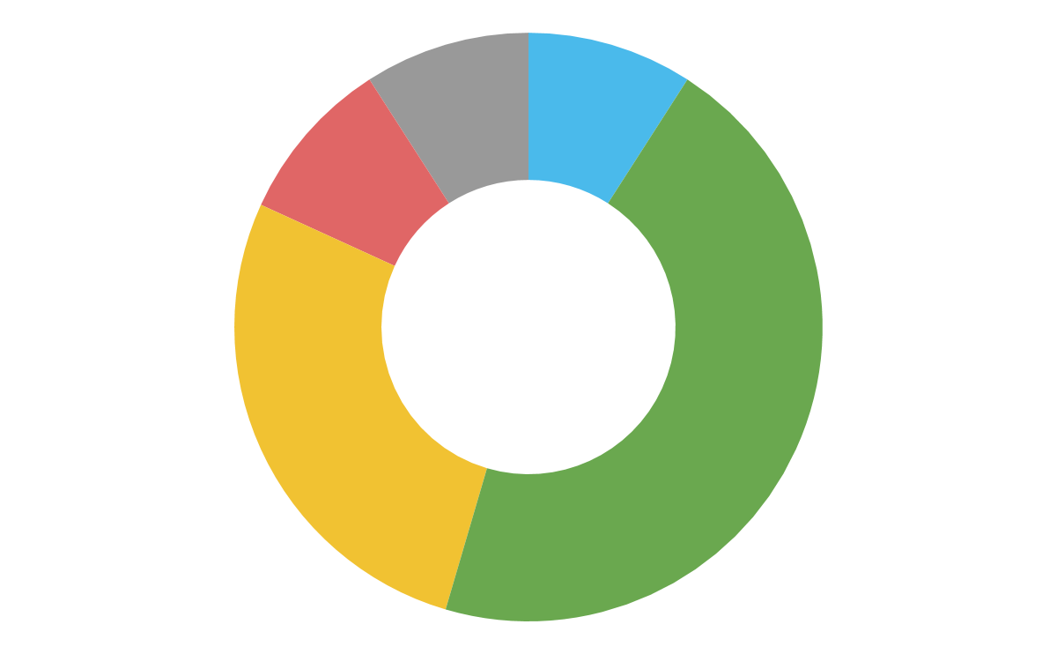
Facility A Synced 11/10 10:02
Facility B Syncing
Facility C Synced 11/10 11:32
Facility D Synced 11/10 11:42
Add more
HOME
CURRENT INVENTORY
FACILITY SALES
Last 3 months
INVENTORY
$500
$400
$300
$200
$100
$0
802
FACILITIES
Products
VENDORS
July
Aug
Sep
ORDERS
TOP PRODUCTS
This week
VENDOR SCORECARD
Performance
Last 3 months
7/1
7/7
7/14
7/21
8/1
8/7
8/14
8/21
9/1
9/7
9/14
9/21
Paracetamol
2.6%
Vendor 1
!
Cough Drops
Vendor 2
!
!
3.0%
Vendor 3
!
Aspirin
1.5%
Early
On time
Late
Not arrived
! Lost or damaged
Notes:
Here’s what those dashboards look like. They offer a variety of features

Slide 22
Facility A Synced 11/10 10:02
Facility B Syncing
Facility C Synced 11/10 11:32
Facility D Synced 11/10 11:42
Add more
HOME
CURRENT INVENTORY
FACILITY SALES
Last 3 months
INVENTORY
500
802
400
802
FACILITIES
300
Products
Optimal Level
114 products
View products
Products
200
100
VENDORS
July
Aug
Sep
ORDERS
TOP PRODUCTS
This week
VENDOR SCORECARD
Last 3 months
7/1
7/7
7/14
7/21
8/1
8/7
8/14
8/21
9/1
9/7
9/14
9/21
Paracetamol
2.6%
Vendor 1
!
Cough Drops
Vendor 2
!
!
3.0%
Vendor 3
!
Aspirin
1.5%
Early
On time
Late
Not arrived
! Lost or damaged
Notes:
Like inventory levels

Slide 23
Facility A Synced 11/10 10:02
Facility B Syncing
Facility C Synced 11/10 11:32
Facility D Synced 11/10 11:42
Add more
HOME
CURRENT INVENTORY
FACILITY SALES
Last 3 months
INVENTORY
500
802
400
802
FACILITIES
Reorder Point
98 products
View products
300
Products
Products
200
100
VENDORS
July
Aug
Sep
ORDERS
TOP PRODUCTS
This week
VENDOR SCORECARD
Last 3 months
7/1
7/7
7/14
7/21
8/1
8/7
8/14
8/21
9/1
9/7
9/14
9/21
Paracetamol
2.6%
Vendor 1
!
Cough Drops
Vendor 2
!
!
3.0%
Vendor 3
!
Aspirin
1.5%
Early
On time
Late
Not arrived
! Lost or damaged
Notes:
See how many products need to be reordered - click to see list of products and where they’re located

Slide 24
Facility A Synced 11/10 10:02
Facility B Syncing
Facility C Synced 11/10 11:32
Facility D Synced 11/10 11:42
Add more
Excess
35 products
View products
HOME
CURRENT INVENTORY
FACILITY SALES
Last 3 months
INVENTORY
500
802
400
802
FACILITIES
300
Products
Products
200
100
VENDORS
July
Aug
Sep
ORDERS
TOP PRODUCTS
This week
VENDOR SCORECARD
Last 3 months
7/1
7/7
7/14
7/21
8/1
8/7
8/14
8/21
9/1
9/7
9/14
9/21
Paracetamol
2.6%
Vendor 1
!
Cough Drops
Vendor 2
!
!
3.0%
Vendor 3
!
Aspirin
1.5%
Early
On time
Late
Not arrived
! Lost or damaged
Notes:
Also, see how many products are in excess so you can move them to a new facility

Slide 25
Facility A Synced 11/10 10:02
Facility B Syncing
Facility C Synced 11/10 11:32
Facility D Synced 11/10 11:42
Add more
HOME
CURRENT INVENTORY
FACILITY SALES
Last 3 months
Facility B
12% growth
View facility
INVENTORY
$500
$400
$300
$200
$100
$0
802
FACILITIES
Products
VENDORS
July
Aug
Sep
ORDERS
TOP PRODUCTS
This week
VENDOR SCORECARD
Last 3 months
7/1
7/7
7/14
7/21
8/1
8/7
8/14
8/21
9/1
9/7
9/14
9/21
Paracetamol
2.6%
Vendor 1
!
Cough Drops
Vendor 2
!
!
3.0%
Vendor 3
!
Aspirin
1.5%
Early
On time
Late
Not arrived
! Lost or damaged
Notes:
On the right is information about each facility’s sales - click to see facility profile

Slide 26
Facility A Synced 11/10 10:02
Facility B Syncing
Facility C Synced 11/10 11:32
Facility D Synced 11/10 11:42
Add more
HOME
CURRENT INVENTORY
FACILITY SALES
Last 3 months
INVENTORY
500
802
400
FACILITIES
300
Products
200
100
VENDORS
July
Aug
Sep
Vendor 1 on 8/1
On time, lost goods
View order
ORDERS
TOP PRODUCTS
This week
VENDOR SCORECARD
Performance
Last 3 months
7/1
7/7
7/14
7/21
8/1
8/7
8/14
8/21
9/1
9/7
9/14
9/21
Paracetamol
2.6%
Vendor 1
!
!
Cough Drops
Vendor 2
!
!
3.0%
Vendor 3
!
Aspirin
1.5%
Early
On time
Late
Not arrived
! Lost or damaged
Notes:
The vendor scorecard tells you how each vendor is doing. Did things go missing? Were they late? We track this information to help you decide who to partner with. Click to see order details

Slide 27
Facility A Synced 11/10 10:02
Facility B Syncing
Facility C Synced 11/10 11:32
Facility D Synced 11/10 11:42
Add more
HOME
CURRENT INVENTORY
FACILITY SALES
Last 3 months
INVENTORY
500
802
400
FACILITIES
300
Products
200
100
VENDORS
July
Aug
Sep
2.6% spike
Paracetamol
Order more
ORDERS
TOP PRODUCTS
This week
VENDOR SCORECARD
Last 3 months
7/1
7/7
7/14
7/21
8/1
8/7
8/14
8/21
9/1
9/7
9/14
9/21
Paracetamol
2.6%
Vendor 1
!
Cough Drops
Vendor 2
!
!
3.0%
Vendor 3
!
Aspirin
1.5%
Early
On time
Late
Not arrived
! Lost or damaged
Notes:
On the bottom left, you can see fast moving products and how they’re doing in a certain time period. Click on product to see product profile. If product consumption is increasing rapidly, you can know when to order more.

Slide 28
Facility A Synced 11/10 10:02
Facility B Syncing
Facility C Synced 11/10 11:32
Facility D Synced 11/10 11:42
Add more
HOME
CURRENT INVENTORY
FACILITY SALES
Last 3 months
INVENTORY
$500
$400
$300
$200
$100
$0
802
FACILITIES
Products
VENDORS
July
Aug
Sep
ORDERS
TOP PRODUCTS
This week
VENDOR SCORECARD
Last 3 months
7/1
7/7
7/14
7/21
8/1
8/7
8/14
8/21
9/1
9/7
9/14
9/21
Paracetamol
2.6%
Vendor 1
!
Cough Drops
Vendor 2
!
!
3.0%
Vendor 3
!
Aspirin
1.5%
Early
On time
Late
Not arrived
! Lost or damaged
Notes:
Up at the very top, you can see which facilities are currently syncing, so you’re always aware how fresh your data is.

Slide 29
Facility A Synced 11/10 10:02
Facility B Syncing
Facility C Synced 11/10 11:32
Facility D Synced 11/10 11:42
Add more
6 new recommendations
HOME
CURRENT INVENTORY
FACILITY SALES
Last 3 months
INVENTORY
$500
$400
$300
$200
$100
$0
802
FACILITIES
Products
VENDORS
July
Aug
Sep
ORDERS
TOP PRODUCTS
This week
VENDOR SCORECARD
Last 3 months
7/1
7/7
7/14
7/21
8/1
8/7
8/14
8/21
9/1
9/7
9/14
9/21
Paracetamol
2.6%
Vendor 1
!
Cough Drops
Vendor 2
!
!
3.0%
Vendor 3
!
Aspirin
1.5%
Early
On time
Late
Not arrived
! Lost or damaged
Notes:
Automated recommendations help you save money by telling you things like how and when to rebalance stock in between your facilities and when to bulk order a product. It helps you do these actions with just the click of a button.

Slide 30
Facility A Synced 11/10 10:02
Facility B Syncing
Facility C Synced 11/10 11:32
Facility D Synced 11/10 11:42
OPTIMIZE
HOME
CURRENT INVENTORY
FACILITY SALES
Last 3 months
INVENTORY
500
Daily Sales Flow
Top Selling Products
Unmet Demand
Expiring Products
Vendor Scorecard
802
400
FACILITIES
300
Products
200
100
VENDORS
July
Aug
Sep
ORDERS
Waste Breakdown
Top Stockout Challenges
Facility Scorecard
Inventory Levels
+ Add More
TOP PRODUCTS
This week
VENDOR SCORECARD
Last 3 months
7/1
7/7
7/14
7/21
8/1
8/7
8/14
8/21
9/1
9/7
9/14
9/21
Vendor 1
!
Vendor 2
!
!
Sales
Vendor 3
Product 1
!
Product 2
Product 4
Product 3
Early
On time
Late
Not arrived
! Lost or damaged
Customers
Notes:
You have the option to add not just these graphs, but a variety of graphs based on what you’re tracking. You can even create new graphs based on the data you collect.

Slide 31
The Problem
Frustrated by stockouts. Losing customers. Lacking data visibility.
Notes:
So, if these problems sound familiar: Frustrating stockouts, which leads to losing customers. Having tons of data, but no simple way to analyze it.

Slide 32
STREAMLINE
TRACK
OPTIMIZE
Simple point of sale
On demand support
Alerts to prep prescriptions
Offline mode
Safety check
Search product availability
Find alternate products
Automated requisitions
Simple bulk ordering
Financial reports
Tools to support your team
Notes:
With OpenLMIS, you can streamline your staff’s day-to-day operations and make their lives easier with the features we have described.

Slide 33
STREAMLINE
TRACK
OPTIMIZE
Waste
Products dispensed
Money exchanged
Vendor performance
Products ordered
Product + location demand
Automated tracking
Notes:
By providing tools for your staff, you can start to track important information on data points like product waste, dispensing, transactions, vendors, orders and demand.

Slide 34
STREAMLINE
TRACK
OPTIMIZE
Daily sales flow
Top selling products
Unmet demand
Expiring products
Vendor scorecard
Waste breakdown
Top stockout challenges
Facility scorecard
Inventory levels
Add more..
Decision making dashboards
Notes:
The data you’re tracking will feed into dashboards that can help you make informed decisions. Overall, you will save time and money by optimizing your business.

Slide 35
OpenLMIS Private Health

