Slide 1


OpenLMIS Workshop Follow-Up
FEBRUARY 12, 2019

Slide 2
Agenda
3 Brief Recap: January Workshop
4 Business Model Selection
7 Phase 2 Timeline & Next Steps
9 Market Sounding
10 GC Next Steps

Slide 3
Brief Recap: January Workshop
Overview
Materials
Joined by 21 members of the OpenLMIS community on January 29, 2019 on the phone and in Washington, DC – thank you!
Presented Phase 1 findings: culmination of desk research, stakeholder interviews, stakeholder mapping, and market sounding
Established 7 core attributes that are most important for future state
Reviewed and evaluated 8 theoretical constructs for OpenLMIS sustainability
The following materials were posted on the Wiki page here:
Presentation
Notes
Recorded sessions
Photos
Pre-meeting materials

Slide 4
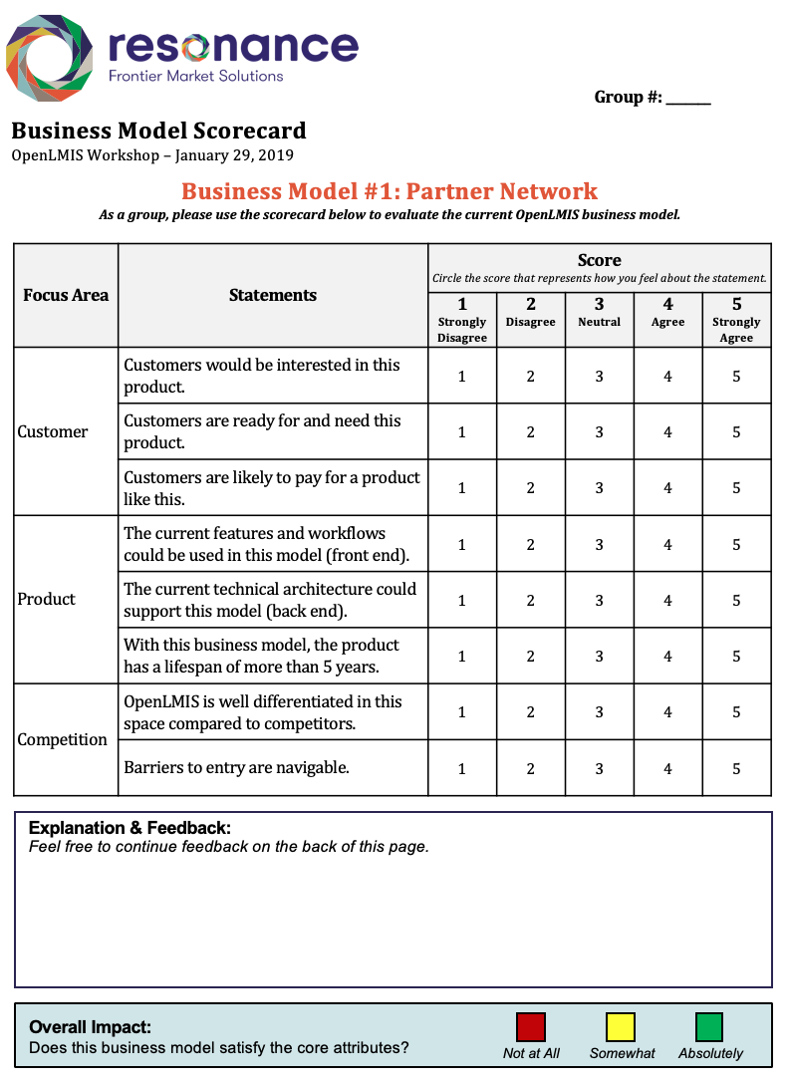
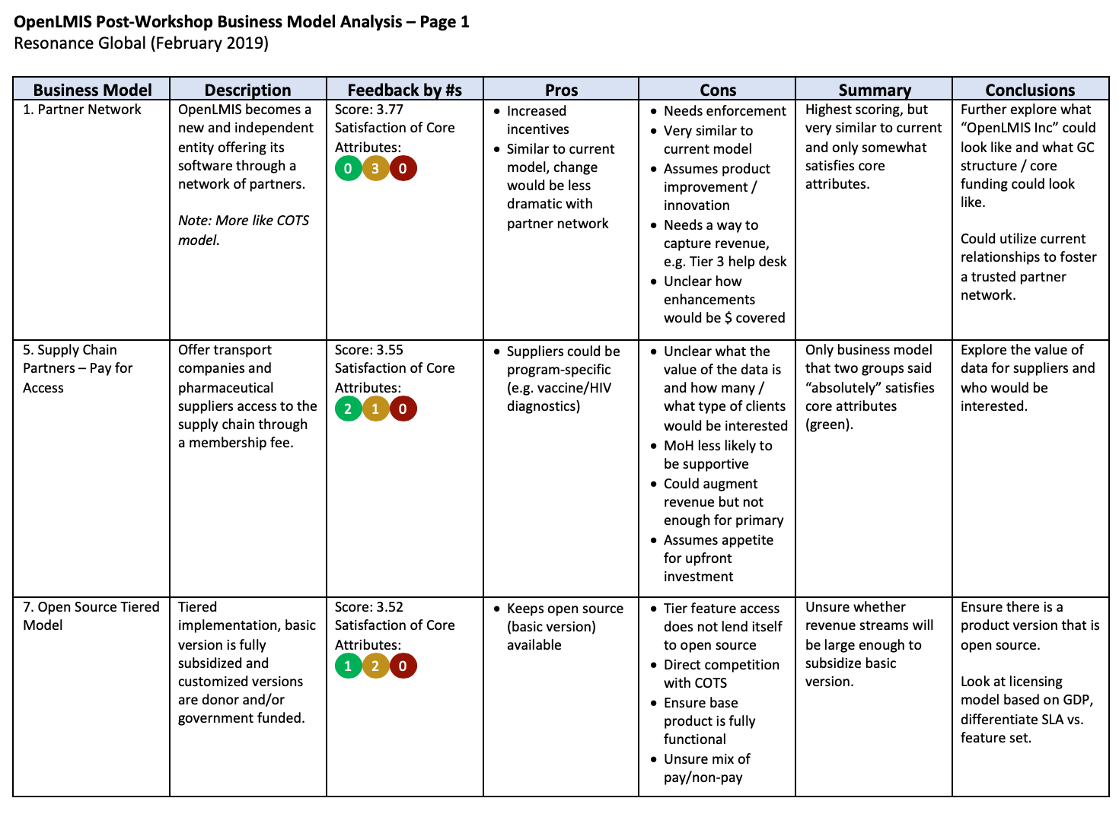
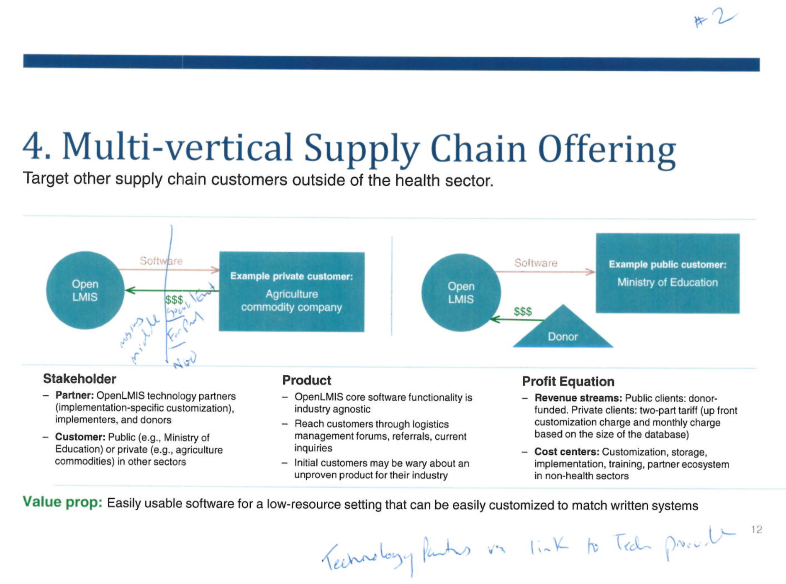
Business Model Selection
An analysis of:
Workshop scores
Individual scorecard feedback
Satisfaction of core attributes
Small and large group discussions
Pros/cons and feasibility based on interviews and desk research
Conclusions based on market sounding observations and interviews

Slide 5
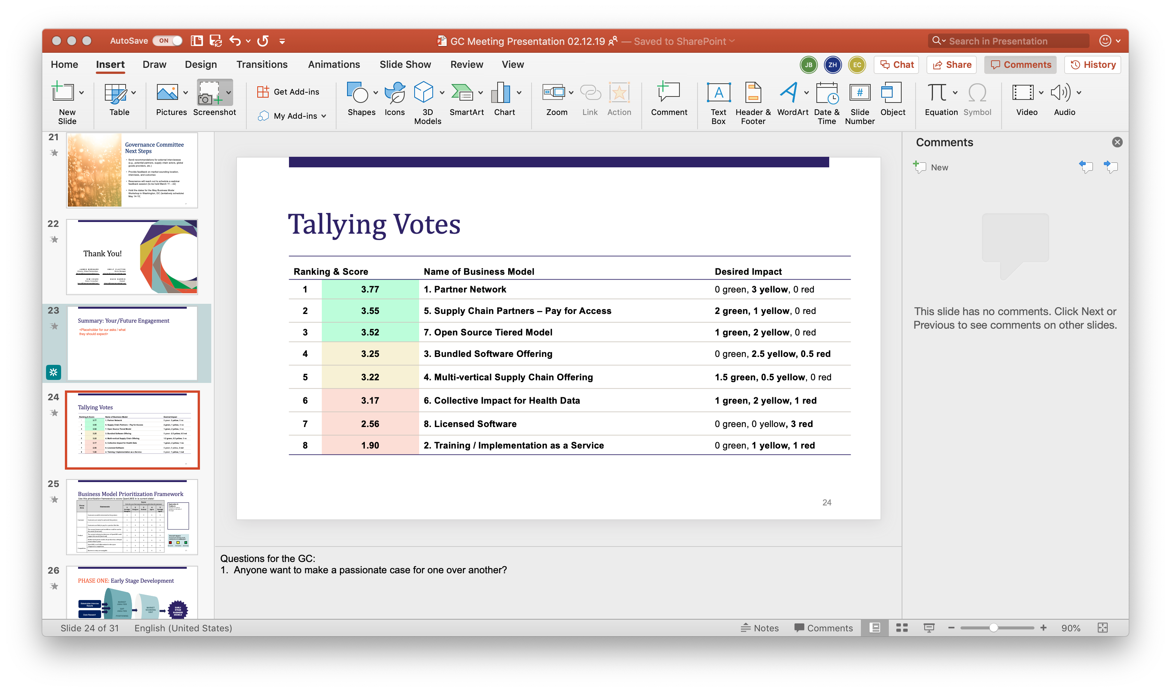
Business Model Selection
Our process:
Removed several theoretical constructs reviewed during the workshop
Determined elements (from the constructs) that are required for sustainability in a future state
Took these elements and decided to look at future state through a customer-centric lens of two options

Slide 6






Taking a Customer-Centric View
Option A:
Privatized / Expanded Health Offering
Explore go-to-market strategies in other health-related areas beyond public health (e.g. supply chain partners)
Option B:
OpenLMIS Goes Beyond Health
Expand OpenLMIS to customers who are outside of the health sector (e.g., multi-vertical supply chain offering)
Description
Target Market
Key Decision Point (business modeling process)
Pricing structure​
Core funds revenue strategy
Go-to-market strategy
Governance structure
Partner roles

Slide 7
Phase 2: Timeline
February
March
April
May
June
Jan 29
Resonance OpenLMIS Workshop
Mar 11-22
Business Model Feedback Webinar
May 14-15 (TBC)
Business Model Workshop
June 28
Final Project Briefing
February – March: Refine 1-2 Draft Business Models; conduct interviews
May - June: Develop Business Plan
March – April: Market Sounding Visit(s)
March – May: Continue to Refine Business Models

Slide 8
Next Steps
Conduct interviews with internal and external stakeholders
Gain additional insight into successful implementations of open source products and best practices for governance
Ascertain feasibility of new OpenLMIS partnerships
Evaluate new markets for potential expansion
Seek feedback from the GC via March webinars
Determine location for next market sounding (next slide)
Continue to evolve constructs into detailed business models

Slide 9
Market Sounding
Criteria for the location:
Current partner presence (e.g., SoftWorks, JSI, etc.)
Potential future partner presence (e.g., One Network) and initial product recognition
LMIC with robust technology user capacity
What we hope to do:
Speak with potential private customers to understand interest in the product
Speak with supply chain actors (e.g., 3PL companies) to understand need and interest in product
Speak with complementors to understand partnership potential
Initial ideas:
Ghana & Nigeria
Zambia & Botswana
Bangladesh & Vietnam

Slide 10

GC Next Steps
Add your available dates to the Doodle for the two-day Business Model Workshop in Washington, DC, which will be held on one of the following:
Send recommendations for external interviewees
Provide feedback on market sounding location, interviews, and outcomes
Resonance will reach out to schedule a webinar feedback session (to be held March 11 – 22)
  May 14 – 15
  May 15 – 16
  May 21 – 22
  May 22 – 23

Slide 11
Thank You!
  JAMES BERNARD
  Director, Global Partnerships
  jbernard@resonanceglobal.com
  EMILY CLAYTON
  Senior Manager
  eclayton@resonanceglobal.com
  KIM COURI
  Senior Consultant
  kcouri@resonanceglobal.com
  ZACH HARRIS
  Analyst
  zharris@resonanceglobal.com

