Slide 1
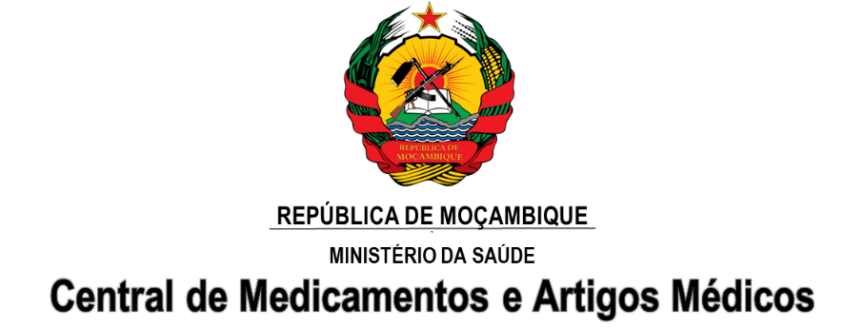
2018 Global Health Supply Chain Summit
Lusaka, Zambia

Slide 2
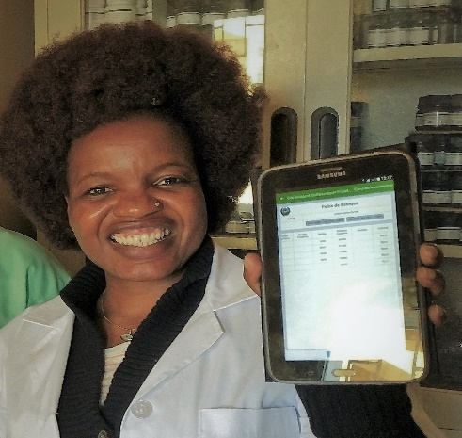
SIGLUS
Implementing eLMIS to Improve Data Visibility and the Health Supply Chain:
Lessons from Mozambique
Brana Branquinho
Deputy Director Central Medical Stores (CMAM)
Mozambique

Slide 3
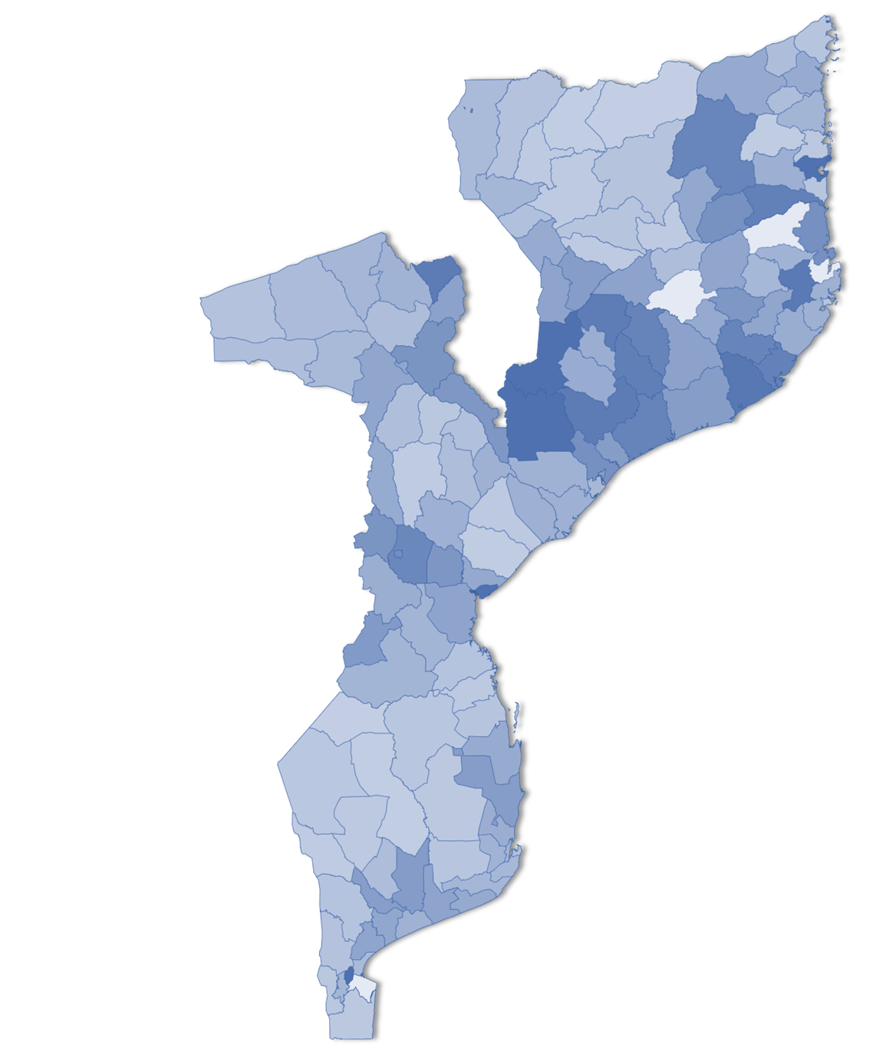
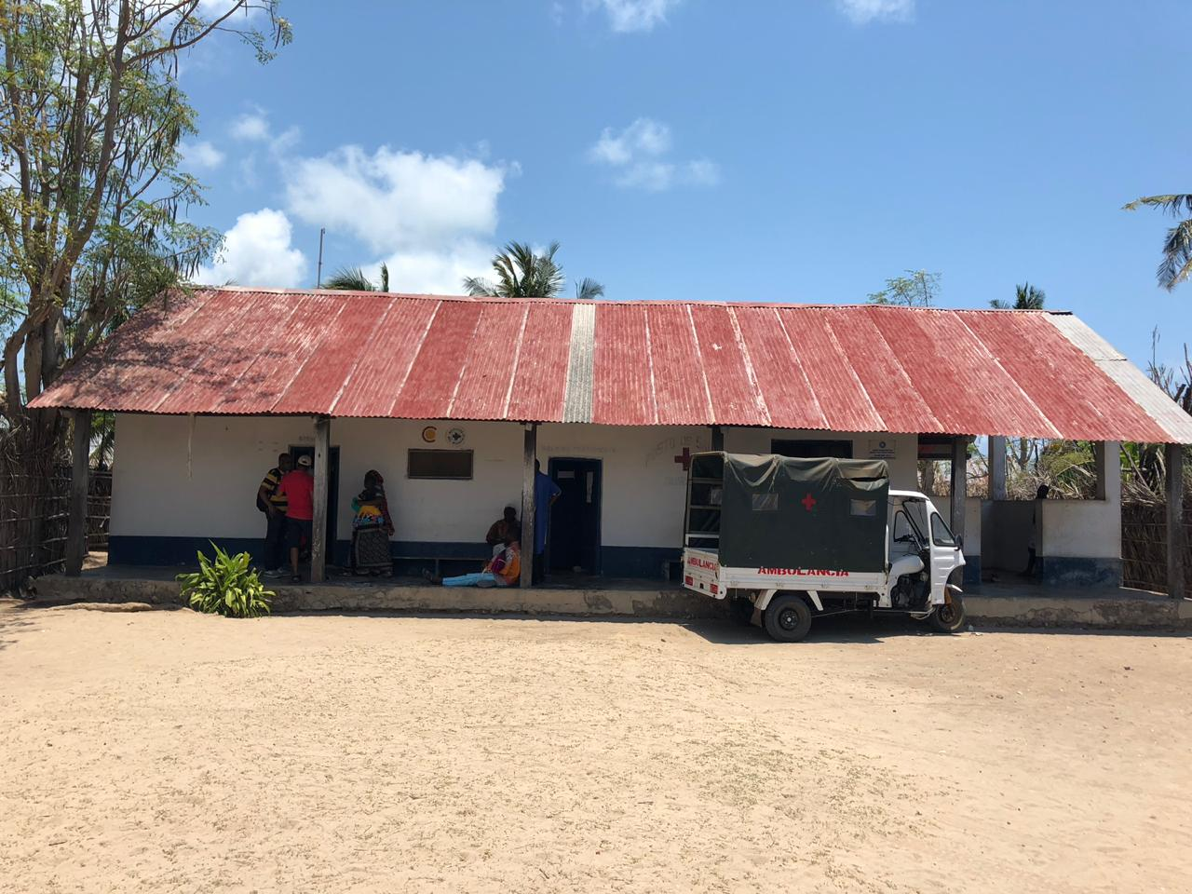
Context
Located in Southeast Africa
Total population 29,668,834
11 provinces
154 districts
HIV prevalence of 13.2%, more than 1.300.000 in ART
1,596 health facilities (INE-National Institute of Statistics)
96% of health facilities are Level 1 (former health posts)
2018 Global Health Supply Chain Summit - Lusaka, Zambia

Slide 4
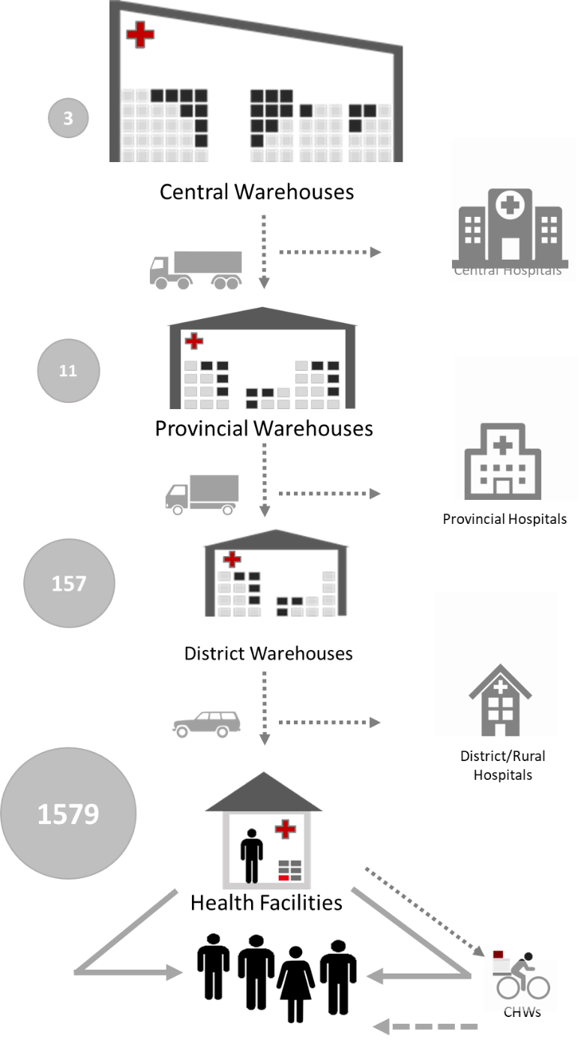
Mozambique’s Supply Chain
Supply Chain Structured in 4 levels; plus the community
Central-level Central Medical Stores & 3 regional warehouses
11 provincial warehouses
147 district warehouses
1,596 health facilities
4,427community health workers
Serving over 29,668,834

Slide 5
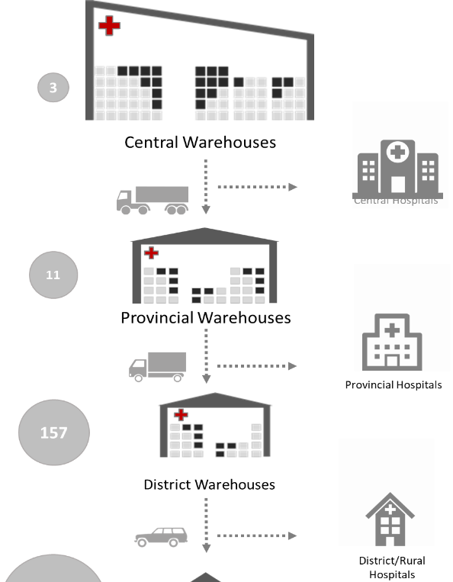
Data Gap in Supply Chain
Before SIGLUS
Only 2% Public health supply chain visible
Only the warehouses had computerized systems
Main stream relies on aggregated paper based data
2%
Computerized
Lack of visibility in vast majority of the system:
98% of the stocking points missing critical data
No HF consumption data
No stockout data at the large bottom of the pyramid
98%
Manual
Notes:
2% real time data; 10% complete data (calculate based on the Nr of sites with SIMAM; remaining paper based

Slide 6
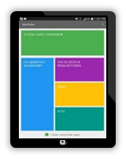
Mobile Solution for impact
SIGLUS is a cloud-based Logistics Management Information System for Health Facilities, used to report stock data via tablets.
Capture data on: :
stock on hand
quantity issued
quantity received
Adjustments
quantities requested
patients by regimen for ARVs
Health Facilities use SIGLUS also to generate and send monthly or quarterly requisition.
SIGLUS

Slide 7
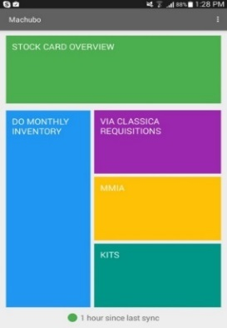
SIGLUS – The Mobile app
Online/offline
Transactional workflows (as opposed to a reporting tool)
Automated calculations for requisition process
Alerts for low stock levels, overstocking, understocking and upcoming expiries
Product expiry date and batch information
Requisitions to supply warehouse
User interface mimics paper forms familiar to healthcare workers to reduce training burden
All Essential Products including
Anti Malaria drugs, Anti-retroviral , Contraceptives, Rapid Diagnostic Tests, Antibiotics, Essential Medicines, Key Medical Articles

Slide 8
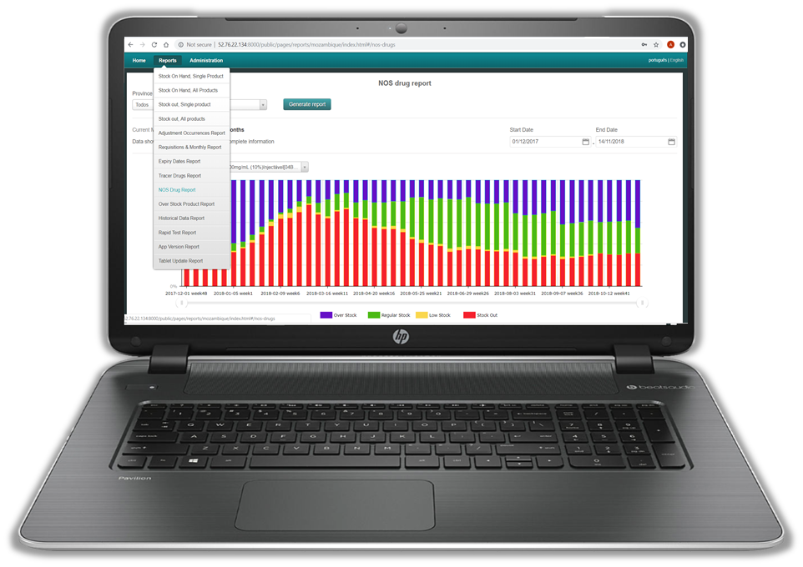
SIGLUS – The Web Portal
Customized reports for Mozambique, such as weekly tracer drug report.
Facility-level and aggregate reports and visualizations
Data export for further analysis
Access to all submitted requisitions
Access to stock cards and transactions of products
Tracking of synchronization status and order requisition timeliness

Slide 9
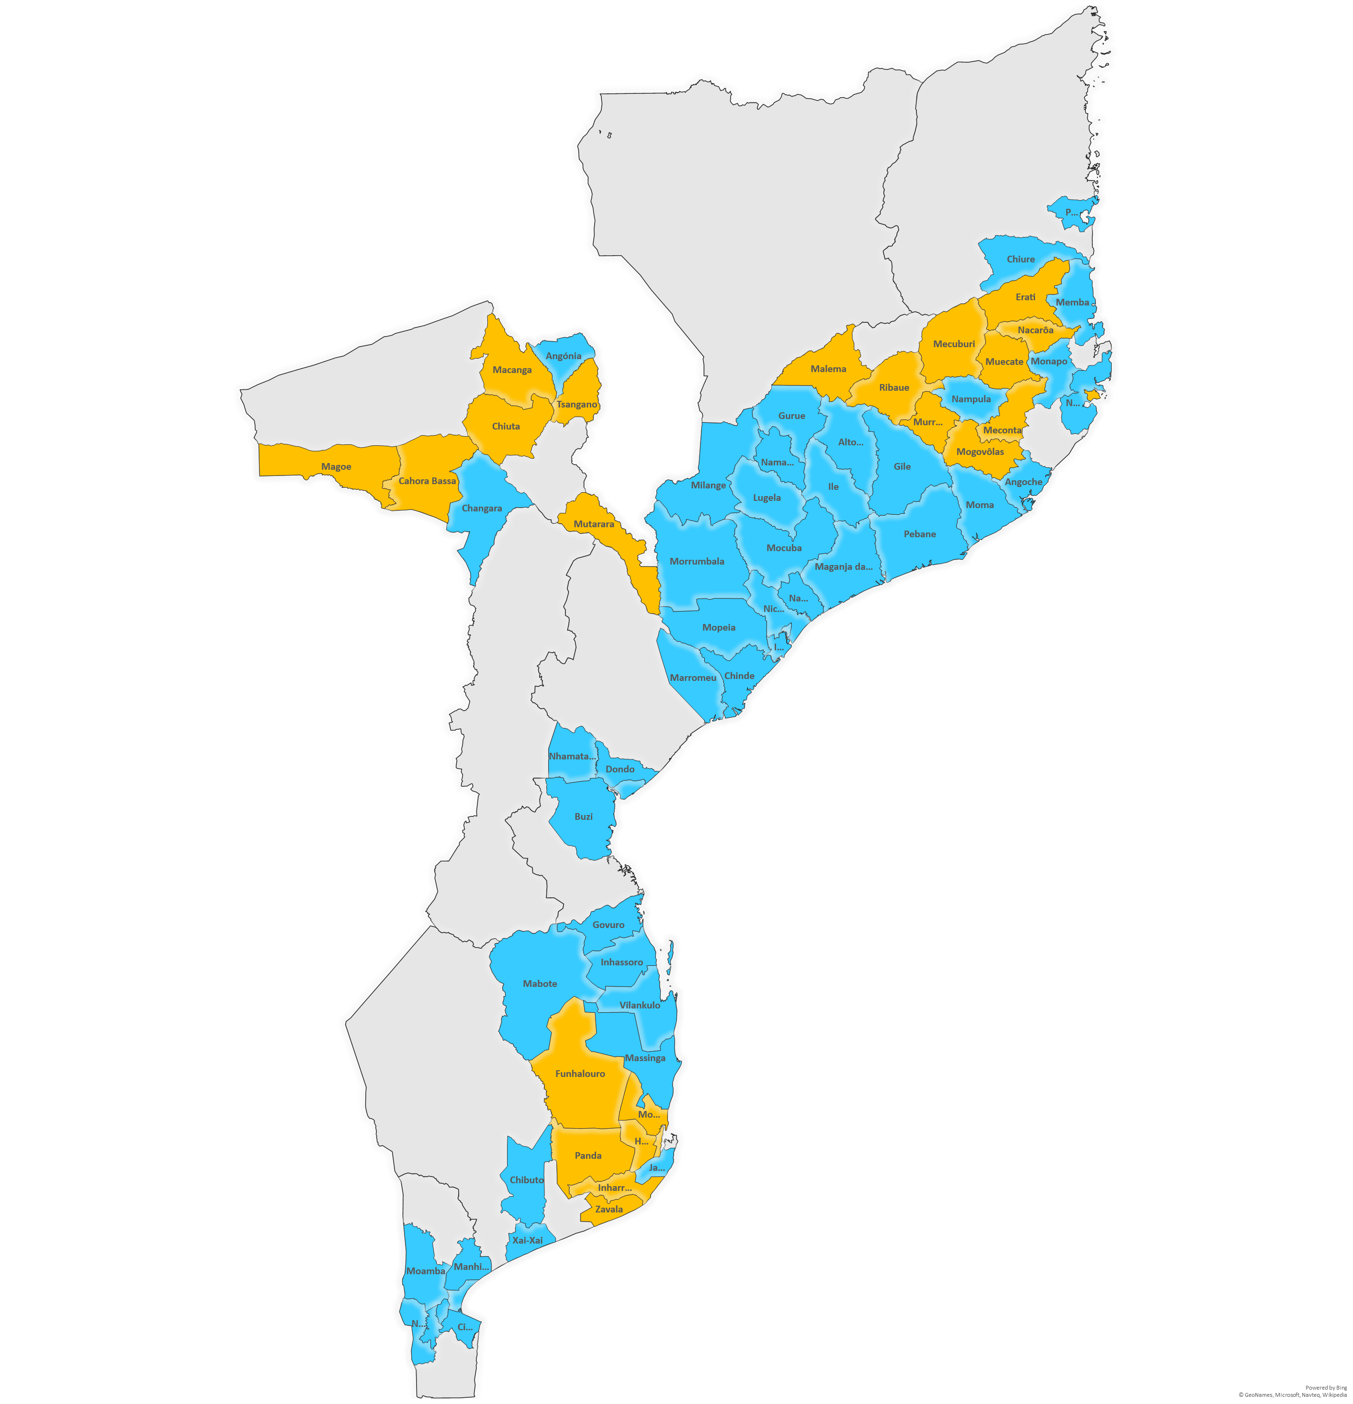
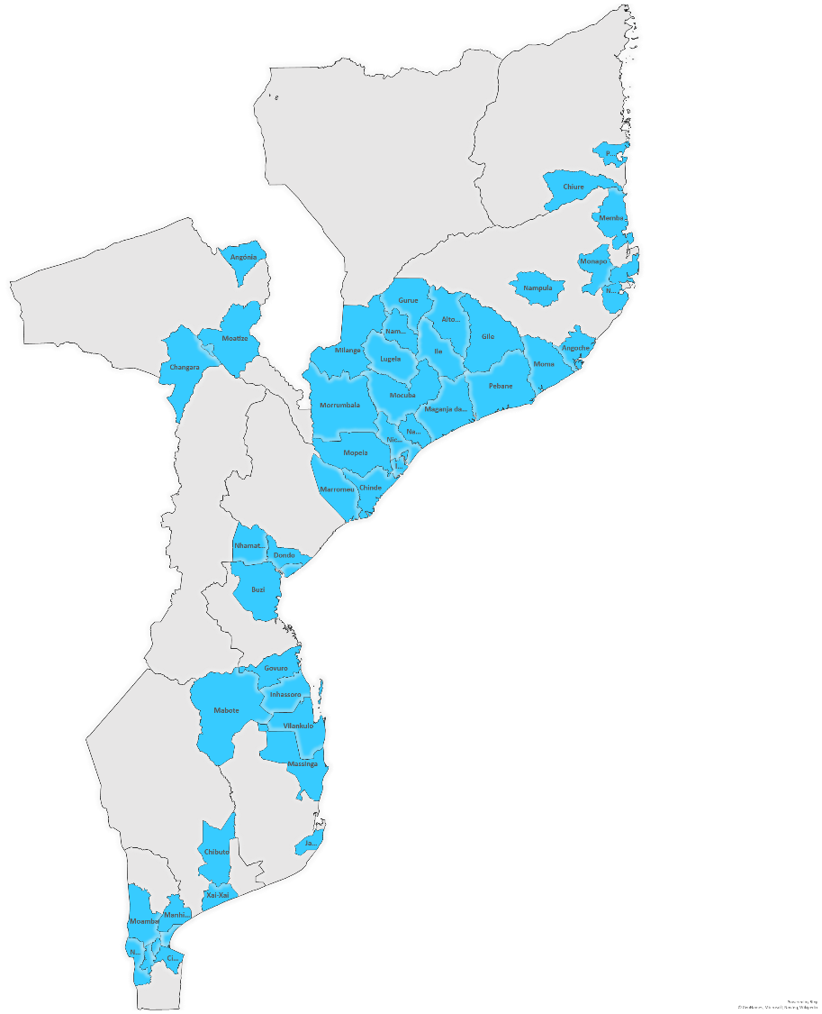
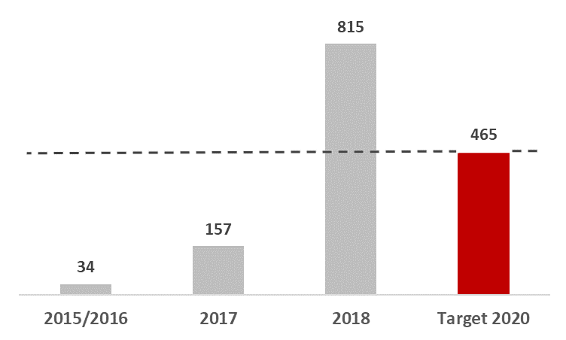
SIGLUS – Current Expansion
Operational
9 Provinces
54 Districts
675 HF (40% HF of Moz)
In the Implementation process
22 Districts
140 HF (53% HF of Moz)
HF with SIGLUS
High expansion of SIGLUS during 2018, exceeding the 30% of the HF with the system implemented by 2020 set as goal.
30%

Slide 10
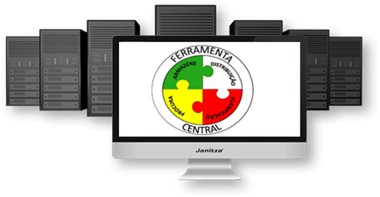
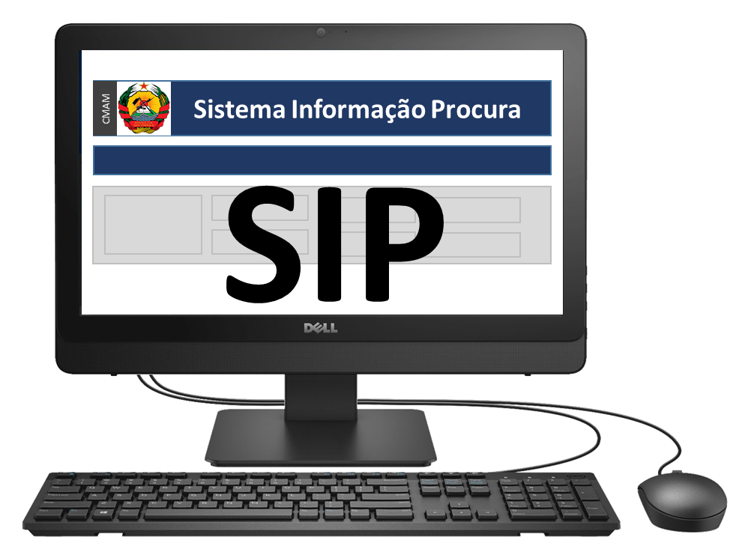
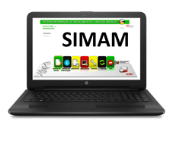
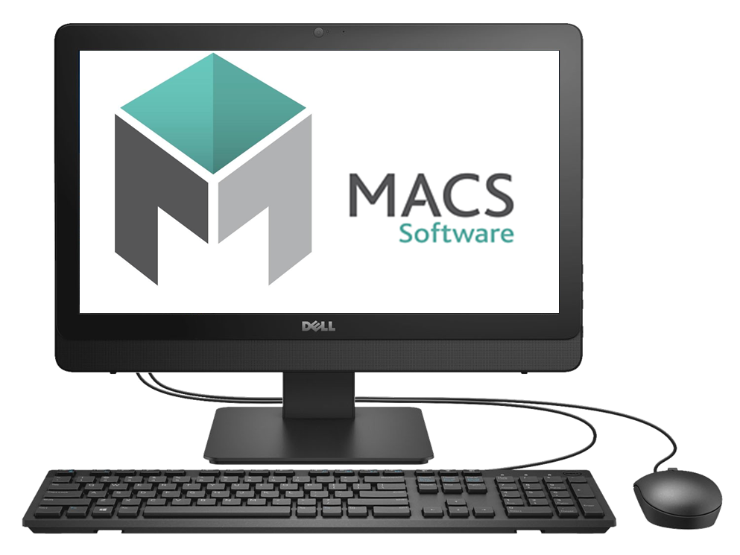
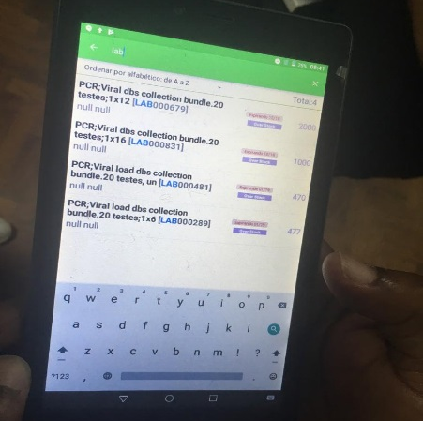
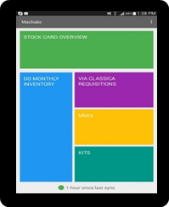
Mobile solution for end-to-end Visibility
8
Distribution Plan
Quantities to be delivery to provinces
Data Visibility
Managers has data visibility of the Provinces, Districts and HF
Master Data Mngt
Quantification
7
5
Procurement
6
Monthly Requisition
Provinces and Districts generates and send monthly or quarterly requisition
4
Warehousing
Daily movements
Quantity issued, quantity received, adjustments
1
cloud
3
2
Data visibility
Managers has real-time data of the HF on:
Stock on hand
Quantities issued
Quantities received
Adjustments
Quantities requested
Stock outs
Expiry dates
Monthly Requisition
HF generate and send monthly or quarterly requisitions including quantities requested

Slide 11
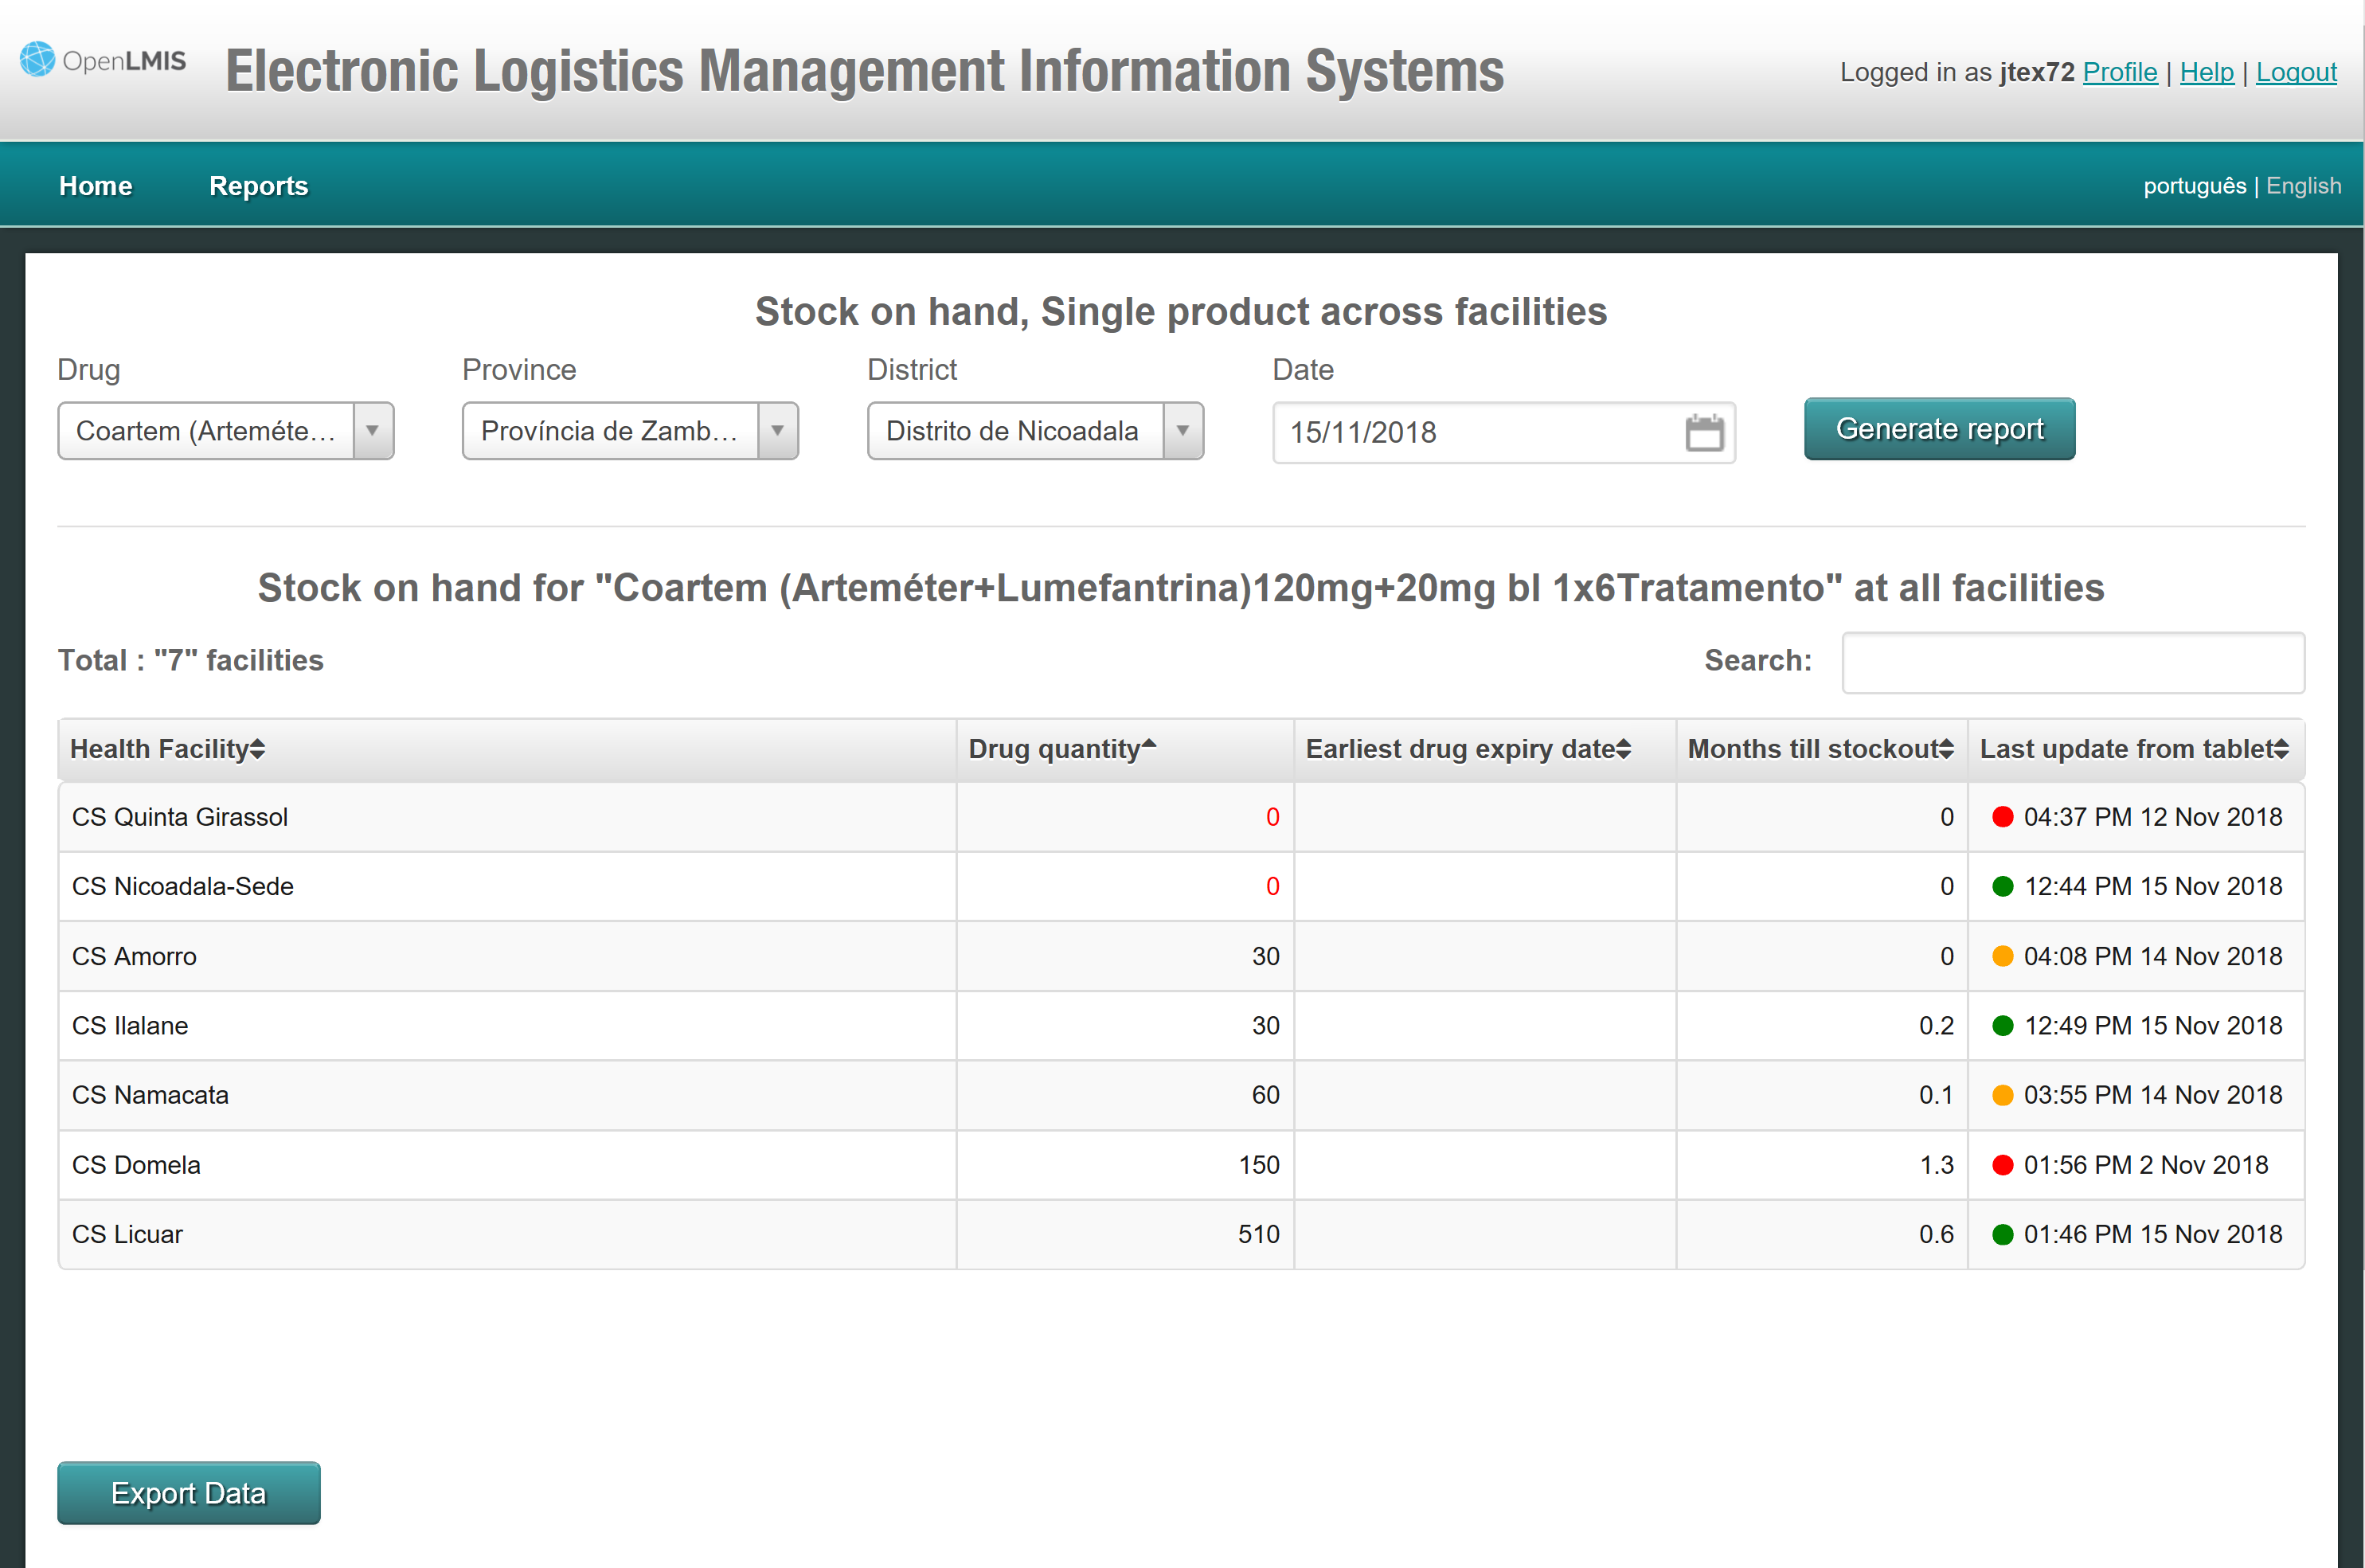
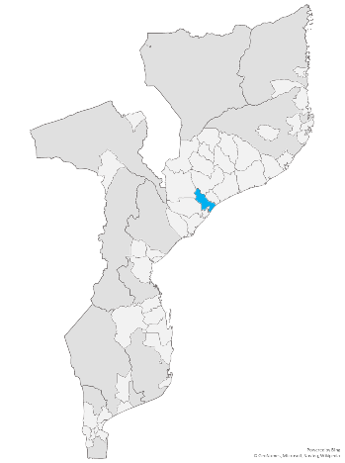
SIGLUS – Data for decision-making
Example Stock Availability in one District
AL 6x1 (ACT)
1 district (Nicoadala)
Zambézia Province
7 Health Units
Health Facility Name
Existing Stock
MoS
Updated
Malária
Excel for analysis
2 Health Facilities in Stock Out

Slide 12
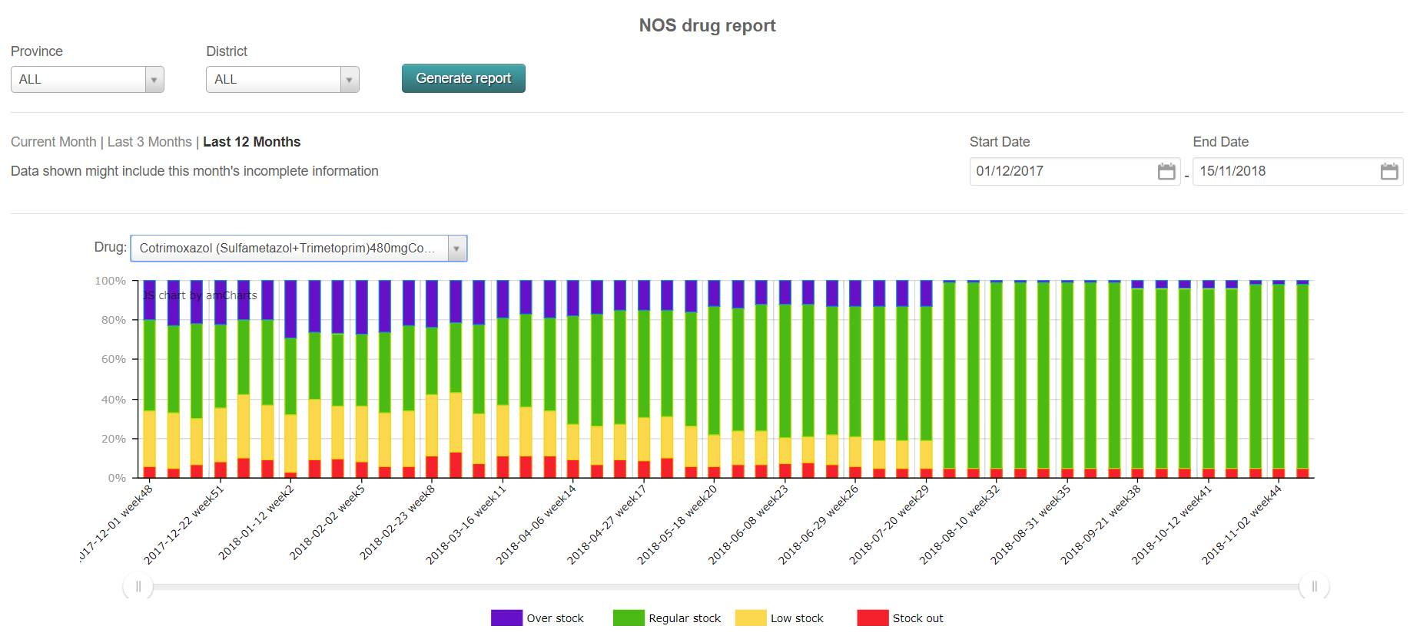
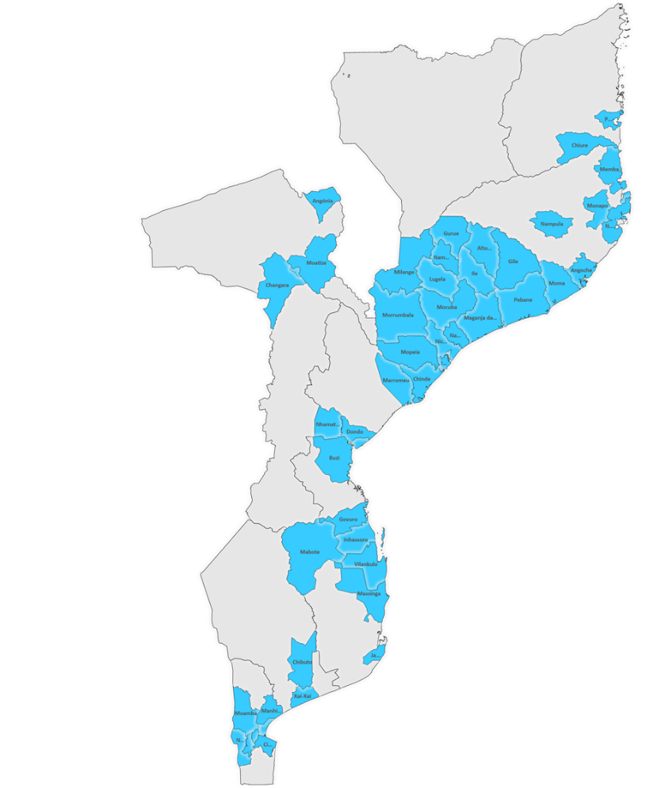
SIGLUS – Data for decision-making
Example Stock According to Plan Report
HIV
Cotrimoxazol 480mg Tablets
All country
Overstock
According to plan
Shortage
Stockout
Cotrimoxazol 480mg Tablets Stock According to Plan over time
HIV/AIDS
2018 Global Health Supply Chain Summit - Lusaka, Zambia

Slide 13
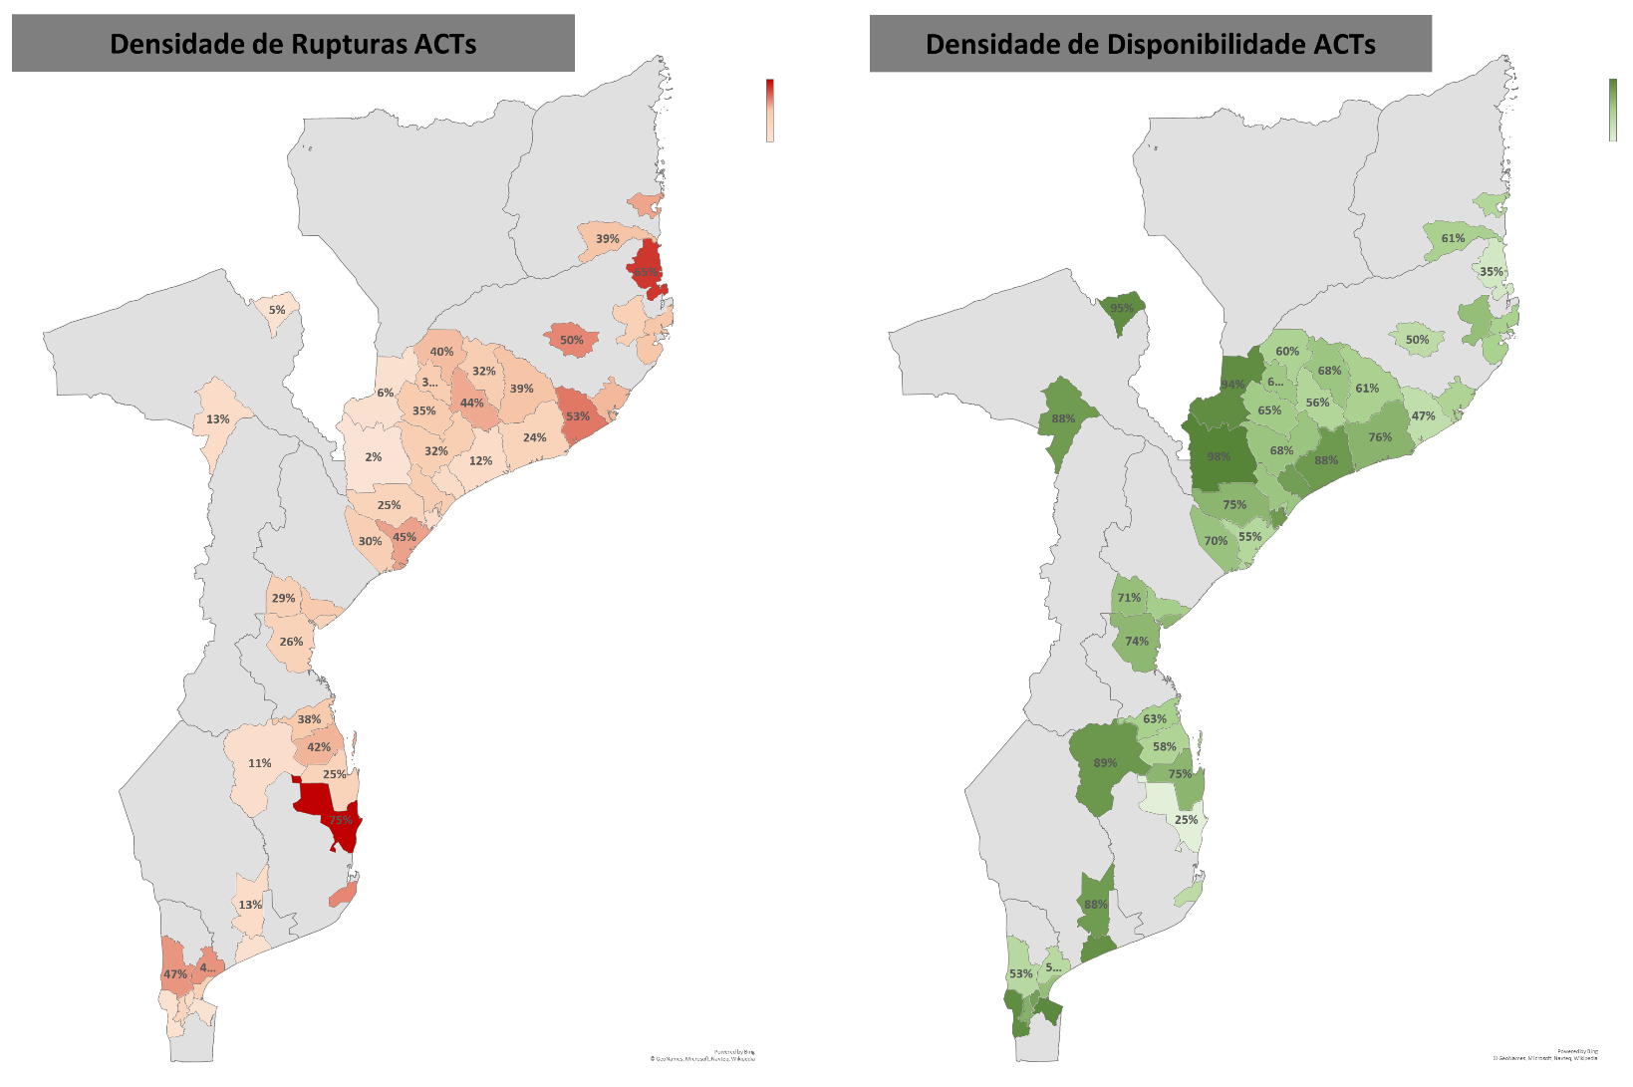
SIGLUS – Data for decision-making
Density of Stock Outs
Density of Stock Availability
One frequent question…
What is the Malaria Medicines Stock Situation?
Malária

Slide 14
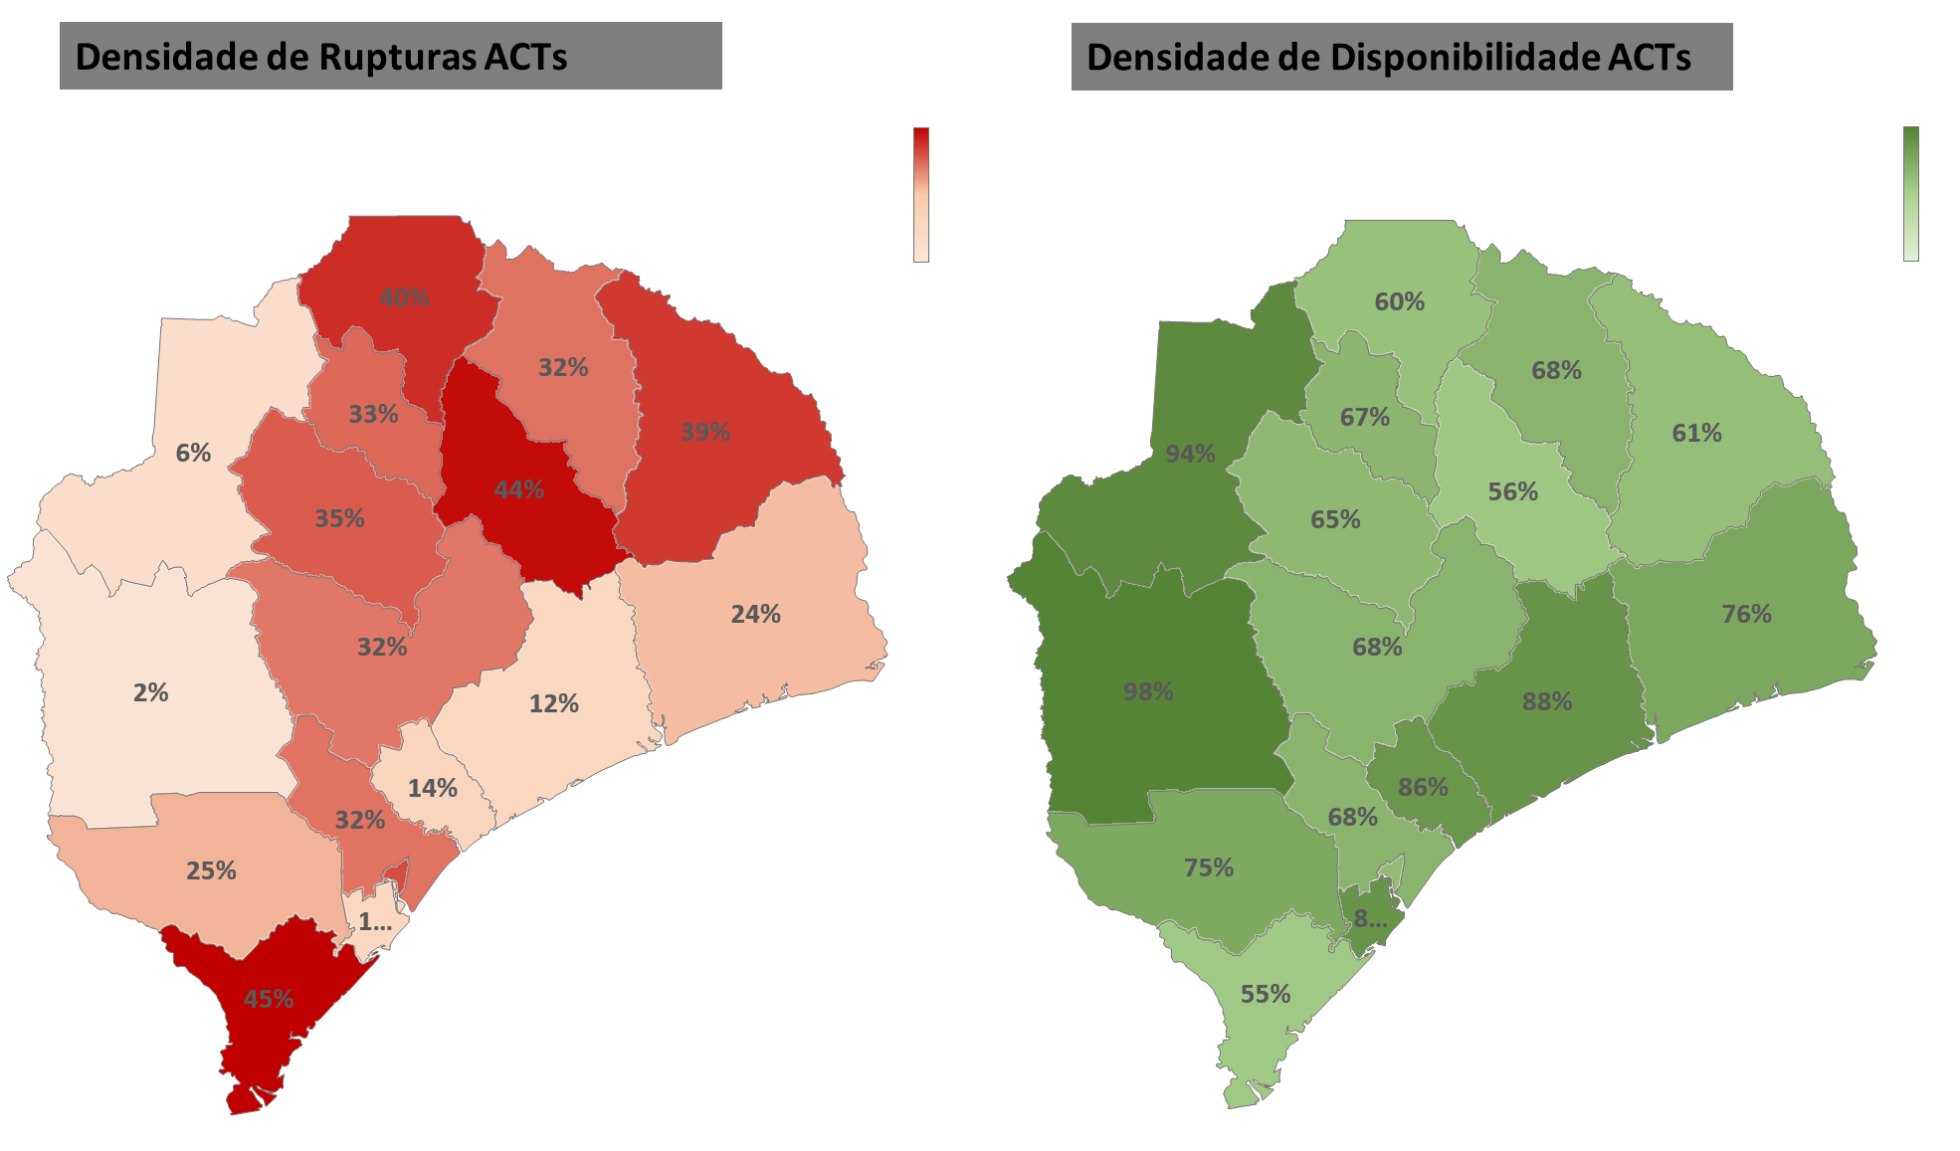
SIGLUS – Data for decision-making
Density of Stock Outs
Density of Stock Availability
One frequent question…
What is the Malaria Medicines Stock Situation?
Malária
Example Stock Availability in one Province
All ACTs
Zambézia Province
All Health Units
GIS data

Slide 15
SIGLUS – Data for decision-making
Development – deep analysis tools
Improved data visualization and early warnings
Comprehensive Dashboards
Use BI tools – over time analysis SIGLUS data
GIS
Integration and interoperability with other LMIS and HIS systems
Including reagents, laboratory and health consumables
Expanding to laboratory logistics
Impact indicators

Slide 16
SIGLUS – Data for decision-making
SIGLUS – The Web Portal
https://lmis.cmam.gov.mz/public/pages/login.html

Slide 17
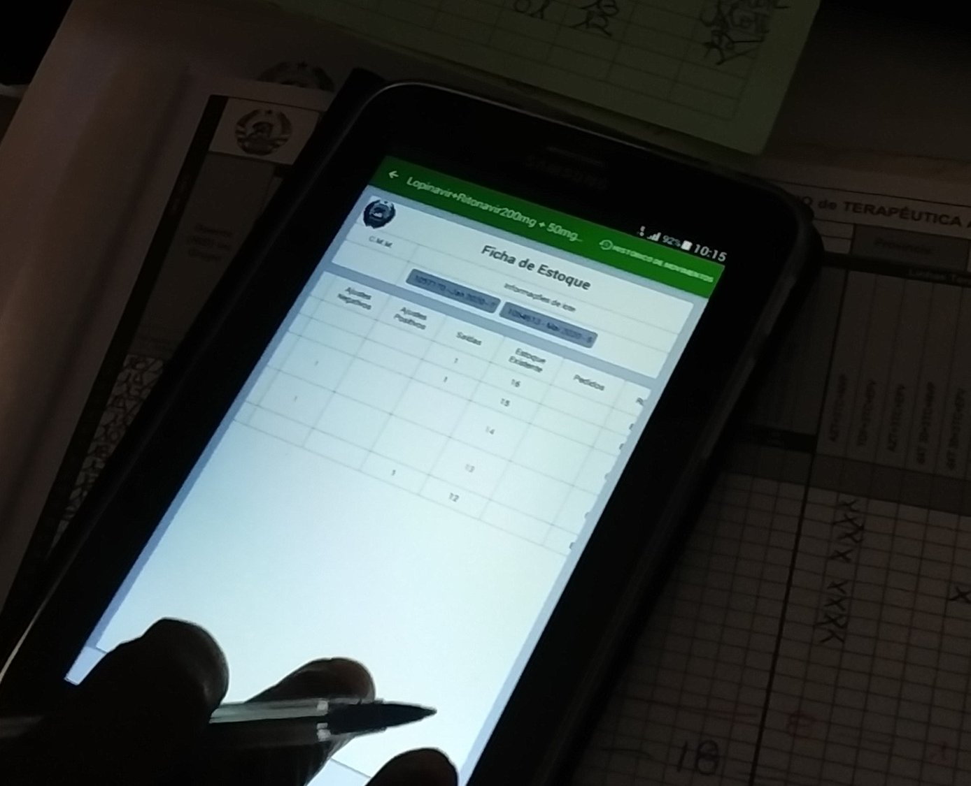
SIGLUS – Data for decision-making
Thank You!

Slide 18
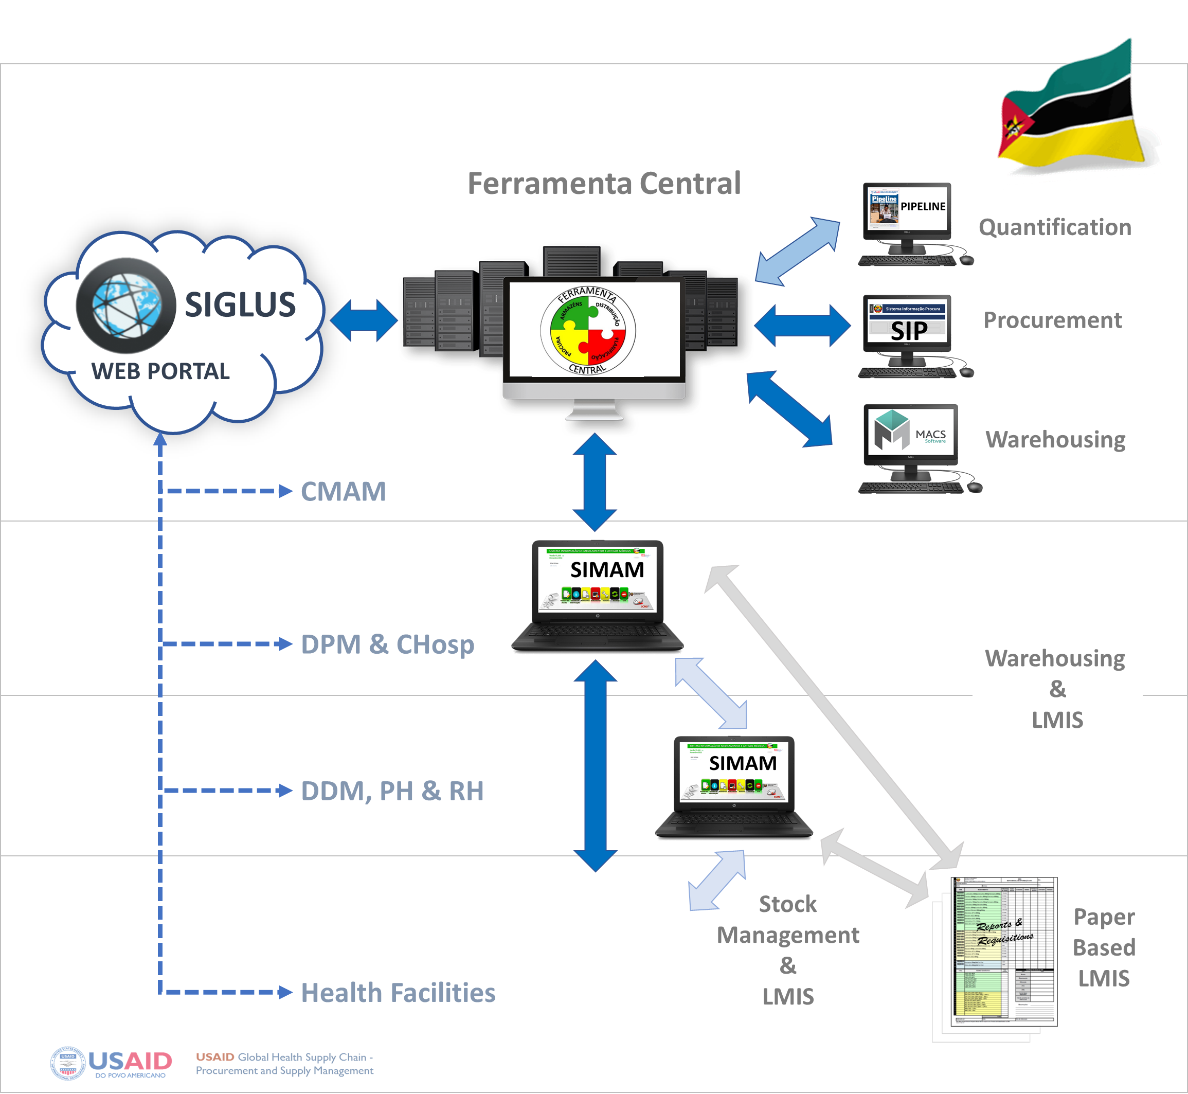
Mozambique - Logistic Management Information System

