Slide 1
BAO Systems & OpenLMIS
OpenLMIS Trusted Partner
Notes:
Hi! I’m Tamara Goldschmidt,
Global digital health and data company. We build data systems that empower our partners to make data-driven decisions to improve health outcomes.

Slide 2
Company Profile
Founded in 2012
Headquarters in Washington, D.C.
Projects in 60+ countries
80+ Clients
60 Staff in 5 regions
Europe
Africa
North America
Caribbean
Central America

Slide 3
What We Do Best
Scale
Interoperability
Data Use
Hosting
Architecture
Data Model
Implementation
Capacity Building
Governance
OpenHIE
Standards
Connectors*
Systems Integration**
Turnkey - OpenLMIS POC
DHIS2 Analytics
Feedback Loops
Data Visualization
Predictive Analytics
Analytics Platform
*Tableau, Power BI, Kobo,Ona, MS SQL
**Commcare, OpenMRS, OpenSRP, financial systems, LIS, cStock
Notes:
We’re best known for our DHIS2 work, but our services

Slide 4
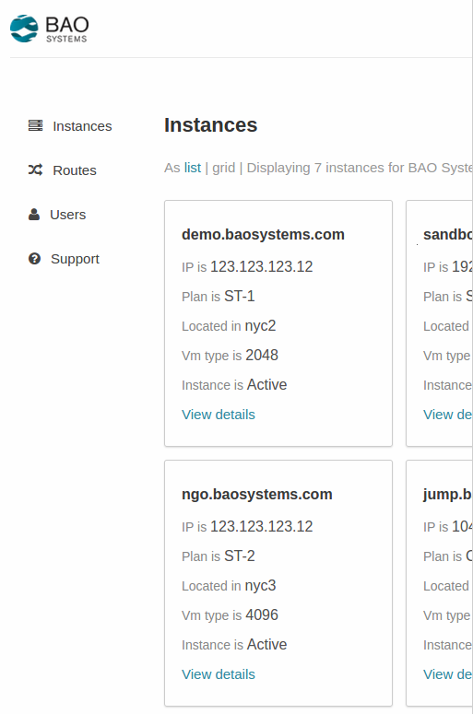
Hosting
Host 300+ Servers
Software as a Service
Built on Amazon Cloud
High availability, high performance
BAO Manager - Self-service system manager
Compliance and Security
HIPPA/FISMA/FIPS - 140
GDPR
Pay for what you use
Hosting Plans
Standard
Continuous Analytics
Notes:
We want to offer this for OpenLMIS

Slide 5
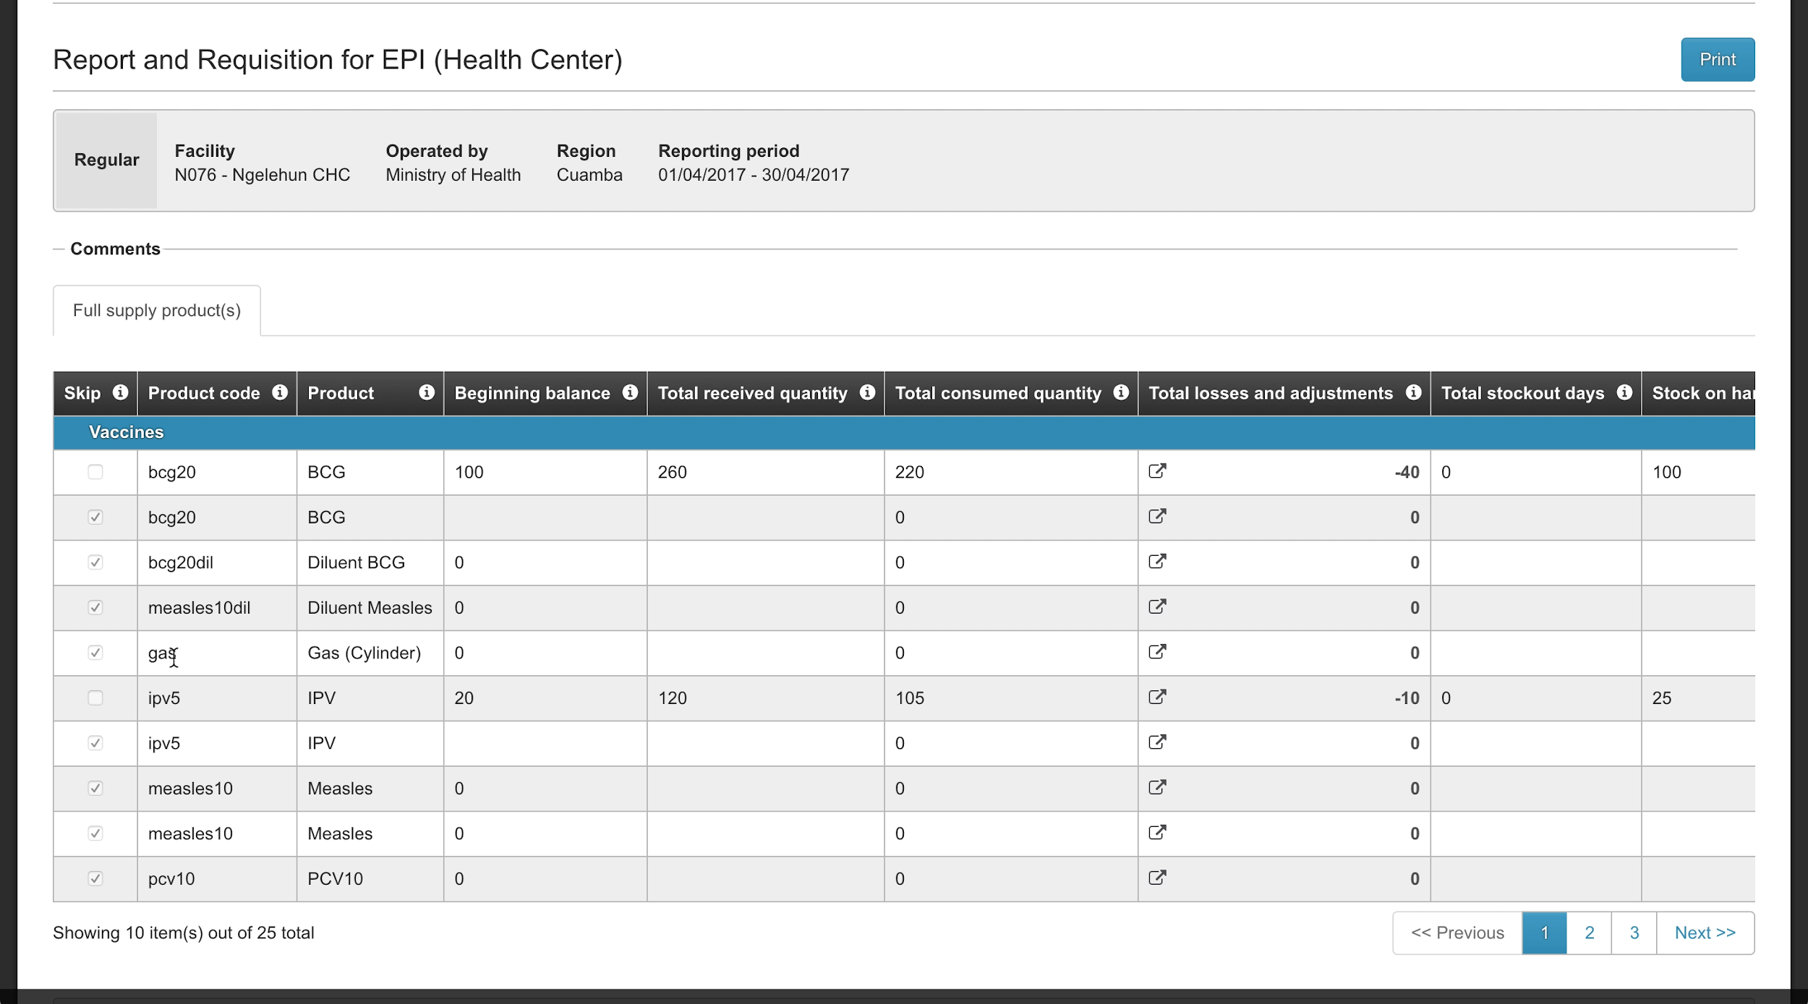
OpenLMIS - DHIS2 Turnkey Interop.
Submitting New Stock Cards

Slide 6
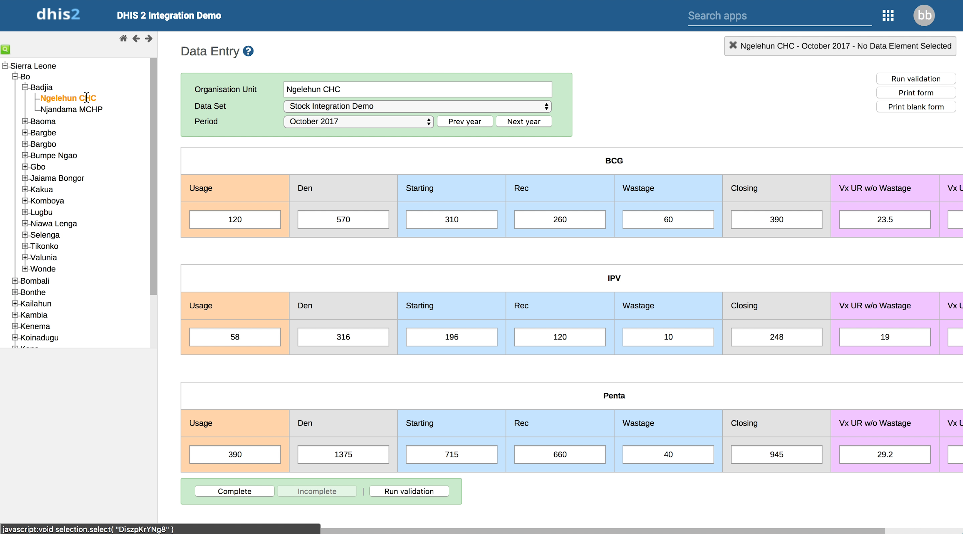
OpenLMIS - DHIS2 Turnkey Interop.
Submitting New Stock Cards

Slide 7
Other BAO Initiatives
DHIS 2 → Tableau Connector
DHIS 2 App Development (BIF, Custom Dashboards, etc.)
DHIS 2 Integration Driver
“Connectors” (Kobo, etc.)
DHIS 2 Annual Symposium
SDG Portal Concept
Trainings / Capacity Building

Slide 8
Our Clients

Slide 9
FOR MORE INFORMATION CONTACT:
Tamara Goldschmidt, Business Development Lead
tgoldschmidt@@baosystems.com

