Slide 1
The Impact of Standards-Based
Open Source LMIS for
Sustainable Supply Chain Management
Notes:
Speaker: Brandon
So, OpenLMIS. We believe in a world where all countries have the data they need to manage their health supply chains and lead to healthier communities.
We are a community initiative and a software platform working to make this vision a reality. AND IT ALL STARTED WITH PATH IN 2008.
-------
CUT:
I’d like to start off with a quick high-level refresher on what OpenLMIS is before outlining the new features in the upcoming release.
OpenLMIS -- it is both an initiative and a software platform. The software allows countries to track products within their health supply chains across all major health programs, from essential medicines, malaria, TB, and family planning products, to vaccines, diluents, and syringes.

Slide 2
The goal
Today, I hope that you leave with a better understanding of:
What OpenLMIS is and what is in the latest release
Where OpenLMIS fits into a country’s information system landscape and where it can provide value
Ways to engage with the OpenLMIS Community and learn more about potential implementation
If I don’t meet this goal or if you’d just like to learn more, please get in touch after the presentation
Notes:
Speaker: Tenly
So what is our goal for this discussion today? We would like to ensure that you leave today with a better understanding of:
1, 2, 3
If we haven’t met that goal, or if you’d just like to talk, come see us after the session where Brandon will also be demoing some of the key features and integrations we mention today. We’ll also be at the happy hour following the session as well if you’d like to connect then.

Slide 3
Presenter & Topics
<INSERT PHOTO>
<Insert Name>
<Insert Title>
<Insert description of responsibility and reasons to be contacted>
Topics
Community
Vision
Features
Impact
Standards
Getting involved

Slide 4
Community
Notes:
Brandon
At the health facility level, we hear how supply data does not always match up with reported demand or coverage numbers. Which data should we trust?
-----CUT:
This quote here highlights what all of you in the room deal with on a regular basis -- coverage rates over a 100% and yet a deeper look at the data shows that there were stock outs.

Slide 5
OpenLMIS Initiative
Donors
Implementers
Technology Partners
Notes:
Speaker: Brandon
Today, the OpenLMIS initiative has many members. But in 2008, it all started when PATH co-lead a collaborative process to define requirements and develop a global standard for logistics systems.
A decade later, OpenLMIS is now this diverse community of 20+ partners bringing expertise from technology to data analytics and quality software development, to on-the-ground implementers, and a global network of engaged donors.
And the impact has been astounding...
------
CUT:
OpenLMIS is an initiative. It started in 2008 as a collaborative process between four organizations, which included PATH, looking to develop a set of common, globally applicable requirements for logistics management systems.
Today, this diverse community comprising 20 partners brings expertise from technology partners specializing in data analytics and quality software development, on-the-ground implementers, to a global network of engaged donors.

Slide 6
Leadership for the community.
defines community processes
leads fundraising and advocacy efforts
Members: Senior representatives of Trusted Community Partners
Helps “build the right product.”
discuss roadmap requirements and new features
reviews contributions from implementations
Members: Community partners with technical experience
Builds the product the “right way.”
manages the system architecture
sets clear standards for code quality
Members: Software developers and active OpenLMIS developers
OpenLMIS Trusted Partners have experience implementing OpenLMIS and other Health Information Systems (HIS) tools.
These partners are available to support OpenLMIS implementations in a variety of ways.

Slide 7
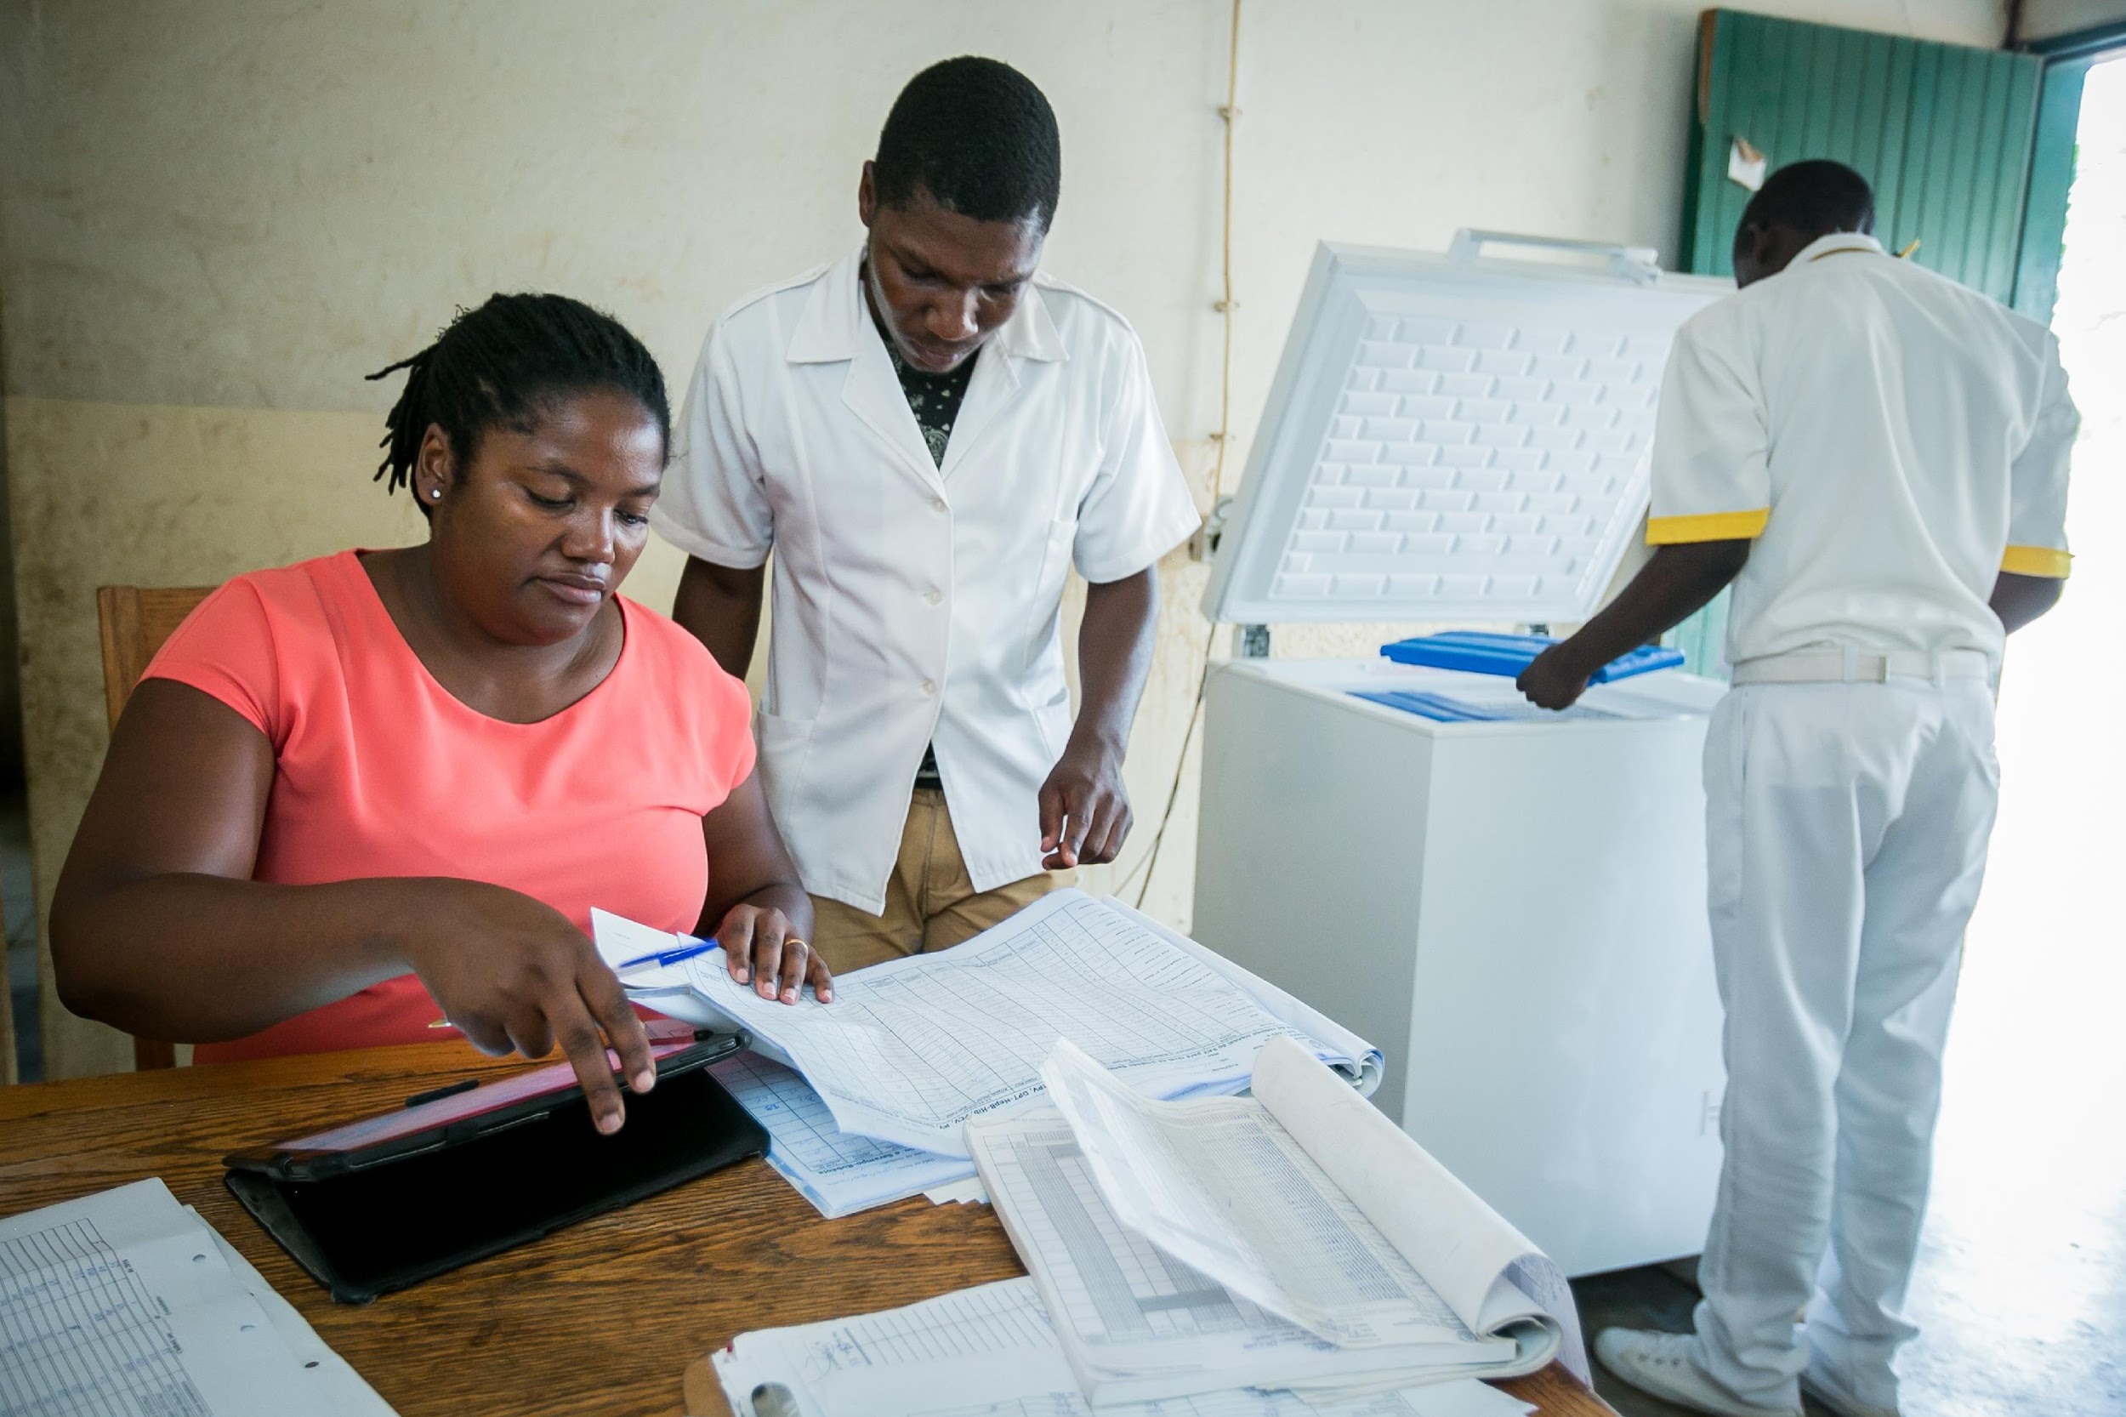
Vision
Notes:
Brandon
And Managers, both at National and Provincial levels, have only aggregate, delayed data with no ability to drill in to what is happening or get quick insights. My hands are tied until I can know more.
-----CUT
Every single EPI Manager --both at the central and provincial levels -- talked to us about their unique role in the EPI hierarchy. They are constantly putting out fires and much of their time is focused on responding to pressures from above them – senior Ministry officials, cabinet members, donors – and in turn, they put pressure on those below them. And at all times, the data that they rely on is quite simply aggregate numbers. They have no way of looking at a national or provincial aggregated indicator on stock availability or cold chain performance or coverage and knowing, “ah, this is the issue!”. Nor can the people that provide them these figures help – because they’re getting a series of static numbers on a piece of paper form themselves. The view and the out-size role that is played by individuals storage sites or health facilities is completely lost when one works in the world of aggregates. And so much of public health supply chain is just lost in the world of aggregates.

Slide 8
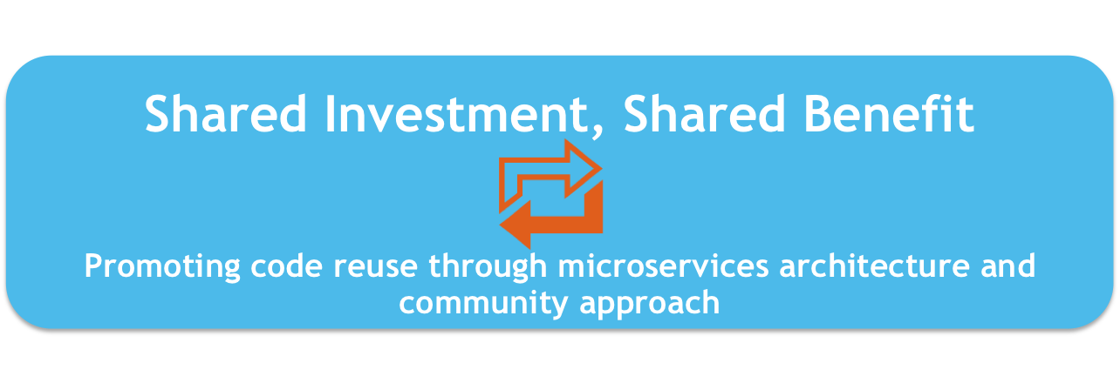
The OpenLMIS Software Vision
Notes:
Speaker: Brandon
Our philosophy is what sets us apart.
OpenLMIS is Open Source software that uses a shared investment and shared benefit model. This means new features built into the system, either by a global donor or specific country, can be leveraged across implementers with its open source reusable micro-service codebase.
We strive for interoperability using standards because we know each country has specific needs and will leverage more than one system. We believe interoperability between all those systems is the best way to achieve visibility and to meet the needs of whole health ecosystem.
And we drive to provide a highly configurable system and an extensible codebase. Any country implementation can extend and change features to address the in-country context. OpenLMIS aims to meet countries where they are at in their supply chain maturity and grow with them as they professionalize and standardise.
Our community of developers delivering this software are rooted in a collaborative and supportive culture of excellence and transparency.
….Vidya will tell us more

Slide 9
Features
Notes:
Brandon
At intermediate levels of the supply chain, logisticians tell us their challenges of seeing relevant data, like fridge status, when making key decisions. I don’t know for sure.
------CUT
...as we just saw briefly in the last demo, when you are about to send stock - there is a lot of things the officer wants to be aware of in making the decision about how many vaccines to send. Cold chain equipment functionality status and active alerts. We are going to specifically zoom in on CCE.

Slide 10
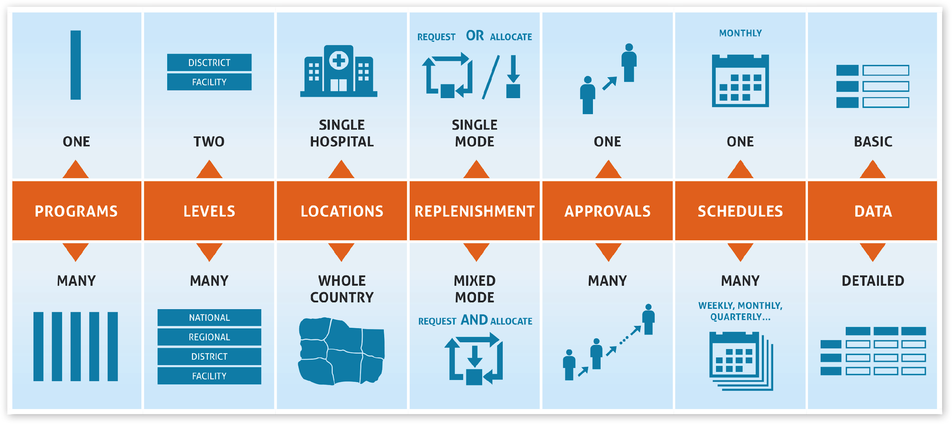
Configurability
Notes:
Speaker: Vidya
Configurability is a key tenant of the OpenLMIS vision
because we want to meet countries where they are at in their supply chain maturity.
Configurability means the implementer can easily, through the UI and uploads, configure the system without any extensive software code modifications.
Let’s say Tenly is a national warehouse manager overseeing ARV product distribution and Brandon is a district-level officer managing the vaccine depot and supply to 10 health facilities.
When they each log in to OpenLMIS, they will see different product lists, approval processes, calendar schedules, and location sites. You can have OpenLMIS support just one level of the health system or multiple, push or pull or mixed method supply practices, have specific supervisory approval rules depending on the level and the program, and have all of the data that is recorded in the system be auditable with a date and user stamp if needed.
----CUT----
For example…..
Program: A country can run Essential Meds and Immunizations without an issue. Each program will have different product lists, approvals, schedules and locations!
Level: Does the country have 3, 4, 5 different hierarchies? No problem.
Locations: Do you want OpenLMIS to support only district? Or maybe some districts and states? Or the whole health system, no issue.
Replenishment: Do you want to send stock to a facility? OpenLMIS supports that. Do you want to request stock from a facility, that’s supported too.
Approvals: multiple level or no approvals of requests for new stock.
Schedules: are flexible and easily changed.
------------------------
Not only does the OpenLMIS software offer a robust set of features to manage your stock from the National store to the Facility level, but it is highly configurable to support

Slide 11
Version 3 Key Features
Modular, API-driven approach emphasizes extensibility and ease-of-customization
Request new stock based on consumption or estimated need
Quality, real-time, data on stock availability for supply chain managers
Cold chain inventory and vaccine stock management, vaccine logistics data
Open source, big data warehouse and analytics infrastructure with visualizations

Slide 12
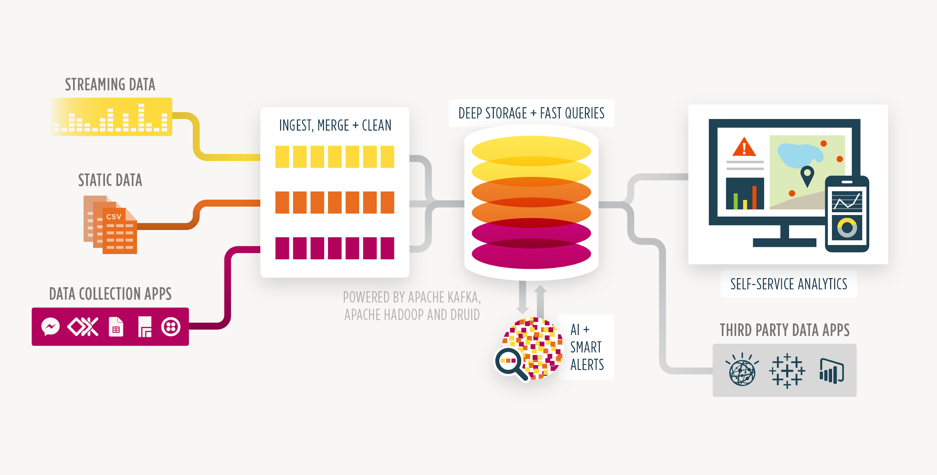
Analytics Infrastructure
Capture
Process
Organize
Visualize
Notes:
Speaker: Vidya
End-to-end supply chain visibility is a desire that a lot of our country stakeholders have expressed, but they often follow that up by saying, we don’t know if that’s really possible in our health systems.
We disagree. We don’t think that end-to-end visibility is just for large private sector supply chains.
To make this happen, and provide risk management across systems OpenLMIS has invested in an open-source “analytics infrastructure” that can support three key things:
high-volume transactional data capture (that means it can support anything from data uploaded monthly or other points in time to transactions that come in every minute),
In-depth data review to conduct root cause analysis across systems, including filters and drill-down disaggregation of interesting data points and
Routine, easy to use, reports and default dashboards and visualization
This infrastructure is a superb foundation for using machine learning and advanced algorithms once enough data is captured.
So the main takeaway from the slide here is that with our analytics infrastructure you can capture data from multiple sources, such as DHIS2, electronic medical records, OpenLMIS, take all that data in by processing it, merge duplicate data points, clean it up, and then organize it in a way that allows for fast queries within a large, integrated database, and finally -- the end view that most of us as users are most interested in -- visualize it either in OpenLMIS or another dashboard application that a country is already comfortable with and has spent time and money in making sure people know how to use it.
----------END
The infrastructure is setup to follow the key needs of data management:
Capture data from multiple sources (includes OpenLMIS)
Process and clean up data
Organize data to optimize performance and quick queries
Easy to use open-source visualizations or use any third party tool already in place in the country
To give you a view introduction to what is possible, we’ll use the framework introduced earlier to demonstrate how to look at the data, specifically focusing in on CVW and FSA DISC indicators…
*notes* The point here is to show that OpenLMIS community has invested in a solid, first class data processing, ingestion and warehousing to support the professionalization of supply chain and increasing amounts of data. This infrastructure can support machine learning

Slide 13
Integrations
Connects dispensing and supply information at the point of care
Proof-of-concept built with Ona
First time RTM data is directly available within the OpenLMIS core platform
Leverages the FHIR standard for exchanging information on facilities and devices
Supports offline health records for all registered clients
Manages stock and is able to match the client to commodity disbursement
Notifies users about outages in cold chain equipment
Within OpenLMIS, logisticiens can review CCE status when planning resupply

Slide 14
Impact
Notes:
Speaker: Brandon
So we have described who the OpenLMIS community is and a brief overview of the software itself.
I want to give you a picture of the people we support and unveil our new advancements that are addressing some long-standing challenges.
-----CUT
Next Vidya is here to tell us about the latest advancements.

Slide 15
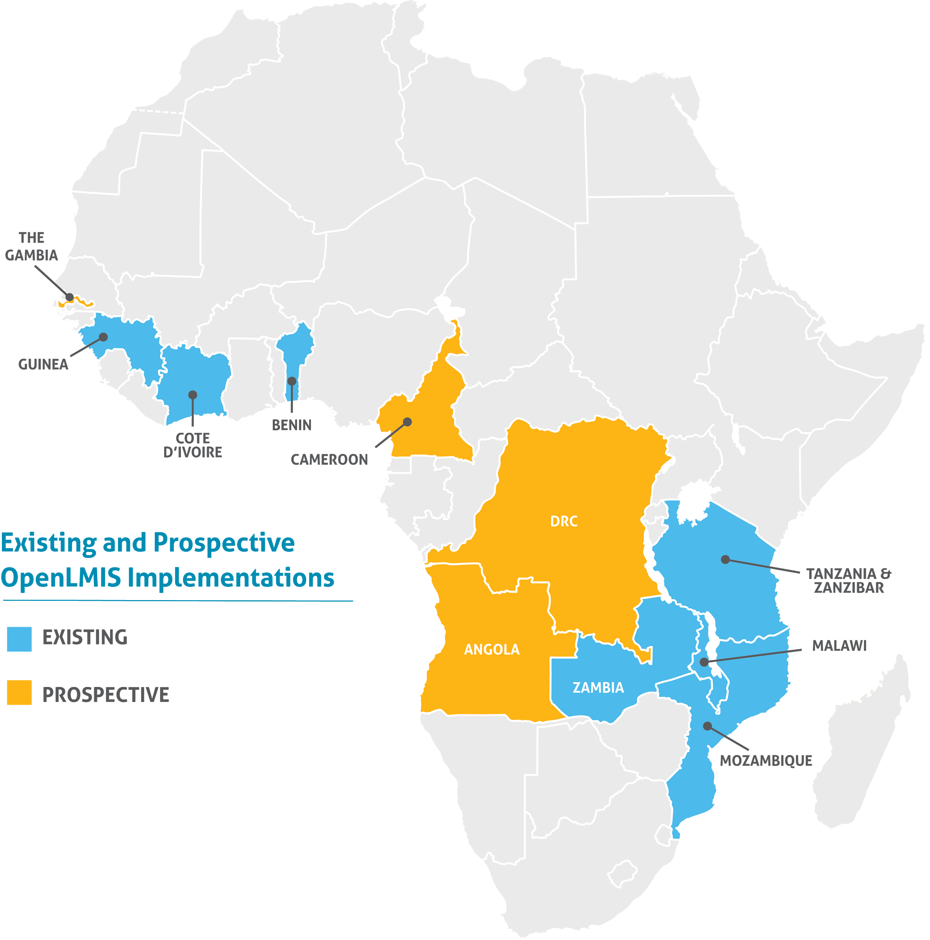
Through 9 implementations
OpenLMIS manages logistics processes for over 11,000 health facilities across Africa
Increasing data visibility and timeliness
Reducing
stockout frequency and duration
Notes:
Speaker: Brandon
OpenLMIS software is now used in multiple countries, each with a local partner who has implemented a specific version…
If you have heard of VIMS in Tanzania, eLMIS in Zambia, SELV in Mozambique, or eSIGL in Cote d’Ivoire, you have heard of some of the country implementations of OpenLMIS.
These systems are used for both vaccine and non-vaccine supply chains to manage logistics processes for over 10,000 health facilities across Africa, with more on the way.
------
CUT:
We focus on meeting countries where they are currently at in their supply chain maturity while making the case to shift toward automation and best practices. This month, we’re excited to be releasing version 3.3, the latest version of the software, which will have brand new vaccine functionality.

Slide 16
OpenLMIS makes it easier for me to elaborate reports at the end of each distribution.
Mumino Amisse, Provincial EPI Manager (Cabo Delgado)
Notes:
Mary Jo:
We have heard about the challenges of seeing relevant data when making key decisions, as we just saw briefly in the last demo, when you are about to send stock - there is a lot of things the officer wants to be aware of in making the decision about how many vaccines to send. Cold chain equipment functionality status and active alerts. We are going to specifically zoom in on CCE.

Slide 17
With OpenLMIS we have an accurate view of actual consumption. Before, it was hard to know what we actually needed. Having access to this data has helped to reduce stockouts and also address the issue of overstocking.”
Provincial Medical Chief, Mozambique (Bertur Alface)
Notes:
Mary Jo
We’ve heard about how supply data does not always match up with reported demand or coverage numbers. This quote here highlights what all of you in the room deal with on a regular basis -- coverage rates over a 100% and yet a deeper look at the data shows that there were stock outs.

Slide 18
How countries have performed with OpenLMIS
 | Without OpenLMIS | With OpenLMIS
Time taken to perform order calculations | 3 hours | 1 minute
Stockout rates | 19% | 5%
Source: User Satisfaction Survey, Mozambique, 2014
Notes:
By standardising ordering and increasing visibility into stock levels, it can reduce stock outs.

Slide 19
Standards

Slide 20
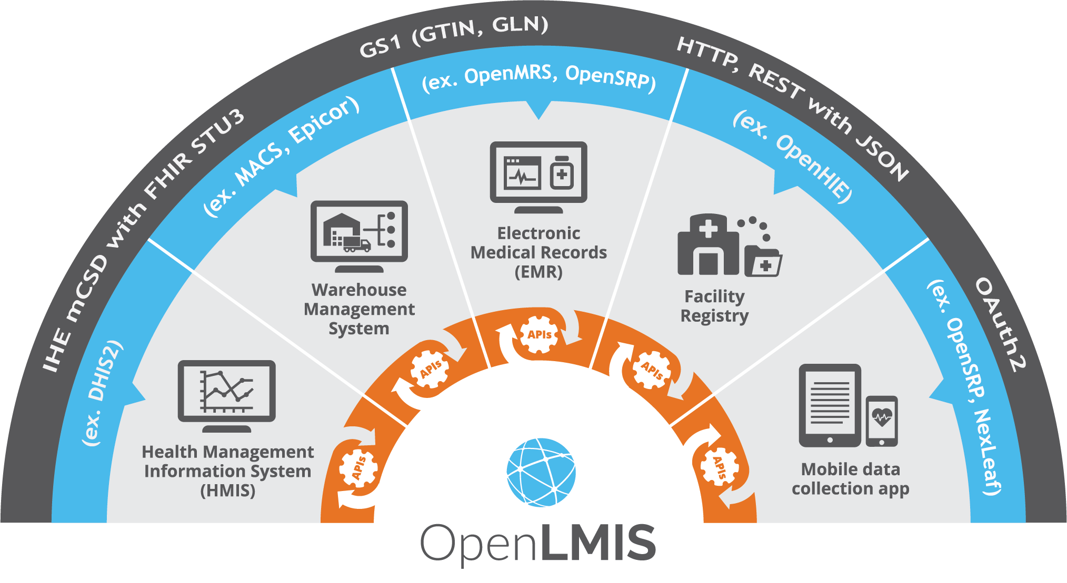
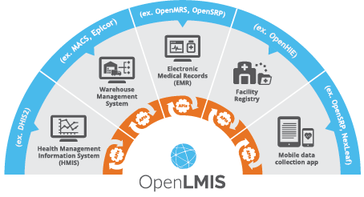
Standards based interoperability
Notes:
Speaker: Brandon
The other key innovation is our progress on interoperability using global standards.
We believe in a world where appropriate systems are used throughout the ecosystem to deliver health commodities and services at the last mile. We believe end-to-end visibility is crucial and achieved through standards based interoperability. Let me tell you what I mean.
------CUT
If there is one slide we hope you remember today, it is this. There is a lot here, but this is the key message: We believe in a world where many systems interoperate to deliver better health care. The different systems and standards in this picture show how we are making interoperability a reality.
End-to-end visibility is most efficiently achieved by interoperating with other systems using industry, best practice, standards.
For example, GS1 standard of a Global Trade Item Number which identifies the exact item so all systems refer to it the same way.
With standard based interoperability, countries can determine which systems are best for which function without giving up the ability to push and pull data across all systems for critical decision making. We have already done, either a country specific integration or global proof of concept, with: DHIS2, a national warehouse management systems (ERPs), a Remote Temperature monitoring platform, and multiple mobile applications…
----------------------------END
Mary Jo: Our vision for Interoperability is rooted in standards. Standards for identifying something with shared definitions, standards for sharing and transmitting data with agreed upon protocols, and standards for capturing data with clear guidance on how information is organized.
Supply Chains are complex, and OpenLMIS, nor any one IT system will ever manage it effectively end-to-end. OpenLMIS has a deep well of functionality to help you manage your logistics, however interoperability through best-practice standards is at the heart of what will make OpenLMIS a part of supply chain best-practice.
Our approach to integration is to define interfaces, based in best practices and industry accepted standards, using well documented Restful APIs so that we can be product and system agnostic. Today we demonstrated two examples of those integrations, one with an EMR/mobile case management tool, OpenSRP, and an RTM platform, Nexleaf. The blue band highlights other example systems which would make sense to integrate with.
The grey band highlights some examples of standards we use. We encourage and advocate for all systems to prioritize using standards, like the GS1 standard of Global Trade Item Number (aka GTIN) so that all systems know exactly what physical item/product/commodity/thing is being referred to. We cannot underscore or emphasis enough how standards can reduce friction, duplication and manual processes of updating multiple systems to refer to the same facility or the same product.
Standards
Product Registry: GS1 (GTIN, GLN)
Facility Registry: IHE mCSD w/ FHIR STU3 (Location), GS1 (GLN)
Equipment Registry: FHIR STU3 Device (inventory location)
Supply Chain transactions and events: GS1 EDI and EPCIS
Barcoding: Code 128 and DataMatrix
Web and Tech: HTTP, REST w/JSON, WebSub and ATOM, OAuth2, etc
Within a supply chain(s):
Metadata alignment, e.g. Identify trade items (GTIN), locations (FHIR and GLN), shipments (SSCC).
Capture devices reading identifiers in barcodes (Code-128 and Datamatrix) - on items, shipments, locations
EDI Transactions such as Order, ASN, Receive Advice (XML)
Web protocols & standards: SSO, leverage HTTP, WebSub to bring ATOM further.

Slide 21
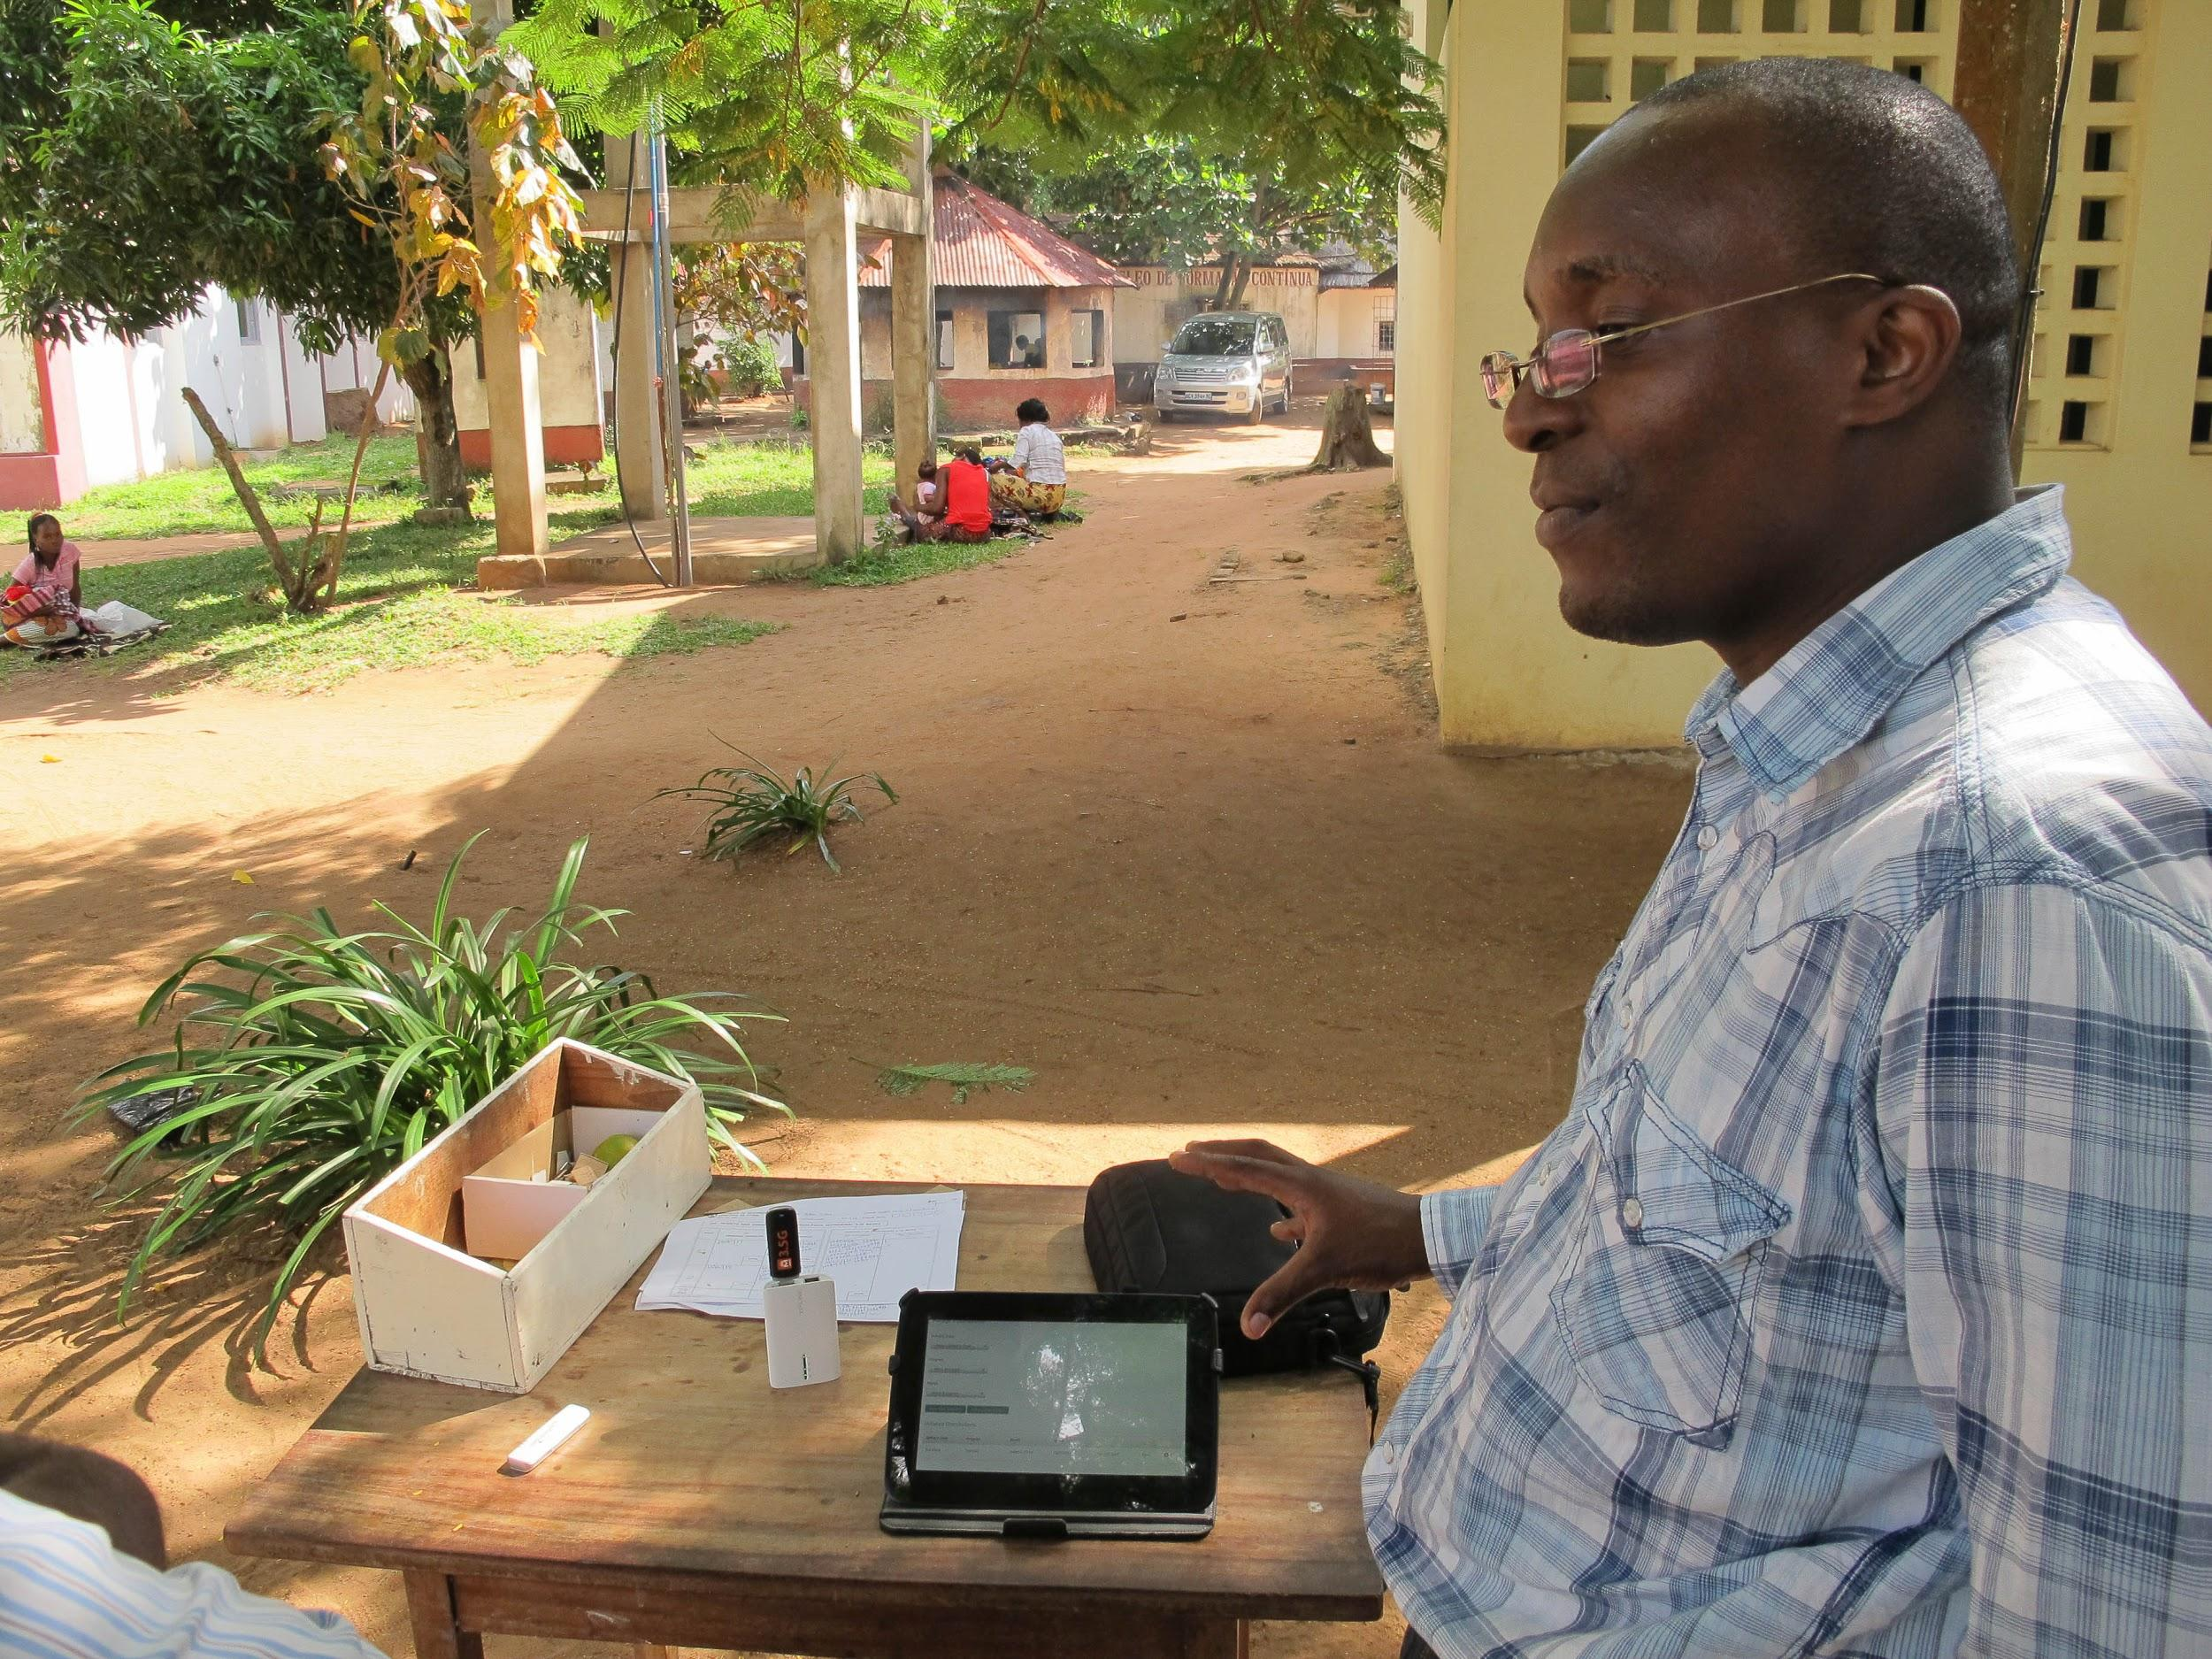
Getting
Involved

Slide 22
New Support Materials
Notes:
Speaker: Tenly
With the 3.3 release, The OpenLMIS community is also releasing the first iteration of the Implement Toolkit which has resources for countries to both contribute to and reference when thinking about or planning to implement an electronic LMIS. OpenLMIS has a consortium of partners like Ona, PATH, JSI, VillageReach, CHAI, BAO systems, and more, who can support implementations in a variety of countries.

Slide 23
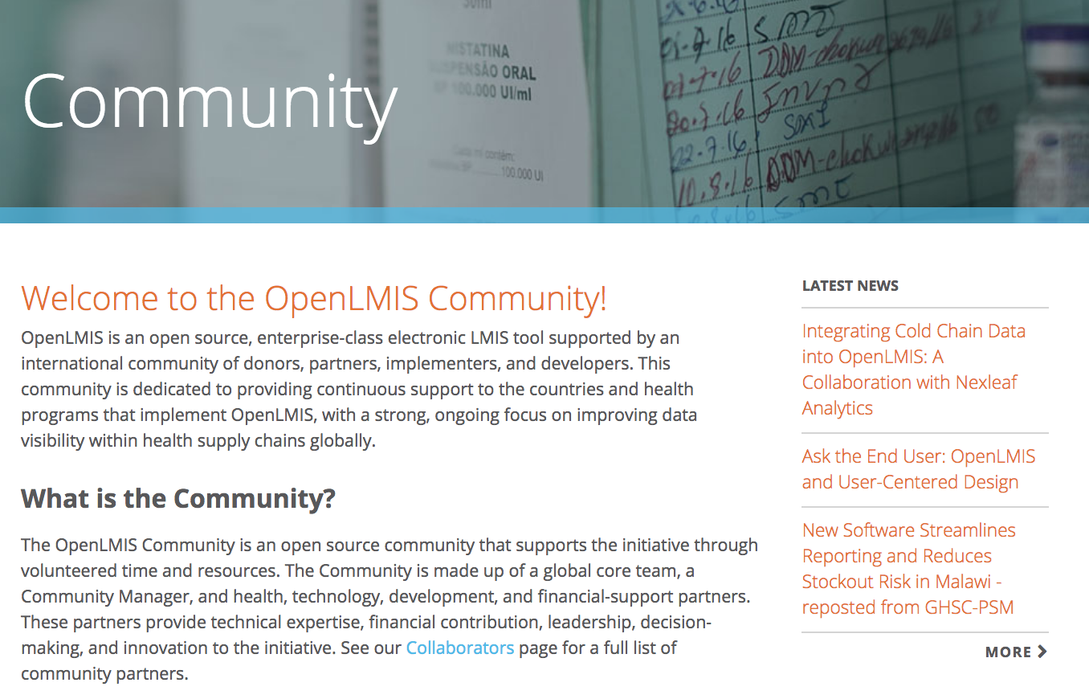
Getting involved
Contribute to the toolkit
The OpenLMIS Implementer Toolkit is
only as good as its contributors!
We welcome feedback and additional resources to help make the Toolkit a valuable and useful guide
Join the Community
What sets OpenLMIS apart is the support
of highly skilled and experienced partners
Add your voice to this growing community of global health leaders and help make OpenLMIS even better
Notes:
Speaker: Tenly

Slide 24
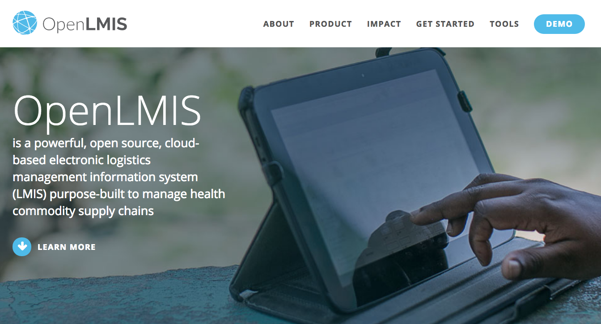
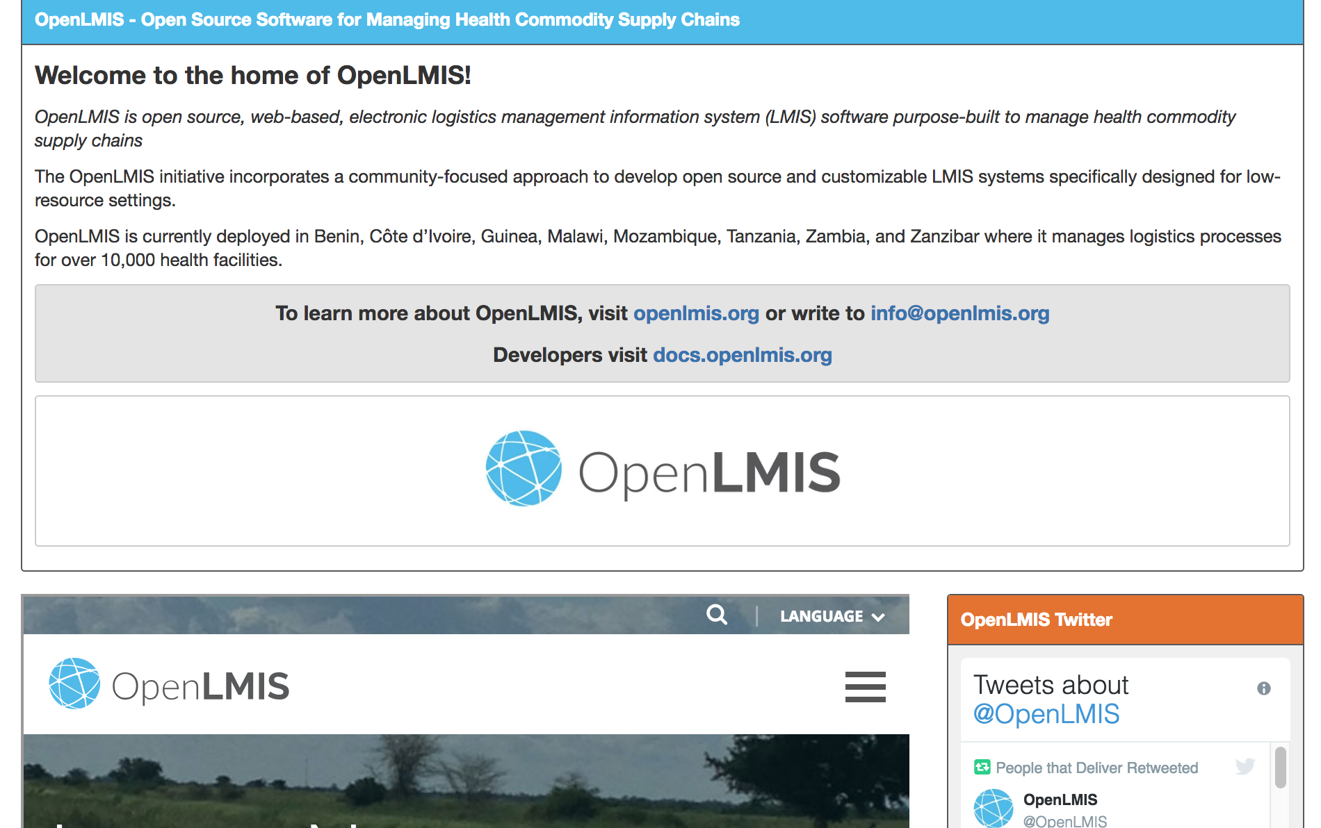
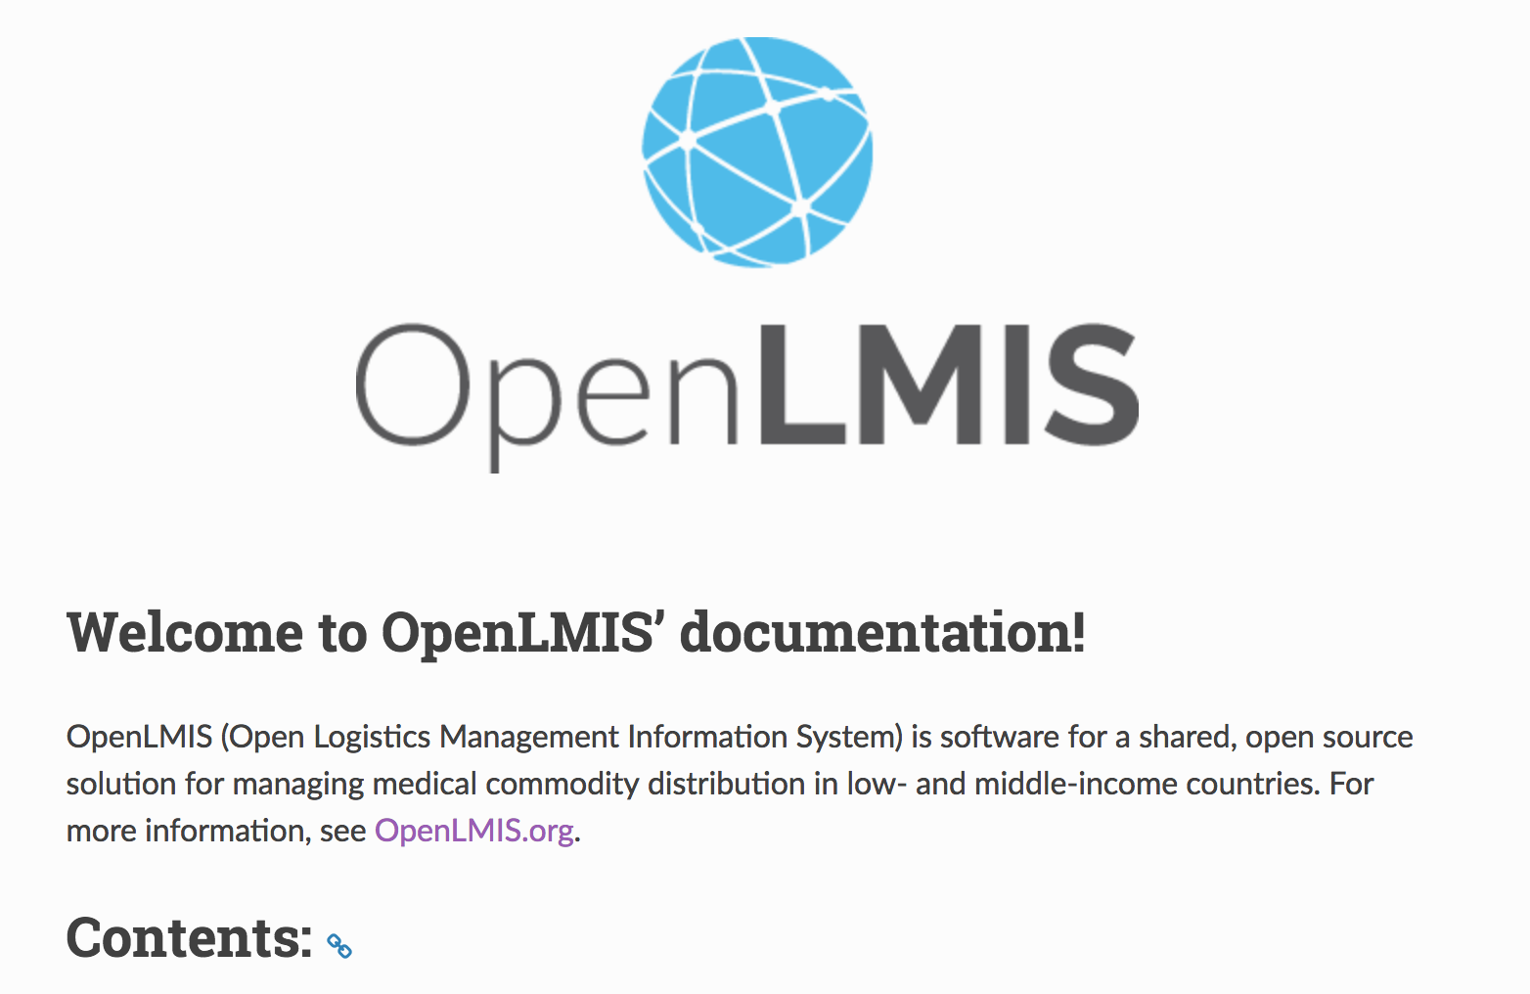
Learning more
openlmis.org
Blog posts, implementation map, features, tools, and the Implementer Toolkit can be found on the OpenLMIS website.
Wiki
The wiki is the source for community meeting notes, committee descriptions, product design considerations, project management, and the living product roadmap.
Documentation
ReadtheDocs contains developer-oriented OpenLMIS documentation. Users can find developer docs, ERD schemas, an OpenLMIS coding style guide, and API documentation.
Visit the OpenLMIS YouTube channel for demo videos and more
Notes:
Speaker: Tenly

Slide 25
Takeaways
1. WHO WE ARE
An open source technology solution and initiative that can help countries actively manage their complex supply chains.
2. WHAT WE CAN DO
End-to-end data visibility, with improved access and quality data to address barriers to data usage--- OpenLMIS improves data reporting and makes it enticing.
3. WHAT SETS US APART
OpenLMIS strives for standards-based interoperability and provides a highly configurable and extensible system to meet countries where they are at.
4. HOW CAN WE WORK TOGETHER
OpenLMIS has no software licensing fee – allowing countries to focus investments on people, processes, and improving local health systems.
Notes:
In summary: Tenly
Who are we? As more products get added to the immunization schedule or as countries integrate across supply chains, OpenLMIS is a solution that can help countries actively manage their complex supply chains.
What we can do? End to end visibility and improved data access and quality to manage risk and improve use of data.
What sets us apart? We are a standards-based software, providing interoperability capabilities with other systems, and being highly configurable to meet current country needs while supporting their supply chain evolution and maturity by keeping the link going to the global codebase
How can we work together? the money you invest in implementation of this software is focused on the people, the processes, and improving local health systems --- not to pay for a software licensing fee. We have a consortium of implementing partners to work with in deploying the system to meet country needs.

Slide 26
Thank you
Come chat now with questions
openlmis.org
info@openlmis.org
Notes:
Speaker: Brandon
So, OpenLMIS. We believe in a world where all countries have the data they need to manage their health supply chains and lead to healthier communities.
We are a community initiative and a software platform working to make this vision a reality. AND IT ALL STARTED WITH PATH IN 2008.
-------
CUT:
I’d like to start off with a quick high-level refresher on what OpenLMIS is before outlining the new features in the upcoming release.
OpenLMIS -- it is both an initiative and a software platform. The software allows countries to track products within their health supply chains across all major health programs, from essential medicines, malaria, TB, and family planning products, to vaccines, diluents, and syringes.

Slide 27
Additional slides

Slide 28
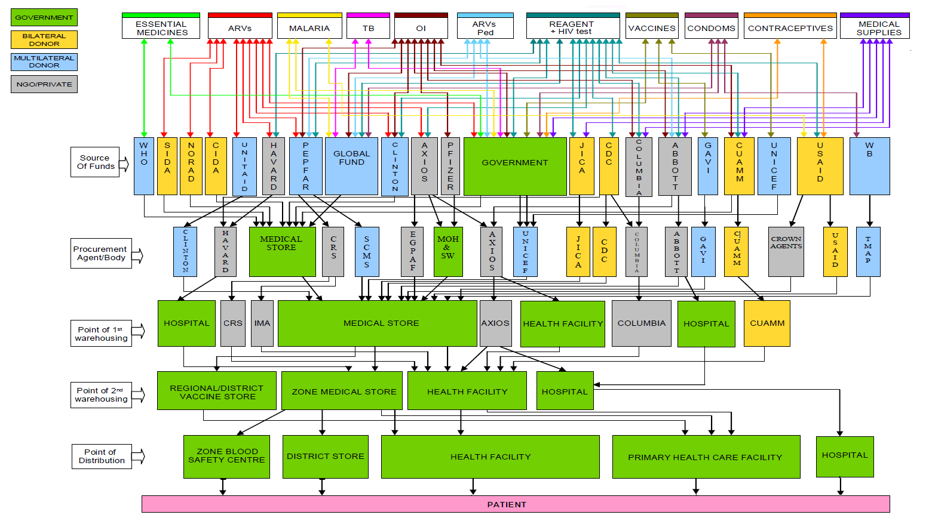
Complex Supply Chain Environment
Complex Supply Chain Environment
= scope of ERP / Warehouse System
= scope of OpenLMIS

Slide 29
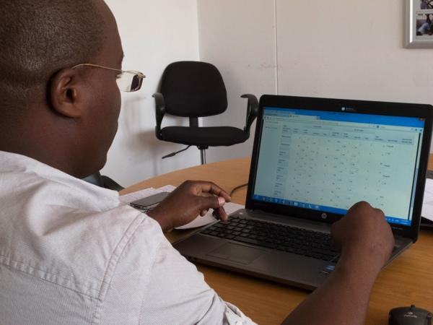
Information System Challenges
Fragmented Solutions
Costly to Donors
Hard to Maintain
Program Specific
Expensive
Low Reporting Rates
Country Specific
Late
Level Specific
Proprietary
Inaccurate
Poor Data Quality
Paper Systems

Slide 30
OpenLMIS Requisition Workflow
Central Warehouse
Fill/Ship
Regional
Regional
Order
Receive
Request
District
District
District
District
Health Facilities

Slide 31
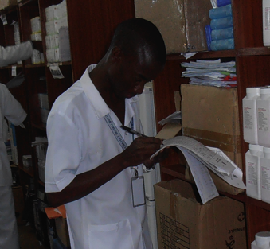
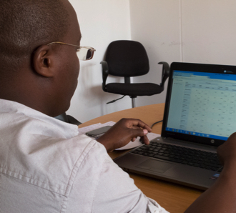
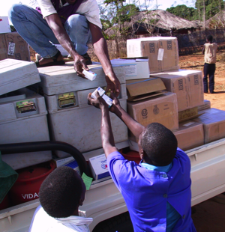
“Pull” System Workflow
Facility
District
Warehouse
Delivery Site
Store Room Clerk
In-Charge
Pack and Ship in Warehouse System (ERP)
District Manager
Warehouse Clerk
Delivery Driver
Submit Requisition
Authorize Requisition
Approve Requisition
Release Order
Enter Proof of Delivery
System Administration
Example workflow. Actual workflow can be configured to match target fulfillment process.

