Slide 1
Open Source LMIS for
Streamlined Supply Chain Management

Slide 2
Presentation Outline
What is OpenLMIS?
Who implements OpenLMIS?
Malawi Success Story
If you would like to learn more, please get in touch after the presentation
Notes:
Today’s presentation will be broken into three pieces. We hope that the presentation will enlighten you about:
What is OpenLMIS; in terms of its capabilities as a software and its benefits,
The different organizations who implement OpenLMIS as part of the OpenLMIS community; we call them Trusted Partners
What are some practical considerations and lessons learned that could help inform a future OpenLMIS Implementation? We will hear from Mr. Vuso Tembo from MoH Malawi about their recent implementation experience

Slide 3
What is OpenLMIS?
Notes:
OpenLMIS is a powerful, open source, cloud-based electronic logistics management information system (LMIS) purpose-built to manage health commodity supply chains. The software allows countries to track products within their health supply chains across all major health programs, from essential medicines, malaria, TB, and family planning products, to vaccines, etc.
OpenLMIS automates and streamlines data collection/reporting so that data is readily available to inform decision making at all levels of the supply chain. Specifically:
-Improve data accuracy through automated calculations and data validation checks
-Improves data timeliness/reporting timeliness through electronic data capture, eases burden on HCW to enter and report data
-OpenLMIS has designated roles and responsibilities for tasks and approvals in workflow increase transparency & accountability
-Electronic supply chain data and data analytics to see what is happening across the supply chain increases data visibility throughout the supply chain.

Slide 4
OpenLMIS Initiative-Strength in numbers
Trusted Partners
Community Members
Notes:
OpenLMIS is not one single company or entity. It is a community of partners who come together to inform software development and implementation. OpenLMIS initiative has over 20 world-class partners bringing expertise from technology, data analytics and quality software development, to on-the-ground implementers. It is this depth of expertise, an strength in numbers, that makes the OpenLMIS community so valuable- and a true global good.
At the top of the slide you can see our implementing organizations, who we call our Trusted Partners. You will be hearing more from each of these organizations later in the presentation. And at the bottom are other partners, who consist of donors, technology partners, and other strategic partners
------

Slide 5
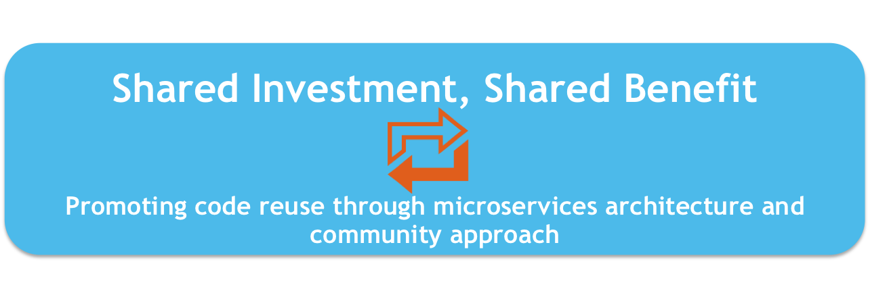
The OpenLMIS Software Vision
Notes:
*OpenLMIS has a unique vision for its software; employs a community approach to share its code and features across a community of users. Any country who implements OpenLMIS is considered part of the community- and will continue to benefit from upgrades and enhancements made in the future. This is what we call the shared investment, shared benefit model
*We strive for interoperability using standards because we know each country has specific needs and will leverage more than one system. We believe interoperability between all those systems is the best way to achieve visibility and to meet the needs of whole health ecosystem.
*And we drive to provide a highly configurable system and an extensible codebase. Any country implementation can extend and change features to address the in-country context. This allows OpenLMIS to meet countries where they are at in their supply chain maturity and grow with them as they professionalize and standardise.

Slide 6
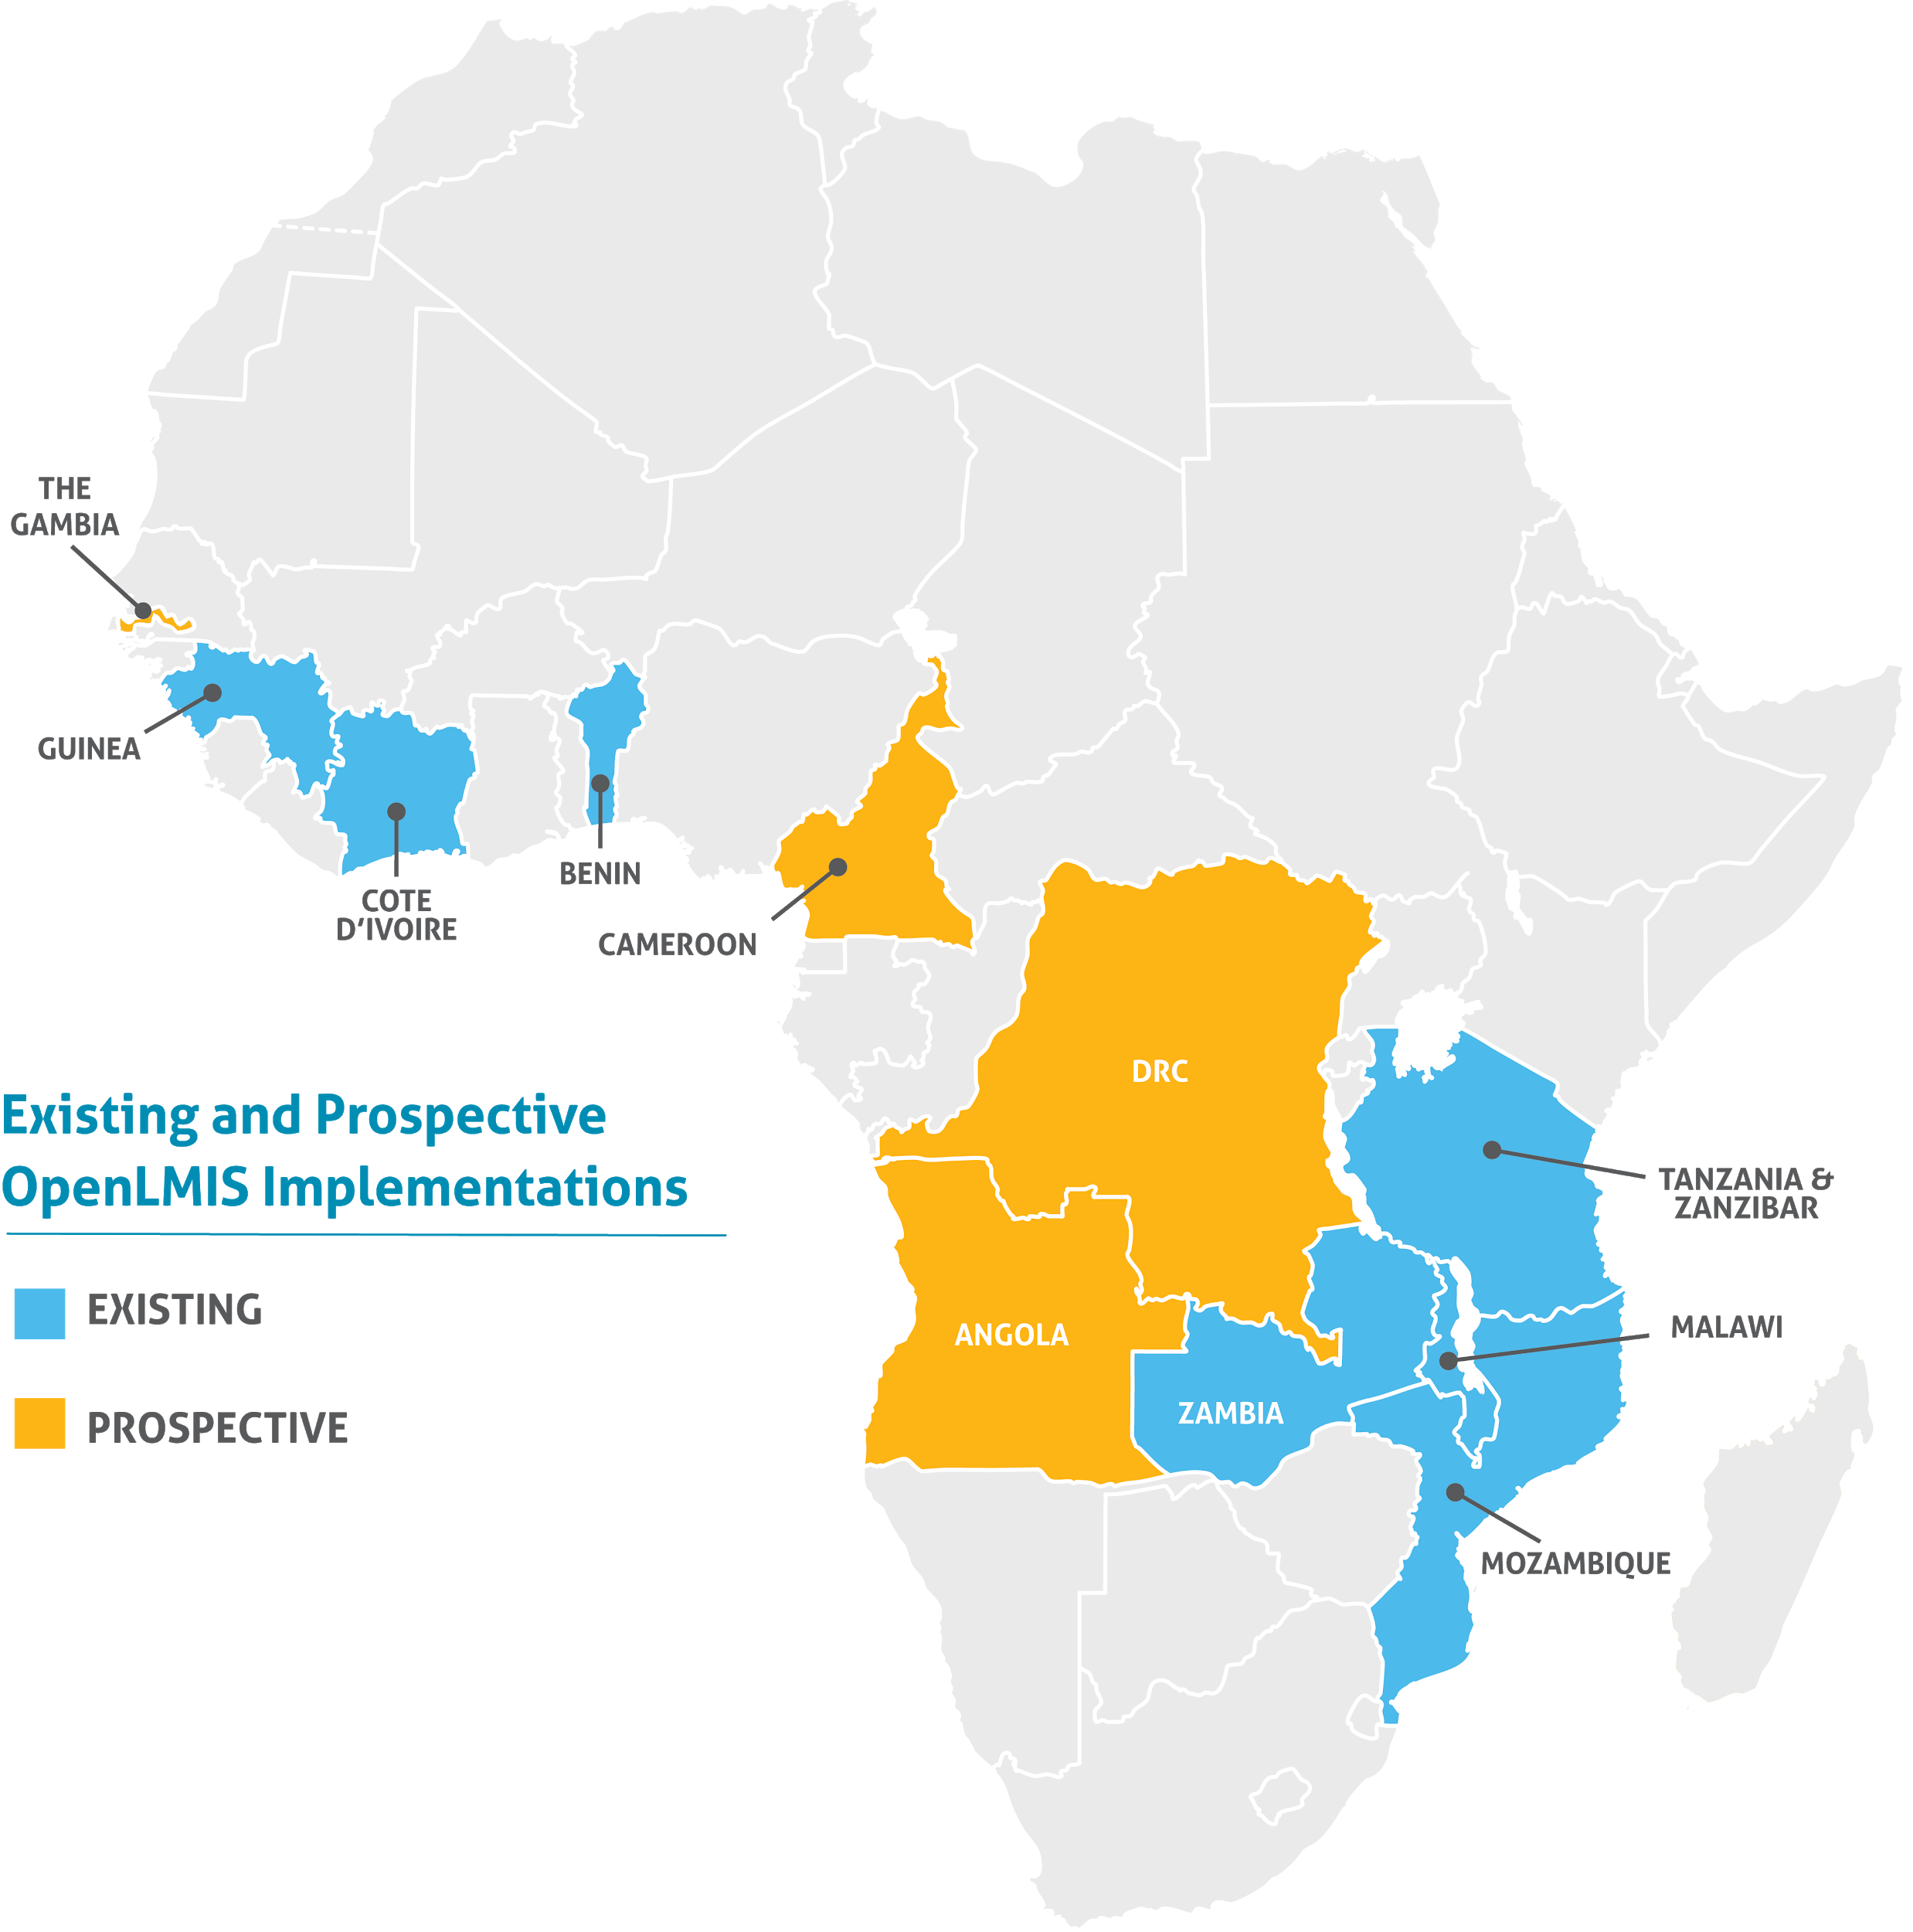
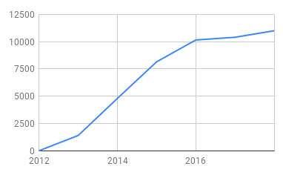
Active growth throughout Africa
OpenLMIS manages logistics processes for over 11,000 health facilities across Africa
Notes:
OpenLMIS is a thriving and constantly growing community. The map to the right indicates in blue where different versions of OpenLMIS is currently being used and in orange where we hope to be implementing soon
OpenLMIS software is implemented with support of local partners who implement a specific version…with a different name…
If you have heard of VIMS in Tanzania, eLMIS in Zambia, SELV in Mozambique, or eSIGL in Cote d’Ivoire, you have heard of some of the country implementations of OpenLMIS.
This graph shows our growth, from 2012 to 2018; where we currently manage logistics processes for over 11,000 health facilities across Africa, with more on the way.

Slide 7
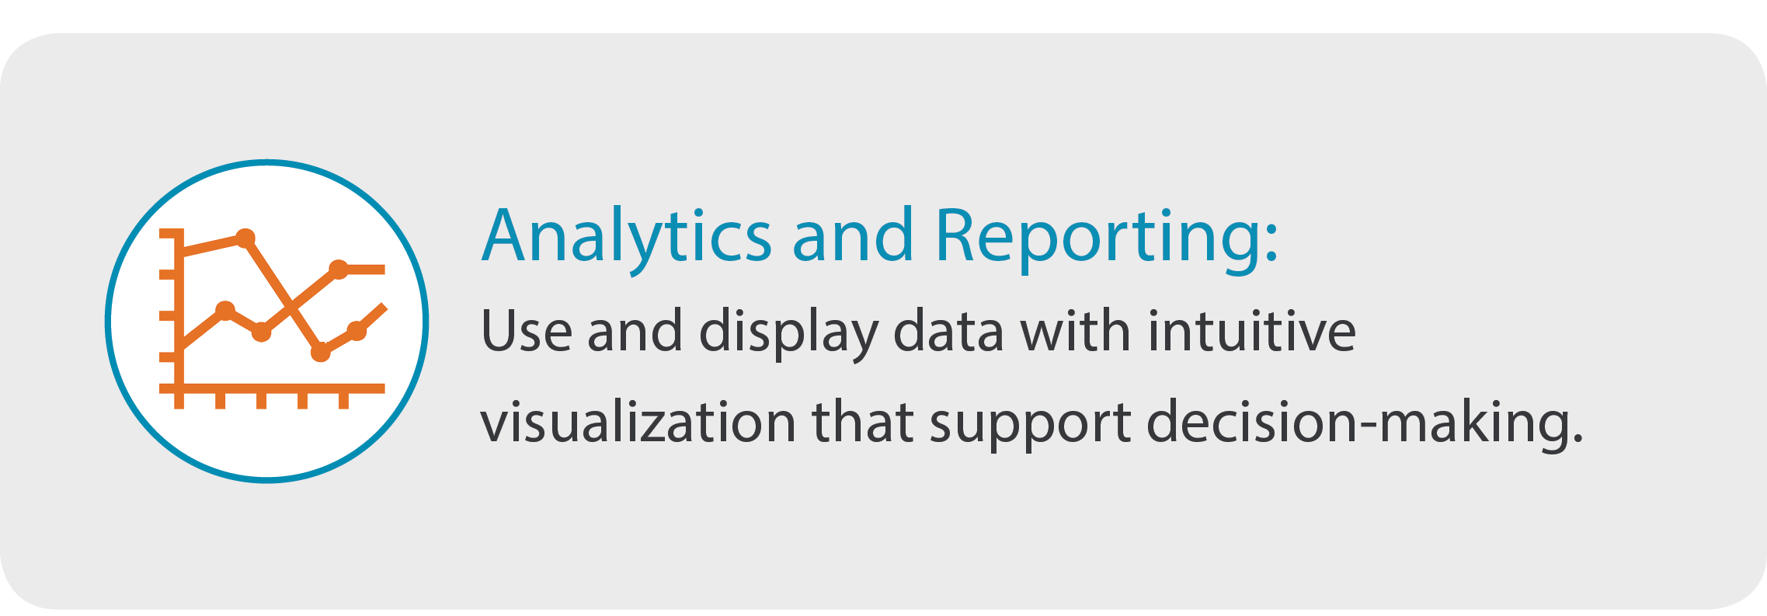
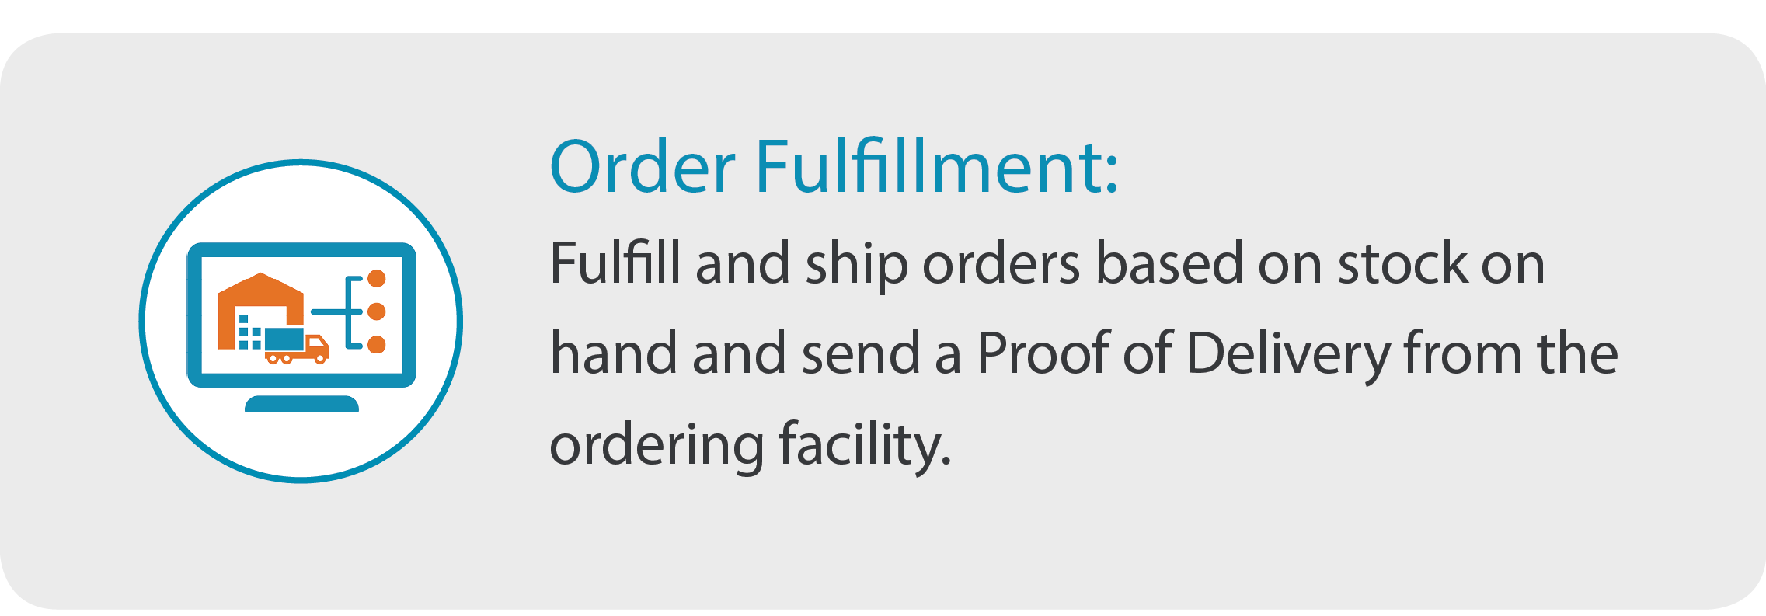
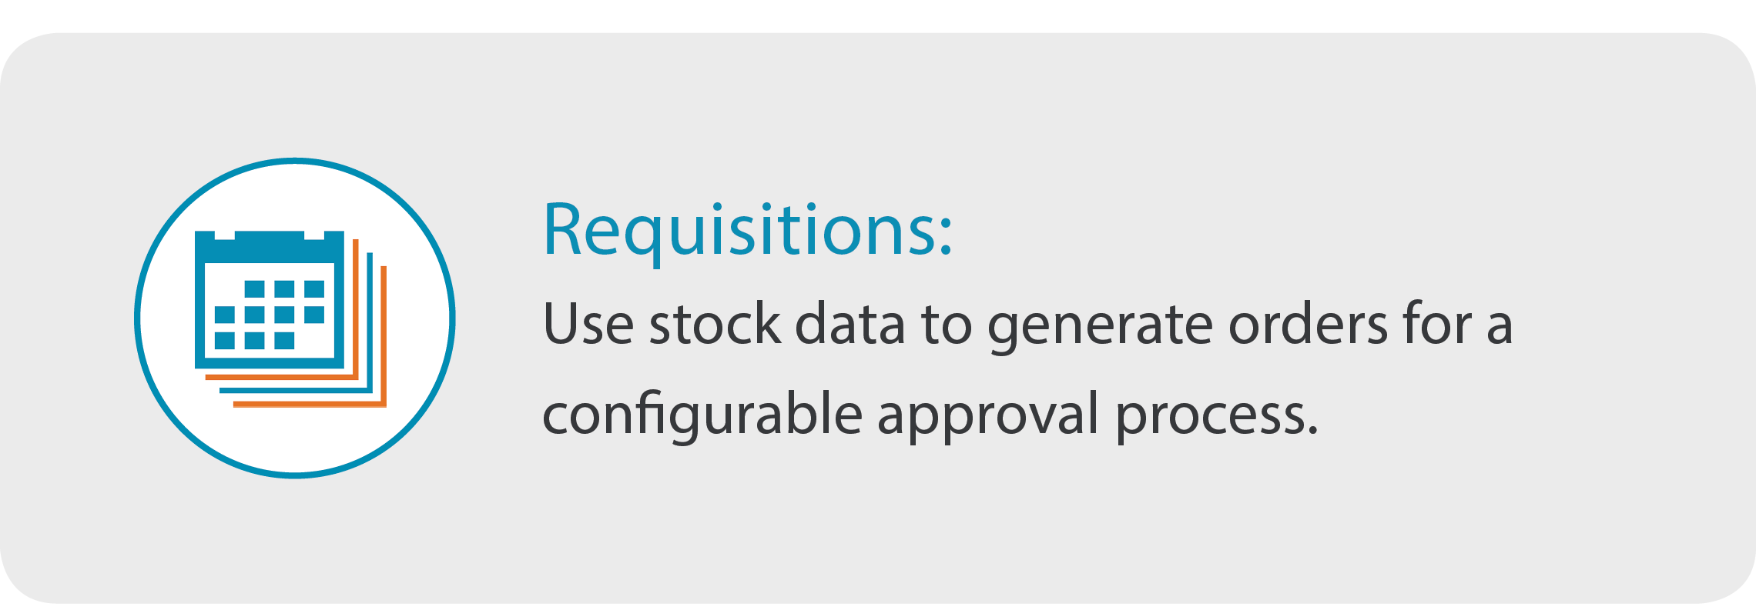
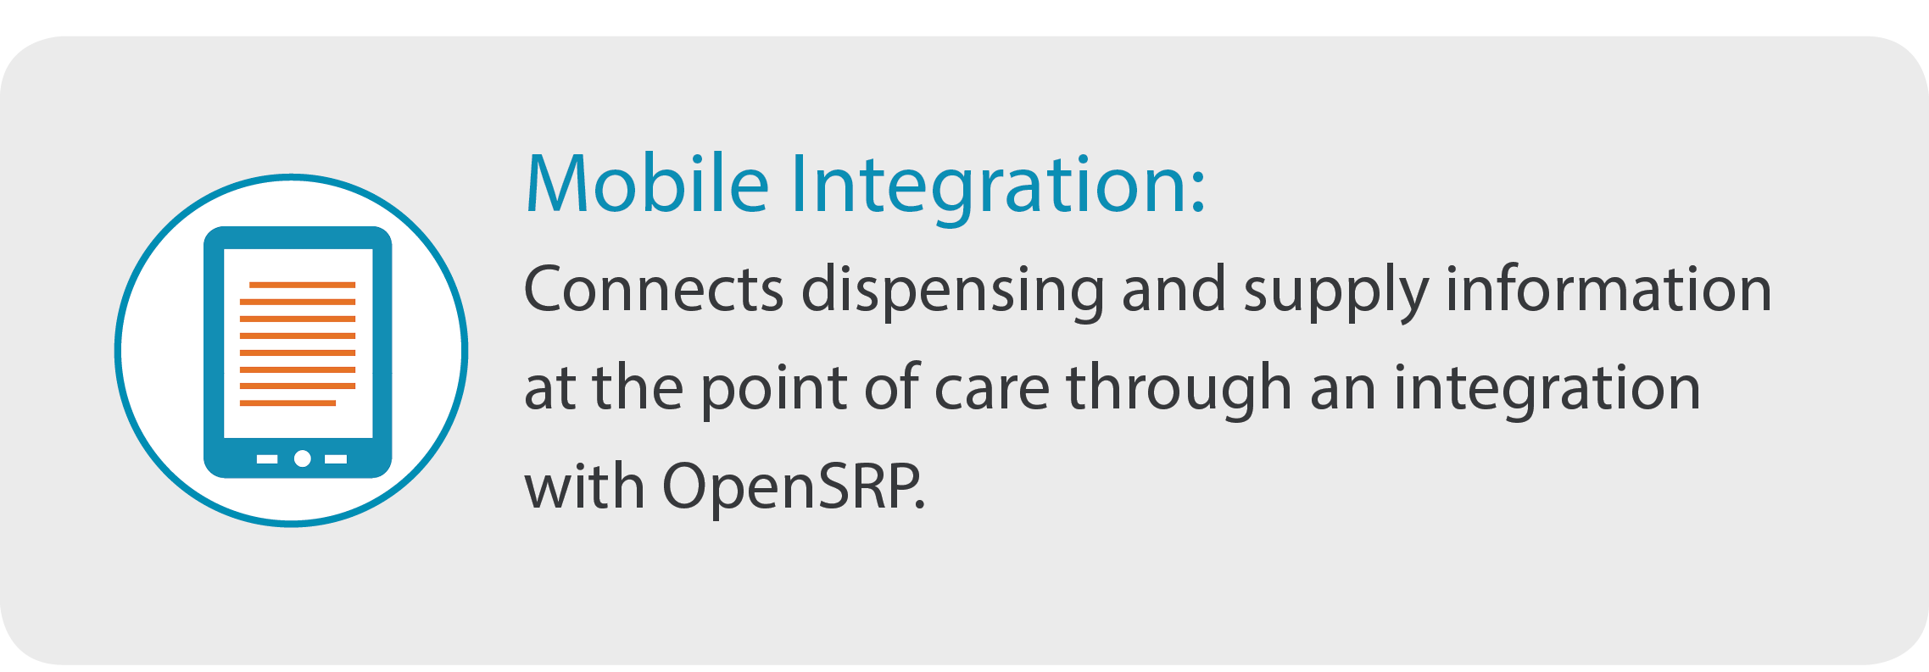
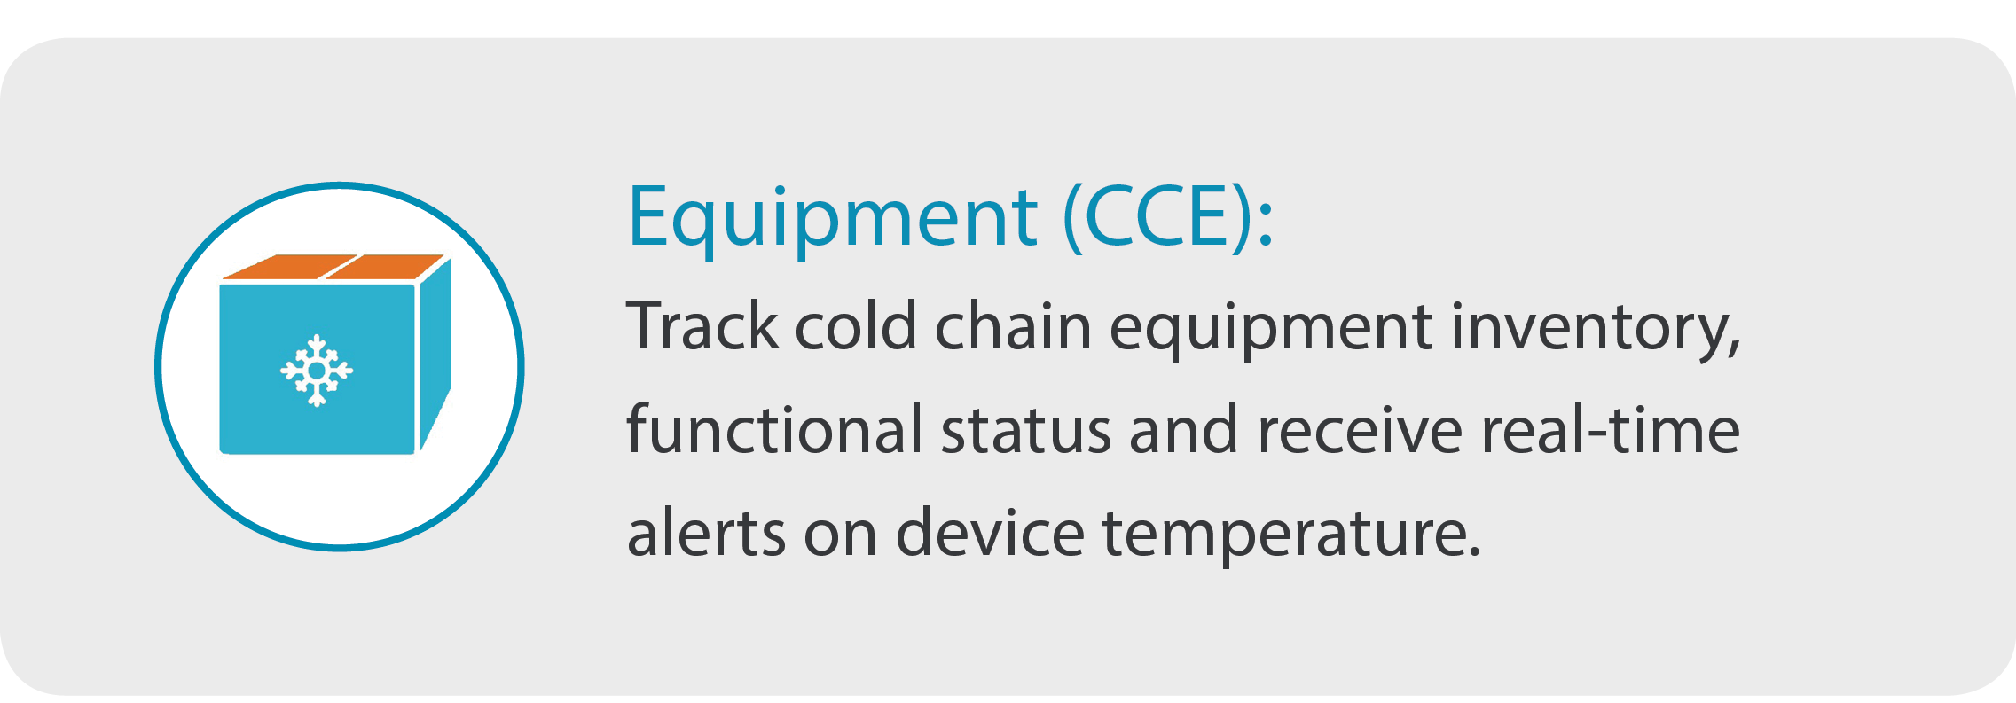
OpenLMIS Features
Stock/Inventory Management
Captures inventory data and stock movements to provide an overview of stock availability
Notes:
OpenLMIS’s foundational features are designed to respond to the most commonly voiced problems in public health logistics.
Many countries have issues with managing your inventory or knowing the current SOH-this feature allows you to record your stock transactions, up to date data on stock availability; all of the ins and the outs.
Analytics and Reporting feature allows you to display data with excellent visualizations; can be configured to monitor whatever KPIs that a country wants to monitor; will show some examples
A store can conduct a “resupply” otherwise described as Order Fulfilment and send stock to facilities with an electronic proof of delivery.
Users at any level of the supply chain can Request stock based off of min/ max stock levels, or the forecasted demand targets.
OpenLMIS offers integration with a mobile application called OpenSRP – connects patient dispensing data at the point of care, with supply chain data. This is a new feature which we are excited about and will show in more detail
You can also manage your cold chain catalog, cold chain equipment inventory and receive real time alerts from remote temperature monitoring devices.

Slide 8
Requesting new stock
Quick and easy data entry; auto populated fields; familiar data points
Notes:
Here is a quick snapshot of what the system looks like:
As per the title at the top of the screen (Report and Requisition for Essential Medicines) this is the screen that a user (perhaps a storeroom manager) would see when they want to initiate a request for new stock. These data fields probably look very familiar; they are similar to what you would normally see on a paper-based Report and Requisition. They can also be configured as per a country’s request
As you can see, some of the fields are automatically populated by the system, starting with the beginning balance. The user simply enters in a few key pieces of information, and then the Calculated Order Quantity will be automatically calculated

Slide 9
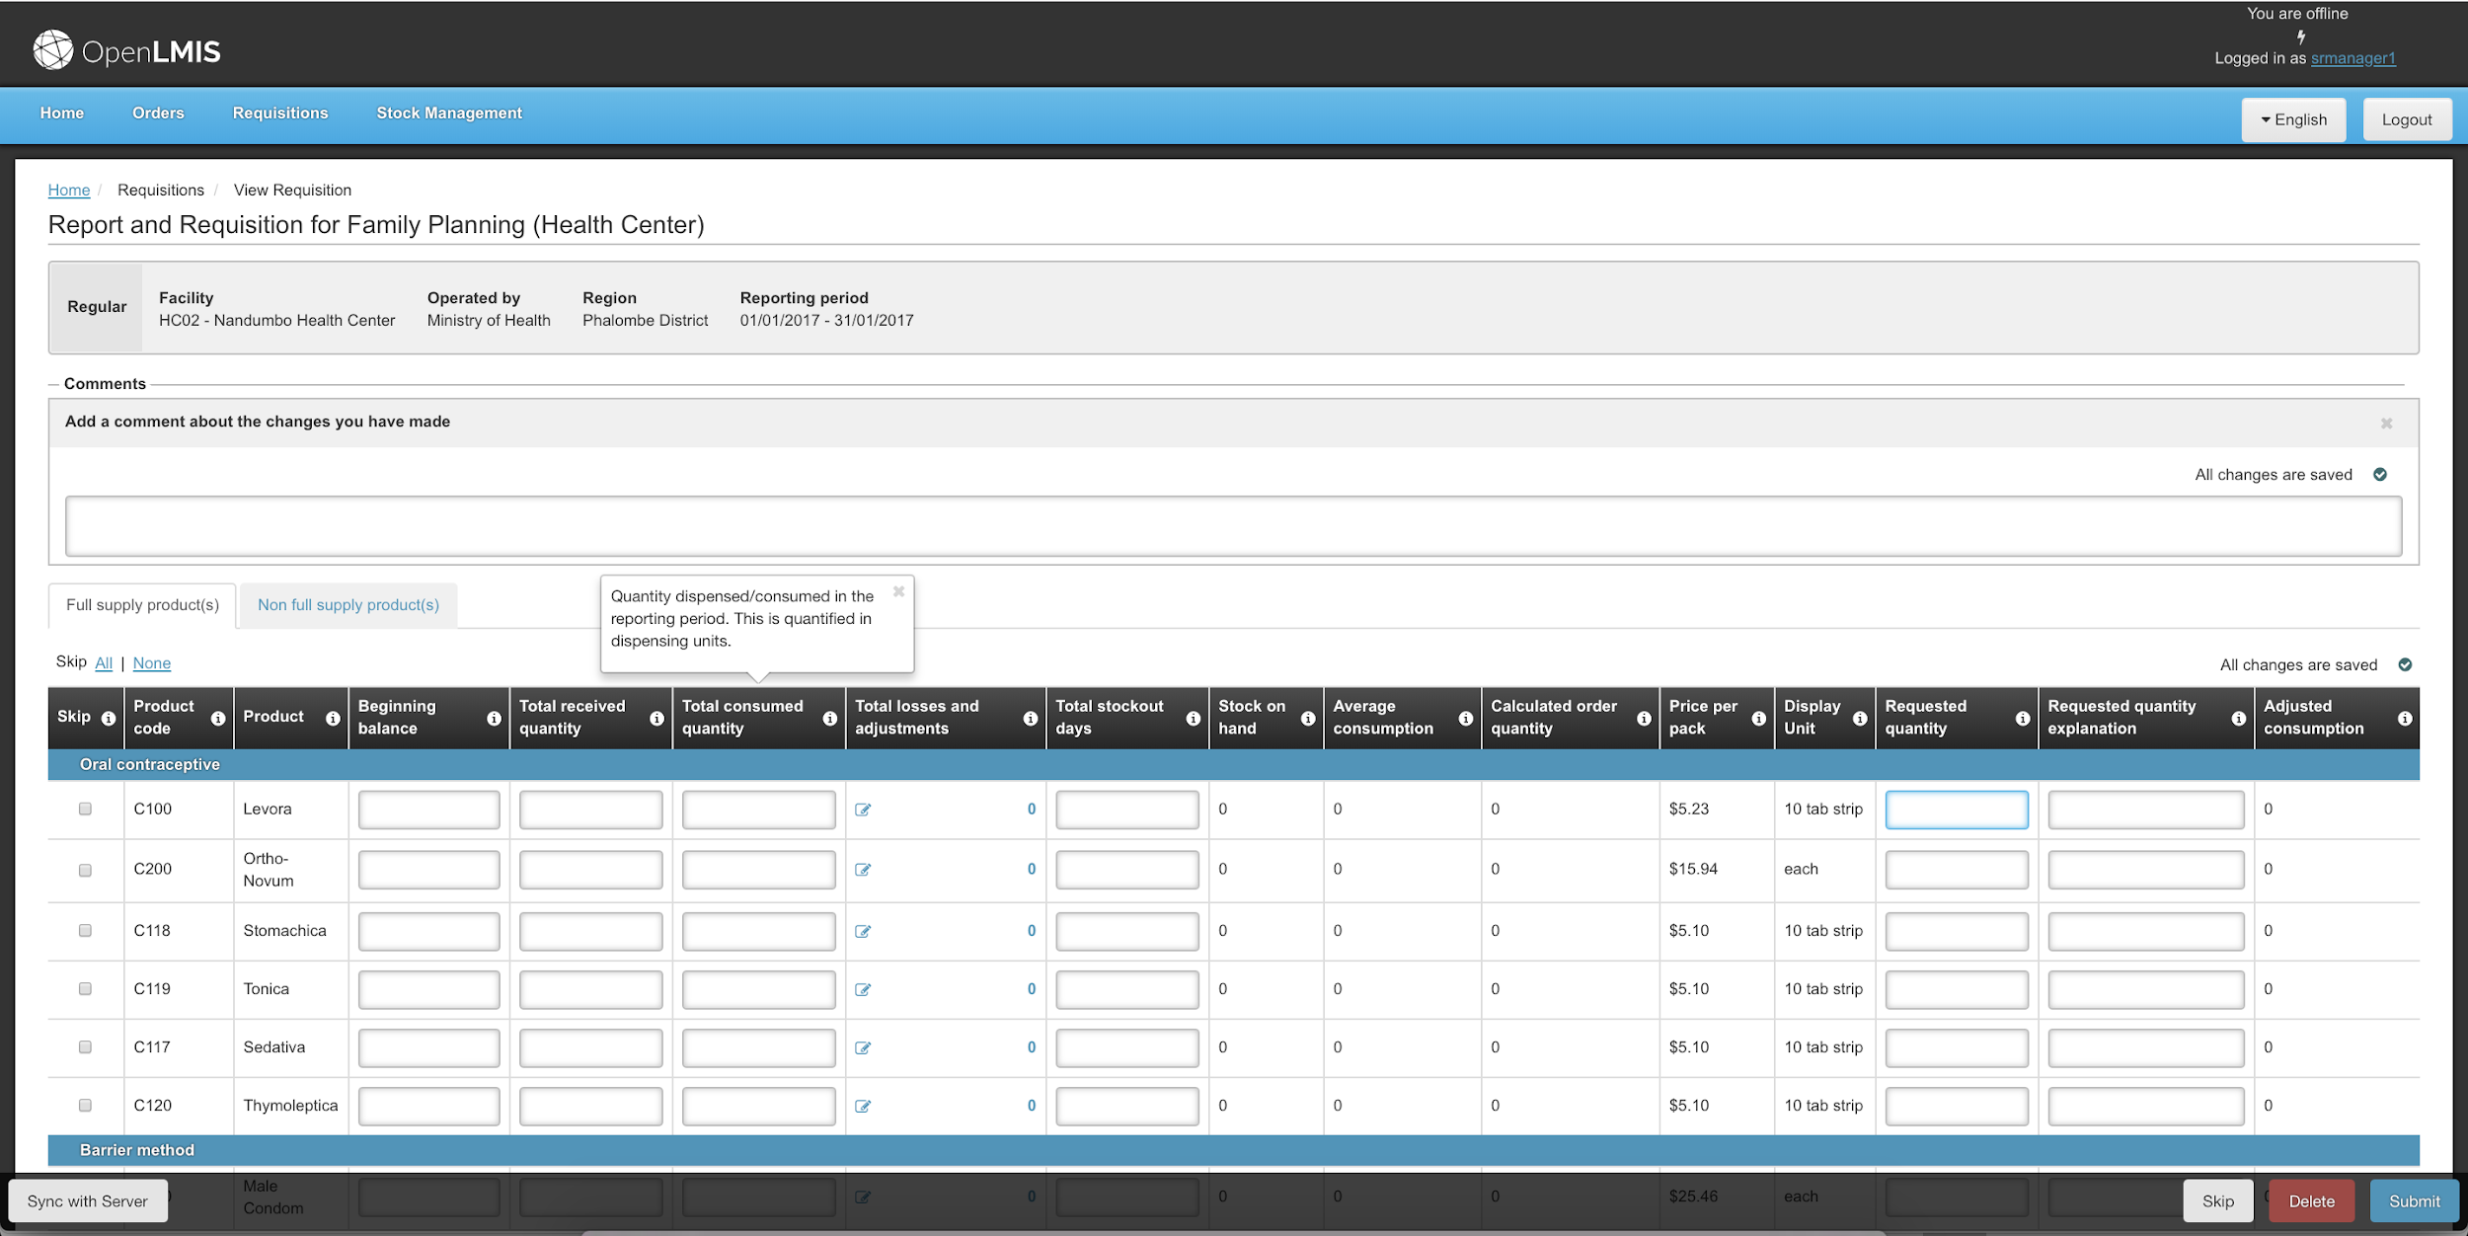
Capture data while offline
To support intermittent internet connections, you can continue to capture your data while offline.
Notes:
Another benefit of OpenLMIS is that you can work in ‘offline mode’- which our implementing countries find as a huge benefit.
You can continue to enter data when offline- the header color changes to black to tell you when you are offline

Slide 10
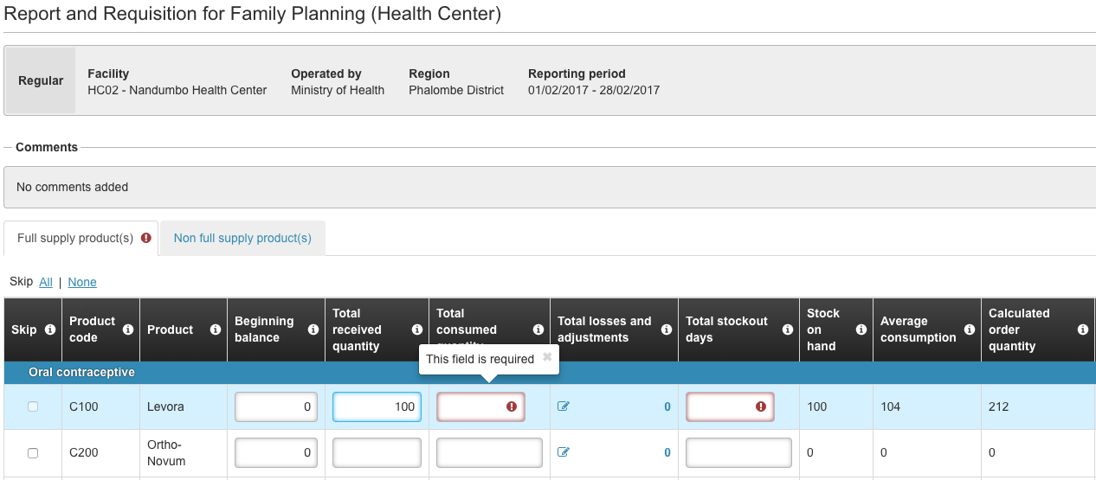
Improve data quality
Data validations and easy to read errors to support users when entering data.
Notes:
What you are seeing here is what we call ‘data validations’- meaning that they system has automatic built-in checks to make sure that the user fills in all data fields appropriately. If the user tries to move forward without filling in a required field, you will see a red indicator (as seen on the screen). As you can imagine, these data validations make life easier for the user, and increase data accuracy

Slide 11
OpenLMIS Features
Stock/Inventory Management
Captures inventory data and stock movements to provide an overview of stock availability
Notes:
I’m going to show a quick snapshot of the stock management feature

Slide 12
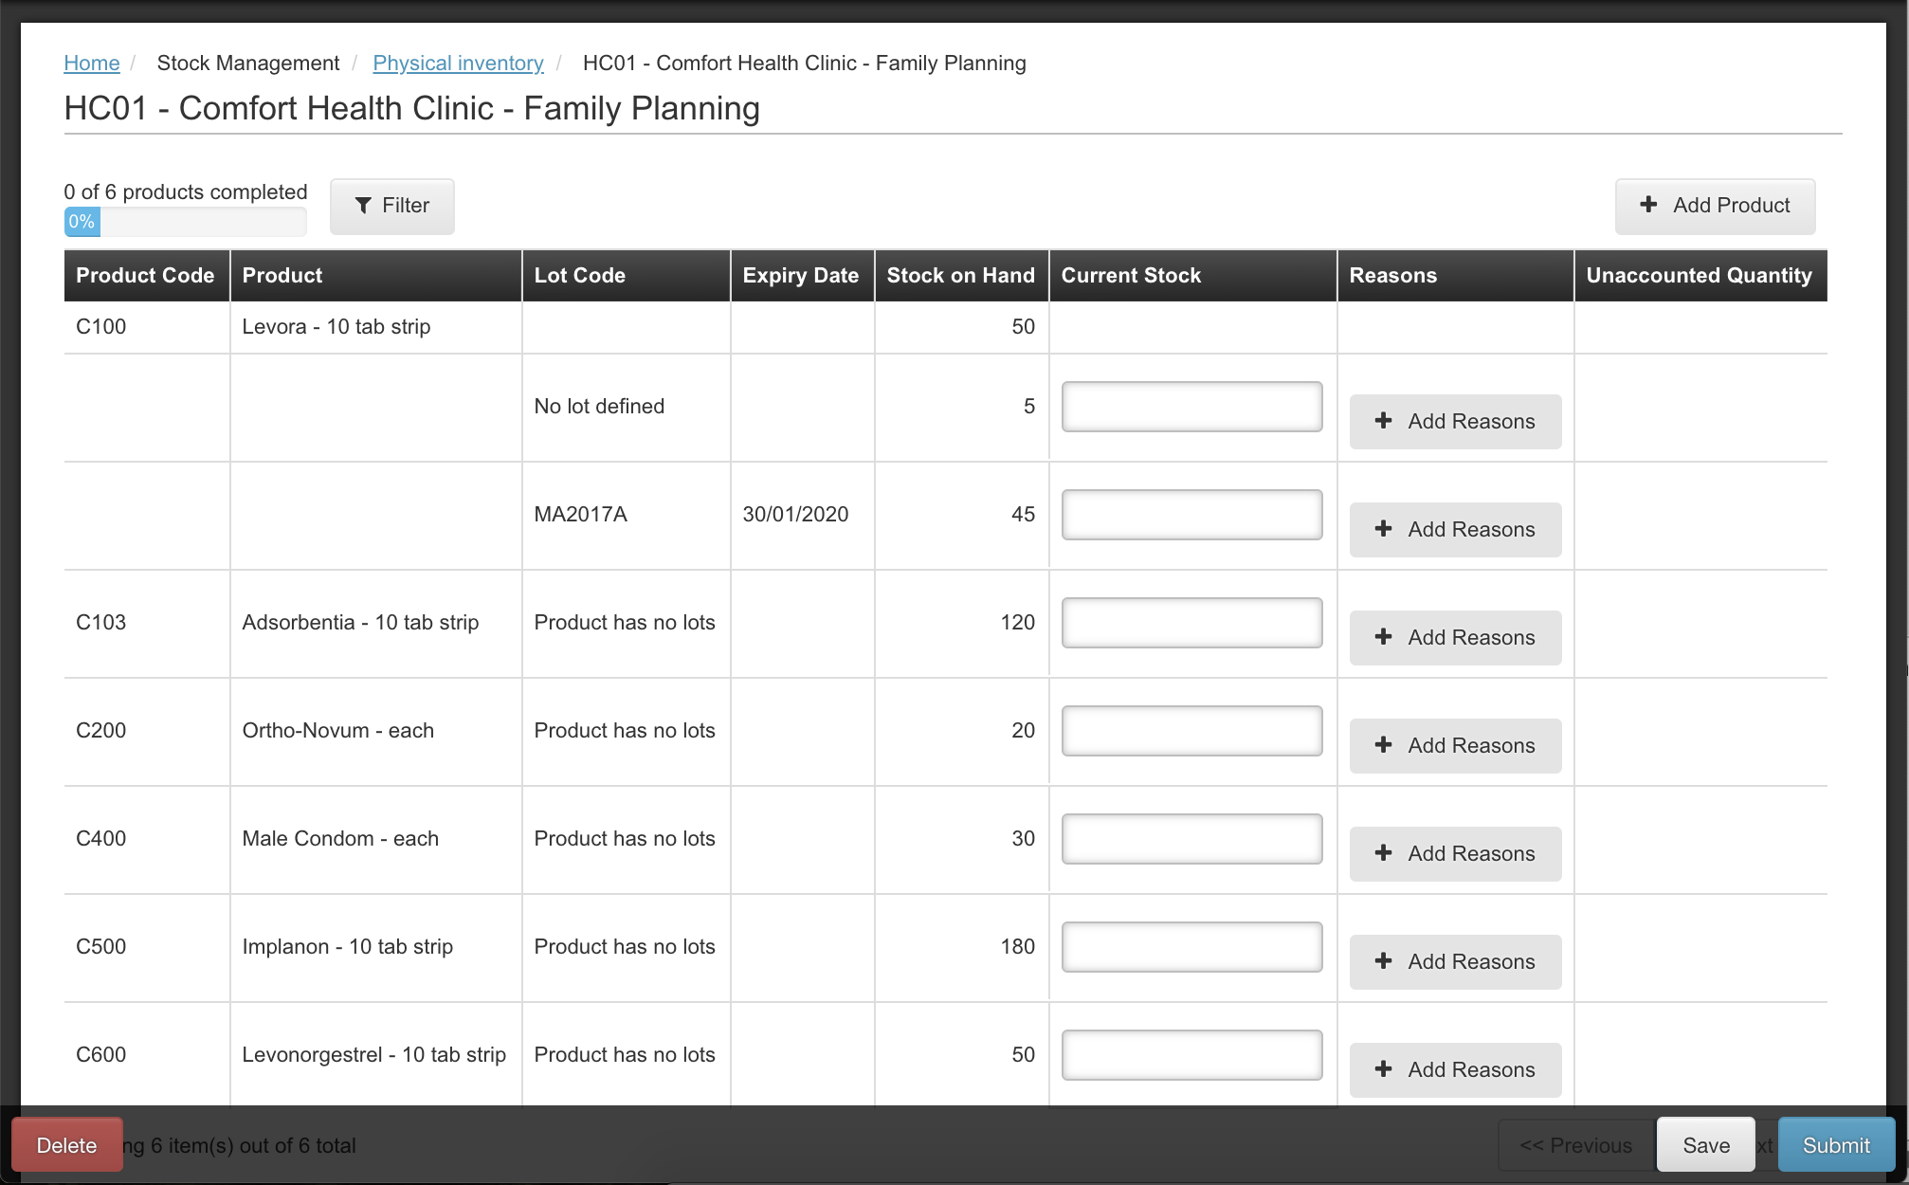
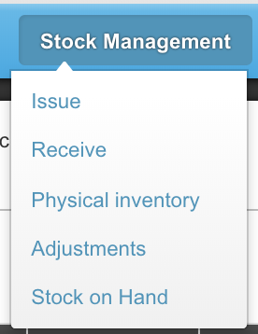
Stock and Inventory Management
Notes:
Quick peek into our Stock Management feature: possible actions are to issue stock, receive stock, conduct a physical inventory, make adjustments to stock quantities, and view current stock on hand (electronic stock card)
This screen shot shows what you would see if you were to take a physical inventory—list of your products, current SoH in the system, physical count. Space for notes in case there are discrepencies

Slide 13
OpenLMIS Features
Stock/Inventory Management
Captures inventory data and stock movements to provide an overview of stock availability
Notes:
Now we will show a couple of examples of the systems reporting capabilities

Slide 14
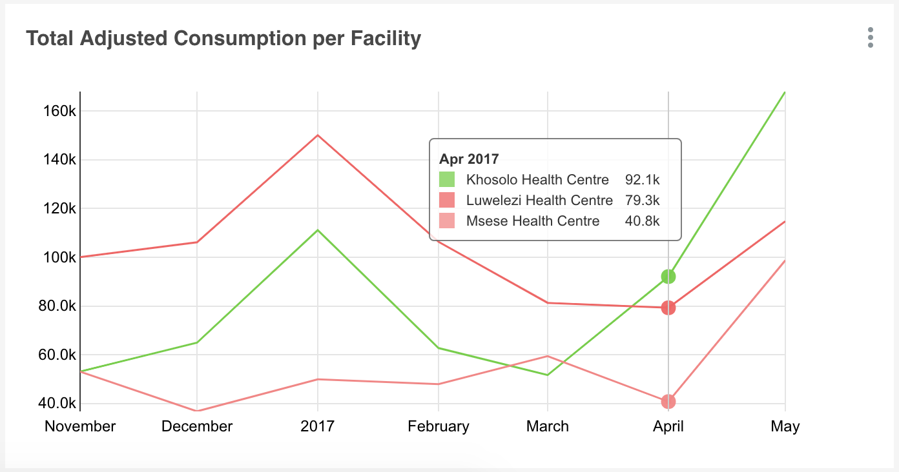
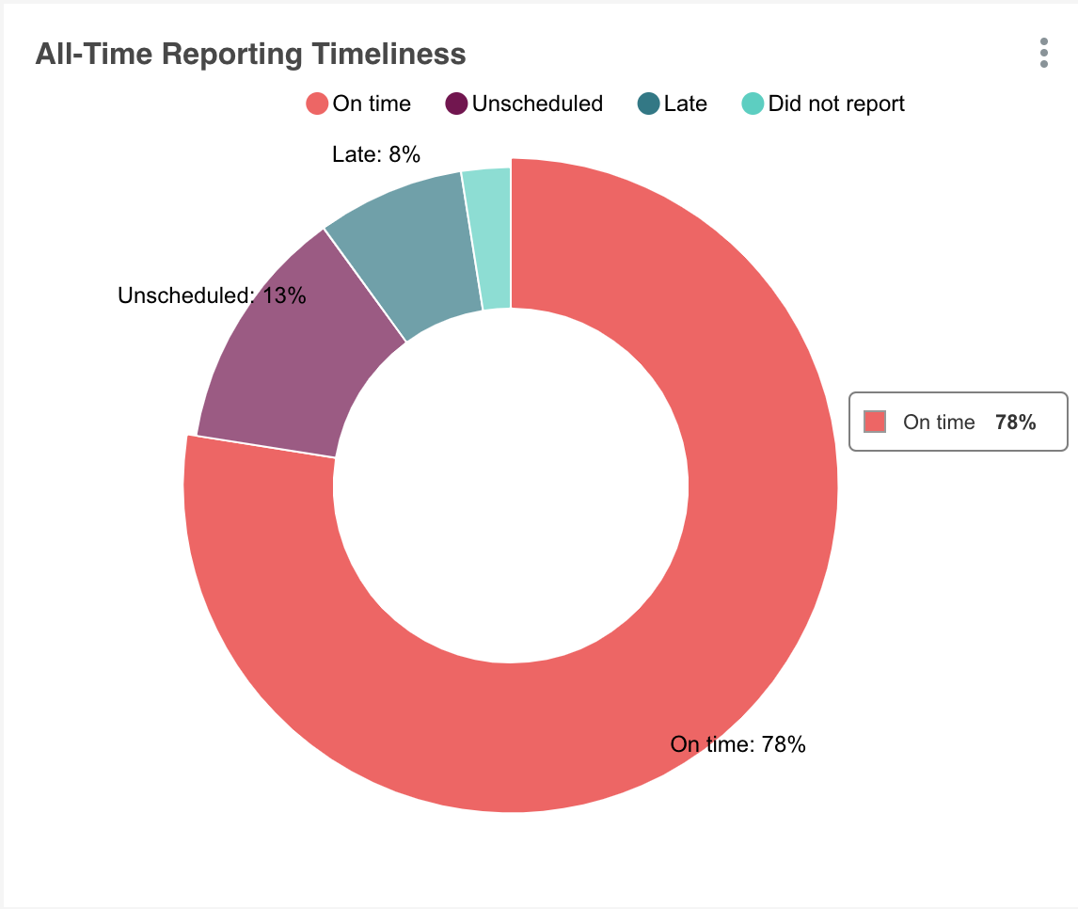
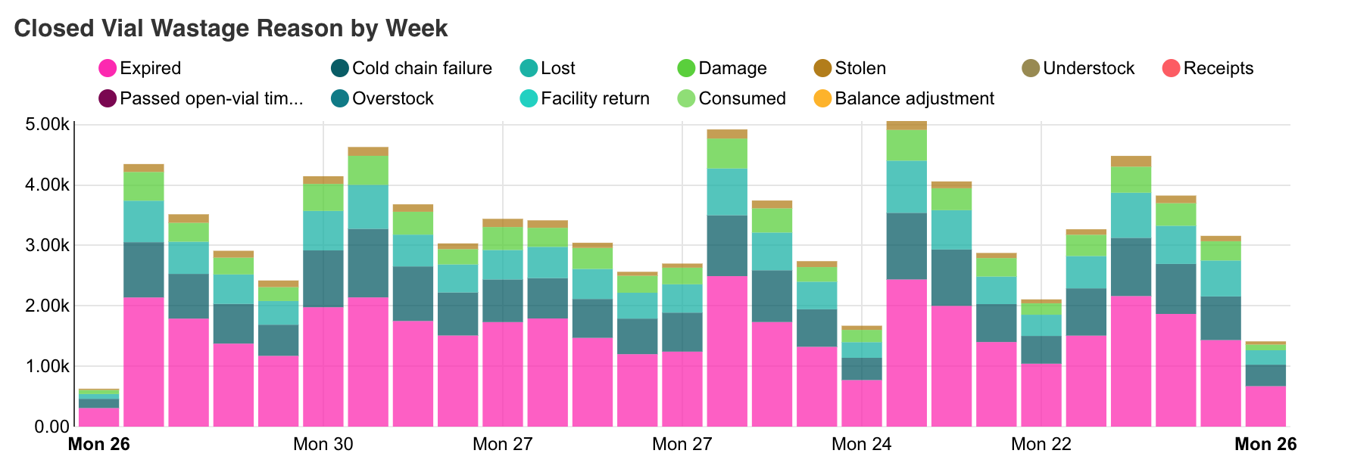
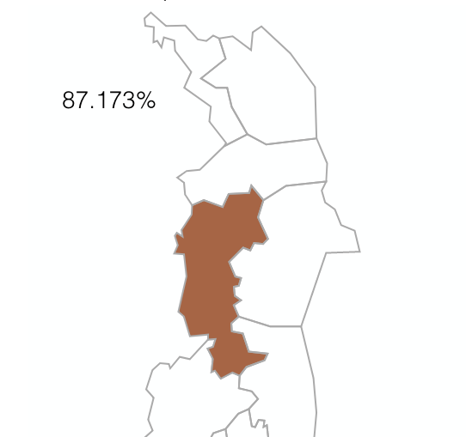
Auto-Generated Reports
Notes:
As a community we recognize the importance of data visibility across the supply chain; and the importance of using data for decision-making. That is why the OpenLMIS community has invested in a first class data processing, ingestion and warehousing to support the professionalization of supply chain and increasing amounts of data..
Here are a few example of reports /visualizations that are possible…
Ex; Consumption per facility—track consumption patterns
Ex: Closed vial wastage- look for patterns and act on them
Another popular visualization is to show data on report submissions. The system can measure reporting rates and measure timeliness of reporting; another option is to get map view of reporting rates. It is visuals such as these that improve data visibility across levels of the supply chain; these can help with conducting root cause analysis and aid decision-makers in follow up actions

Slide 15
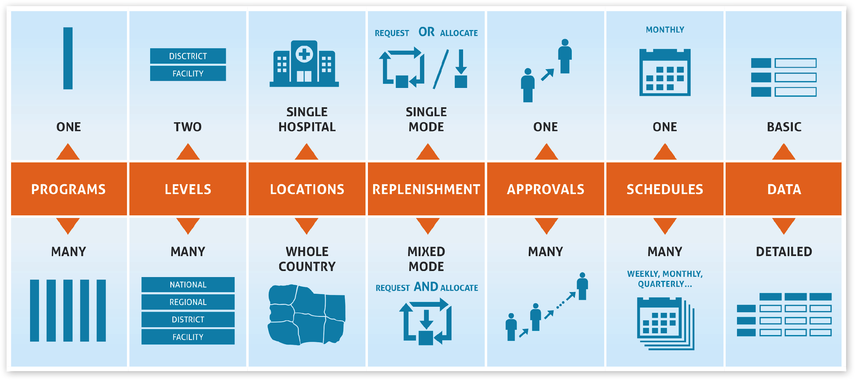
Configurability
Notes:
All of the features that we have mentioned so far are configurable; meaning that the implementing country can make changes to how they work in their specific country. Configurability is a key tenant of OpenLMIS, because we want to meet and support countries wherever they are in their supply chain maturity
For example…..
Program: A country can run Essential Meds and Immunizations without an issue. Each program will have different product lists, approvals, schedules and locations!
Level: Does the country have 3, 4, 5 different hierarchies? No problem.
Locations: Do you want OpenLMIS to support only district? Or maybe some districts and states? Or the whole health system, no issue.
Replenishment: Do you want to send stock to a facility? OpenLMIS supports that. Do you want to request stock from a facility, that’s supported too.
Approvals: multiple level or no approvals of requests for new stock.
Schedules: are flexible and easily changed.
--------

Slide 16
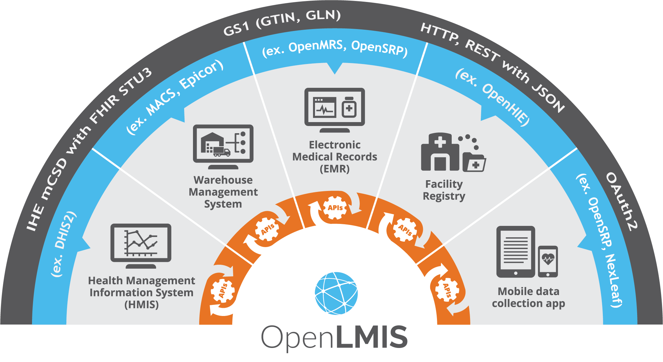
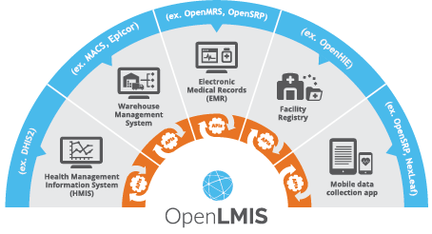
Standards based interoperability
Notes:
Supply Chains are complex, and OpenLMIS, nor any one system will ever manage it effectively end-to-end. OpenLMIS has a deep well of functionality to help you manage your logistics, however interoperability through standards is the best way to optimize systems and ensure they work together effectively to cover all key areas of the supply chain. The grey band highlights some examples of standards we use, allowing interoperability with external HMIS, warehouse mgmt. systems, electronic medical records, facility registries, and mobile data collection apps. We encourage and advocate for all systems to prioritize using standards, like the GS1 standard for example

Slide 17
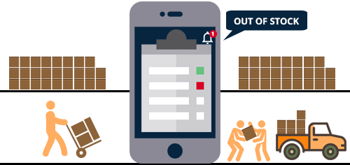
Offline Tablet App
Manage your inventory offline at a facility
Record wastage
Issue stock; Adjust stock levels
Connects dispensing and supply information at the point of care
Supports offline health records for all registered clients
Manages stock and is able to match the client to commodity disbursement
Notes:
OpenSRP integrations—links supply chain data with patient level dispensing records

Slide 18
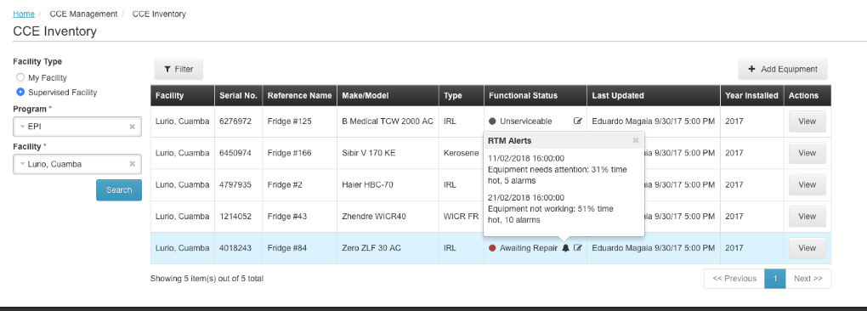
Remote Temperature Monitoring
Notifies users about outages in cold chain equipment
Within OpenLMIS, logisticians can review CCE status when planning resupply
Example RTM Alert:
Notes:
NextLeaf integrations- remote temperature monitoring, cold chain equipment management

Slide 19
Summary of OpenLMIS Benefits
End user
Data Validations
Faster data calculations
Offline functionality
Visibility into Reporting Rates
Reporting capabilities
Can interface with other ERPs
Big Picture
Open Source
Community of support
Experience in many countries
Benefit from future enhancements
Countries can select which features they want to adopt
.
Notes:
End User Benefits
Data validations-->increased data accuracy and confidence in data
Faster data calculations→ makes the life of end user easier; and can encourage improved reporting. Data has shown that OpenLMIS can improve reporting rates and timeliness
Offline mode- this is a unique capability not offered by other software; don’t miss a beat when there is poor internet connection
Improved monitoring of reporting rates→ another example of how OpenLMIS increases accountability in the supply chain
Reporting capabilities are very sophisticated; allow for synthesized information to be shared across the supply chain→ this is increased data visibility
Ability to interface with other ERPs- so systems can choose what warehouse management took works best for them
Long Term Benefits:
OpenLMIS is an open-source tool and therefore you would pay no software licensing fees to use it; leaving lots of room in your budget for training and other implementation costs
We are an established community of experts to help support the implementation process, and ensure that the software is continually improving to respond to user needs
OpenLMIS has many capabilities- a country could choose to gradually implement certain features; or add new features over time as their needs/capabilities evolve
We draw from implementation experience from many countries throughout Africa
As the software continues to improve, all countries that use OpenLMIS benefit from the enhancements made over time
OpenLMIS does not take an ‘all or nothing approach’ to implementation– it is flexible. Countries determine what their priorities are and only implement features that they want (for example some only use report and requisition, and plan to integrate stock management at a later phase).

Slide 20
Meet the
Trusted Partners
Notes:
Transition: tell audience that Trusted Partners are organizations that have been vetting by the community with proven capabilities to implement OpenLMIS; some will be more technology-focused implementers, and others have more comprehensive global health experience and would be able to lead an overall implementation effort. They are here today to introduce themselves and explain how they can support OpenLMIS

Slide 21
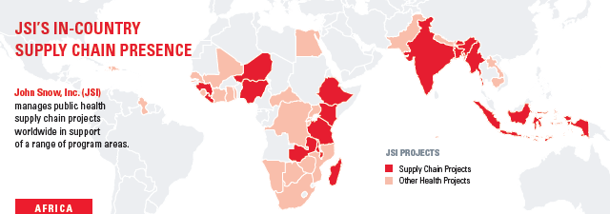
Who We Are
Dedicated to improving access to healthcare to underserved and vulnerable communities around the world
Operating in 44 countries (including the US) with over 3,000 staff
Over 30 years of experience in supply chain management in over 70 countries

Slide 22
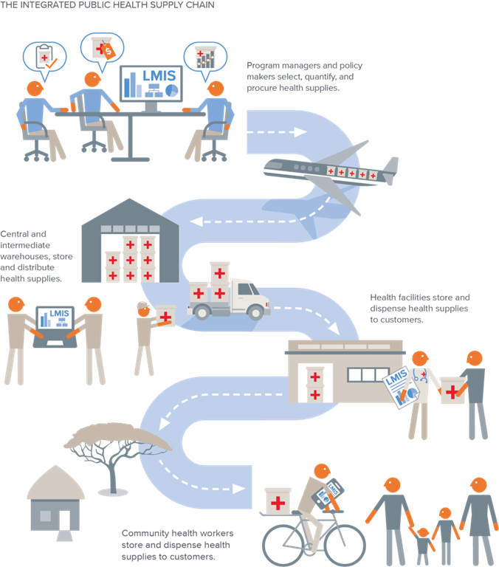
Digital Health/OpenLMIS Expertise
Digital LMIS Experience
Enterprise resource planning solutions to manage global supply chain operations and national medical stores
Web-based LMIS solutions in Bangladesh, Ethiopia, Guinea, Mozambique, Myanmar, Nepal, Pakistan, Philippines, and Zimbabwe
OpenLMIS in Tanzania, Zambia, Cote d’Ivoire, and Guinea
Mobile technology for last mile ordering and reporting in Malawi, Kenya, and Tanzania
GS1 bar code functionality to support receiving and distributions workflows in Ethiopia
Digital Health/OpenLMIS Expertise

Slide 23
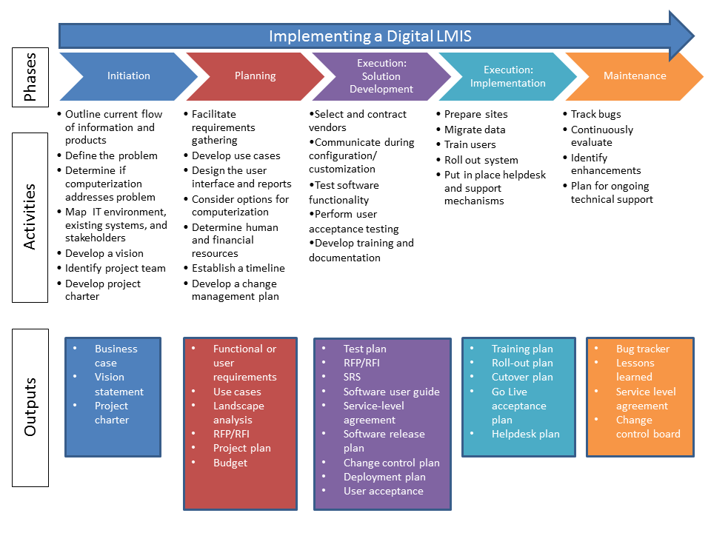
Key expertise
Key Expertise
Supply chain analysis, design, and implementation
Business process reengineering and change management
Information system design and implementation
Data use and performance management
Digital management information system implementation

Slide 24
Contact Us
supplychain@jsi.com
www.jsi.com/supplychain

Slide 25
SolDevelo

Slide 26
Digital Health Expertise

Slide 27
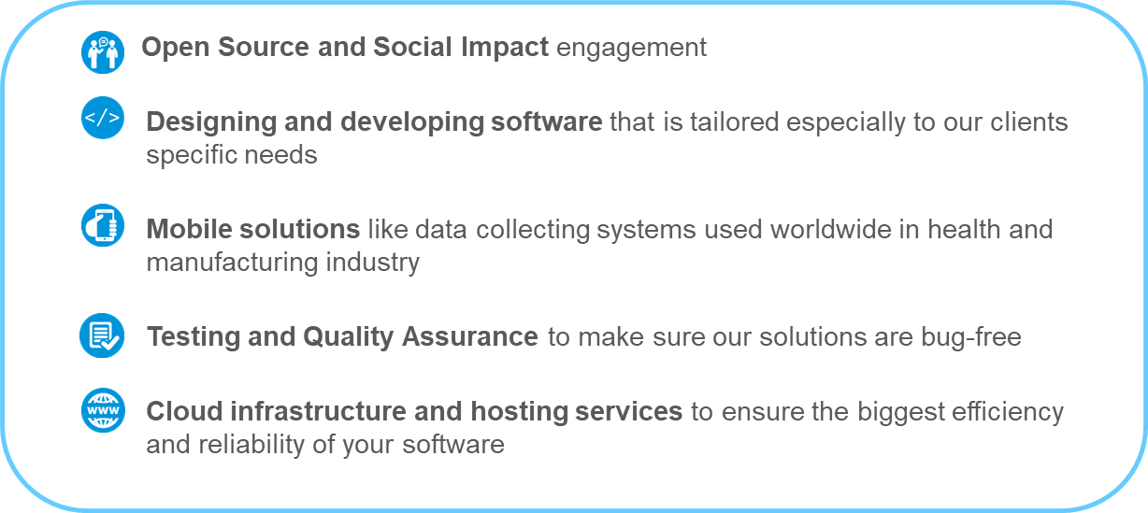
Key Experience

Slide 28
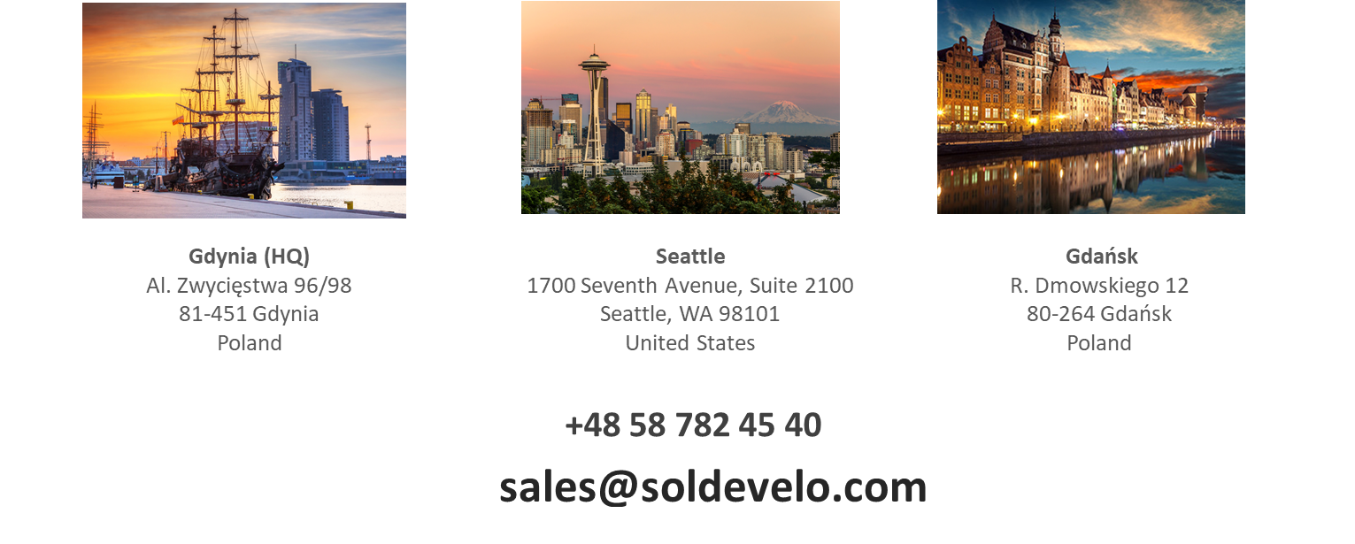
Contact Us

Slide 29
SoftWorks
SoftWorks is a software development company, specialization in supply chain information system development
Established in 2007, total 16 staff
Software implemented in 19 countries, mostly African subcontinent
Experience working with International NGOs – Management Sciences for Health, Chemonics, PATH, WaterAid, ICIMOD
Donors and funding agencies – USAID, JICA, Global Fund
Trusted Partner of OpenLMIS Community since July 2018

Slide 30
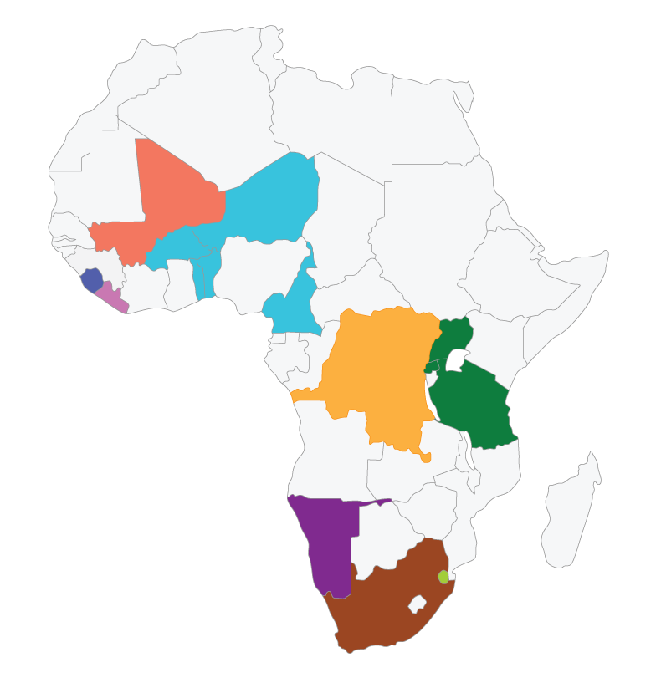
Digital Health Expertise
MALI
https://ospsante.org
LMIS for FP/MCH/Malaria/Nutrition/HIV
BANGLADESH
https://scmpbd.org
LMIS, Procurement, Asset Management
SIERRA LEONE
http://slpharmadb.org
LMIS for HIV/FP
OSPSIDA
https://ospsida.org
https://ospsida-cameroon.cm
HIV LMIS+Patients
LIBERIA
https://liberiaelmis.org
LMIS for all Products (500+)
Digital Health/OpenLMIS Expertise
DRC
https://infomedrdc.org
Tracer Products (107)
NAMIBIA
http://pmis.org.na
LMIS for all Products (1200+)
RWANDA/UGANDA/TANZANIA
https://ecsascportal.org
Regional Portal -TB LMIS+Patients
SOUTH AFRICA
https://perseus.org.za
Pharmaceutical System Performance Monitoring
SWAZILAND
https://lmis.org.sz

Slide 31
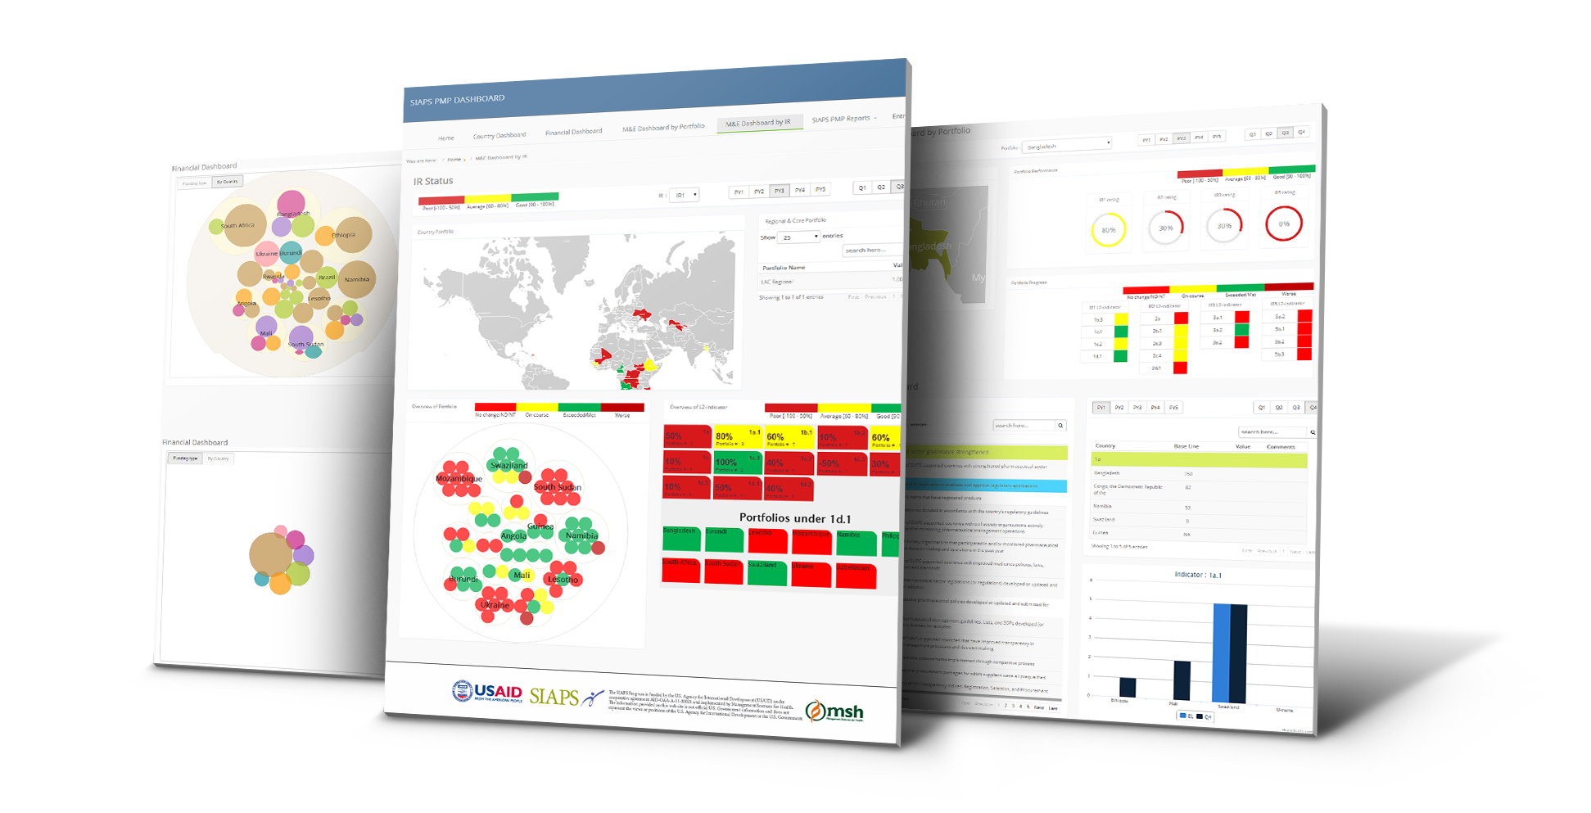
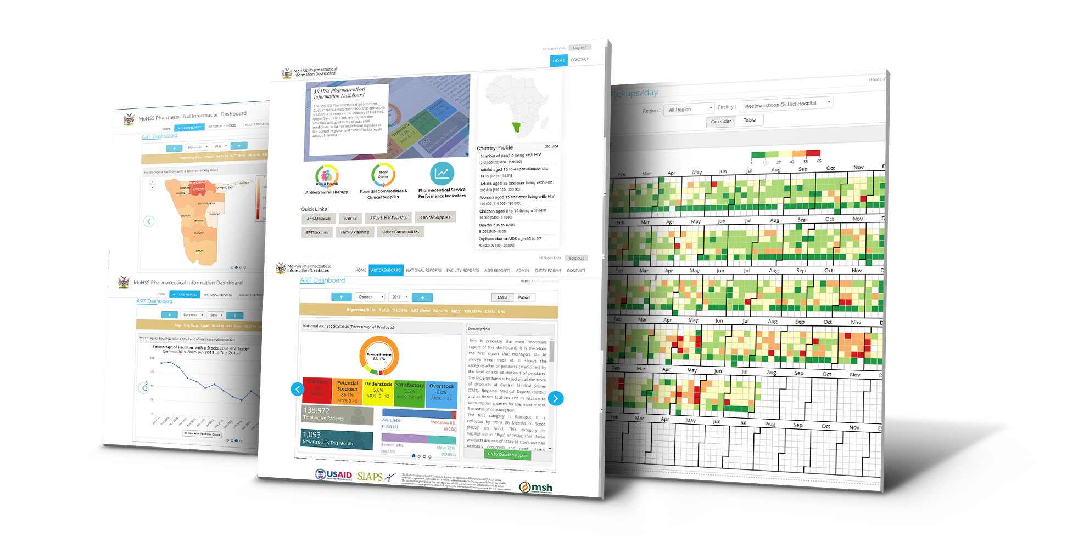
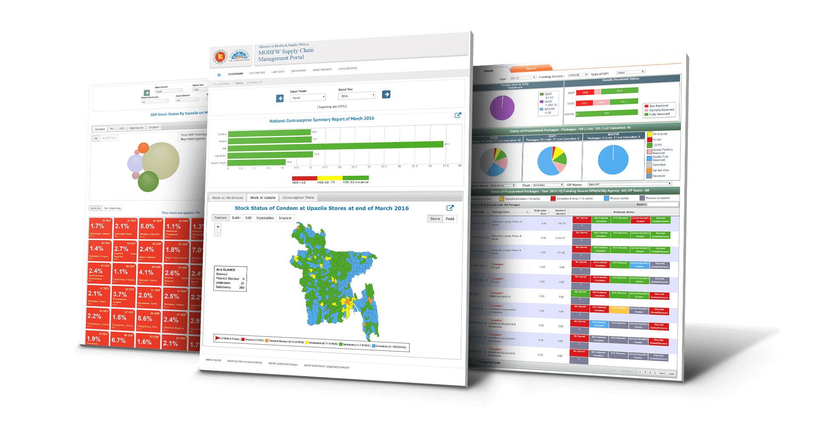
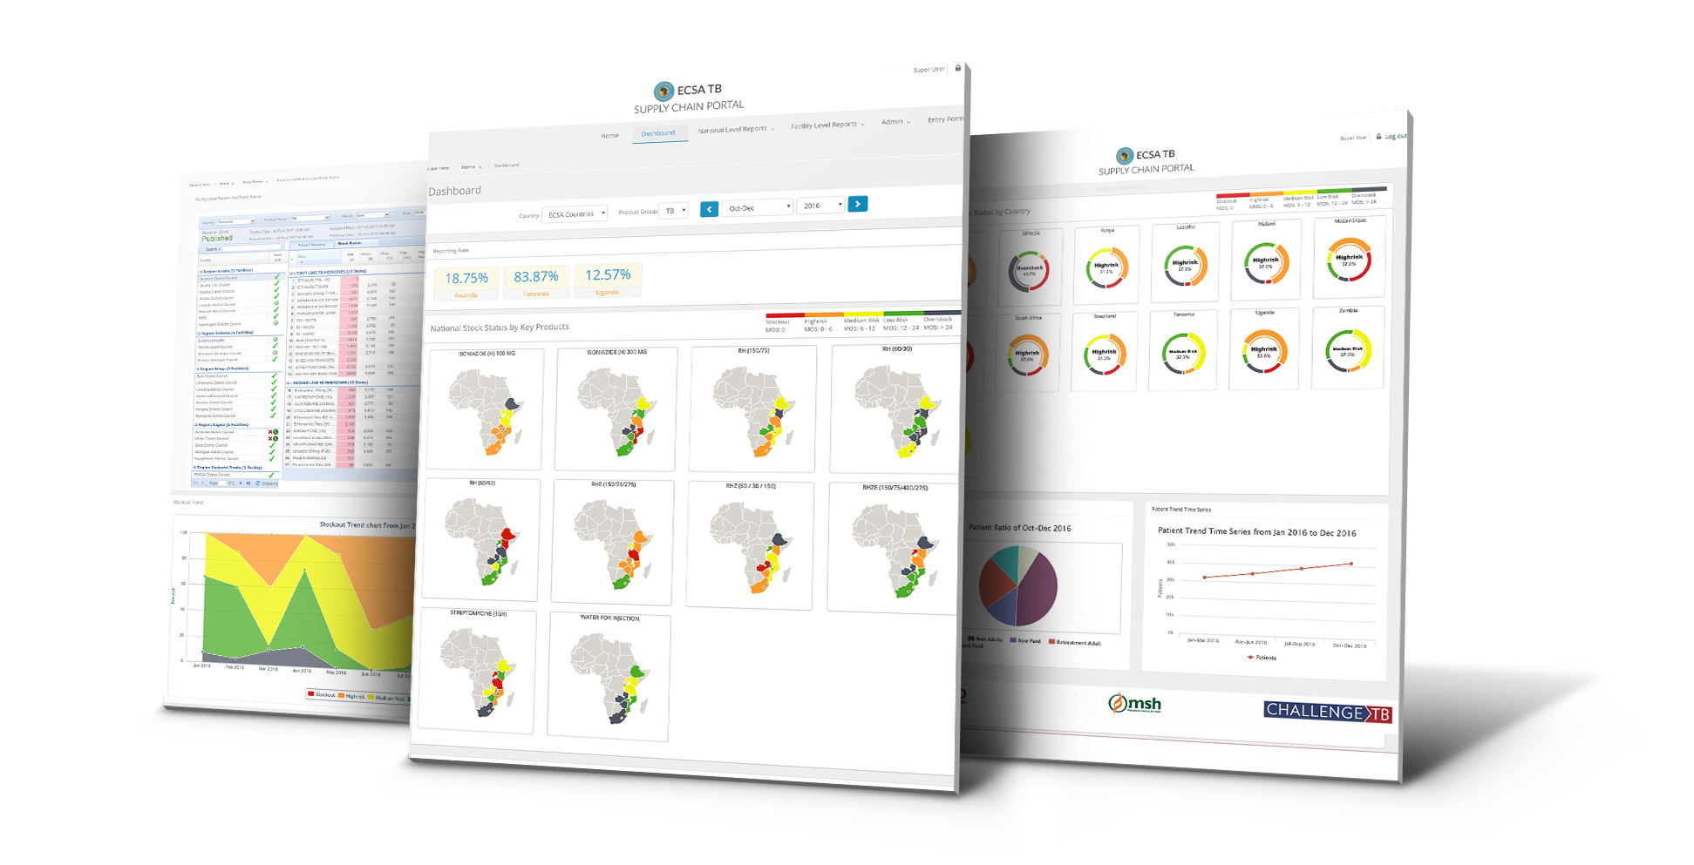
Key expertise
Major work area in health system strengthening –
- National level LMIS
- Inventory Management System for warehouses
- Interoperability with DHIS2
System requirements analysis
Software development
User Acceptance workshop
Rollout and implementation
Maintenance support

Slide 32
Contact Us
info@softworksbd.com
http://softworksbd.com

Slide 33
Our Mission
Save lives and improve health by increasing access to quality health care for the most underserved communities.
What we do
VillageReach works with governments to solve health care delivery challenges in low-resource communities.
To maximize its impact, VillageReach focuses on three areas of the health system.
Health Workers
Access to Products
Data Systems

Slide 34
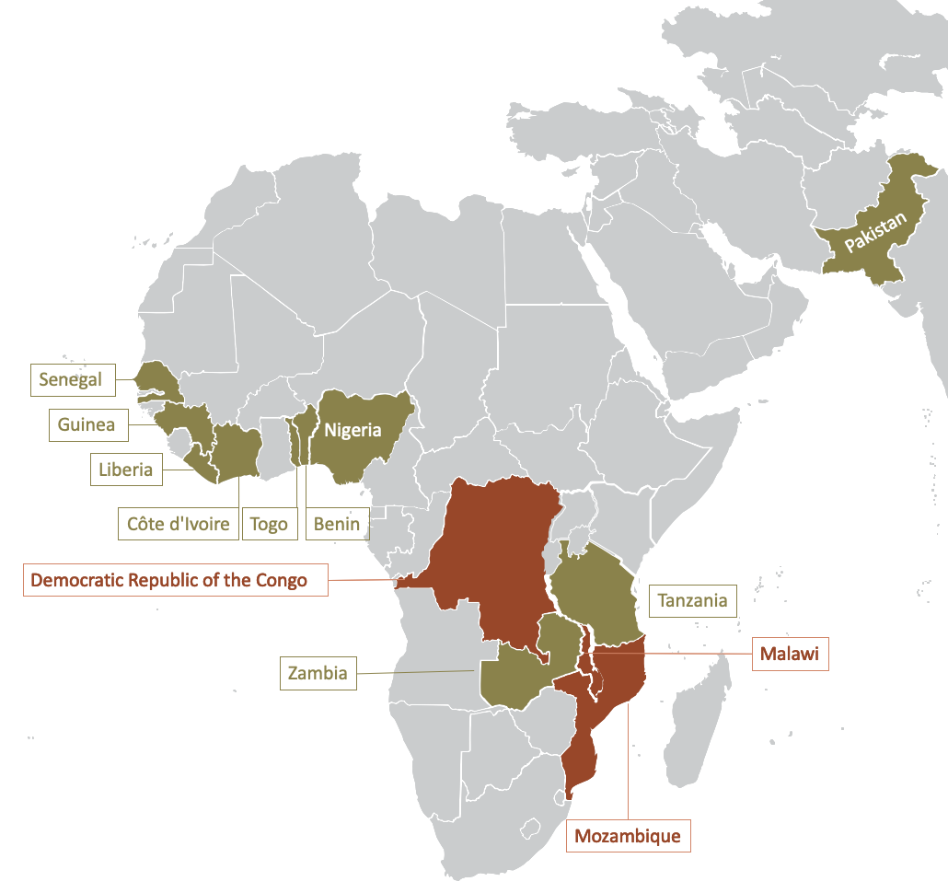
Digital Health/ OpenLMIS Expertise
Malawi
OpenLMIS v3 implementation & support
Chipatala Cha Pa Foni (health center by phone)
Mozambique
SELV (OpenLMIS v2 for vaccines)
SIGLUS (OpenLMIS v2 mobile stock management) upgrade assessment
Angola
OpenLMIS v3 implementation
Cote d’Ivoire
mVaccine
Benin
SIIL (OpenLMIS v2 for vaccines)
Tanzania
Support for eLMIS & gap project
DRC
Mobile logistics data collection for NextGen Health Commodity Supply Chains

Slide 35
Key expertise
User-centered design
Data visualization & analytics
Solution
innovation
Business
analysis
Software development
Supply chain
design

Slide 36
Contact us
General inquires:
Email: info@villagereach.org
Phone: +1 206.512.1530
Brandon Bowersox-Johnson
Director, Digital Solutions
Email: brandon.bowersox-johnson@villagereach.org
WhatsApp/Phone: +1 217.766.1166

Slide 37
Clinton Health Access Initiative (CHAI)
CHAI is a global health organization committed to saving lives and reducing the burden of disease in low- and middle-income countries, while strengthening the capabilities of governments and the private sector to create and sustain high-quality health systems that can succeed without it’s assistance
CHAI operates in 36 countries with offices in 28 countries and has approximately 1500 staff
CHAI works on almost all communicable and non-communicable programs in public health
CHAI aims for universal access to services by improving capacity, enabling access to commodities and services and building sustainable systems to deliver these services

Slide 38
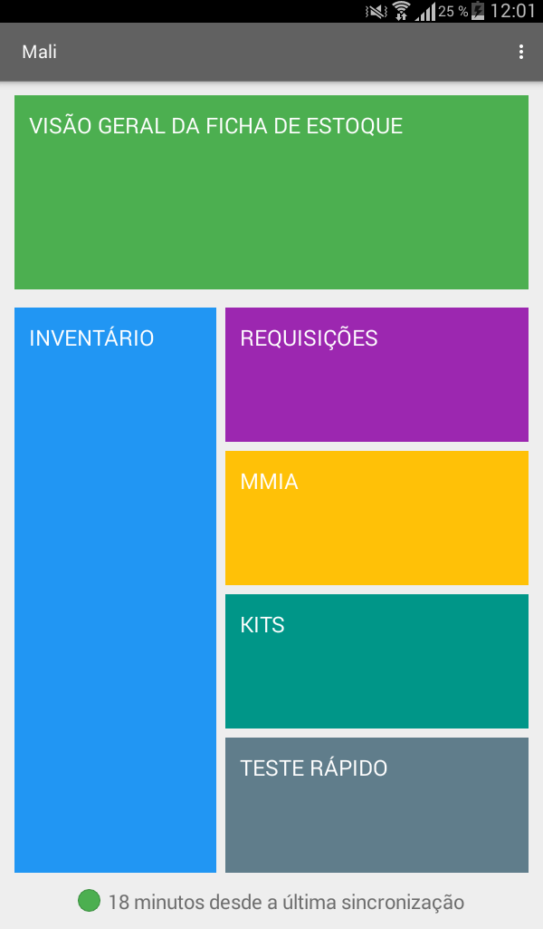
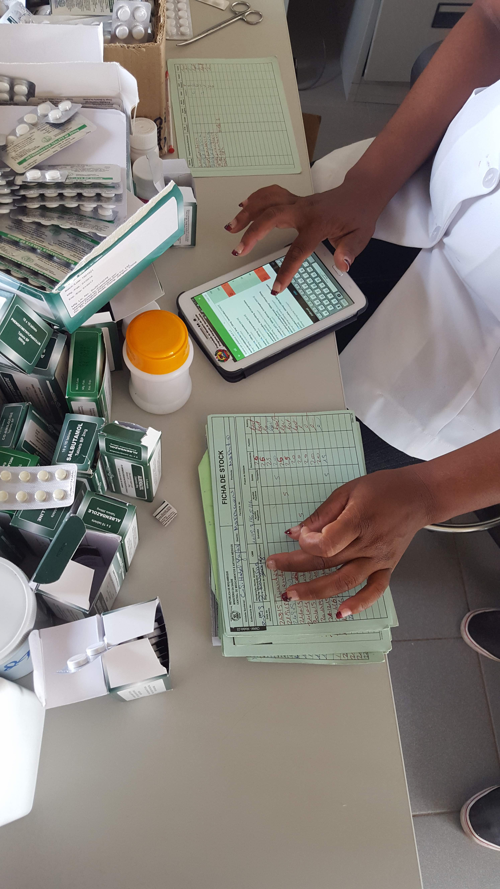
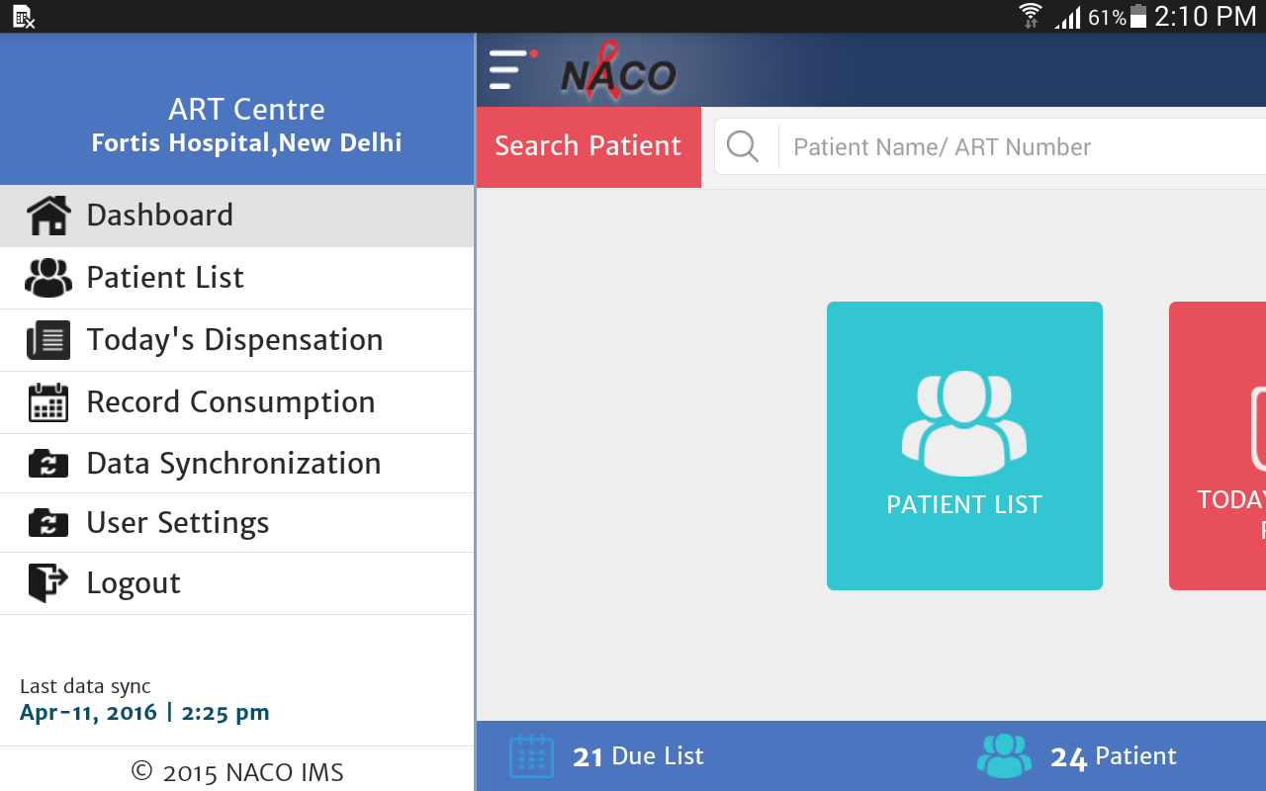
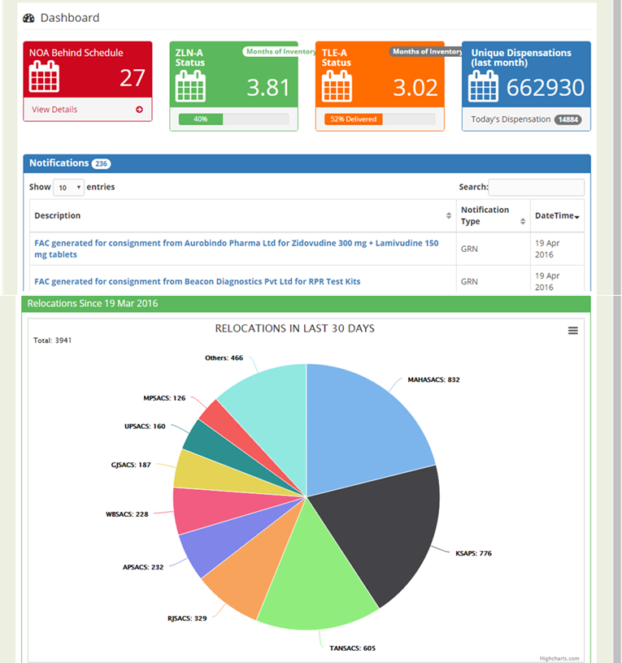
Digital Health/OpenLMIS Expertise
Digital Health & OpenLMIS Experience
As a Core member of the OpenLMIS community since 2013:
Provided major technical expertise into building Stock Management functionality in OpenLMIS v3
Contributed to overall vision, governance and design of OpenLMIS product
Contributed to building features and functionalities into OpenLMIS
As an Implementer, developed and implemented:
In Mozambique: SIGLUS, a mobile stock management system for all commodities and programs. SIGLUS uses OpenLMIS v2 as back end
In India: Inventory Management System (IMS) for HIV and deployed at national scale
In Kenya: Health Commodity Management Platform
In Kenya: CHANGO, an LMIS for Vaccines
In various countries: SMS-based stock management and reporting tools

Slide 39
Key expertise
Key Expertise
At Country Level, we understand environmental and programmatic context given extensive work in country at all levels and on a majority of programs. This provides us with the following expertise:
Localization of an OpenLMIS instance before deployment
Business process mapping and opportunities for re-engineering
Efficient and comprehensive system set up process with adequate ongoing stakeholder engagement
Capacity building,
Service and maintenance set up
Hand over / transition
At Global Level, we have expertise in:
Supply chain
Business process mapping and re-engineering
Information systems design, development and deployment
Project Management of software development or deployment
Interoperability

Slide 40
Key expertise
Contact Us
Gaurav Bhattacharya
Director, Information Systems Team
gbhattacharya@clintonhealthaccess.org
Phone/WhatsApp: +1 571 488 8808
Satish Choudhury
Information Systems Team
schoudhury@clintonhealthaccess.org

Slide 41
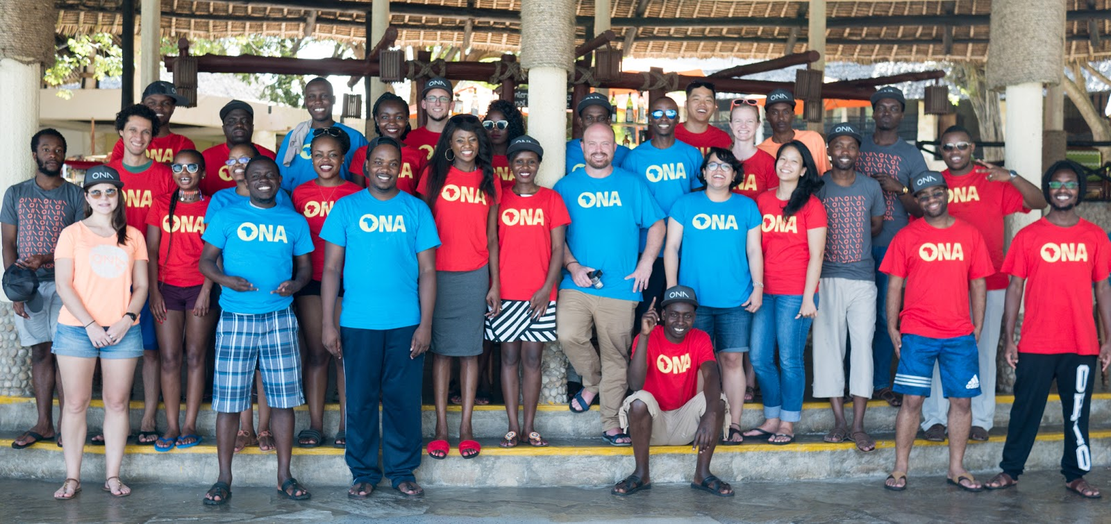
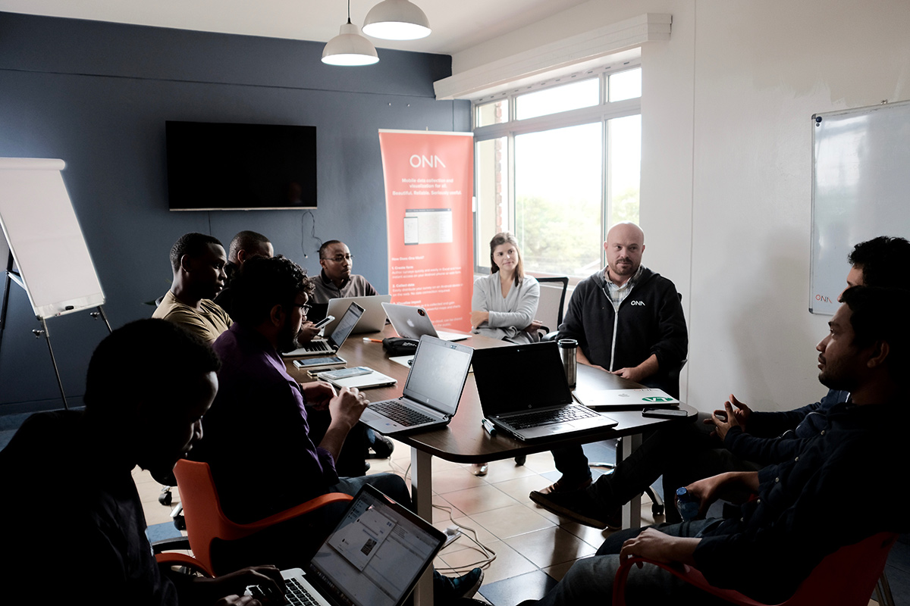
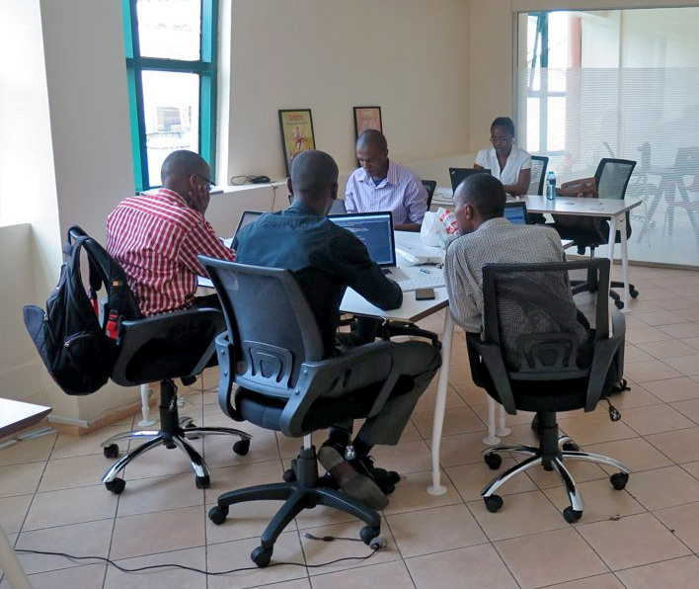
Ona is a social enterprise with extensive experience in the humanitarian and development sectors globally.
We build technology that affords new opportunities for governments and development organizations to be increasingly collaborative, data-driven, and accountable to the people they serve.
Notes:
Ona is a software company that provides data solutions for humanitarian and development organizations
Our mission is to provide organizations with powerful, flexible tools to serve the communities that are most in need
We offer tools that enable flexible data collection via XLS forms, we have a specialized mHealth tool, and an analytics platform to complement the data collection done in our systems or can be integrated with other systems like OpenLMIS
photos are taken from a recent company retreat and our team members in the Nairobi office. We currently have about 40 team members at our Nairobi headquarters.

Slide 42
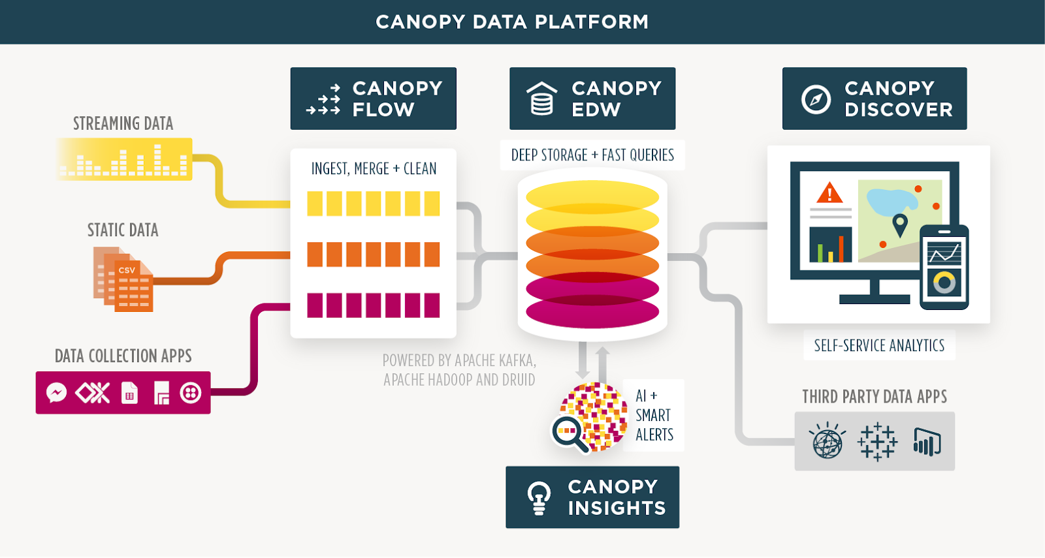
Data Analytics
Notes:
Ona is developing the OpenLMIS analytics and reporting solution based on our open source Canopy Data Platform which is an assembly of
Data is ingested from multiple sources into an electronic data warehouse that allows implementations to build their own self service reports
We have developed this platform in partnership with the OpenLMIS community and have demonstrated pulling information from emails, DHIS2, custom accounting systems and OpenLMIS all into a single system that can be built upon with minimal engineering.

Slide 43
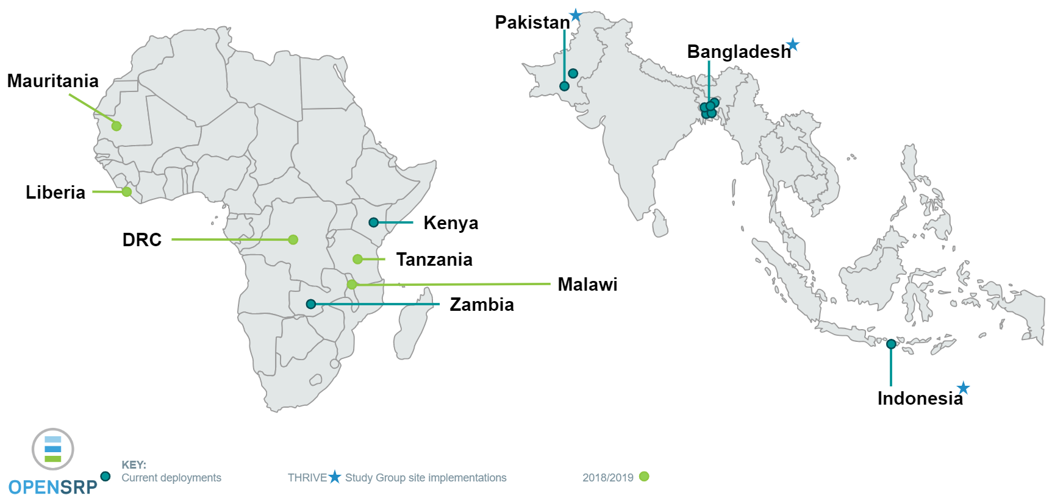
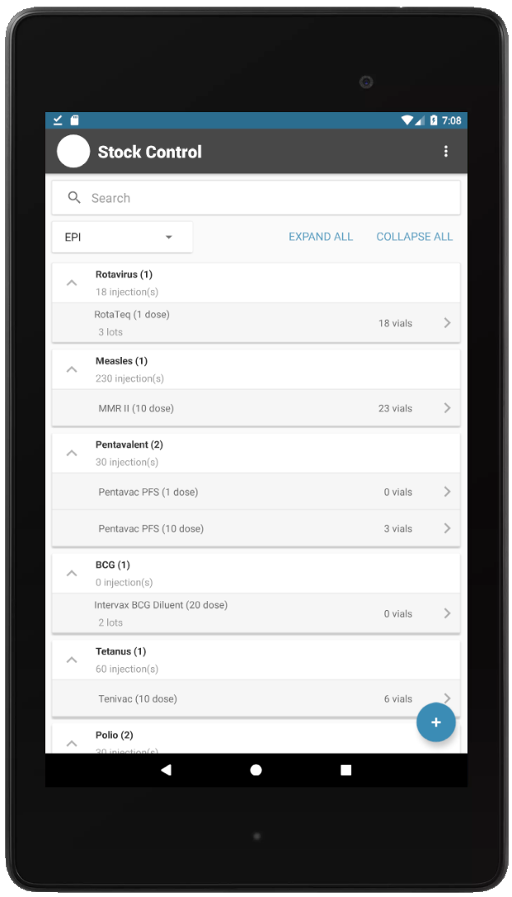
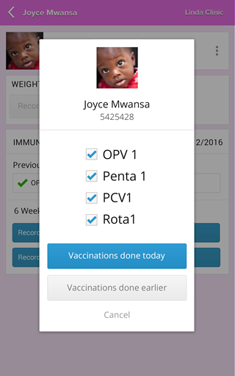
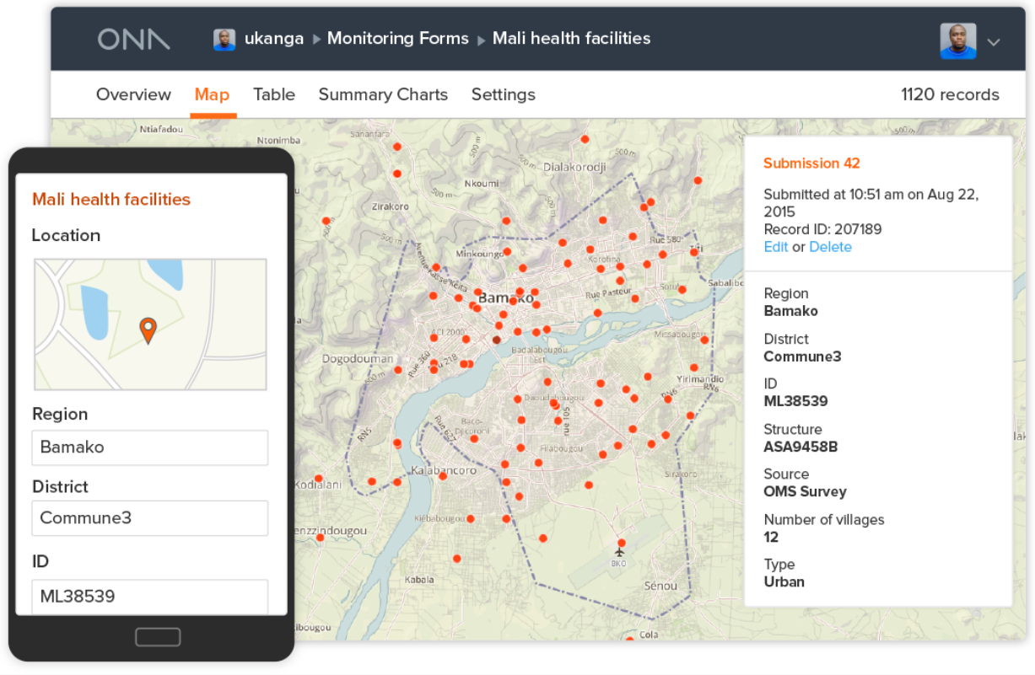
Mobile Platforms
OpenSRP Provides Mobile Stock Management and Child Immunization All In One
Ona.io 30,000+ users in over 200 countries
Ona.io 30,000+ users in over 200 countries
Notes:
Ona develops two primary mobile platforms, the Open Smart Register Platform (OpenSRP) and Ona.io, our software as a service offering.
Integration between OpenSRP and OpenLMIS to support managing stock offline in the OpenSRP Android app
Provides a mobile interface that can work offline for long periods of time, only exchanging information with OpenLMIS when the internet becomes available
Stock management module
Compliments numerous other OpenSRP implementations focused frontline health workers who provide immunizations and essential medicines to women and children
Link the dispensed immunization to the list of children who received it on any given day
Ona’s Software as a service platform Ona.io is a global online tool used by more than 30,000 users in over 200 countries
Allows individuals and organizations to develop, deploy and manage surveys in hard to reach places without engineering required.
Linking all of this together, Ona provides thought leading technologies in this space with the mission to ensure equitable access to services for those who need them most
We are focused on partnering to deliver sustainable technology solutions that support your needs.

Slide 44
Contact Us
Clay Crosby
Reporting and Analytics Lead
Email: ccrosby@ona.io
Notes:
Please contact me with any queries and I will be sure to route to the appropriate Ona team where needed.

Slide 45
Community Contact
openlmis.org
info@openlmis.org
Notes:
The info@openlmis.org email address that you see on the screen is how you would contact the OpenLMIS Community as a whole, for general inquiries about the software or any OpenLMIS community-related inquiries. Feel free to reach out to us at any time!

Slide 46
Malawi Implementation Experience
Mr. Vuso Tembo- Ministry of Health Malawi
Chifundo Chilivumbo- VillageReach
Notes:
Introduction of both presenters
Vuso Tembo is a Pharmacist working with MoH in Nsanje a district 700Km from the Capital City. Vuso has been part of the OpenLMIS implementation from validating requirements to the launch and day to day operations of OpenLMIS
Chifundo Chilivumbo-OpenLMIS Senior Technical Advisor- lead and managed the implementation of OpenLMIS in Malawi

Slide 47
OpenLMIS- Success in Malawi
Reflections: How OpenLMIS has improved our supply chains
OpenLMIS has made life easy: Users can easily report & order supplies using one system within one sitting.
Auto-calculations save time for users and improves data accuracy
Improved data visibility: enables informed decision-making at all levels fo the supply chain; helps in drug redistribution through stock status reports
OpenLMIS in Malawi is used as a reporting and ordering system used by Facilities, MoH and CMST (Warehousing agent)
Notes:
Talk about how easy it is to report when the LMIS reporting data is used as draft ordering data requiring users to modify only some fields.
Highlight the order qty auto-calculation and that auto-calculation saves users time (so that they can focus on other important aspects of their jobs, like seeing patients!); and improves data accuracy by reducing arithmetic errors.
On data visibility: making supply chain data available to decision-makers facilitates informed decision making and problem-solving. Can identify stock issues quickly and respond quickly. For example, re-distribution of commodities. Commodities that have over 100 months of stock; you will notice that you are overstocked and can redistribute them accordingly
Reporting and ordering can be done from different computers

Slide 48
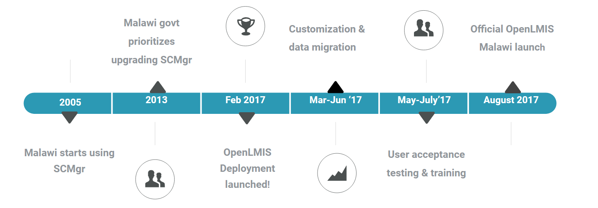
Implementation timeline
2013 MoH noticed that SCMgr was not easily scalable and maintainable due to Desktop baseded on Ms Access architecture
MoH was involved requirement definition and reviews in - Feb 17
As users we were key in user acceptance testing – July 17
A set of users was selected to be Trainer of Trainees -July 17
Started using the System on 01 August 17
Notes:
Requirements gathering and review was important in the sense that as users were informing developers on what we want to be in the system-this aspect of user-centered design is what ensures OpenLMIS is user-friendly and responding to needs of the various types of users in the field
With UAT (User Acceptance Testing) we were validating whether the system has been developed as we defined

Slide 49
Implementation Costs
Requirements Engineering
Requirements engineering include requirements gathering, system specific, validation and user stories development.
Software development and testing
Development included development, customizations, migrations and system tests
User Trainings and Deployment Support
ToT trainings, Users Trainings, Managers training and post deployment user support cost
Hosting and IT infrastructure
On-going User Support
Notes:
Ongoing costs for Hosting and IT infrastructure: you will need to have appropriate infrastructure to host the system, purchase any additional desktops or devices if there aren’t ones currently available, and dongles with data bundles

Slide 50
System Support
Routine Support
Technical team travels around the country periodically to offer user support
New versions management
Users are notified days before a new version is deployed and the changes that it will bring
System update support
Once a major update is made to the system, support team orients users on new the features using On-Job-Trainings
Support forums
Users can inform support team of the challenges through OpenLMIS WhatsApp Support Group, 24/7 Support Phone Lines and E-mails
Notes:
Ongoing support is important for maintaining the system

Slide 51
Key Successes
Users satisfaction
System has been deemed as easy to use and provides all the services users want (OpenLMIS User Survey, 2018)
Ordering/reporting together
Reporting data is used for automatic order preparation that allows users to edit -this saves time for pharmacy personnel to focus on other important tasks
Timely access to the reports by MoH
Once data is captured it is considered reported, MoH will be able to view the data
Flexible work environment
OpenLMIS allows users to work from anywhere as long as there is internet.
Notes:
User Satisfaction Survey was done from November 2017 to February 2018

Slide 52
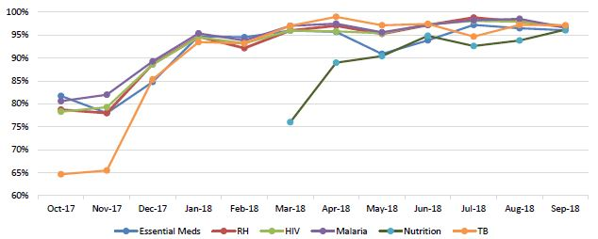
Impact of OpenLMIS
Improved reporting rates
Improved data quality
Improved decision-making; thereby reducing budget expenses
Digital Health/OpenLMIS Expertise
Notes:
Reporting Rates: Talk about how low reporting rates were when SCmgr was being used and with the use of OpenLMIS. Notably, reporting rates have moved from 80% to above 95% in all programs (as shown in the graph below). Improved reporting rates improve overall data quality
Improved Data Quality: Talk about LMIS that were submitted with only one line item which was not balancing, SCmgr was not validating the figures being entered. OpenLMIS does not accept data that is not balancing, improving data accuracy
Improved Decision making: Cover issues to do with stock status report which show MoS per product. Without this commodities were expiring as facilities were dependent on manual checking

Slide 53
Lessons Learned
Users require time to get used to any new system
There was resistance in some quarters to start using the new system.
Power outages heavily affected OpenLMIS implementation
Users were capturing data in the evening
Users were using laptops that were charged when power was available
CMST took time to start recognizing OpenLMIS orders
MoH had to write to CMST about receiving all orders in OpenLMIS otherwise users were forced to use a parallel system for orders only
Notes:
Having several systems resulted in poor data use and monitoring
The support team provided users manuals, quick reference guides and On-Job-Training for those struggling to use the system
MoH was highly involved in buy-in users to use the system
Posting of how each district is performing to the WhatsApp group acted as a reference point for other users to ensure that they are the first to capture 100% of their forms/requisitions

Slide 54
Key expertise
What’s next for OpenLMIS in Malawi?
Integration with DHIS 2 and other systems used in Malawi
Discussion to leverage other OpenLMIS features,
Stock management
Vaccine module
Notes:
Talks have started in the direction of adding stock management module in the application
There is a lot interest to have integration with DHIS 2 and other systems
Facility registry, terminology services, potentially
EPI Department of MoH and other NGO have shown some interest in the using Vaccine module of the system

Slide 55
Thank you
--
Zikomo

Slide 56
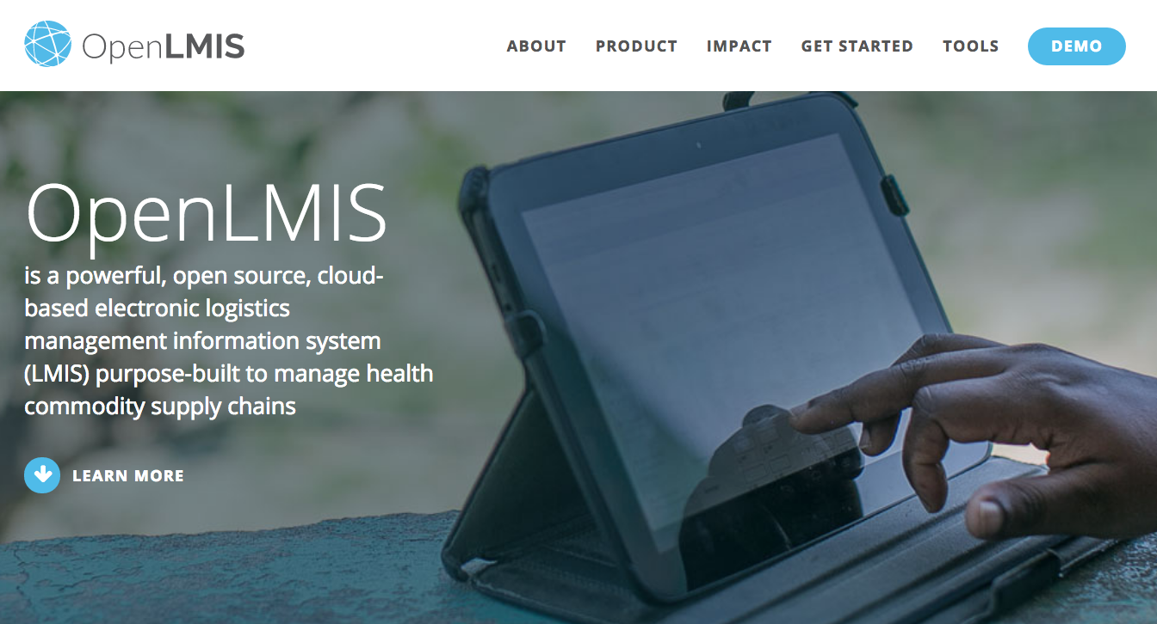
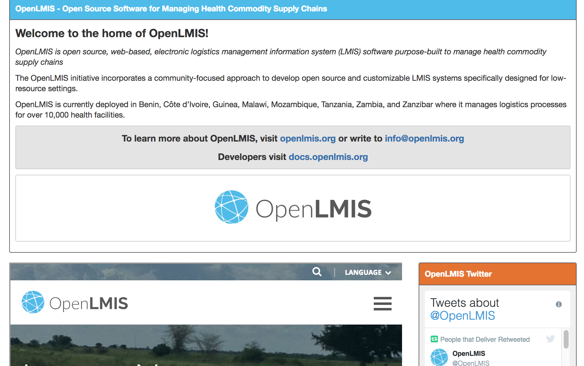
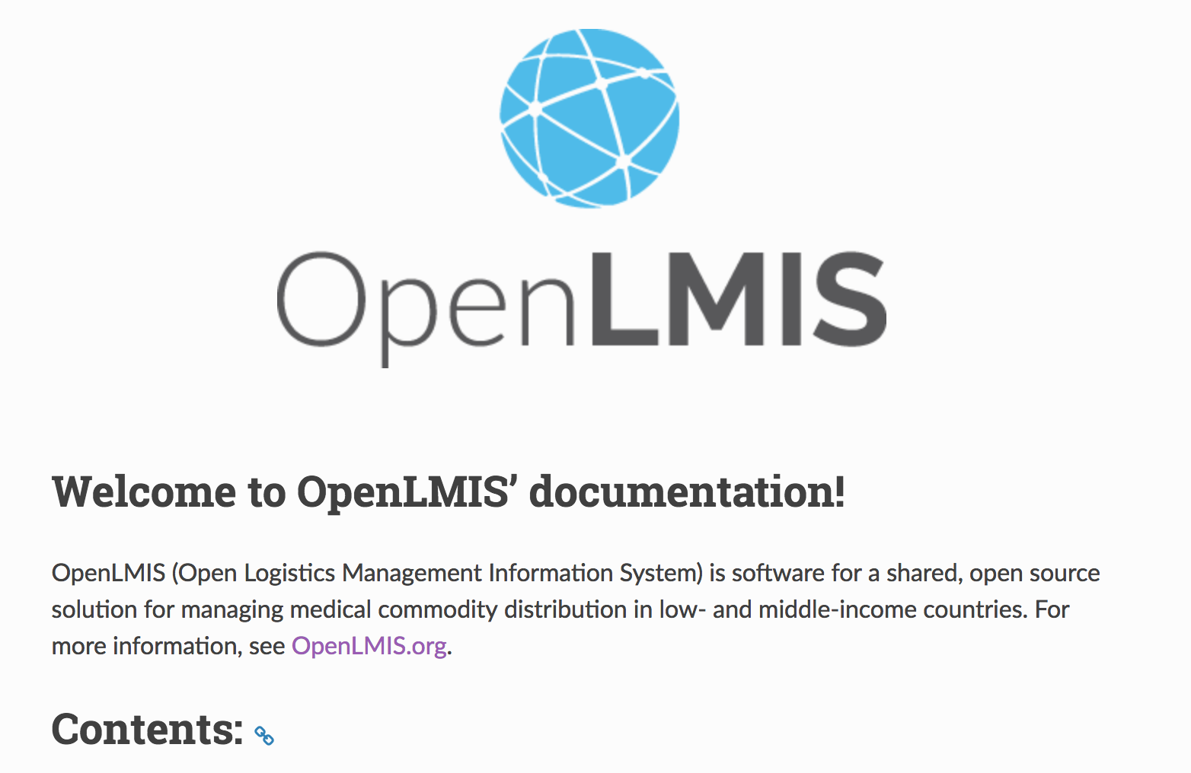
OpenLMIS Community Resources
openlmis.org
Blog posts, implementation map, features, tools, and the Implementer Toolkit can be found on the OpenLMIS website.
Wiki
The wiki is the source for community meeting notes, committee descriptions, product design considerations, project management, and the living product roadmap.
Documentation
Contains developer-oriented OpenLMIS documentation. Users can find developer docs, ERD schemas, an OpenLMIS coding style guide, and API documentation.
Visit the OpenLMIS YouTube channel for demo videos and more

Slide 57
Thank you and Q&A
openlmis.org
info@openlmis.org

