Slide 1




Empower
FOCUS AREAS
Learning & Development,
Digital Solutions,
Research & Consulting
Member of
Quality Council of India
Board Member of People that Deliver
Administering the IAPHL India Chapter

Slide 2


Introducing Empower
Empower is a global health academic, research and consulting institute which builds empowered communities. Empower offers services in these areas including but not limited to:
    Research and Technical Assistance
    Learning and Development for building human resource capacity
    Health Systems Strengthening
    Public Health
    Leadership
    Digital solutions across programs

Slide 3
Our Reach
50+
Countries Reached
100+
Organizations Supported
Countries: Afghanistan, Cambodia, Nepal, Myanmar, Fiji, Vietnam, Timor Ethiopia, Zambia, Zimbabwe, Uganda, Nigeria, Burundi, Lesotho, Liberia, DRC, Malawi, Sudan, Moldova, Russia, Ukraine and many more Organizations: UNDP, UNFPA, UNICEF, UNOPS, WHO, UNAIDS, UNRWA, USAID, Ministries of Health, AGPAF, CHAI, Chemonics, Care International, Save the Children, Red Cross, USP and many others

Slide 4



Empower’s Areas of Expertise
Research & Consulting
Learning and Development
Digital Solutions

Slide 5
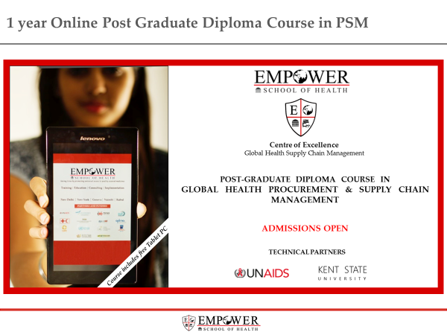
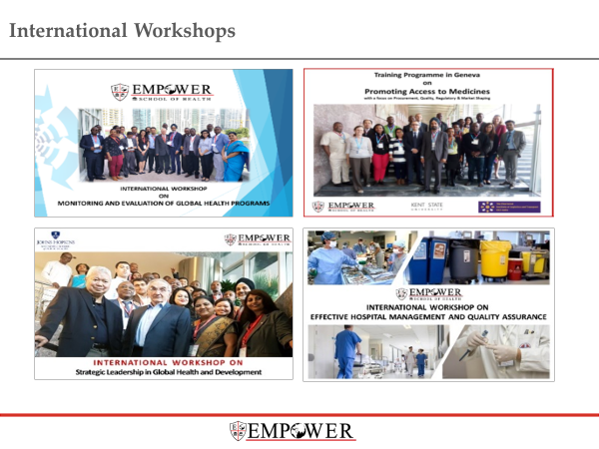
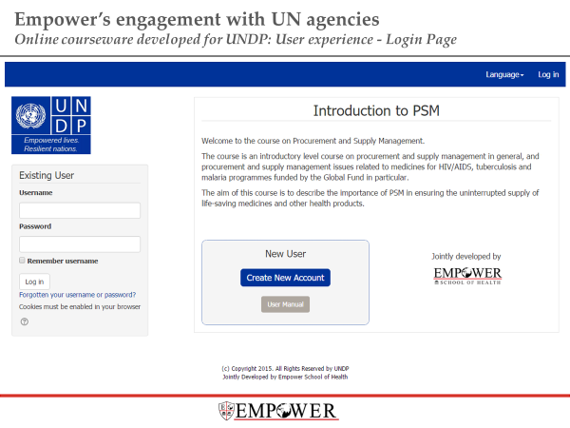
Learning and Development
Learning and Development
Online
ePGD Course
UNDP Certificate Course
Face to Face

Slide 6
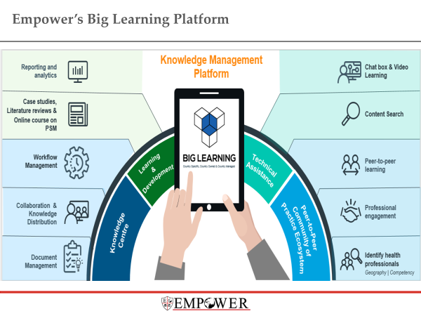
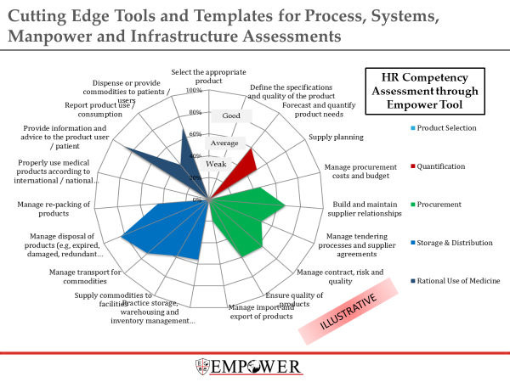
Digital Solutions
Digital Solutions
Big Learning
Competency Assessment Tool (CAT)

Slide 7
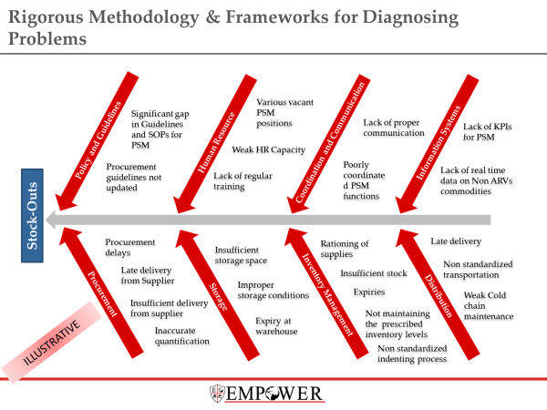
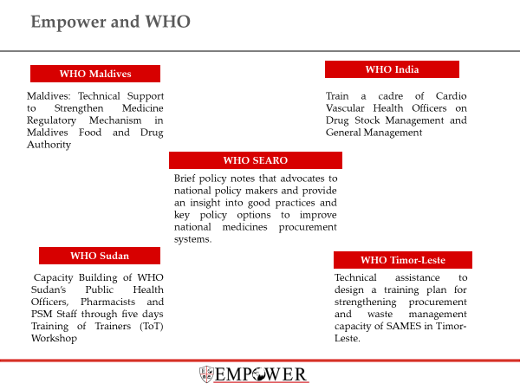
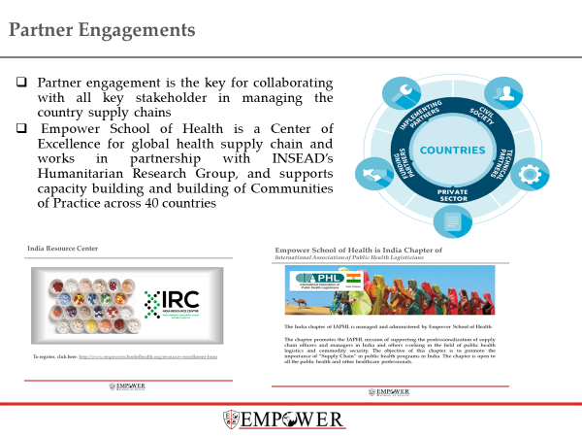
Research & Consulting
Research & Consulting
In-country health supply chain assessment & diagnostics
LMIS Solutions
Stakeholder Engagement and Community of Practice
Supply Chain Design and Strategy
Supply Chain Process Re-engineering

Slide 8
eLMIS Offerings and Experience

Slide 9
Empower e-LMIS Offerings
The core areas where we provide solutions are:
eLMIS Landscape Study
Conducting assessment and feasibility studies for introducing eLMIS and analyse the factors in implementing the eLMIS
LMIS Design & Selection
Align the design to country/program policies, guidelines, processes and goals
Identify the user requirements and develop the functional and technical specifications
LMIS Development and Implementation
System Integration of all LMIS- supply chain solutions
Data reporting and dashboards
Help the programs to select and on-board vendors, develop detailed system specifications and use cases
Lead user acceptance testing and pilot rollouts. Train and handover the system to program staff. Plan and execute full-scale rollouts.
Evaluate the level of compatibility of the LMIS with other existing systems and detail the integration specs
Designing web-based dashboards for managers, enabling them to visualize data from across supply chain and health systems covering all locations and product categories.

Slide 10
Online Logistics Information System - Zimbabwe
Empower with MOHCC Zimbabwe worked to develop an online integrated supply chain system in the form an eLMIS to manage health commodities and equipment across supply chain functionalities.
The broad scope of the consulting project was:
Gathered user requirements and assessed and analysed the local fragmented systems in use. Compared with the Rwanda and Zambia system as per reports available and gauged the suitability to the Zimbabwean context
Finalized functional, technical and integration specification for the eLMIS and analyse the existing requirements and related documentation while taking into consideration stakeholder inputs to recommend an appropriate eLMIS system.
Prepared a detailed implementation plan and costing of the project including each component such as software licensing, customisation, hardware, network & internet addition/up-gradation, installation, training, technical support

Slide 11
Implementation of the eZICS (Enhanced Zambia Inventory Control System) Software for Medical Stores Limited, Zambia and the Health Sector
Empower successfully rolled out the powerful inventory management system at MSL to automate and enhance the core inventory management processes.
eZICS was rolled out in 60 facilities across the country by the Empower team and MSL team jointly.
Following was executed as part of the scope of the project:
Liaise with the eZICS vendor (IBM) for development and user acceptance testing to ensure the system is developed optimally in the process also detailing and refining the system specifications
Develop the M&E and reporting framework for the eZICS project (activities, costs, etc) and develop guidelines for pilot roll out of eZICS
Develop the eZICS project costed implementation plan and coordinate meetings with stakeholders related to eZICS project
Oversaw the rollout and conducted training of users and administrators

Slide 12
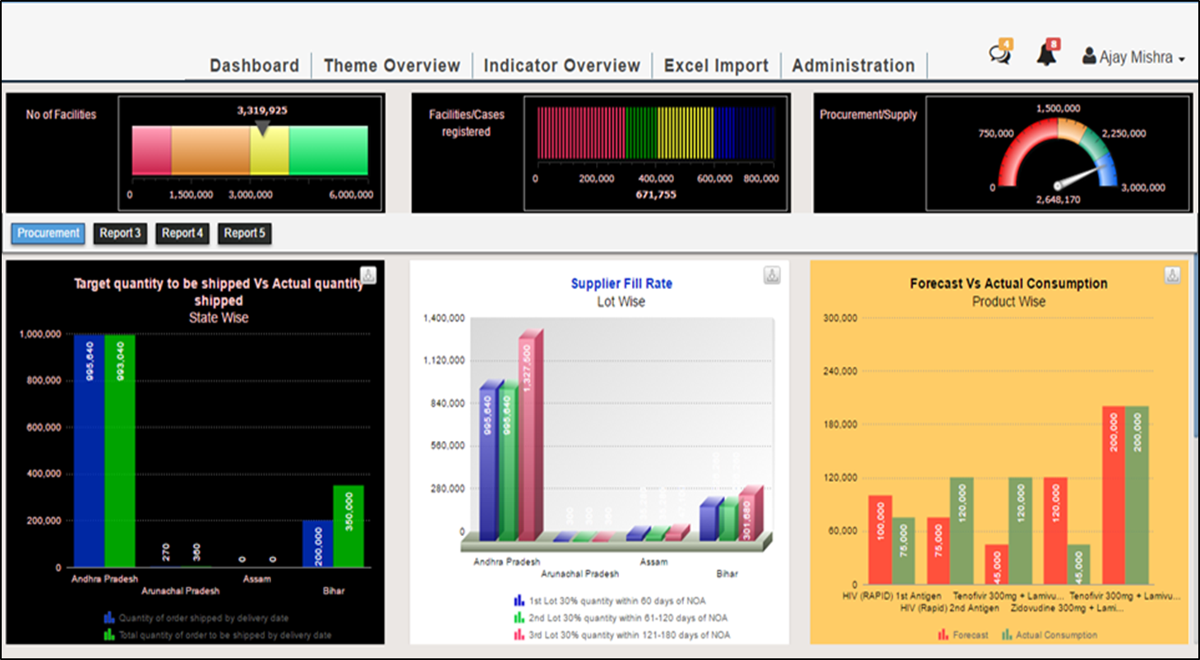
LMIS Data Reporting & Analysis through Integrated Dashboard at NACO
Procurement and Supply Chain Dashboard for Senior Management
ILLUSTRATIVE

Slide 13
Training on LMIS in Myanmar
Empower covered general principles of LMIS
Leveraging information for decision making from Logistimo and m-Supply systems
Practical elements of implementing and using LMIS solutions

Slide 14
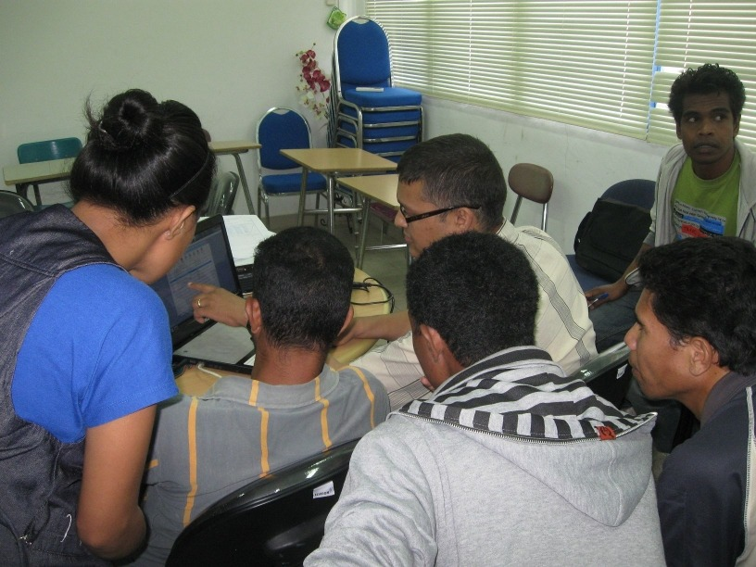
High level LMIS Advisory for Timor Leste (Project in Progress)
High level assessment of country LMIS needs
Analysis of existing and alternate systems
Key recommendation on future LMIS strategy and roadmap

Slide 15
Expected Outcomes from becoming a Trusted Partner of the OpenLMIS Community
Exploring possibility of conducting regional OpenLMIS workshops: East and West-Africa based workshops to bring together community members and current and prospective users
Through the Product Committee, influence the direction of OpenLMIS development and priorities
Through the Technical Committee, influence specific software development considerations and help address issues within the OpenLMIS
Opportunity to collaborate with other leading organizations in the global health space with shared values regarding LMIS
Targeted demonstrations outreach visits to meet with potential financing or implementing partners of OpenLMIS to solicit support and/or encourage uptake of OpenLMIS within their managed geographies.
Targeted outreach visits to key countries where an electronic LMIS project is being planned to help facilitate and support the project.

Slide 16




























Clients and Funders
Empower has offered its expertise in digital engagements to numerous health agencies across the world. These include
Government Bodies
Government
of Indonesia
Government
of Pakistan
Government
of Philippines
Government of Ghana
Biomedical Society of Zambia
UN Agencies
Donor Funds
Industry Assoc
NGOs

Slide 17
Thank You!

