Slide 1
Angola Implementation
Lessons Learned
Dércio Duvane • November 19, 2019

Slide 2
Contents
Agenda
SIGLOFA
  Overview
  Developed features: Improvements and Contributions to Core
  Implemented Activities
  Successes
  Challenges
    Mitigation Steps
  Lessons Learned
Discussion

Slide 3
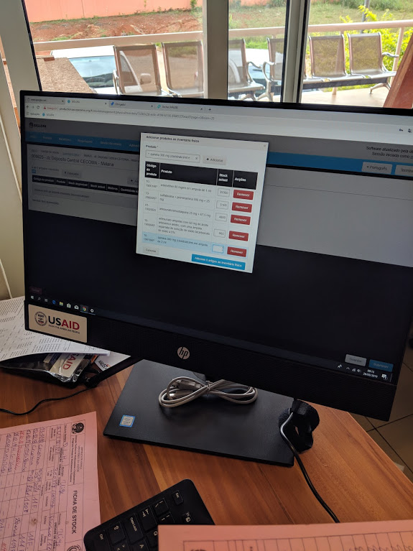
Sistema Informático de Gestão de Logística Farmacêutica de Angola
Angolan Pharmaceutical Logistics Management Information System

Slide 4
Implementation Objectives
Improve health logistics performance.
Improve the quality and availability of logistics information.
Simplify logistics processes.
Assure the availability of key medicines for the country.

Slide 5
Improvements and Contributions to core
UI
  Better errors and messages presentation:
    messages in json vs translated and standardized errors;
    Password resets and user validation emails translated to PT;
  Inclusion of a Contact Support menu that links to JIRA ServiceDesk;
  Improvement of translations to Portuguese;
  Stock-management related performance improvements.
  Ability to limit the available source/destination values shown to users performing stock movements.
Security
  Ability to securely use SSL with an on-premise OpenLMIS server;
Reporting
  Implementation of 15+ SuperSet reports;
  Inclusion of SuperSet reports based on Stock Management
  Translation of Jasper Reports to Portuguese
In the background
  Improved the (security-related) integration between Superset and OpenLMIS.
  Updated the frequency with which reference-data becomes available for reporting.
  Added a unified language selector applicable to both OpenLMIS’ embedded reports and the rest of its UI.
  Improved the reporting UI by stripping it of needless clutter.

Slide 6
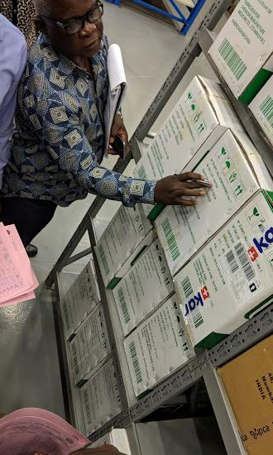
Activities
Technical Working Group (SIGLOFA) established with MOH staff from Central and Provincial levels.
System requirements collected, analysed and approved with the support of the Technical Working Group.
Assessment of facilities in all provinces (18) to identify an implementation strategy and bottlenecks.
Creation of SOPs for each supply chain program.
3 Month pilot of SIGLOFA in 4 provinces with 7 sites.
UAT and system acceptance by MoH and stakeholders
National Rollout
Notes:
In order to ensure a smooth implementation the following activities have been held

Slide 7
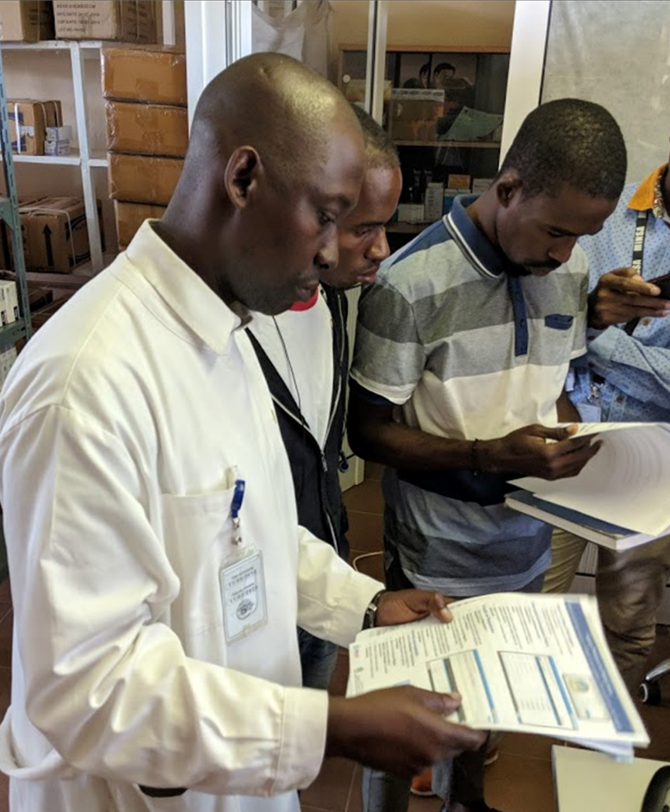
Successes
Successful testing and training in SIGLOFA saw formal acceptance and adoption of SIGLOFA by the Technical Working Group, including:
  Extensive Integration Testing of stock management, requisitions, reporting and translations to ensure all baseline requirements were satisfied.
  2 rounds of User Acceptance Testing conducted with +10 Ministry of Health staff.
  Training of Trainers, targeting staff from the National School of Public Health (ENSP), and existing experienced MoH staff from the TWG.
  User Training of 14 staff from National Hospitals, and 14 staff from national programs.
  Administrator Training of 6 staff from GTI and GEPE MoH departments, responsible for the management of SIGLOFA.

Slide 8
SIGLOFA User Adoption

Slide 9
Successes
By the end September 2019, SIGLOFA was successfully implemented and in operation at 13 sites throughout Angola, including:
  Luanda Provincial Warehouse
  Uige Provincial Warehouse & Provincial Hospital
  Cuanza Norte Provincial Warehouse & Provincial Hospital
  Hulia Provincial Warehouse & Provincial Hospital
  6 PEPFAR supported health facilities in Luanda
Following system approval, the Technical Working Group approved the plan to implement SIGLOFA at the remaining 48 sites in Angola.

Slide 10
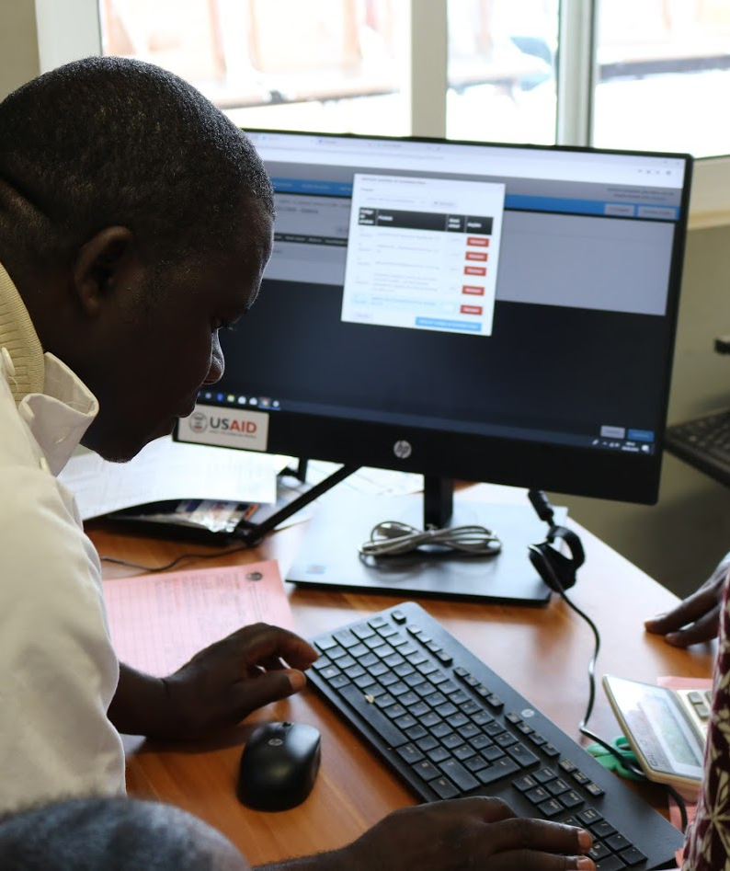
Challenges
General Logistics, System, and Computer Knowledge of target users.
  Knowledge of technology and how to use technology to apply of logistics processes remains a challenge, particularly in provincial locations;
  Additional time is required to teach some users basic computer literacy which impacts implementation and training duration;
Free Data Plans on the Unitel Network
  Agreements with Unitel to enable “free” access to the SIGLOFA platform over their network hit several roadblocks with audit, risk, compliance and infrastructure issues;
  GHSC-PSM maintains payments to implemented sites to ensure sites can continue to access the SIGLOFA platform;

Slide 11
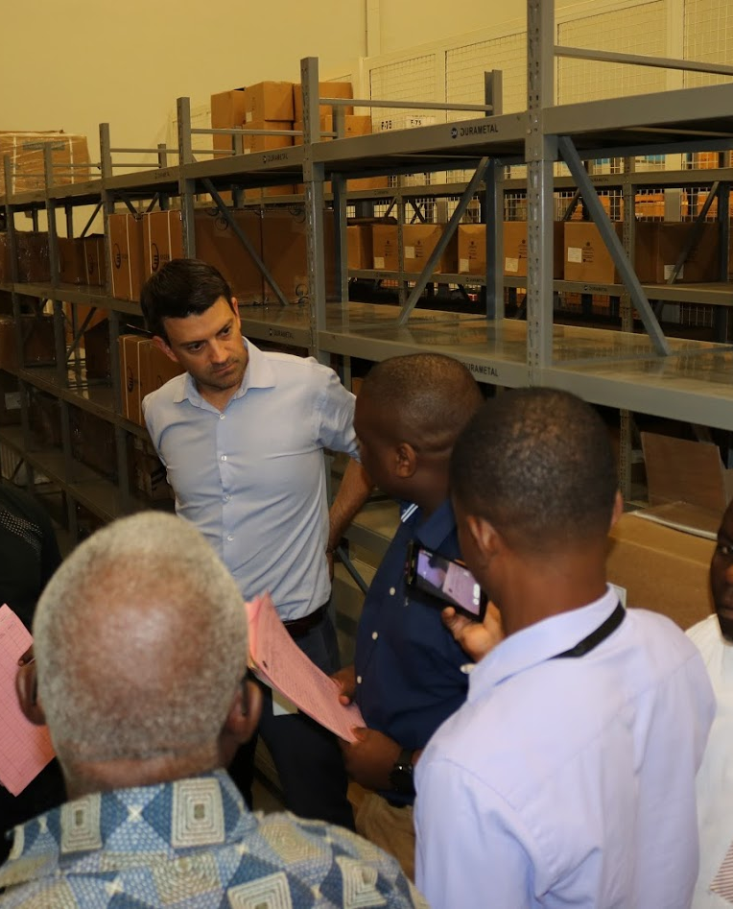
Mitigation Steps
General Logistics, System, and Computer Knowledge of target users.
  System familiarization start prior to site visits with dissemination of support material including the SOPs for inventory and requisition management.
  Shadow users through each of the SIGLOFA logistics processes multiple times. Ensure the user is in control of the system;
Free Data Plans on the Unitel Network
  Engage USAID to represent the SIGLOFA project objectives and reinforce the Memorandum of Understanding made between USAID and Unitel;
  Identify alternative data plan and cost options to ensure access to the SIGLOFA platform is maintained;
  Assess alternative methods for synchronizing data and its impact to availability of data for reporting;

Slide 12
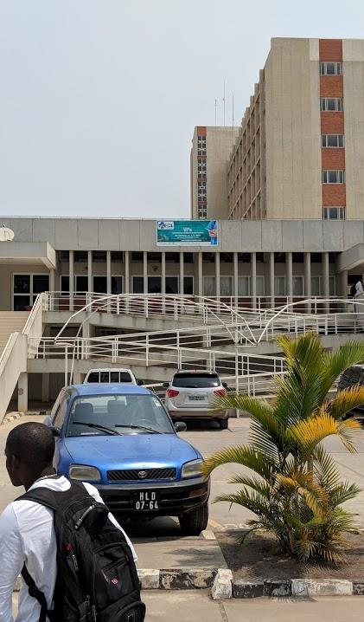
Planning for FY20 - National
The focus for FY20 will be to complete the national scale-up of SIGLOFA to all remaining facilities, including regular supervisory site visits throughout the year to monitor usage, improve data quality and incorporate updates and suggestions.
The national eHealth Architecture will be improved to define the processes involved in systems integration in readiness for master data databases being brought online for Product and Facilities registry data.
Further activities will focus on the improvement and expansion of reporting and Business Intelligence analytics for the data captured in SIGLOFA.

Slide 13
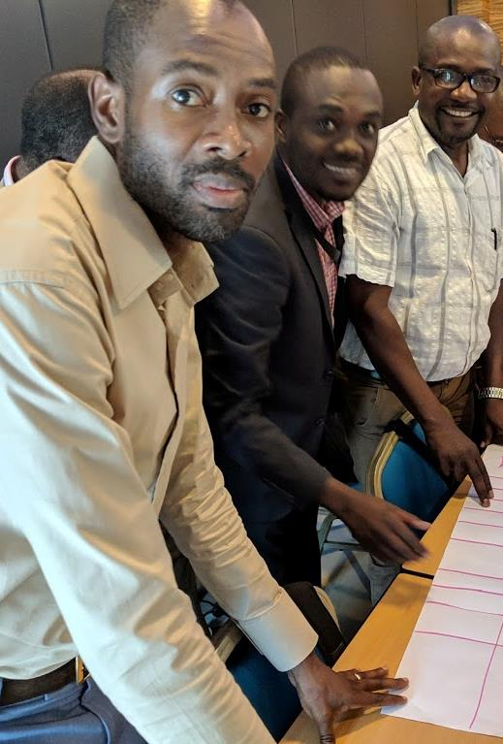
Planning for FY20 - Municipal
Activities will include a GHSC-PSM led selective site evaluation in combination with MoH self-evaluation activities to capture the conditions and infrastructure requirements and constraints at each facility.
A systems evaluation will be performed on the available solutions to determine the best solution available for these facilities, whether it be an expansion of SIGLOFA on portable devices or a compatible alternative solution such as OpenSRP.
The 6 PMI provinces will be the focus for this activity, and an additional 3 provinces will additionally be included, potentially reaching 90 municipalities receiving data from 1,217 health facilities.

Slide 14
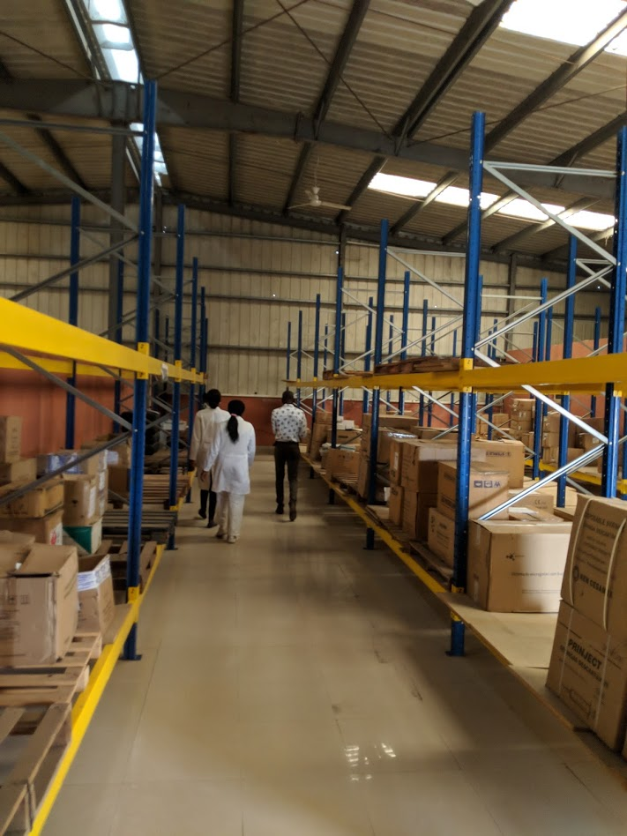
Future Planning FY21+
Continue expansion of digitizing the Supply Chain to all health posts and health facilities across all supply and distribution levels.
Integrate systems to automate processes and improve data availability, e.g. WMS, TransIT, DHIS2, etc.
Expansion of OpenLMIS functionalities, e.g. track and manage consumables, equipment, vaccines, temperature monitoring
GS1 support
Improve integration between Stock Management and Requisition processes to pre-populate data for fulfilment.
Analyse large data sets to improve reporting and decision making
Expand Dashboards to Improve Support Chain Reporting

Slide 15
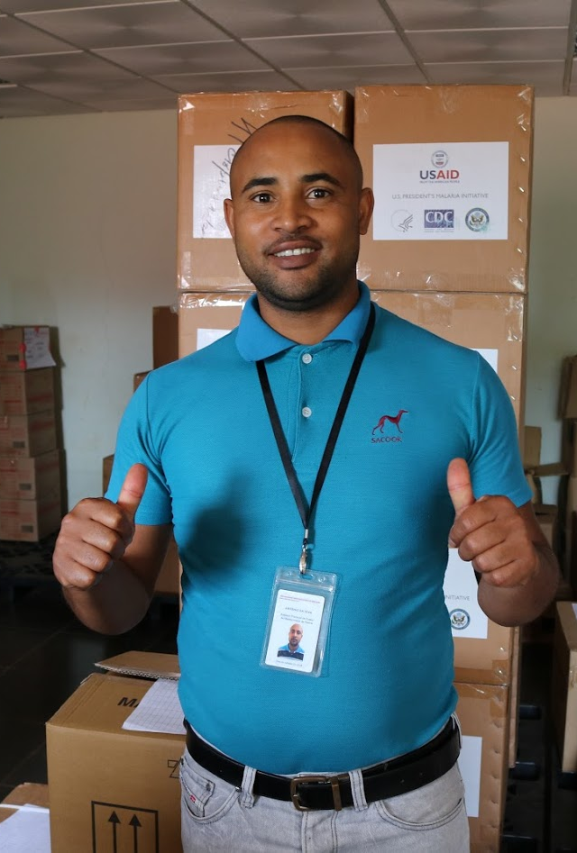
Operational Support
Support channels:
  WhatsApp, Jira Support Desk, email, phones
Bug reporting & tracking:
  Jira Support Desk, Mantis
Support personnel are familiar with these systems
GHSC-PSM and MoH ensuring operational support staff in presence and remotely:
  Participation in the TWG
  Multiple training exercises in SIGLOFA and SOPs.
  Involvement in all support channels, i.e. WhatsApp group, JIRA and email.
Proposed actions as a results of system validation pilot:
JIRA webform inside the application for ease of reporting issues
Plans to ensure communications and appropriate response times are maintained for adequate support

Slide 16
Lessons Learned

Slide 17
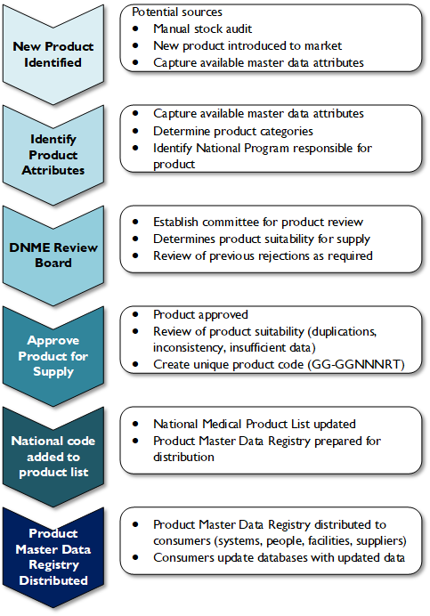
The need for Ministerial coordination
Completeness of Medicines List
Establishment of an SOP for the approval and inclusion of new products to Master Product List
Manual process of review and certification to prevent duplication and ensure system consistency
SIGLOFA Master Data establishes the baseline for the future drug registry, and is not reliant on LNM* approval.
Codification will have unique national identifier followed by UNSPSC classification & already approved by DNME
* LNM - Lista Nacional de Medicamentos / National Medicines List

Slide 18
Lessons Learned
Area | Title | Anomaly | Resolution
Configuration | Completeness of Medicines List | National Program lists of medicines and the DNME medicines list (LNME) is incomplete and inconsistent. Information impacted includes: Naming and Presentation Package sizes Costs of products | Conduct an inventory audit at CECOMA to capture missing information. Where products and data are not available, the data will be captured and updated as the stock enters CECOMA. This information will update SIGLOFA to become the authoritative source for this information
 | Product Naming Standards | Each province may decide how a product is named which led to some users not being able to find products in the system | Adjust training to inform users to look for the medicine product name rather than the brand or trade name.
 |  |  | Provide multiple methods for searching for products with SIGLOFA, including aliases, brand names and other product naming schemes, e.g. “Vitamin B12” is also called “Cobalamin”

Slide 19
Lessons Learned
Area | Title | Anomaly | Resolution
Human Resources | High Turn Over | It is registered a high turnover rate amongst health workers of all tiers, making it difficult to have a continuous user base for the System. | Institutionalize the warehousing and national program logistics SOPs. Advocate to ministry and sites management on staff retention policies Increase the number of trained staff at facilities;
 | Consistency of Logistics Knowledge | Consistency of knowledge and adherence to logistics procedures varies between sites. Issues identified included reporting frequency, stock handling, and inventory processes. | Identify gaps or weaknesses in logistics knowledge prior to training users.
 |  |  | Educate users on logistics knowledge areas that require strengthening.
 | User Confidence | Provincial logistics staff are transitioning from a paper-based logistics reporting system. Accordingly, user computer skills and speed is slow for navigation and data entry. | Provide additional one-on-one time with site logistics staff to strengthen their knowledge in the system.

Slide 20
Lessons Learned
Area | Title | Anomaly | Resolution
Systems | User Support Material and UX | Improve support material to ensure information is relevant, accurate, up-to-date, easy to read, and accessible. | Provide each site with multiple copies of the user cheat-sheet, user guide, process flows and approval processes / matrix. Improve System’s UX in order to guarantee continuous usage even for unexperienced users and lower resource environments.
 | Operational Support communication channels | Operational Support communications are currently limited due to infrastructure limitations at MoH preventing phone and email provisioning. | Resolve landline phone configuration issues. Establish a phone route to a GTI/GEPE desk phone for support escalation
 |  |  | Resolve email communication channel challenges

Slide 21
Discussion
  How do we capture and disseminate the lessons learned to the community?
  How can community members capitalize from the experiences of others?
Disclaimer
  A complete report with the lessons learned from this implementation can be found here.

