Slide 1

OpenLMIS Sustainability
Project Overview
Community Meeting – November 18, 2019

Slide 2

Session Contents
Filling a Gap
2. Sustainability Research
3. OpenLMIS in Private Health
4. Where We Are Today
5. Questions & Discussion

Slide 3
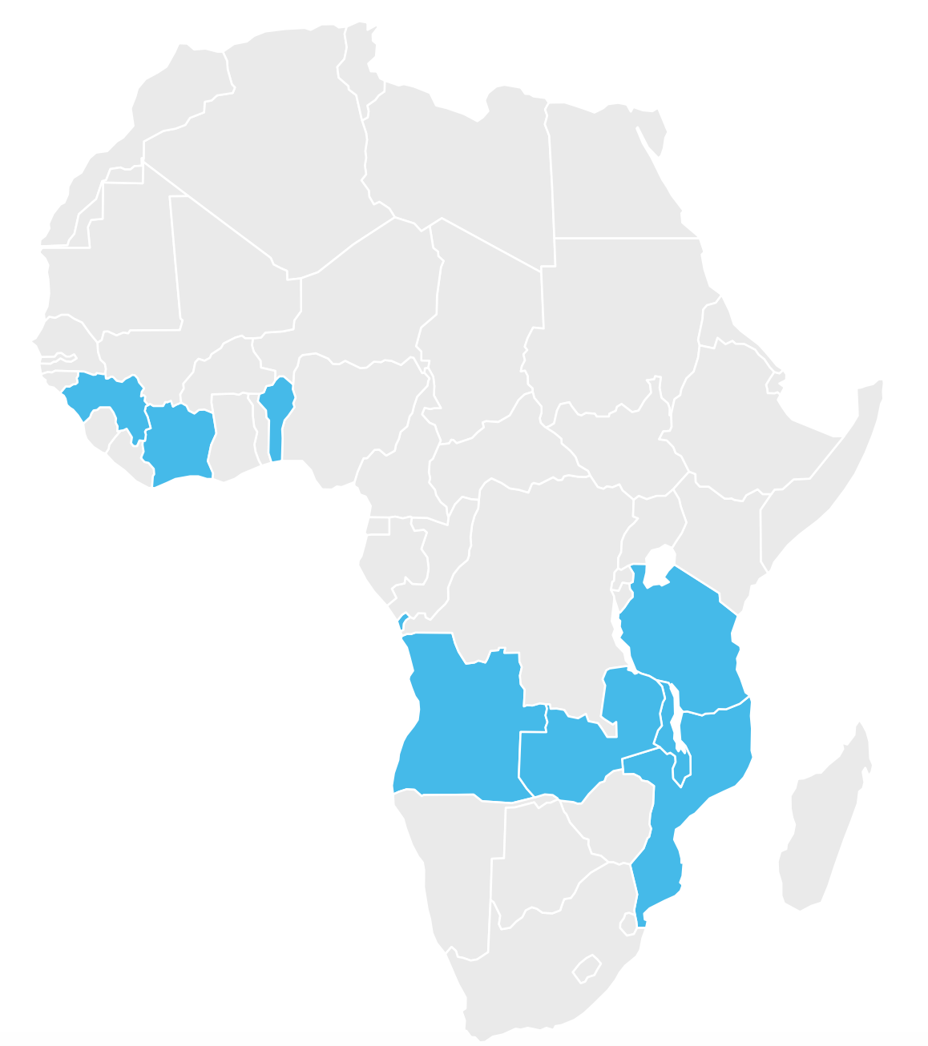
Filling a Gap
Celebrating the Journey of OpenLMIS
Emily Bancroft | VillageReach

Slide 4

Overview of Sustainability Research

Slide 5


Resonance’s Role
Overview
Reimagine OpenLMIS
Explore avenues for sustainability, including options for product expansion within and outside of the global health market
Evaluate opportunities for revenue and financing, including new channels, partnerships, donor funding, and impact investing
Support decision making and the pivot to a long-term plan

Slide 6



One Year of Analysis
Overview
Foundational
Elements
Desk
Research
Market
Soundings
Webinar
Series
Early Stage Business Models
Business
Model Prioritization
Deep Community Collaboration
Model Selection & Transition
Stakeholder Interviews
Stakeholder Mapping
Market
Sounding
Modeling
Workshop
Strategy
Sessions
Transform Research into Insights > Discover, Build Out, & Prioritize Models > Select, Validate, Test, & Transition

Slide 7






Community Engagement
Overview
We have consistently collaborated, exchanged ideas, and held strategy sessions with key partners.

Slide 8
External Stakeholders
Overview
We have conducted dozens of interviews to dig into feasibility of the future-state opportunities.
Interview Type | Examples | Value of the conversation
Other Global Goods | OpenCRVS, OpenMRS | Benchmarking and best practices; case studies
Customer possibilities within & outside of health | Medical Teams International, Sigma Pharmacy, MoH | Customer needs, willingness to pay, decision-making
Potential partners | IQVIA, Jembi, Mezzanine | Business proposition, value of OpenLMIS
Technology innovators | mPedigree, Living Goods, Kasha, mPower | Innovative product and revenue models
Donors and funders | USAID, BMGF | Available bridge and future funding, impact measures

Slide 9

Long-Term Expansion Strategy
Overview
Future state: Expand into other sectors and new countries
High risk / High return
Sectors / Customer segments
New sectors
Same geography
New sectors
New geography
Short-term recommendation
Expand into private health customer segments and new countries
Health sector
Same geography
Health sector
New geography
Current state: This is the current growth trajectory with emphasis on acquiring public health facilities as customers.
Countries/Regions

Slide 10
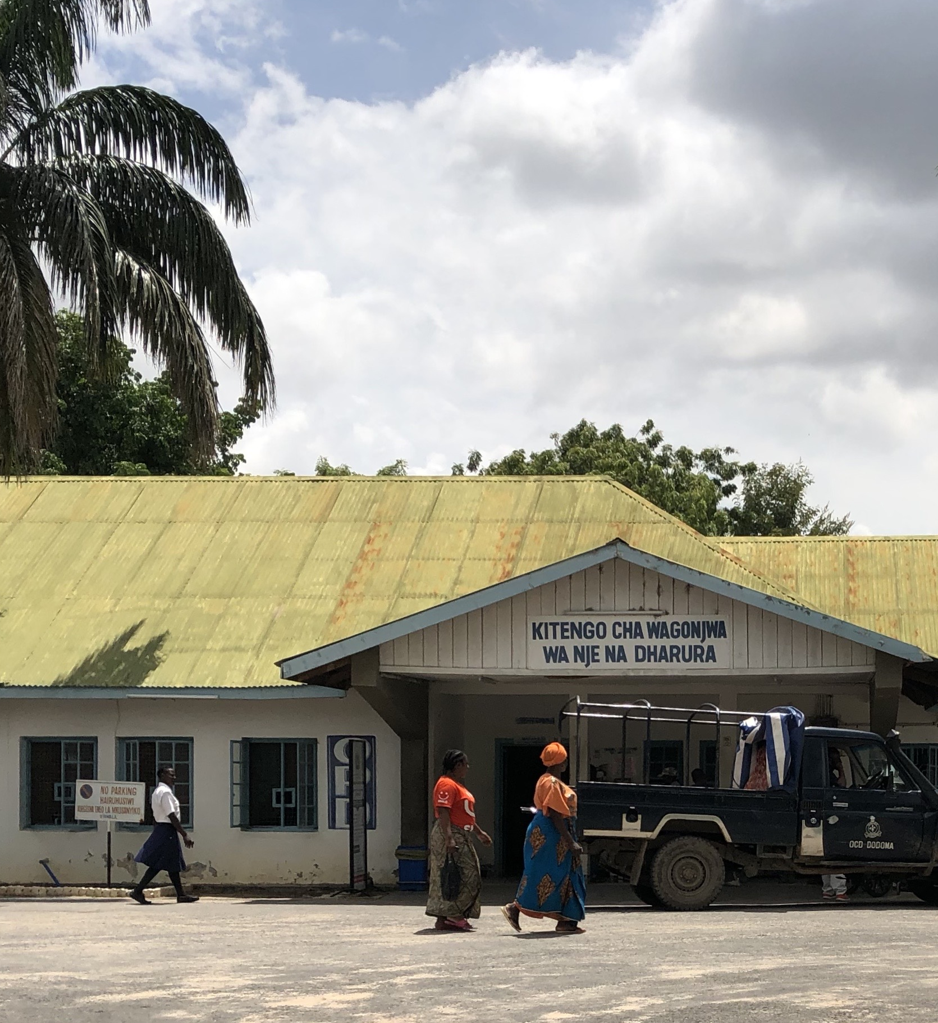
OpenLMIS in Private Health

Slide 11

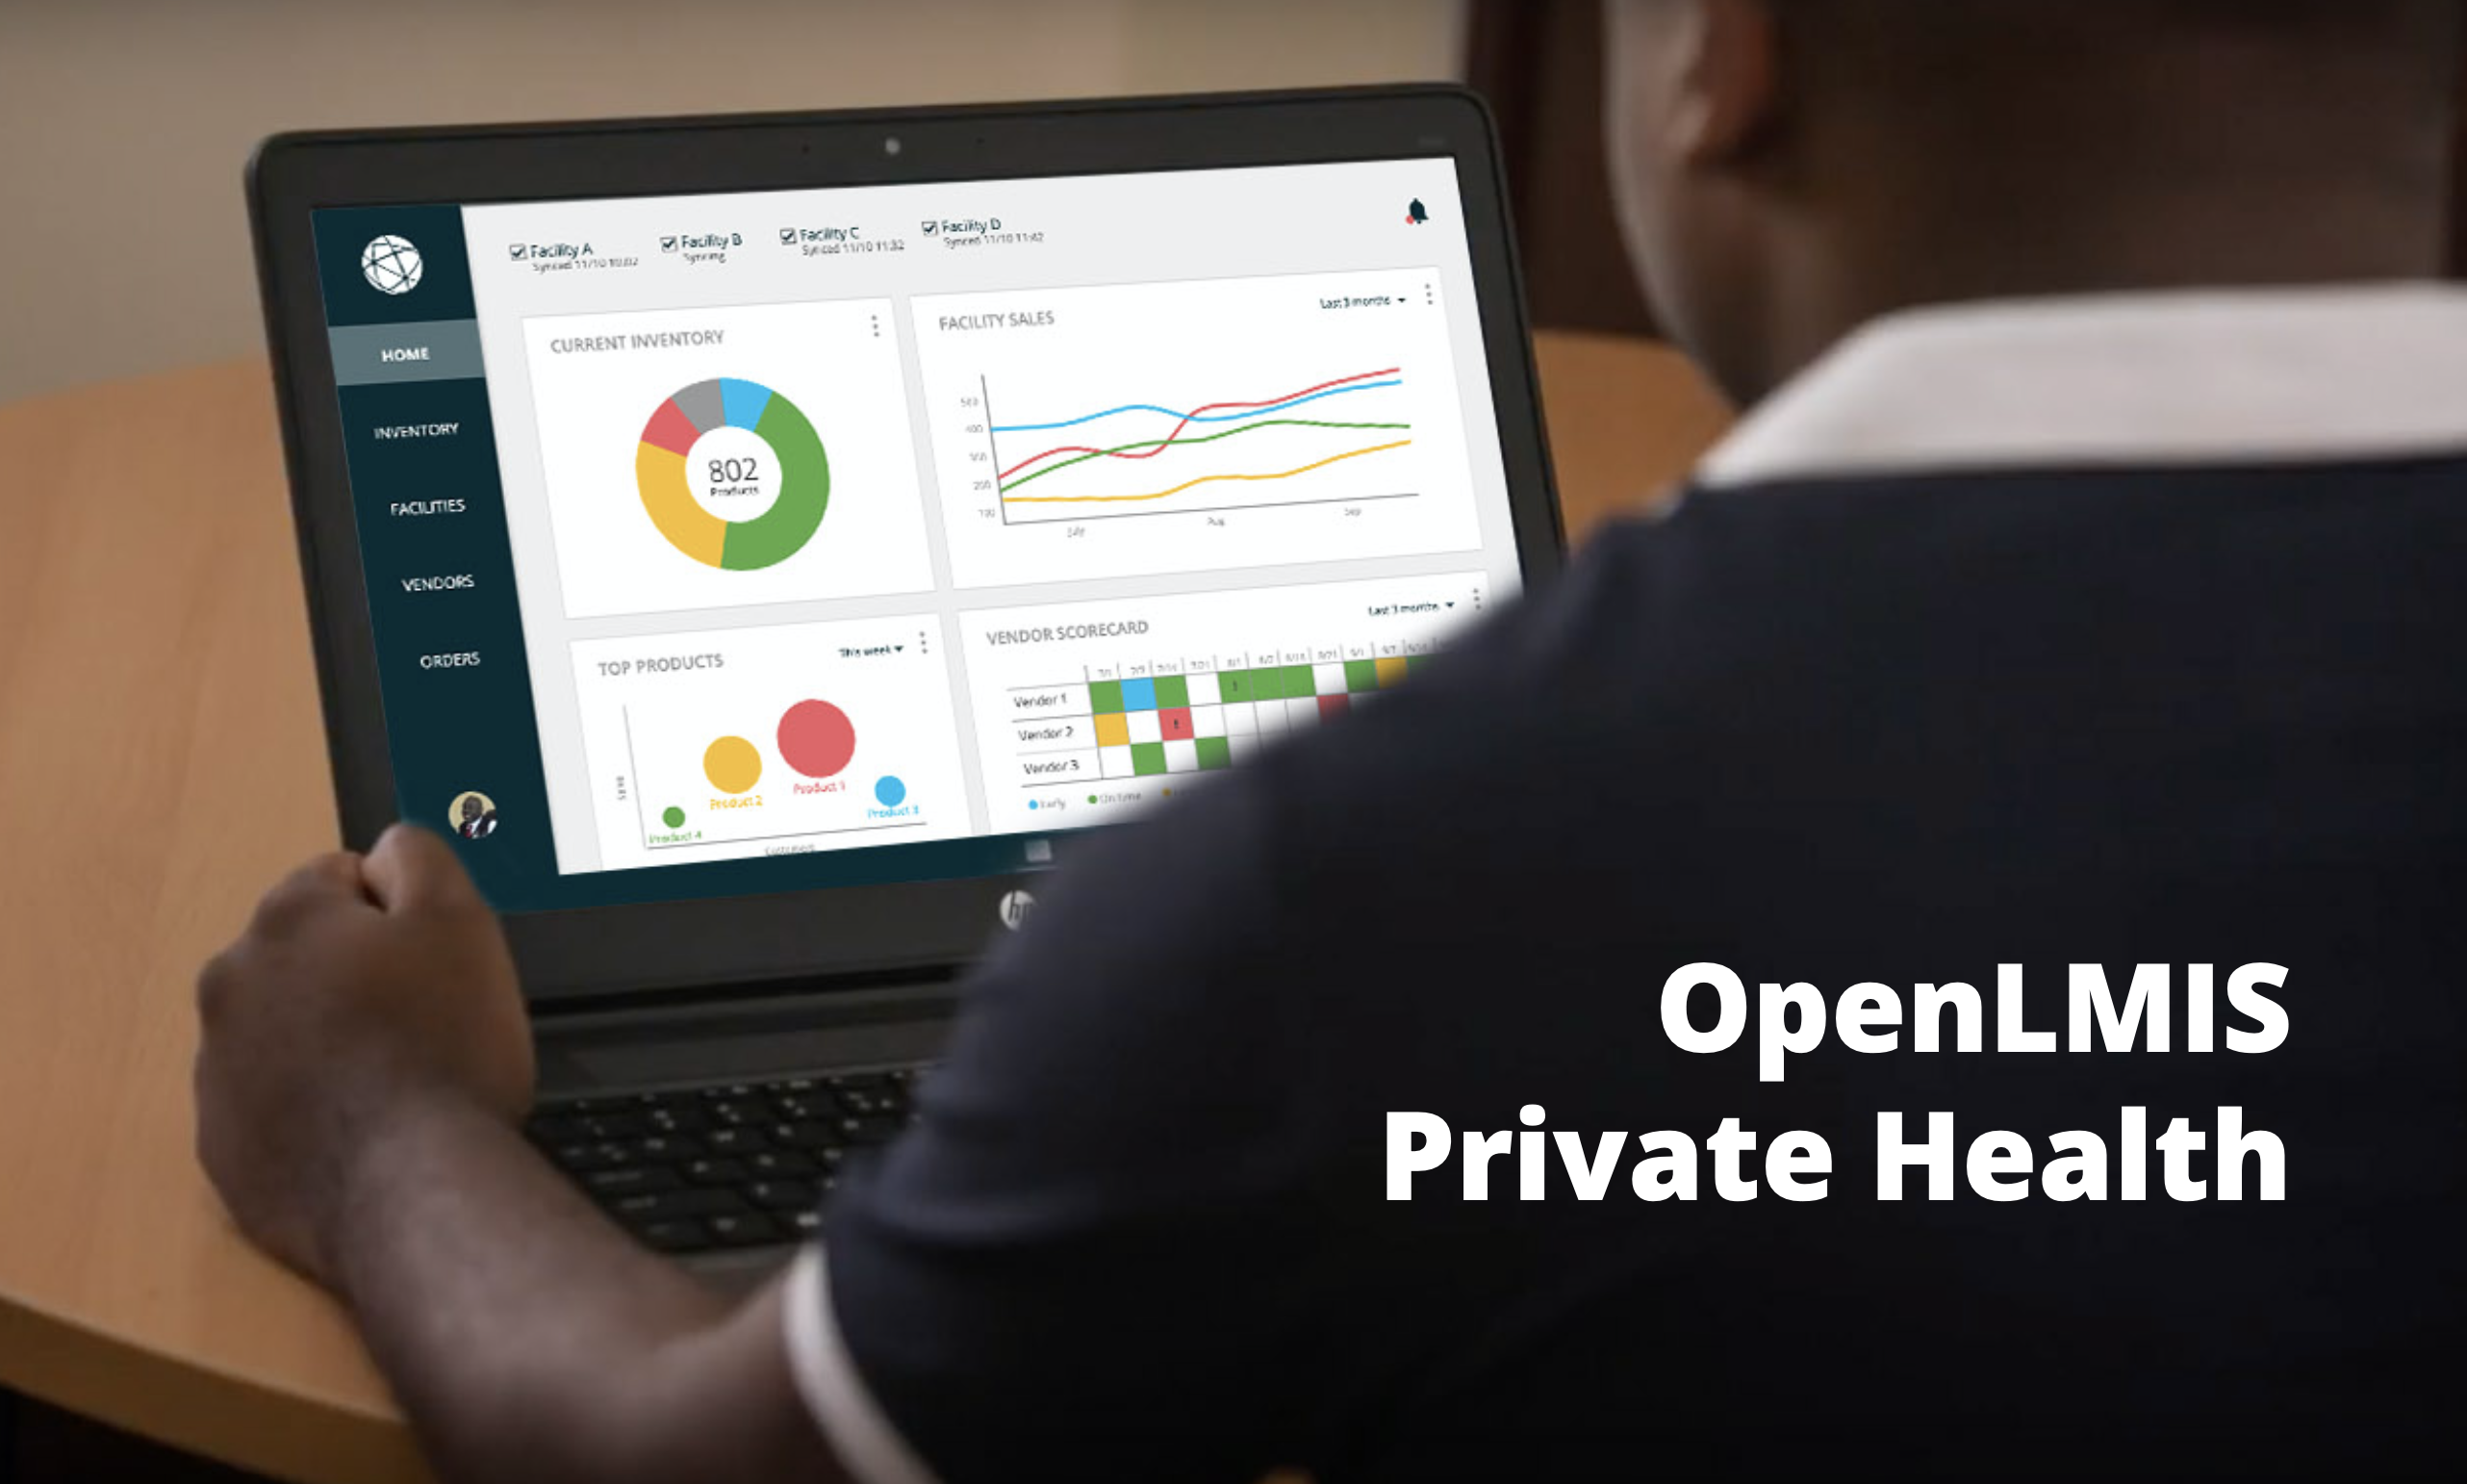
OpenLMIS for Private Health
Private Health
As part of its broader effort to reimagine OpenLMIS, Resonance identified opportunities to expand its footprint from public health to private health in target markets
While keeping the core product open source and the public implementations active, a parallel product would be created to serve private clinic networks, hospitals, and pharmacy retail networks
This SaaS product would help subsidize the cost of public health implementations and create a path for long-term revenue generation
Over time, synergies between the two products would help elevate its offering in both sectors; and product tiers could be created, providing options for different levels of local engagement and support
A series of interviews were conducted with health and last mile supply chain subject matter experts, potential customers, and we socialized a product prototype with select potential customers.

Slide 12
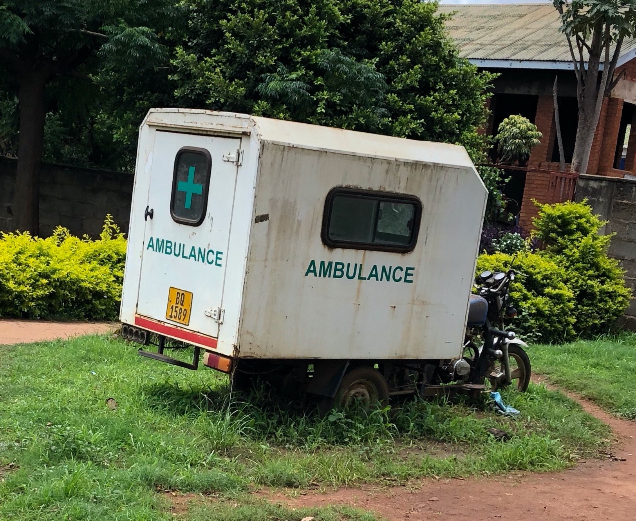
The Problem
Private Health
Most private health networks in developing countries track inventory – either fully or partially – on paper because they don’t have a digital tool that meets their needs
Networks that have digital tools will often combine multiple types of software or develop a home grown solution that is either inefficient, too expensive to maintain, or still requires manual processes to operate
These challenges have created a gap in the private health market that is not currently filled by commercial solutions

Slide 13
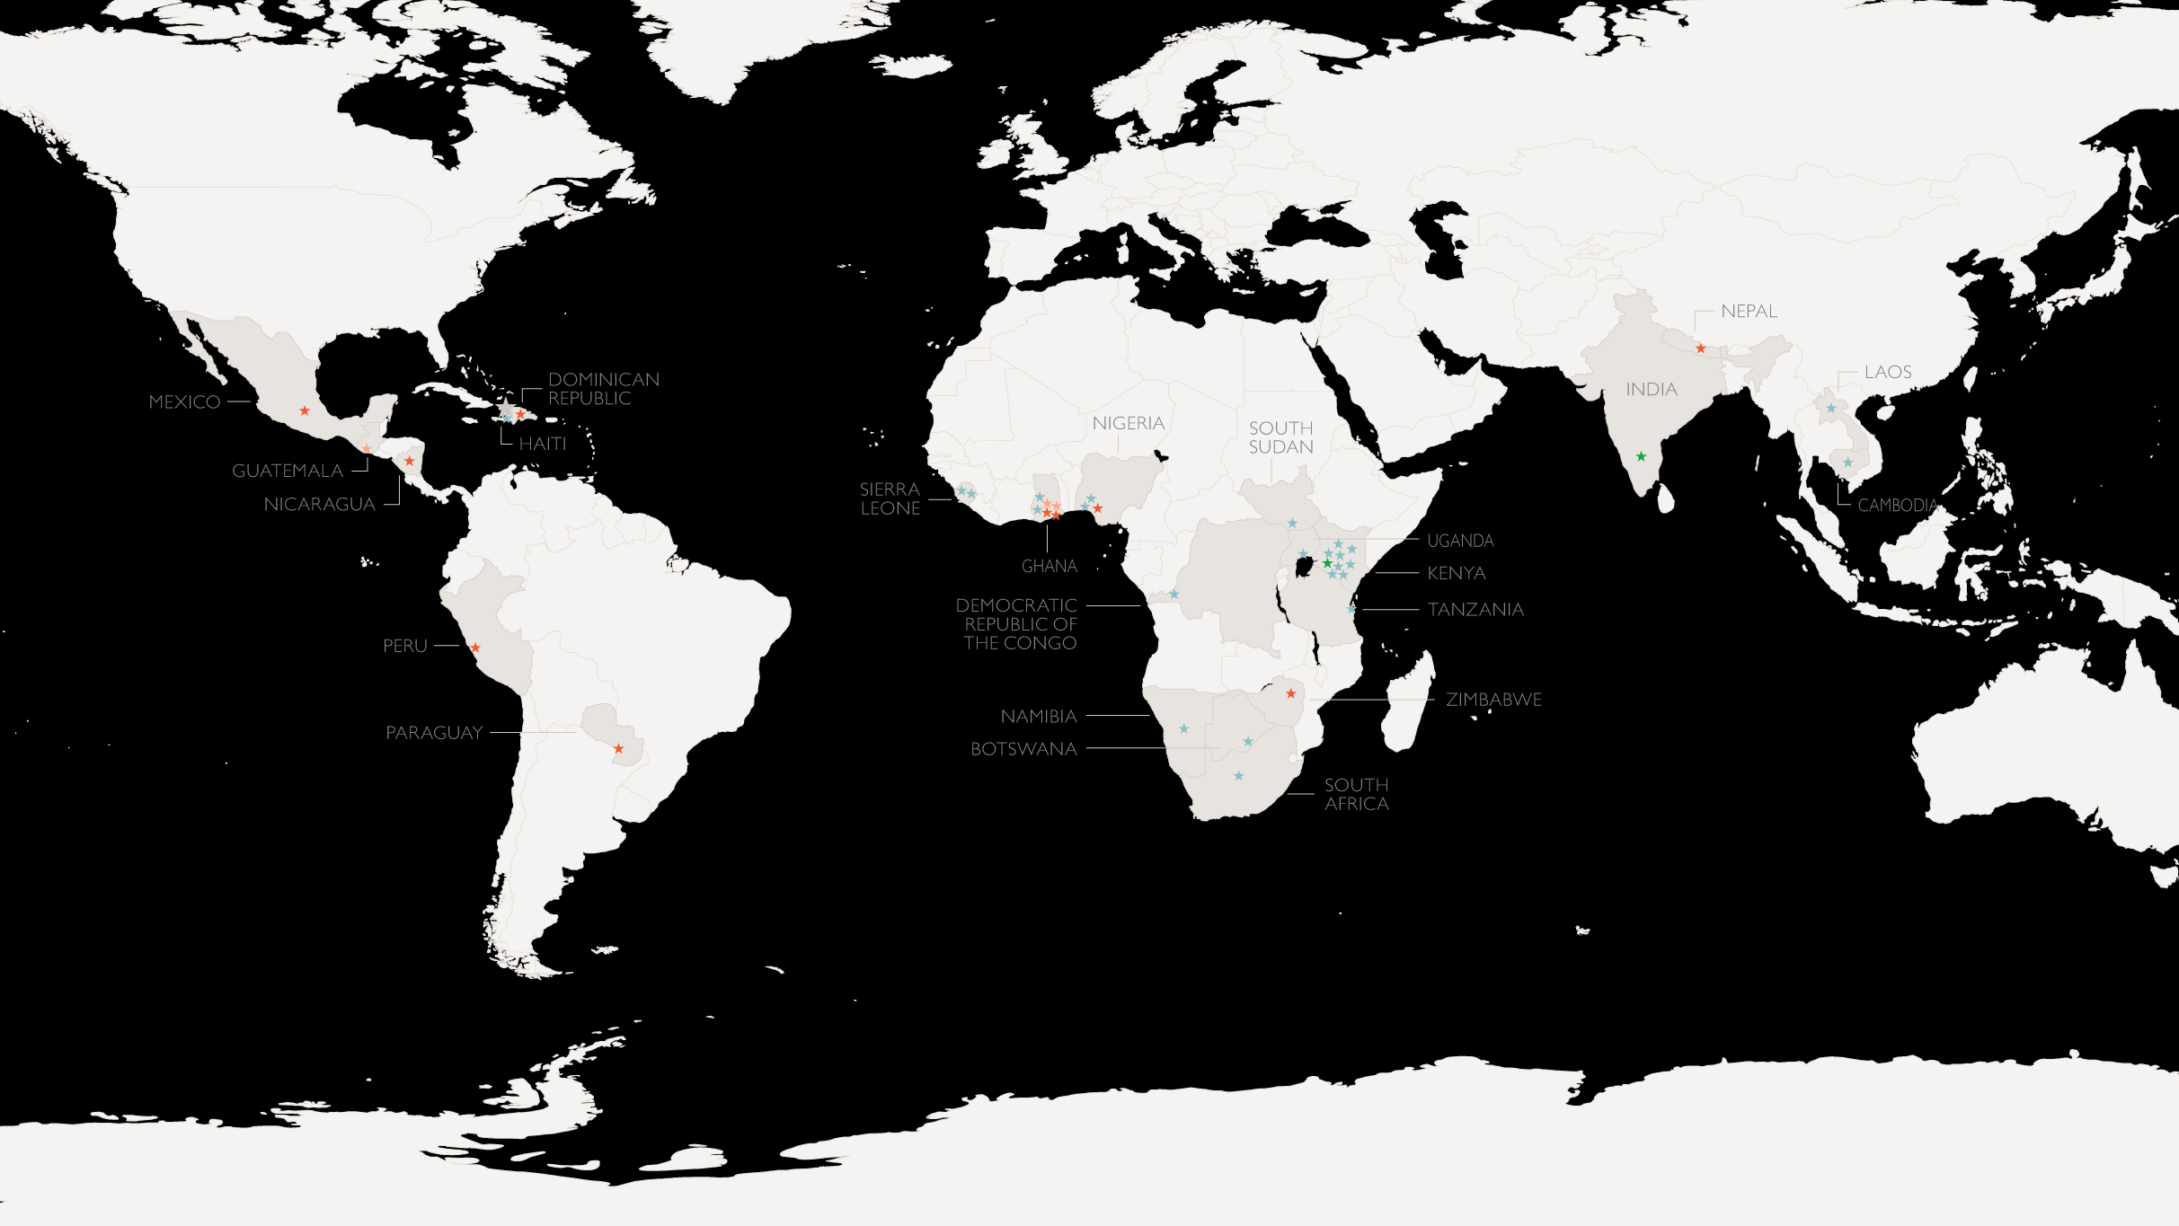

Target Markets
Private Health
Most promising markets are large economies in Sub-Saharan Africa (e.g. Ghana, Nigeria, Kenya) with dynamic private health sectors
Opportunities also exist in smaller, somewhat limited private health economies (e.g. Zimbabwe, Senegal), east/south Asia.
Key: Interviewee Type
Subject Matter Expert (15)
Clinic Network (6)
Hospital Network (5)
Pharmacy Network (1)
Investor (2)
Less promising markets are Latin America and the Caribbean with few potential customers and/or national software restrictions; and more mature/saturated markets (e.g. South Africa, Thailand).
Notes:
Gotten great traction
15 SME interviews, focused on global health, private health, health technology, low-middle-income countries, plus 2 investors
12 customer interviews (6 clinic networks, 5 hospital networks, 1 pharmacy retail network
Conclusions:
Customers are out there and their needs match OpenLMIS features
Customers have demonstrated interest in OpenLMIS and are willing to pay (something) for it
OpenLMIS can differentiate itself from competition as an ideal solution for (some of) these customers

Slide 14



Target Customers
Private Health
There are opportunities to support private clinic, hospital, and pharmacy retail networks.
In a fragmented market, there are growing customer segments in low- and middle-income countries
Needs are similar (but not identical) to current OpenLMIS users
Target customers are eager to address common supply chain challenges, which are major pain points for their organization
They understand the need for software investment alongside growth​ and are looking for a suitable solution
 | Clinic Network | Hospital Network | Pharmacy Retail Network
Defining feature | Out-patient facilities | In-patient facilities | Standalone dispensaries
May include | Pharmacies, laboratories | Clinics, pharmacies and/or laboratories | Distribution/ wholesaler component

Slide 15
Sample Customer Profile
Private Health
 | Growing Private Clinic Network Actively seeking appropriate, user-friendly supply chain management solution on a limited budget
About | Private company/organization operating a network of 5-20 clinics in a low-resource setting
Goals/Mission | Ambitious expansion of clinic facilities and/or service offerings
Supply Chain Management | Current solution: Partially paper-based with facilities/employees combining multiple solutions (e.g. clinic management system + Excel) Unreliable and inefficient, leading to errors, stockouts, delays, waste, and higher costs Holding back company growth/expansion
Software Use and Orientation | Some software use: Locally built clinic management system, basic accounting system Current system(s) offer only partial solution(s) to supply chain needs System(s) not user-friendly or designed for their needs/circumstances
OpenLMIS as a Solution | Requisitions, inventory management, and reporting/analytics support that interoperates with existing clinic management and accounting systems to address supply chain management gaps
15
Pain points identified in italics.
Notes:
Alice
From what we know about clinic networks in LMICs and our customer interviews so far, here is what we think a potential target customer could look like.
Italics indicates pain points
5-20 facilities, ambitious growth objectives
Already knows that supply chain is an issue that must be addressed for growth to happen
Currently using a combination of tools to manage supply chain (e.g. clinic management system + Excel +paper) and this is leading to unacceptable delays, stockouts, errors, wasted time and products, high costs, etc.
Need a tool that can neatly address the gaps in their supply chain, particularly requisitions support, and interoperate with their existing solution to create more efficient processes for $6000 or less per year
FOR REFERENCE:
Numbers based on the 3 clinic networks we interviewed, here are the budget numbers they gave us:
Penda: expected budget for all software solutions $4300-8600/year, probably closer to $2000-5000 for supply chain management only.
Rabito: $15k up front plus $12k/year for current clinic management system, if we assume they will pay 40% of this for OpenLMIS that comes to $6000 + $4800/year which I think we can round up to $5000/year.
Rapha: $600/year for current EMR, probably not willing to pay more than $1000/year for supply managemen

Slide 16

Prototype Interview Feedback
Private Health
Most Valuable Features and Characteristics​
    Inventory visibility from supplier to customer
    Data/reporting dashboards​
    Health sector focus​
    Offline sync capabilities​
    User-friendly ​and intuitive
    Configurable with existing systems
Questions and Concerns​
Timeline: Customers are looking for this product now
Integration and interoperability​ with existing or future EMR/HIS, financial/accounting, point of sale, and mobile systems
Perceived Value
Customers are willing to pay up to $25,000 annually for this product
“
I wish we could get better visibility into our supply chain and the data we need. It's hurting our business and we're losing money, which makes it difficult to serve patients and take collective action.
- Private Clinic Network, Kenya
"
Notes:
Kim
Overall positive: clear solution to customers' pain points
What they love:
Data / reporting dashboards: easily view where their problems are (vs. Previous complex, duplicative, error-prone processes to understand patterns)
end to end visibility of their supplies for better planning and easy action (I.e. redistribute supplies among facilities vs. Time-consuming manual processes that allowed for mistakes or theft)
Health sector focus – built for them
Offline sync capabilities (⅔)
User-friendly and intuitive interface, less need for service/ training – but they really value on-demand service options
Configurable: make it work for their business needs over time
Some questions/ concerns
? Timing: Good news and bad news is that the customers we've spoken to need this now. All looking to buy in the next 3-12 months
? Integration/ interoperability, considering software updates/ upgrades: Some pain points are in their financial/ accounting systems or EMR/HIS systems, some already have a working POS system. Some want data entry on tablets and phones. How to make OLMIS work over time to add value to these systems or the others that replace them?
Perceived value: High, up to $25k! We are being more conservative because it's unlikely all customers will pay this, and it depends on what the product becomes
What's next?
Keep talking to potential customers to gather feedback on prototype
Identify potential customers to pilot the prototype
Keep discussions going with VR on costing, product development and options to make the product (and its presentation) as appealing as possible

Slide 17
Click to begin:
A Product Prototype | VillageReach

Slide 18

OpenLMIS Paths Forward
Notes:
Kim
Objective: Validate the viability of private hospital, clinic and pharma retail networks in low- and middle-income countries (LMICs*) as paying OpenLMIS customers.

Slide 19
While we consider OpenLMIS for private health to be a strong contributor to sustainability, there are a couple of paths and decisions that need to be made to get there…
Notes:
Kim

Slide 20

Where We Are Today
Sustainability
Governance Committee Meeting
(Today)
Governance Committee Meeting
(November 12)
Future State Partner Engagement Survey
(November 12-15)
OpenLMIS Community Meeting
(November 18-20)
Donor Check-In,
Part I
(October 17)
Donor Check-In,
Part II
(November 6)
Share project update and demonstration of private health prototype
Build options and create a package of information to share with the Governance Committee
Present options for path forward and take a temperature check-style poll during the call
Collect responses of voting members about ways to engage in the future state
Engage with the OpenLMIS community for transition and future-state planning
Notes:
Rebecca

Slide 21



OpenLMIS Paths Forward
Sustainability
1
2
3
Independent Entity
Partnership to Handover
Unsupported Release
Create a new non-profit entity to manage software & stewardship
Keep public health implementations active and pursue a parallel product in private health
Transition public health to include routine contributions
Seek initial seed stage funding followed by impact investor funding
Partner with a private organization and gradually transition software & stewardship over 1-2 years
Keep public health implementations active and product open source
Let partner drive which business opportunities to pursue
Collaborate on contract terms
Seek initial seed stage funding
Release the IP and licensing
Leave future software enhancements and stewardship up to the open source community
No funding for core community, product management, or maintenance
No mechanism for partners to guide the future of OpenLMIS
Notes:
Private health could be pursued in options 1 or 2

Slide 22
Comparing Paths Forward
Sustainability
1
2
3
Independent Entity
Partnership to Handover
Unsupported Release
Risk | High | High | Low
Cost | $$$ | $$ | Free
Control | High (for partners involved) | Low (enforce contract terms) | None
Stability for current public user base | High | Medium | Low
Notes:
Kim
Other key factors here?
Current partners will be essential in effectively transitioning OpenLMIS in Options 1 and 2
Keep in mind that handover would de-risk a private entity
Leverage existing sales teams and channels
Include core attributes in contract (e.g remain open source)
Partner would drive which business opportunities to pursue

Slide 23
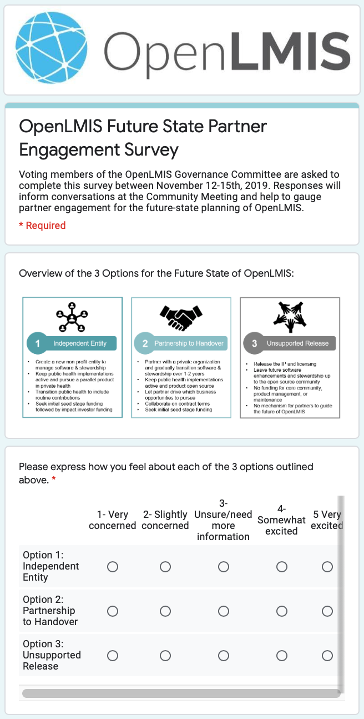
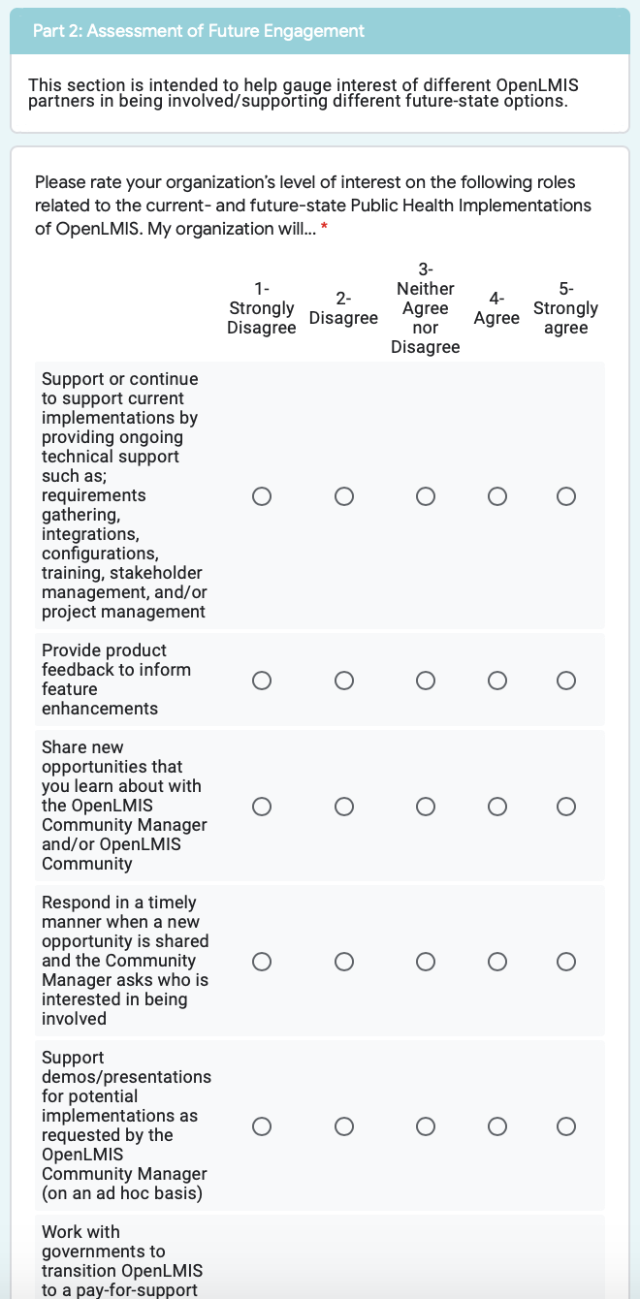
Future State Partner Engagement Survey
Sustainability
Open November 12 – 15, 2019
Following the Governance Committee Meeting
Survey sent via email to voting members
Participants were encouraged to consult with others at their organizations to inform responses
Purpose was to gauge interest in the various roles that could be played by partner organizations
While non-binding, the survey has informed today’s discussion
4 responses to date from BMGF, VillageReach, SolDevelo, & JSI

Slide 24
Community Sentiment on Options
Sustainability
Number of Votes

Slide 25
Total Concern vs. Excitement
Sustainability
How does this resonate with you?

Slide 26
Level of Interest in Public Health Roles
Sustainability
Strongly Agree
Strongly Disagree

Slide 27
Interest in Active Private Health Roles
Sustainability
Strongly Agree = 2 points, Agree = 1 point

Slide 28
Interest in Leadership & Governance
Sustainability
Strongly Agree
Agree

Slide 29
Moving Toward a Decision
Sustainability
What has been decided?
Up until today, we have 3 active options:
#1 Independent Entity
#2 Partnership to Handover
#3 Unsupported Release
Based on the survey results, we have decided to focus these next two days on the terms and requirements that our community needs to make #2 work.
We will also engage with two potential partners to understand their terms and requirements.
Funding
Donor support - tentatively Gates Foundation - is needed for a transition to either #1 or #2. By the end of these two days, we hope to have an outline of what support is needed over the next 12-24 months to support this transition.

Slide 30
What Are the Next Steps:
Sustainability
1. Community Input on Terms/Future State Criteria
At this community meeting, we will define the requirements and nice-to-haves for Partnership to Handover or Independent Entity. We will also define what success looks like after 12-18 months.
2. Negotiation
Those community members who want to be engaged in Option 2 will share these terms with potential partners to understand the partners requirements.
3. Concept Note
Assuming enough alignment to proceed, we will draft a concept note outlining the support needed to further test and move towards the Partnership to Handover model. This concept note will be refined after the Community Meeting.
4. Transition to Future State
We expect a 12- to 24-month period to launch the future state. After March 2020 (when current VR stewardship ends), the Governance Committee may change membership and/or a new board may be formed to support the transition.

Slide 31

Reactions & Discussion
Sustainability
1
Independent Entity
2
Led by Resonance
Partnership to Handover
3
Unsupported Release
Notes:
Kim
Keep in mind that handover would de-risk a private entity
Leverage existing sales teams and channels
Include core attributes in contract (e.g remain open source)
Partner would drive which business opportunities to pursue

Slide 32
Thank You!
  JAMES BERNARD
  Director, Global Partnerships
  jbernard@resonanceglobal.com
  EMILY CLAYTON
  Senior Manager
  eclayton@resonanceglobal.com
  KIM COURI
  Senior Consultant
  kcouri@resonanceglobal.com
  DIPA SHARIF
  Consultant
  dsharif_ct@resonanceglobal.com

Slide 33
Types of Funding
Sustainability
Seed Stage Funding
Donor or philanthropic capital
Options for 12-24 months
Impact Investment Funding
Impact-first investors
7-10 year investment term
Year
0
1
2
3
4
5
6
7
8
9
10
11
12
Notes:
Dipa’s slide

Slide 34
Funding Overview
Sustainability
Seed Stage Funding
Transitional funding for Options #1 & #2
Uses would be to:
  Enable sustainable business model
  Develop software for private customers
  Enact public health strategy
  Build a foundation for future investment, which may include the very important role of de-risking for other investors, collecting impact data that aligns with SDGs, and/or pitching to impact investors or foundations with PRI / MRI*
Impact Investment Funding
Funding necessary only with Option #1
IQVIA would become the investor in #2
Uses would be to:
  Further build out business and development team
  Diversify revenue streams
  Drive growth in paying customers
  Expand Channel Partner network
PRI = Program Related Investments; MRI = Mission Related Investments
Notes:
Dipa’s slide

Slide 35
Sustainability
Donor-Supported Paths to Sustainability
 | OpenLMIS.org |  |  |  | IQVIA*
Donor support | 12 months | 18 months | 24 months |  | 12 months | 18 months | 24 months
Support public sector implementations
Effectively transition from VillageReach
Develop software for private heath
Acquire private health customer(s)
Develop channel partner(s)
Acquire paying public customer(s)
Collect impact data that aligns with SDGs
Successful pitch to impact investors
Key:
Very low chance of activity success
Low chance of activity success
Moderate chance of activity success
High chance of activity success
N/A or Unknown
Notes:
Kim

Slide 36
IQVIA Costing Estimate
Sustainability
IQVIA still requires seed stage funding to prove the model but less than an ‘OpenLMIS.org’ option given their strong sales team and institutional efficiencies.
Based on percentages of the OpenLMIS.org costing estimates
A partnership with IQVIA would require approximately 25% less donor / seed stage funding than #1
There are additional areas that could further reduce this estimate (which have not been factored in), including faster time to market, quicker paying customers, lower risk, and other efficiencies
Function | % of OpenLMIS Estimate*
Private Health Software Development & Maintenance | 100%
Public Health (Modified) Maintenance | 100%
Legal | 50%
Sales | 10%
Marketing & Community Mangement | 20%
Finance | 20%
Overhead | 20%
*Based on assumptions that need to be further validated with IQVIA.
Notes:
Kim

Slide 37
Revenue Streams
Sustainability
With support from seed stage funding, and/or impact investors, OpenLMIS would aim to generate revenue from various sources.
OpenLMIS
Training / Certification Consulting Fees
Conference Fees
Advertisement Fees
Licensing & Customer Support Fees
Direct Sales
(Private Health)
Indirect Sales / Channel Partners
(Private Health)
Sales
(Public Health)
Sales
(New Industry Segments)

Slide 38


Community Decision Tree
Deliverables
Leadership from current partners and the possibility of seed stage funding are both needed to pursue sustainability through private health, otherwise releasing the code (Option #3) will happen by default.
Availability of Seed Stage Funding
Opportunities for Engagement
Future State Options
Community Interest
Enough Momentum to Seek Funding
Option #1
Current Partners Opt Into Necessary Leadership Roles
This Meeting
Option #2
Survey
Current Partners Not Interested in Leadership Roles
Community Meeting
No Possibility of Funding
Option #3
Notes:
Emily

Slide 39
OpenLMIS.org Costing
Sustainability
Estimated cost for 24 months is $3.1 MM inclusive of both public and private health
Assumes 10 months of software development for the “OpenLMIS for Private Health” product as well as maintenance thereafter
Software team is assumed to be primarily based in Kenya, with two US-based roles (product owner and transitional architect)
Public health costs have been modified to reflect a hybrid product owner role and capture a lower run rate
Notes:
Kim

Slide 40
Types of Funding
Sustainability
Seed Stage Funding
Donor or philanthropic capital
Options for 12-24 months
Impact Investment Funding
Impact-first investors
7-10 year investment term
Year
0
1
2
3
4
5
6
7
8
9
10
11
12
 | 12 months | 18 months | 24 months
OpenLMIS.Org | $1.6 MM | $2.4 MM | $3.1 MM
IQVIA* | $1.2 MM | $1.8 MM | $2.3 MM
*Based on assumptions that need to be further validated with IQVIA.
Notes:
Dipa’s slide

