Slide 1
SIGLOFA Update FY19

Slide 2
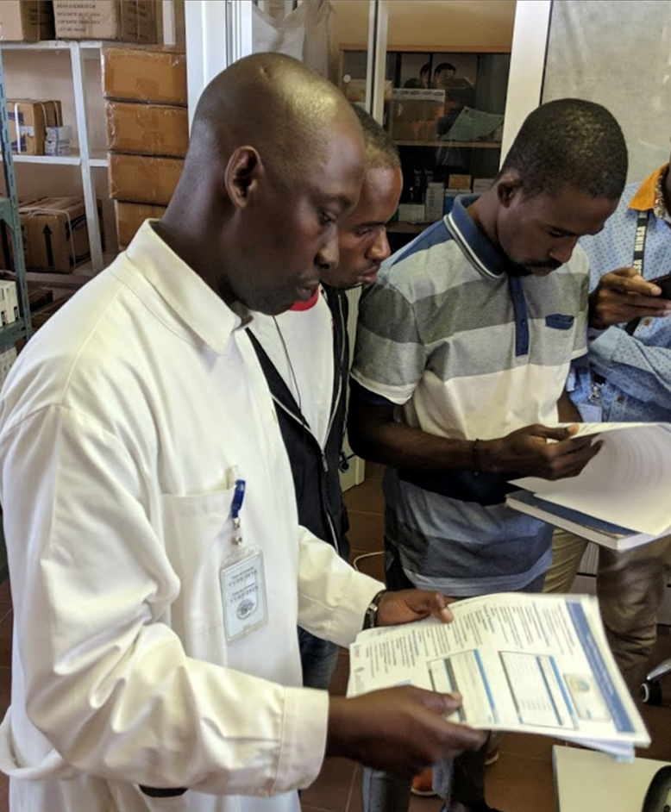
Priorities of Key National Actors in Angola
National eLMIS implementation
Improved reporting
Improved forecasting
Coordinated supply planning
Workforce development of supply chain expertise

Slide 3
To change this photo (and any other photo in this presentation):
Delete the current photo and click on the “insert photo” icon in the middle of the box:
If you don’t need a photo on the slide, change the slide layout by going to the “Home” tab and clicking on “Layout”, as shown to the right →
Improved stock visibility within the supply chain
Support informed creation of requisitions & distribution plans
Improve inventory management with categorization of expiry alerts
Electronically process reporting, report aggregation, and evidence-based decision making
Automatic calculation validation of stock balances
Notes:
Need to change foto.

Slide 4
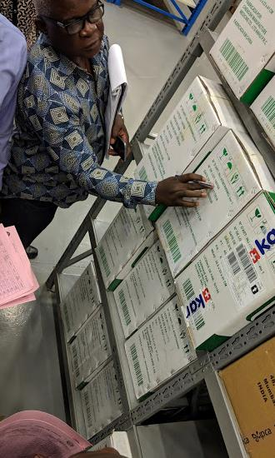
TA Systems Strengthening 2018-2019
Pilot implementation of SIGLOFA in 4 provinces with 7 sites.
Creation of SOPs for each supply chain program.
Technical Working Group (SIGLOFA) established with MOH staff from all three levels of the supply chain
Assessment of facilities in all provinces (18) to identify improvement strategy.
System requirements collected and finalized in the Technical Group.
Notes:
Victorino Jamba (GTI)
Costancio Joao (DNME)
Simon Dean (PSM)
Ritchie dos Santos (PSM)
Dercio Duvane (VillageReach)
6 pessoas do deposito provincial e 2 pessoas do deposito hospital foram formado no primeiro dia, no local de deposito provincial.
6 pessoas do deposito hospital e 3 tecnicos informática foram formado no segunda dia, no local de deposito hospital.
Inventários para as programas de Malaria, TB, HIV foram feito. Inventário para o programa de medicamentos essenciais foi iniciado.
Foi difícil de realizar o processo de inventário – alguns medicamentos não constam na proposta da Lista de Nacional de Medicamentos Essenciais.
Dois computadores e dispositivos de rede foram doada pela o projecto de USAID para os instalações
Os “Avaliações dos Sites” foram actualizada para ganhar mais informação para suporte no futuro

Slide 5
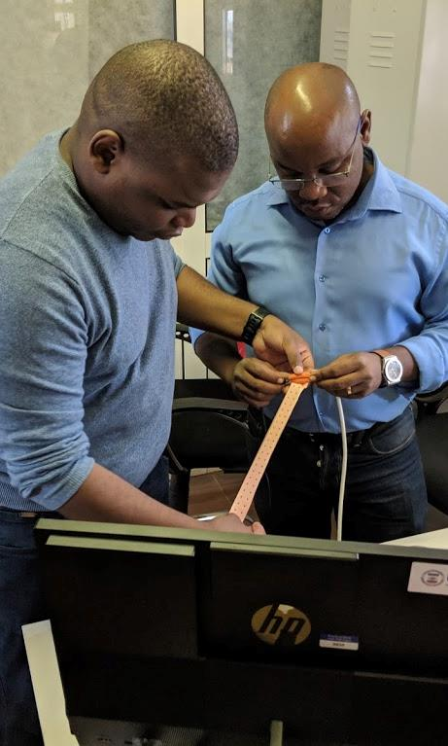
TA Systems Strengthening 2017-2019 (Cont.)
Operational Support Plan and team formed at the Angolan Ministry of Health.
Completed a preliminary knowledge transfer session for core system users to develop understanding of the system and improve quality of requirements.
Validation of the system through the pilot phase at seven provincial sites.
MoU with Unitel (national mobile network provider) to provide free network traffic for the SIGLOFA platform.
Notes:
Victorino Jamba (GTI)
Costancio Joao (DNME)
Simon Dean (PSM)
Ritchie dos Santos (PSM)
Dercio Duvane (VillageReach)
6 pessoas do deposito provincial e 2 pessoas do deposito hospital foram formado no primeiro dia, no local de deposito provincial.
6 pessoas do deposito hospital e 3 tecnicos informática foram formado no segunda dia, no local de deposito hospital.
Inventários para as programas de Malaria, TB, HIV foram feito. Inventário para o programa de medicamentos essenciais foi iniciado.
Foi difícil de realizar o processo de inventário – alguns medicamentos não constam na proposta da Lista de Nacional de Medicamentos Essenciais.
Dois computadores e dispositivos de rede foram doada pela o projecto de USAID para os instalações
Os “Avaliações dos Sites” foram actualizada para ganhar mais informação para suporte no futuro

Slide 6
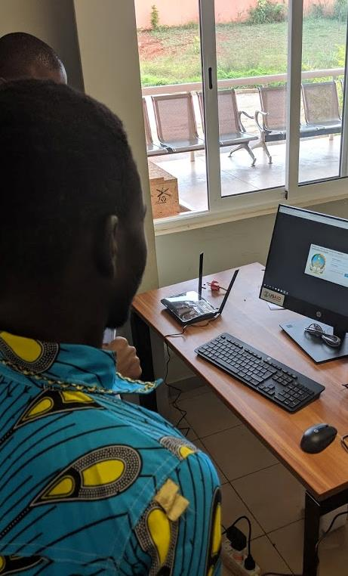
SIGLOFA Pilot Objectives
Evaluate and test the system at specific locations between March and May 2019
Training:
Logistics and Supply Chain
SIGLOFA with practical element
Install computers and equipment
Training and system assessment
Update of Site Evaluations
Conduct an inventory audit for major programs: HIV, Malaria, Reproductive Health, Tuberculosis, Essential Medicines at each site.

Slide 7
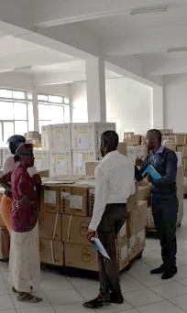
SIGLOFA Pilot Scope
System Validation environment with basic Angola specific configuration and no custom development.
Hardware:
Huila (2) 1 x Hospital; 1 x Warehouse
Cuanza Norte (3) 1 x Hospital; 1 x Warehouse, 1 x Malaria
Uige (3) 1 x hospital; 1 x warehouse; 1 x Malaria.
Luanda (1)
CECOMA (2), with plans to install 2 more
Modules live in system validation environment:
Inventory Management Module
Digital Stock Card
Requisition
Production environment will have Reporting Module and Angola specific configuration (distribution plan creation with approval matrix)

Slide 8
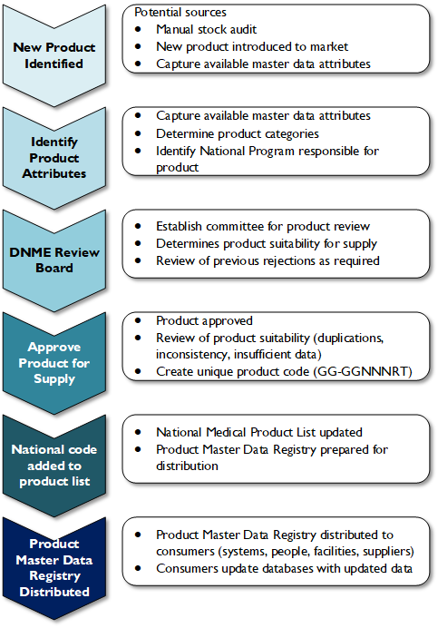
Master Data Management
Manual process of review and certification prevent duplication and ensures system consistency
SIGLOFA MD sets ground for future drug registry
This process is not reliant on NEML approval
Codification will have unique national identifier followed by UNSPSC classification (GS1 compliant) & already approved by DNME

Slide 9
User Logistics, System, and Computer Knowledge
Conducted system familiarization prior to site visits with dissemination of support material including the SOPs for inventory and requisition management.
Shadow users through each of the SIGLOFA logistics processes multiple times. Ensure the user is in control of the system.
Additional steps to support users:
Perform a SIGLOFA skills assessment for each field staff member to identify areas of strength and weaknesses
Project Plan updates to allow for more adaptable and responsive on-the-job training during installation.

Slide 10
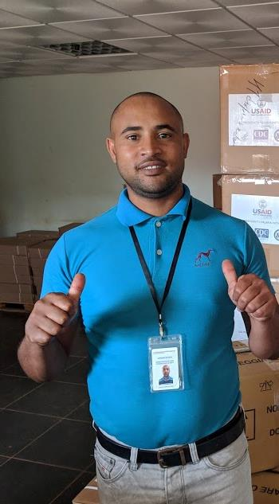
Operation Support
Support channels via WhatsApp, Jira Support Desk, email, phones
Bug reporting and tracking systems in use: Jira Support Desk, Mantis
GHSC-PSM ensuring MoH operational support staff in all pilot and site supervisory activities.
Support Staff participate in the TWG, have been trained on SIGLOFA and the associated SOPs.
Support Staff are involved in the WhatsApp group, JIRA and email.
Proposed actions as a results of system validation pilot:
JIRA webform inside the application for ease of reporting issues
Plans to ensure communications and appropriate response times are maintained for adequate support -see proposed plan

Slide 11
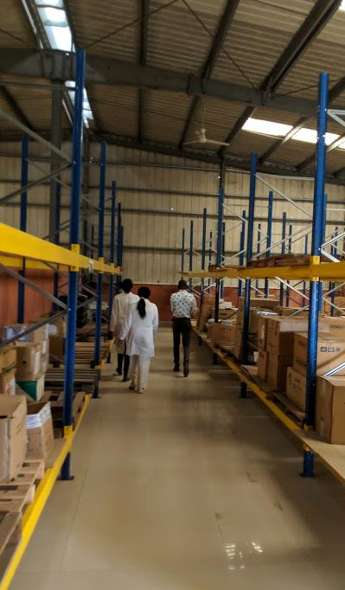
Technical Challenges
System performance
This needs to be accompanied with metrics such as the current load (no of programs, no of medicines for each program) and how will it change in future.
Need to understand the performance impact when no of users, products and programs increases.
High volume site
High task loads and requirements for data entry may impact user adoption.
E.g. Dispensary functioning as a hospital warehouse; GHSC-PSM staff advocated for hospital leadership to make warehouse operational; plans to move commodities in the next month

Slide 12
Next Steps
Mar –June 2019 Pilot Go-Live 7 Sites; supervisory site visits; finalize production testing
June – mid Aug 2019 Operational support ramp-up; pre-site communication, PEPFAR site installs
Sept 2019 User Acceptance Testing (UAT) and bugfix, Train the Trainers, Train National Hospitals, Train administators.
Preparation and travel planning for implementation incl. refresh of 7 sites to PROD and CECOMA.
Oct-Dec 2019 Remaining 28 sites Go-Live, supervisory visits and continued operational support.
Post-implementation reviews for each implementation and supervision cycle.
Operational Support, Bug Remediation, & Training

