Slide 1


OpenLMIS Sustainability Update
September 10, 2019

Slide 2
Agenda
Spotlight: Current Workstreams
Private Health Viability Discussion
Next Steps & Discussion

Slide 3






Current Project Focus
Overview
Past: Since the June Workshop, Resonance has focused on five main workstreams
Today: Incorporate feedback from today and from directional check-in last week with Gates, USAID, VillageReach, and PATH into Resonance’s last two-month workplan
Upcoming: final analysis on private health presented in late October, hand-off of the sustainability analysis at GHSCS in November
Private Health
Community & Partnership
Agriculture
Financing
GTM Planning*
*Supported by Lenati.

Slide 4
Workstreams – Where We Are Today
Overview
Key:
= Complete
= Outcomes
Private Health
Community & Partnership
Financing
Agriculture
GTM Planning*
Lots of opportunity and interest
Will require investment & validation
Next: Continue to test product, determine viability, & entry points
Refine & determine customers
Begin testing with customers
Secondary workflow conversations with customers
Create target profiles
Community readiness
Synergy with SVS
Concept note from IQVIA
Next: Continue & develop strategy for channel partners
Costing & viability analysis
Continued community engagement
Interviews with advisors
Explore avenues with Mezzanine & IQVIA
Sustainability will come from more than one revenue stream
Blended finance is a great option
Next: Validate model; shortlist funders /investors
Define funding structures
Determine outcomes & impact
Crate list of funders & requirements
Update financial model
Opportunities exist in both public/private
Value chain focus needed
Consider in long-term with sector specialization
Next: Deliver summary report
In-depth desk research
Identify & conduct SME interviews
Synthesize & assess information
Create report
Pricing tiers based on users and after-market support
Distribution via channels
License should allow for expansion
Next: Deliver for later consideration
Outline licensing options and distribution models
Provide options for paths to market and after-market support
Analyze pricing options
*Supported by Lenati.

Slide 5
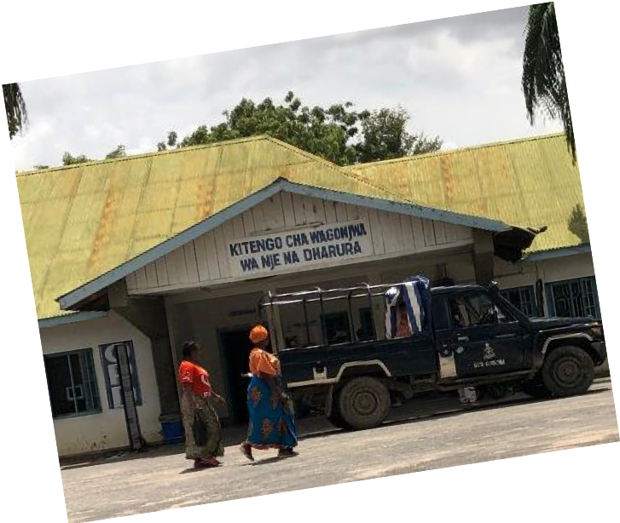
Directional Drivers (to Date)
Overview
Future sustainability will need to support current public health implementations. New revenue streams include:
Pursuing private health customers
Partnerships (e.g. white label)
Expanding into other, adjacent markets
Current and future public sector implementations
There are important pieces to consider prior to expanding and pursuing new entity formation.
Validate market feasibility for new customers
Determine the product
Establish a framework for partnerships
Understand investment cost, growth strategy, financial model, and return

Slide 6
Private Health Exploration: Interview Approach
Private Health
Subject Matter Experts
Potential Customers
Individuals specialized in low- and middle-income countries, whose focus areas include:
Private health markets
Health supply chains and/or
Health technology/ global goods
Individuals who manage clinic/ hospital/ pharma retail networks in low- and middle-income countries, whose roles include:
Executives (decision makers)
Operations or supply chain leads
Interviewed to Date | 15
Health tech developers/implementers | 6
Logistics specialists/distributors | 5
OpenLMIS stakeholders/partners | 2
Impact investors | 2
Management consultants | 2
Private health sector associations | 2
Academia | 1
Interviewed to Date |  | 7
Clinic networks | Zimbabwe Kenya Ghana | 3
Hospital networks | Guatemala Nepal Ghana (2) | 4

Slide 7



Private Health Exploration: Definitions
Private Health
 | Clinic Network | Hospital Network | Pharmacy Retail Network
Defining feature | Out-patient facilities | In-patient facilities | Standalone dispensaries
May include | Pharmacies | Clinics and/or pharmacies

Slide 8
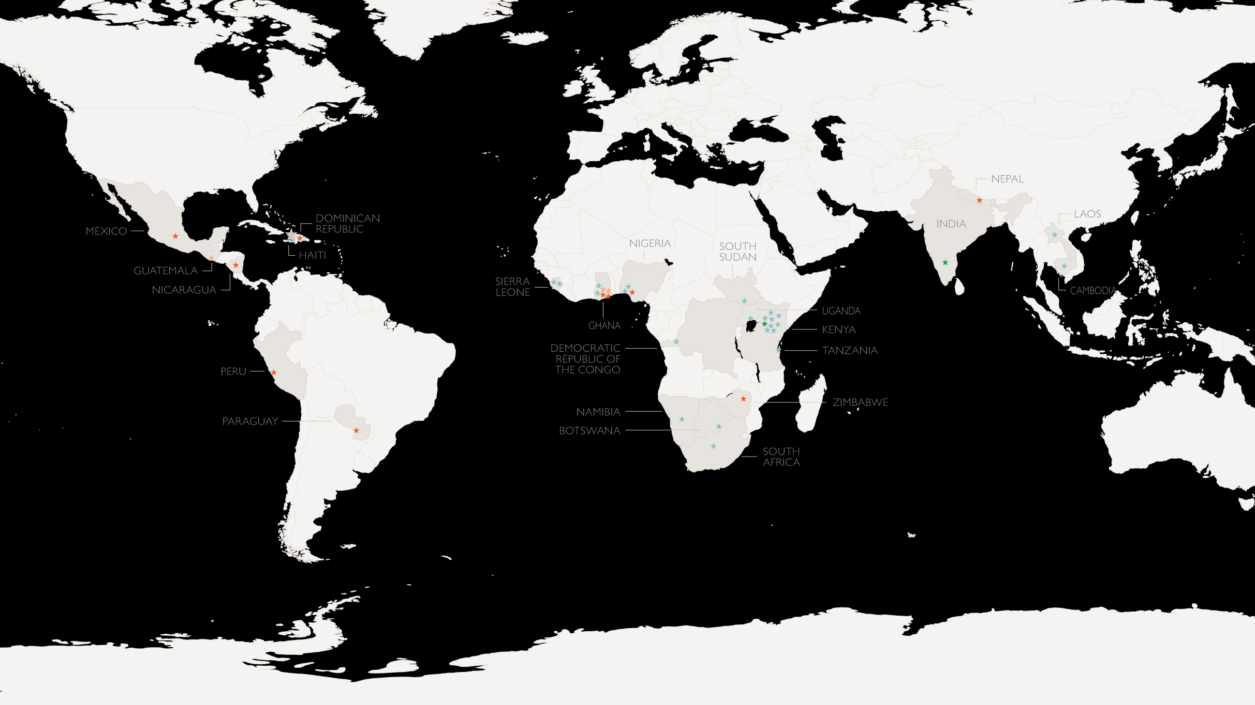
A Global Perspective
Private Health
Most promising markets are large economies in sub-Saharan Africa (e.g. Ghana, Nigeria, Kenya) with dynamic private health sectors, with 10+ customers per country.
Opportunities also exist in smaller, somewhat limited private health economies (e.g. Zimbabwe, Senegal), east/south Asia.
Key: Interviewee Type
Subject Matter Expert (13)
Clinic Network (4)
Hospital Network (3)
Investor (2)
Less promising markets are Latin America and the Caribbean with few potential customers, and/or national restrictions; and more mature/saturated markets (e.g. South Africa, Thailand).

Slide 9

Key Takeaways
Private Health
As LMIC private health markets grow, the supply chain management needs of clinic, hospital, and pharma networks are evolving.
Challenges with inefficiencies, price inflation and counterfeit/quality risks
Eagerness to reach more patients with high-quality products and services
Understanding of the need for software investment alongside growth
Potential OpenLMIS customers are seeking to improve their existing solutions.
Supply chain pain points affect core business, limiting capabilities
Often combining multiple software systems that only partially meet needs
Using paper, XLS, homegrown solutions, and/or SAP Business One
Demonstrated interest and resources to replace/improve systems

Slide 10
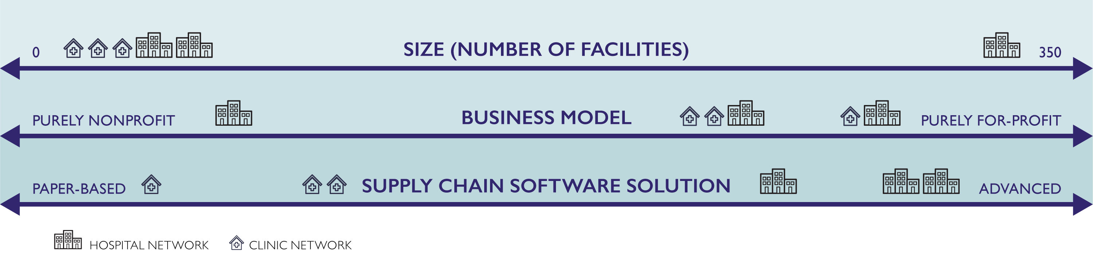



Characteristics of Potential Customers
Private Health
Target OpenLMIS Customer
*Observations based on research to date; we will iterate and provide further trends as more information is gathered.

Slide 11
Target Customer Profile
Private Health
 | Most Viable Customer: Growing Private Clinic Network Actively seeking appropriate, user-friendly supply chain management solution on a limited budget
About | Private health company/organization operating a network of 5-20 clinics in low-resource settings
Goals/Mission | Ambitious expansion of clinic facilities and/or service offerings
Supply Chain Management | Current solution: partially paper-based with facilities/employees combining multiple solutions (e.g. EMR + Excel). Unreliable and inefficient, leading to errors, stockouts, delays, waste and higher costs Holding back company growth/expansion
Software Use and Orientation | Some software use/integration: implementing locally built clinic management system Current system(s) offer only partial solution(s) to supply chain needs System(s) not user-friendly or designed for their needs/circumstances
OpenLMIS as a Solution | Requisitions support that interoperates with existing clinic management system to address gaps in supply chain management
Supply Chain Management Solution Budget | $1,000 – $6,000 USD/year
11
Pain points identified in italics.

Slide 12

Workstream Next Steps
Private Health
OpenLMIS will reach private health customers through sales channel partners.
Source channel partners (e.g. technology resellers working with clinic, hospital, and pharmacy networks) in key markets
Interview and gauge channel partner interest and relevance to OpenLMIS
Customers need to see a product to react to.
Create and socialize a slideware private health prototype
Deepen outreach with target customers to hone understanding of needs, product fit, and budget

Slide 13
High-Level Roadmap
Sept.
Oct.
Nov.
Dec.
Jan.
Feb.
Mar.
Apr.
May
June
Jul.
Aug.
Determine Future Funding
Assess Public Health Revenue Stream
Support Outreach to New Investors*
Donors
Develop Prototype*
Support Sustainability & Host Community Meeting
Costing & Product Refinement*
Transition & Knowledge Transfer
Continue Support in New Capacity as Determined
(May require more funding)
VillageReach
Governance Committee
Be Active Decision-Makers
Support Transition at Community Meeting
Reevaluate GC Roles & Structure
Determine Role in Future State & Transition
Implement New Role
Resonance handover at Community Meeting
Current VillageReach Funding Ends
*As determined.

Slide 14

Next Steps
Incorporate feedback into updated two-month workplan
Create and socialize a slideware private health prototype and deepen outreach to potential customers
Engage in channel partner exploration and develop strategy for sourcing and onboarding future partners
Refine financial model and future funding strategy
Create handover plan and support community discussion around future sustainability at GHSCS

Slide 15
Thank You!
  JAMES BERNARD
  Director, Global Partnerships
  jbernard@resonanceglobal.com
  KIM COURI
  Senior Consultant
  kcouri@resonanceglobal.com
  EMILY CLAYTON
  Senior Manager
  eclayton@resonanceglobal.com
  ALICE HELBING
  Consultant
  ahelbing_ct@resonanceglobal.com
  DIPA SHARIF
  Consultant
  dsharif_ct@resonanceglobal.com

Slide 16
Appendix

Slide 17

Software Decision Making
Private Health
Actively seeking ways to optimize or replace their existing supply chain solution
Using software to support multiple aspects of private health management
Prioritize solutions with efficiency gains and performance improvements over lowest cost
Employ an in-house supply chain/operations lead with in-house and/or external IT support
Make decisions to invest in software as a management team with buy-in from operations, IT, finance, etc.

Slide 18

What OpenLMIS Customers Want
Private Health
Customer preferences and needs vary, but usability, interoperability and end-to-end inventory visibility are key.
Priority Features
User-friendly: Simple, easy-to-maintain, suitable for low-resource settings
Value for money: Demonstrably reduces costs and/or improves performance
Best fit to address major supply chain pain points
  Seamless end-to-end solution not always feasible/practical
  Interoperability with existing systems (e.g. EMR, parts of ERP) is a must
Durability: Customization/add-on options to adapt to future changes/growth
Data ownership/sharing: Options to address data sensitivity issues
Future Considerations
Add to/enhance current OpenLMIS features/functionality to offer product that appeals to new customer(s)
Package OpenLMIS with other tech products/global goods to strengthen/expand product offerings
Identify channel partners who can identify and target customers that are good match for OpenLMIS
*Observations based on research to date; we will iterate and provide further trends as more information is gathered.

Slide 19
Software Budget
Private Health
Wide range of software/IT budgets across potential customers
Hospital networks tend to have invested in more software systems that offer more advanced and/or customizable features
Clinic networks' biggest software investment is typically their clinic management system
Based on what we know to date
Some customers not willing/able to share
Different interpretations (e.g. salary as budget)
Based on responses to questions about cost of current solutions and/or expectations about cost of future solutions
Does not include up-front costs for software
Annual software
Budget (USD)*
Data
Estimate
$25,000
Average
~$16,000
$13,000
$6,500
$600
*Illustrative, not to scale
Software sophistication

Slide 20
Other Potential Customers
Private Health
 | Growing Hospital Network | Growing Pharmacy Retail Network
About | Private health company operating 2-10 facilities, including at least 1 hospital | Private health company operating 5-20 pharmacy retail outlets
Goals/Mission | Gain competitive edge by adding/improving facilities and/or services | Gain competitive edge by adding facilities and improving availability of goods
Supply Chain Management | Using outdated/inefficient solutions(s) for supply chain management needs, which prevents company from achieving goals | Using partial, inefficient solution(s) for supply chain management needs, which prevents company from achieving goals
Software Use and Orientation | Using hospital management system and some accounting software, likely with some inventory management features Previously invested in software that is too cumbersome and/or that company has outgrown | Using some front-office (e.g. point of sale) and/or back-office (e.g. accounting) software, likely with some inventory management features
OpenLMIS as a Solution | Affordable, user-friendly supply chain system to replace or supplement existing system(s) | Need to have a POS component or strong integration with a known POS that already exists in target markets
Budget | $4,000 – $12,000 USD/year | Unknown
Text in italics is hypothesized and needs to be further validated with customers.

