Slide 1


OpenLMIS Sustainability Update
November 12, 2019
Notes:
Rebecca

Slide 2
Agenda
Timeline & Upcoming Engagements
Future State Opportunities
IQVIA Presentation/Q&A
Discussion & Temperature Check
Next Steps
Notes:
Rebecca

Slide 3

Timeline & Expectations
Overview
Governance Committee Meeting
(Today)
Governance Committee Meeting
(November 12)
Future State Partner Engagement Survey
(November 12-15)
OpenLMIS Community Meeting
(November 18-20)
Donor Check-In,
Part I
(October 17)
Donor Check-In,
Part II
(November 6)
Share project update and demonstration of private health prototype
Build options and create a package of information to share with the Governance Committee
Present options for path forward and take a temperature check-style poll during the call
Collect responses of voting members about ways to engage in the future state
Engage with the OpenLMIS community for transition and future-state planning
Notes:
Rebecca

Slide 4
This Week
Overview
Governance Committee Meeting
November 12, 2019 (Today)
Very important meeting to get everyone up to speed on what current options are; prepare for the Community Meeting
30m presentation/Q&A by IQVIA, one of the potential partners who could be involved in an OpenLMIS “handover”
Temperature check re: options
Future State Partner Engagement Survey
Open November 12 (Today) – November 15
Survey will be sent via email
Voting members only
Encouraged to consult with others at your organizations to inform responses
Purpose is to gauge interest in the various roles that could be played by partner organizations
Non-binding, will inform discussion at the Community Meeting
Notes:
Rebecca

Slide 5


Community Meeting Logistics
Overview
November 18, 19, & 20th
Future State Discussions + Learning Sessions
8:30 am to 5:00 pm
Protea Hotel by Marriott
Maude Street, Sandown, Sandton
2126 South Africa
Food & Beverages:
A light breakfast, as well as lunch will be served
Coffee, tea, and water will be available all day
A cocktail hour will be organized on Tuesday
Additional information can be found on the OpenLMIS Community Meeting wiki page.
Notes:
Rebecca

Slide 6
Community Meeting Agenda
Overview
Day 1
Future State Discussions
Day 2
Future State Discussions + Learning Sessions
Day 3
Learning Sessions +
Side Meetings
Outcome: Common understanding & reactions
Who: Community
What: Sustainability research to date, future-state options
How: Presentation, discussion in small groups and plenary
Outcome: Understanding of key considerations + learnings / feature demonstration
Who: Community
What: Collaborate on future state considerations and share learnings
How: Exercises and hands-on learning in small groups and plenary
Outcome: Community goals and consensus
Who: Community + potential external partners
What: Brainstorm goals and priorities, open for deepening discussions
How: Plenary and small group discussions
Formal agenda is forthcoming.
Notes:
Rebecca

Slide 7
Community Meeting Considerations
Overview
Who will be there? 22 community participants, including trusted partners, implementers, funders, thought partners, stewards, plus the Resonance team, and a facilitator
How can I prepare? Review this presentation and past materials-begin to brainstorm concerns and points of excitement about different options; and how your organization is interested in being involved. Try to come to the meeting with an understanding of what you can commit to on behalf of your organization (desired engagement with future state options)
What will decision-making look like? For partner organizations whose voting member cannot be present, a proxy may be able to fill that role. Voting will not happen per se, but partners are encouraged to weigh in on what role they would like to play in the future state; hope to reach community consensus
What happens after the meeting? A readout will be shared and steps will be taken that are agreed upon during the sessions; stewards to follow-up on agreed goals and priorities for 2020
Notes:
Rebecca

Slide 8

Future State Opportunities
Notes:
Kim

Slide 9

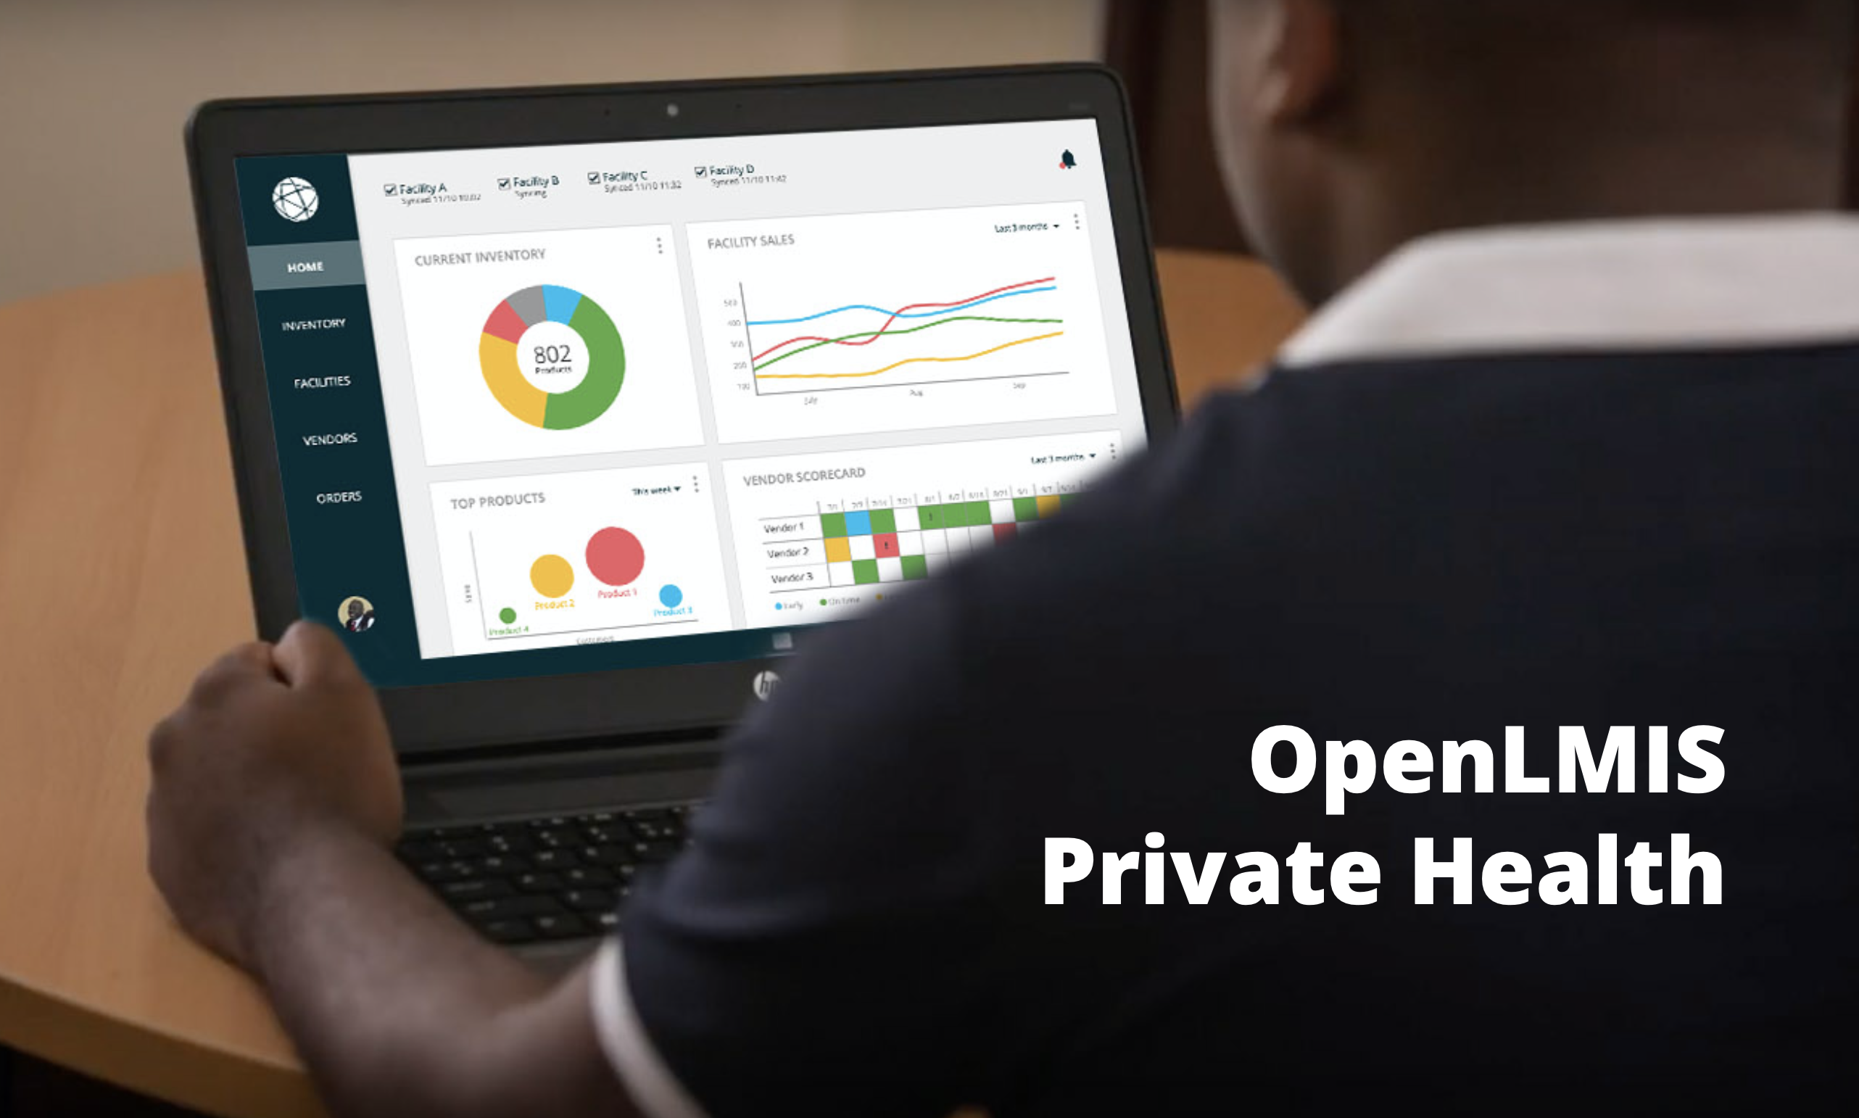
OpenLMIS for Private Health
Sustainability
There are opportunities for OpenLMIS to expand its footprint from public health to private health in target markets
While keeping the core product open source and the public implementations active, a parallel product would be created to serve private clinic networks, hospitals, and pharmacy retail networks
This SaaS product would help subsidize the cost of public health implementations and create a path for long-term revenue generation
Over time, synergies between the two products would help elevate its offering in both sectors; and product tiers could be created, providing options for different levels of local engagement and support
A series of interviews were conducted with health and last mile supply chain subject matter experts, potential customers, and we socialized a product prototype with select potential customers.
Notes:
Kim

Slide 10
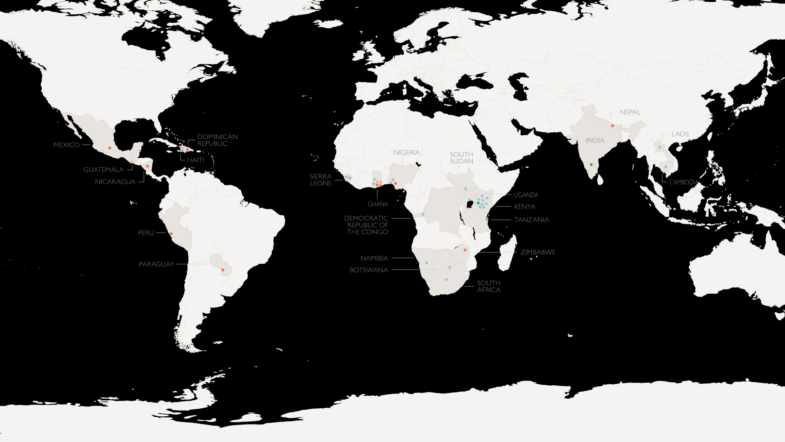

A Global Perspective
Sustainability
Most promising markets are large economies in sub-Saharan Africa (e.g. Ghana, Nigeria, Kenya) with dynamic private health sectors, with 10+ customers per country.
Opportunities also exist in smaller, somewhat limited private health economies (e.g. Zimbabwe, Senegal), east/south Asia.
Key: Interviewee Type
Subject Matter Expert (13)
Clinic Network (4)
Hospital Network (3)
Investor (2)
Less promising markets are Latin America and the Caribbean with few potential customers, and/or national restrictions; and more mature/saturated markets (e.g. South Africa, Thailand).
Notes:
Kim

Slide 11

Prototype Interview Feedback
Sustainability
Most Valuable Features and Characteristics​
    Inventory visibility from supplier to customer
    Data/reporting dashboards​
    Health sector focus​
    Offline sync capabilities​
    User-friendly ​and intuitive
    Configurable with existing systems
Questions and Concerns​
Timeline: Customers are looking for this product now
Integration and interoperability​ with existing or future EMR/HIS, financial/accounting, point of sale, and mobile systems
Perceived Value
Customers are willing to pay up to $25,000 annually for this product
“
I wish we could get better visibility into our supply chain and the data we need. It's hurting our business and we're losing money, which makes it difficult to serve patients and take collective action.
- Private Clinic Network, Kenya
"
Notes:
Kim
Overall positive: clear solution to customers' pain points
What they love:
Data / reporting dashboards: easily view where their problems are (vs. Previous complex, duplicative, error-prone processes to understand patterns)
end to end visibility of their supplies for better planning and easy action (I.e. redistribute supplies among facilities vs. Time-consuming manual processes that allowed for mistakes or theft)
Health sector focus – built for them
Offline sync capabilities (⅔)
User-friendly and intuitive interface, less need for service/ training – but they really value on-demand service options
Configurable: make it work for their business needs over time
Some questions/ concerns
? Timing: Good news and bad news is that the customers we've spoken to need this now. All looking to buy in the next 3-12 months
? Integration/ interoperability, considering software updates/ upgrades: Some pain points are in their financial/ accounting systems or EMR/HIS systems, some already have a working POS system. Some want data entry on tablets and phones. How to make OLMIS work over time to add value to these systems or the others that replace them?
Perceived value: High, up to $25k! We are being more conservative because it's unlikely all customers will pay this, and it depends on what the product becomes
What's next?
Keep talking to potential customers to gather feedback on prototype
Identify potential customers to pilot the prototype
Keep discussions going with VR on costing, product development and options to make the product (and its presentation) as appealing as possible

Slide 12
While we consider OpenLMIS for private health to be a strong contributor to sustainability, there are a couple of paths to get there and few options…
Notes:
Kim

Slide 13



OpenLMIS Paths Forward
Sustainability
1
2
3
Independent Entity
Partnership to Handover
Unsupported Release
Create a new non-profit entity to manage software & stewardship
Keep public health implementations active and pursue a parallel product in private health
Transition public health to include routine contributions
Seek initial seed stage funding followed by impact investor funding
Partner with a private organization and gradually transition software & stewardship over 1-2 years
Keep public health implementations active and product open source
Let partner drive which business opportunities to pursue
Collaborate on contract terms
Seek initial seed stage funding
Release the IP and licensing
Leave future software enhancements and stewardship up to the open source community
No funding for core community, product management, or maintenance
No mechanism for partners to guide the future of OpenLMIS
Notes:
Kim
Private health could be pursued in options 1 or 2

Slide 14
Comparing Paths Forward
Sustainability
1
2
3
Independent Entity
Partnership to Handover
Unsupported Release
Risk | High | High | Low
Cost | $$$ | $$ | Free
Control | High (for partners involved) | Low (enforce contract terms) | None
Stability for current public user base | High | Medium | Low
Notes:
Kim
Other key factors here?
Current partners will be essential in effectively transitioning OpenLMIS in Options 1 and 2
Keep in mind that handover would de-risk a private entity
Leverage existing sales teams and channels
Include core attributes in contract (e.g remain open source)
Partner would drive which business opportunities to pursue

Slide 15
Presentation | Q&A
Notes:
Kim introduce
As part of exploring partners in option 2, bringing in IQVIA to help explain how this could work

Slide 16

Discussion
Sustainability
Enter in the chat or speak aloud.
1
Independent Entity
What reactions do you have?
What excites you?
What scares you?
What else do you want to know?
2
Partnership to Handover
3
Unsupported Release
Notes:
Kim
Keep in mind that handover would de-risk a private entity
Leverage existing sales teams and channels
Include core attributes in contract (e.g remain open source)
Partner would drive which business opportunities to pursue

Slide 17
Quick Poll
Sustainability
If you had to select an option now, what would you choose? Vote in Zoom chat: 1, 2, or 3.
1
2
3
Independent Entity
Partnership to Handover
Unsupported Release
Create a new non-profit entity to manage software & stewardship
Keep public health implementations active and pursue a parallel product in private health
Transition public health to include routine contributions
Seek initial seed stage funding followed by impact investor funding
Partner with a private organization and gradually transition software & stewardship over 1-2 years
Keep public health implementations active and product open source
Let partner drive which business opportunities to pursue
Collaborate on contract terms
Seek initial seed stage funding
Release the IP and licensing
Leave future software enhancements and stewardship up to the open source community
No funding for core community, product management, or maintenance
No mechanism for partners to guide the future of OpenLMIS
Notes:
Kim

Slide 18

Next Steps
The OpenLMIS Future State Partner Engagement Survey will be circulated shortly after this call to voting members, please submit your responses by this Friday, November 15
An agenda for the upcoming OpenLMIS Community Meeting will be also be circulated, we look forward to seeing many of you there!
Resonance’s work will be concluding next week and we are in the process of preparing a final report and handover; components will be shared as determined by BMGF and VillageReach
Notes:
Kim

Slide 19
Thank You!
  JAMES BERNARD
  Director, Global Partnerships
  jbernard@resonanceglobal.com
  EMILY CLAYTON
  Senior Manager
  eclayton@resonanceglobal.com
  KIM COURI
  Senior Consultant
  kcouri@resonanceglobal.com
  DIPA SHARIF
  Consultant
  dsharif_ct@resonanceglobal.com

