Slide 1
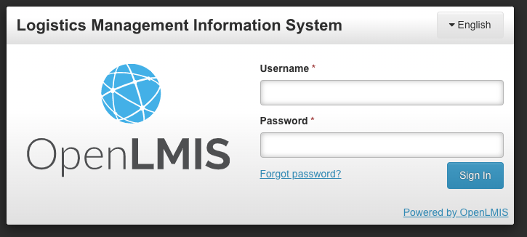
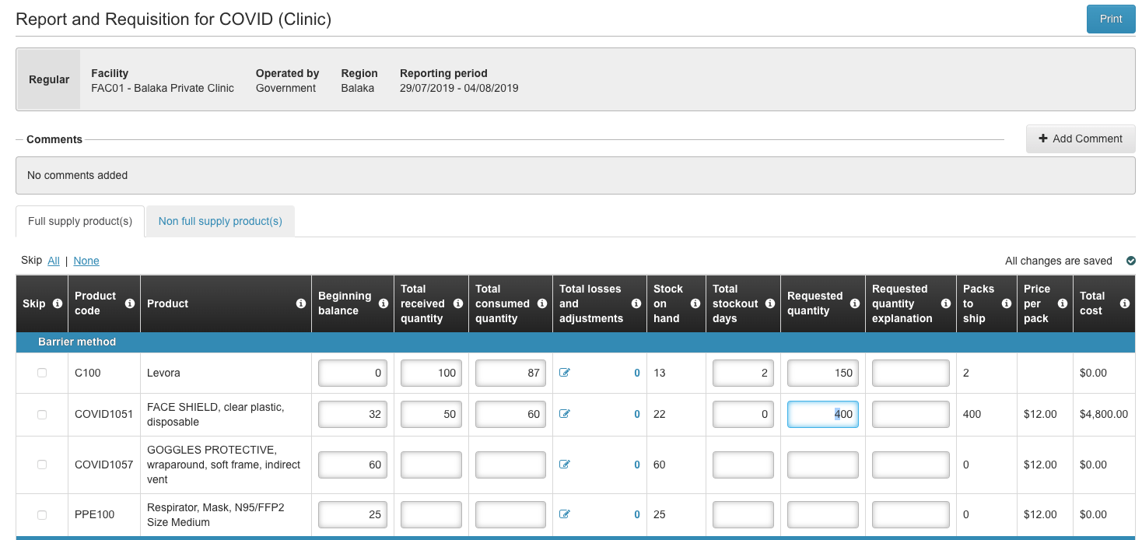
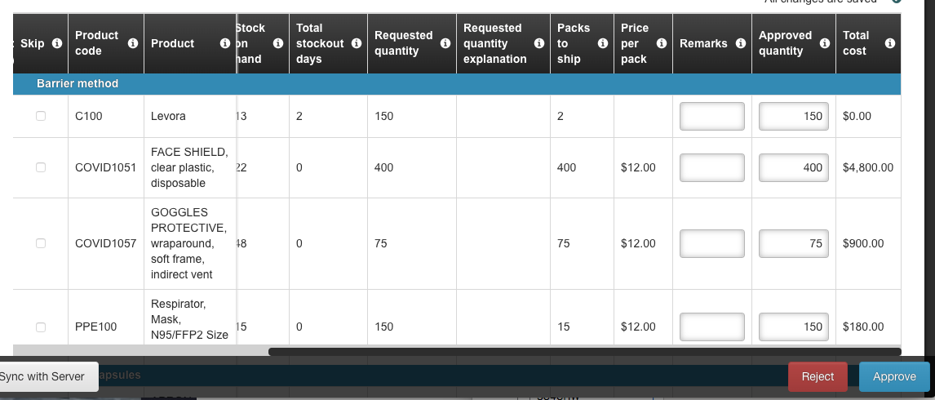
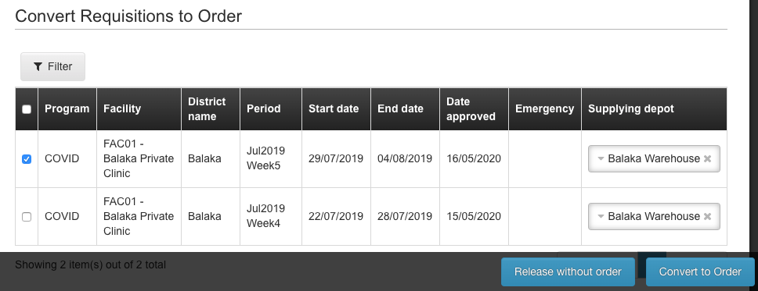
Quick Reference Guide
Sign in
Enter your Username and Password
Click Sign In
Complete a Physical Inventory
On the navigation bar, click Stock Management > Physical Inventory
Click Start for the desired program
Enter the Current Stock for all products
Add Reasons to account for any differences in SOH and Current Stock
Click Submit to finish
Create & Submit Requisitions
On the navigation bar, click Requisitions > Create/Authorize
Select the Facility and Program
Click Search
Click Proceed on the available period
Enter the required information, including the Requested Quantity
Click Submit & Authorize
Approve Requisitions
On the navigation bar, click Requisitions > Approve
Click the Selection Box for the requisition(s) to be approved
Click View Selected Requisitions
Verify/update the Approved Quantity
Click Approve
Convert to Order
On the navigation bar, click Requisitions > Convert to Order
Click the Selection Box for the requisition(s) to be converted
Ensure the correct Supplying Depot is selected
Click Convert to Order
1

Slide 2
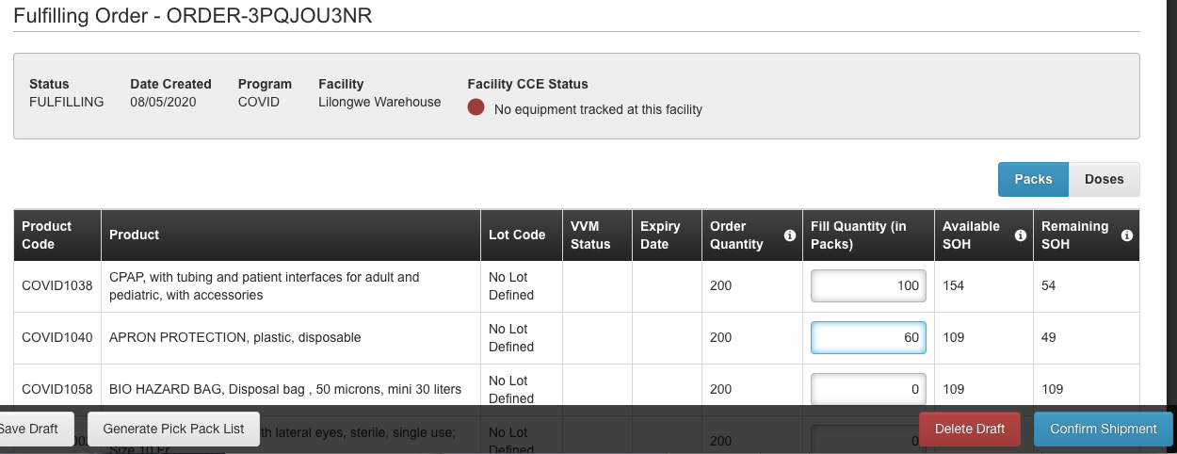
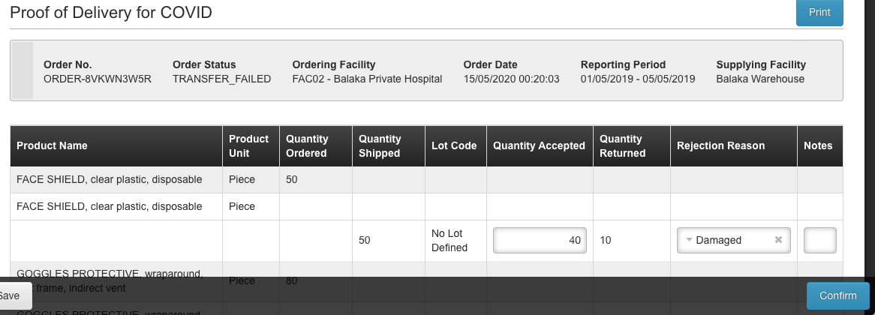
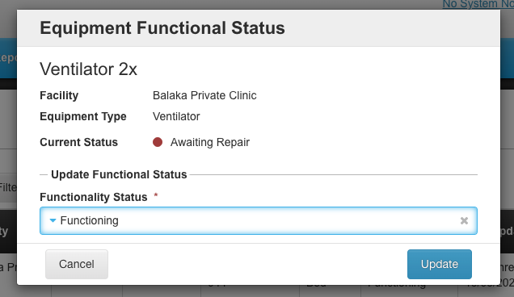
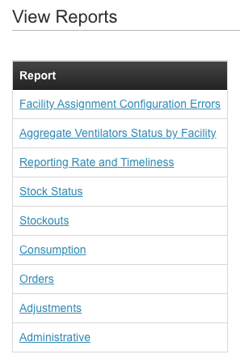
Quick Reference Guide
Fulfill An Order
On the navigation bar, click Orders > Fulfill Orders
Click Start Fulfillment for the order
Add the Fill Quantity for ordered products
Click Generate Pick Pack List to create a PDF pick pack list
Click Confirm Shipment
Manage Proof Of Delivery
On the navigation bar, click Orders > Manage Proof of Delivery
Select Requesting Facility and click Search
Click Manage for the POD
Enter the Quantity Accepted for each product and Rejection Reason (if needed)
Enter Delivered by, Received by, and Received Date
Click Confirm
Update Equipment Status
On the navigation bar, click Equipment > Equipment Inventory
Select the Facility and Program and click Search
Click on the Functional Status edit icon
Select the new Functionality Status
Click Update
Record Stock Movements
On the navigation bar, click Stock Management > Issue/Receive/ Adjustments (type of movement)
Click Make Issue/Receive/Adjustments
Add the Product(s)
Enter the Destination/Source, Reason, Quantity, and Date
Click Submit
View Reports
On the navigation bar, click Reports > View Reports
Click on the report you want to view
Add any necessary Filters
Dashboards will generate automatically. Click Generate for PDF/XLS reports
2

